Slide 1

File carving Retrieval of video file segments Using CARVING METHODS
SVN Ramakanth
1602-19-733-118
S Kavyasree
1602-19-733-075

Slide 2
Problem statement
We address the problem of decoding video file fragments by the retrieval of video file segments using structural evidence
Keywords:
Mp4
Codec
Container
Atom
Box

Slide 3
Literature Survey
A Quick Dive Into MP4
MP4 is a container format, it doesn't actually handle the decoding of the video and audio streams, it just contains them as tracks along with their metadata.
A container can store some of the following information:
General metadata such as file type and compatibility
Video, audio and subtitle tracks and codec details
Metadata: duration, timescale, bitrate, width/height, etc
Progressive and fragmented metadata details
A series of video frames or audio samples known as "Sample Data"

Slide 4
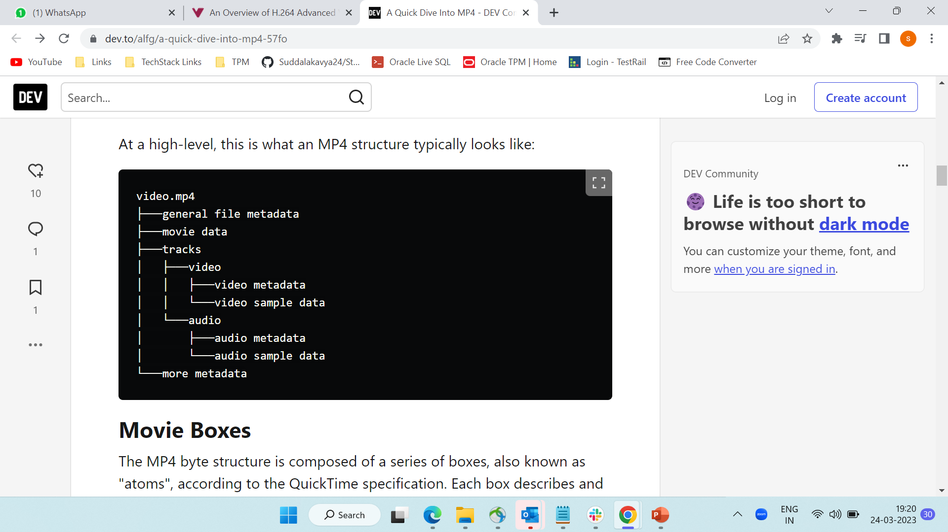
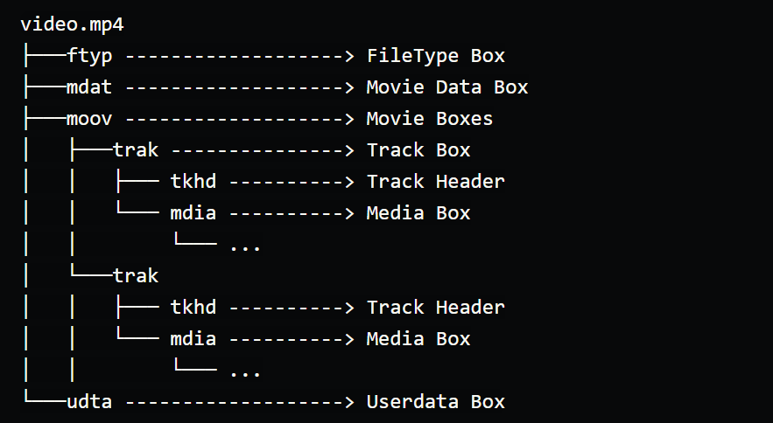
General mp4 structure

Slide 5
Codec - H.264
Elements of the H.264 Video/AAC Audio MP4 Movie by Cimarron Systems
The discussion here focuses on a subset of the container elements like
MP4 Atom Descriptions
the MP4 movie container file format has a very specific hierarchy of elements called Atoms
(in MPEG-4 terminology, they are called Boxes)
Movie and Movie Header Atoms
Track and Track Header Atoms
Movie Media, Movie Media Header
Media Handler Reference Atoms
Media Information, Media Information Header, Media Data Information, and Media Data Reference Atoms

Slide 6
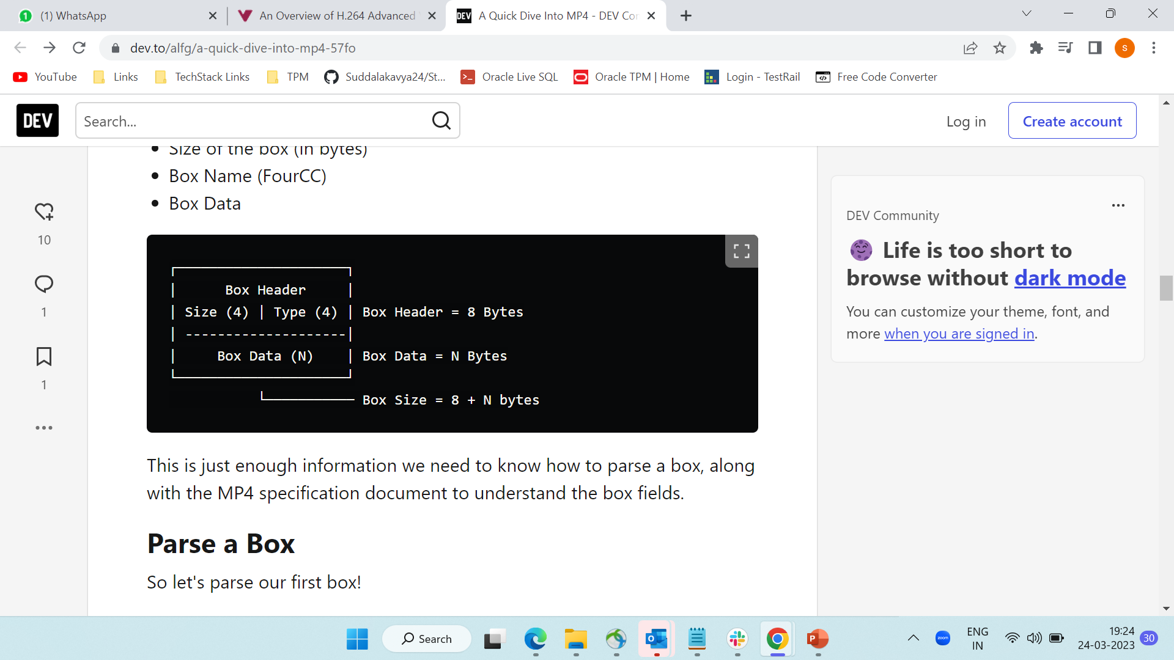
Box structure
An MP4 "Box" contains just enough information to read and parse the box name, size and data.
A box typically contains the following base information:
Size of the box (in bytes)
Box Name (FourCC)
Box Data

Slide 7
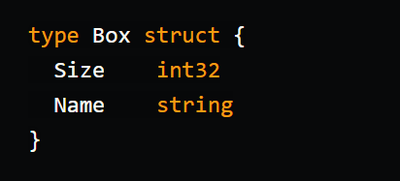
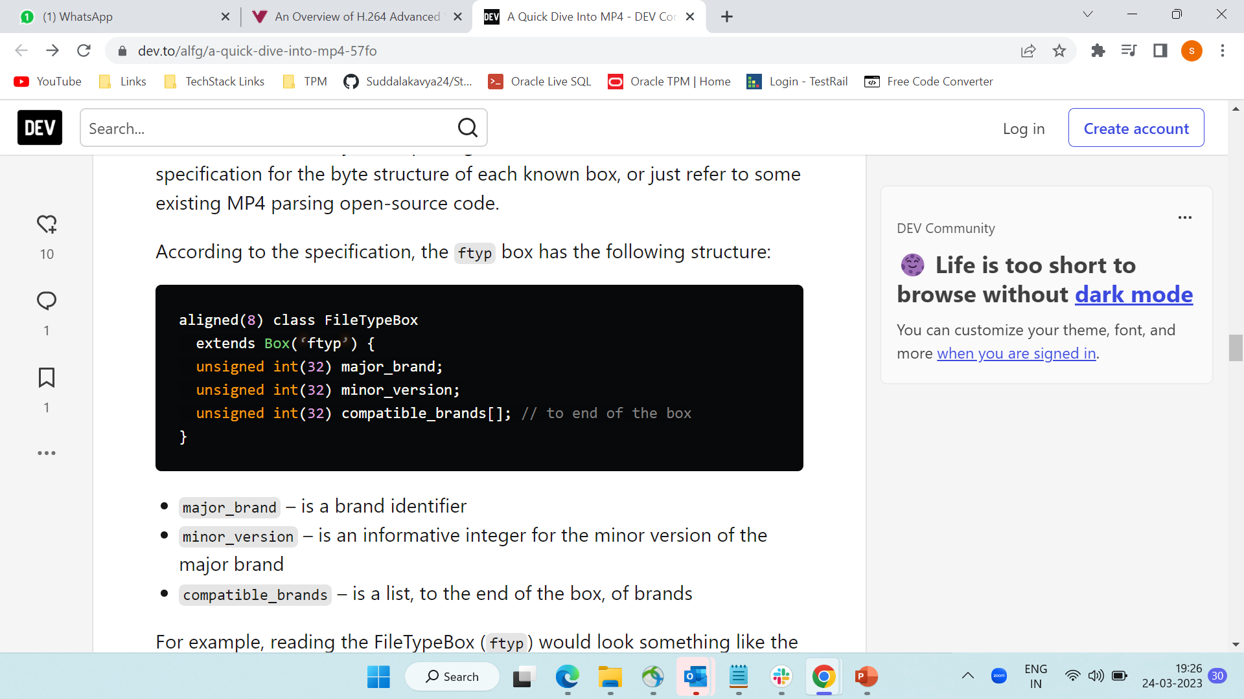
Box - sample

Slide 8
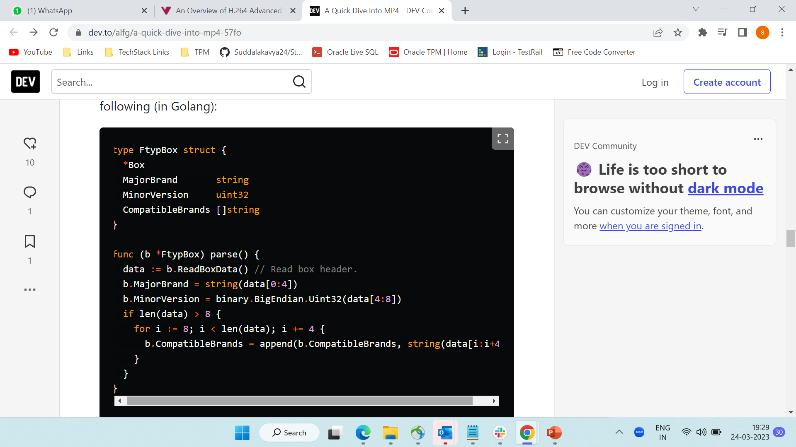
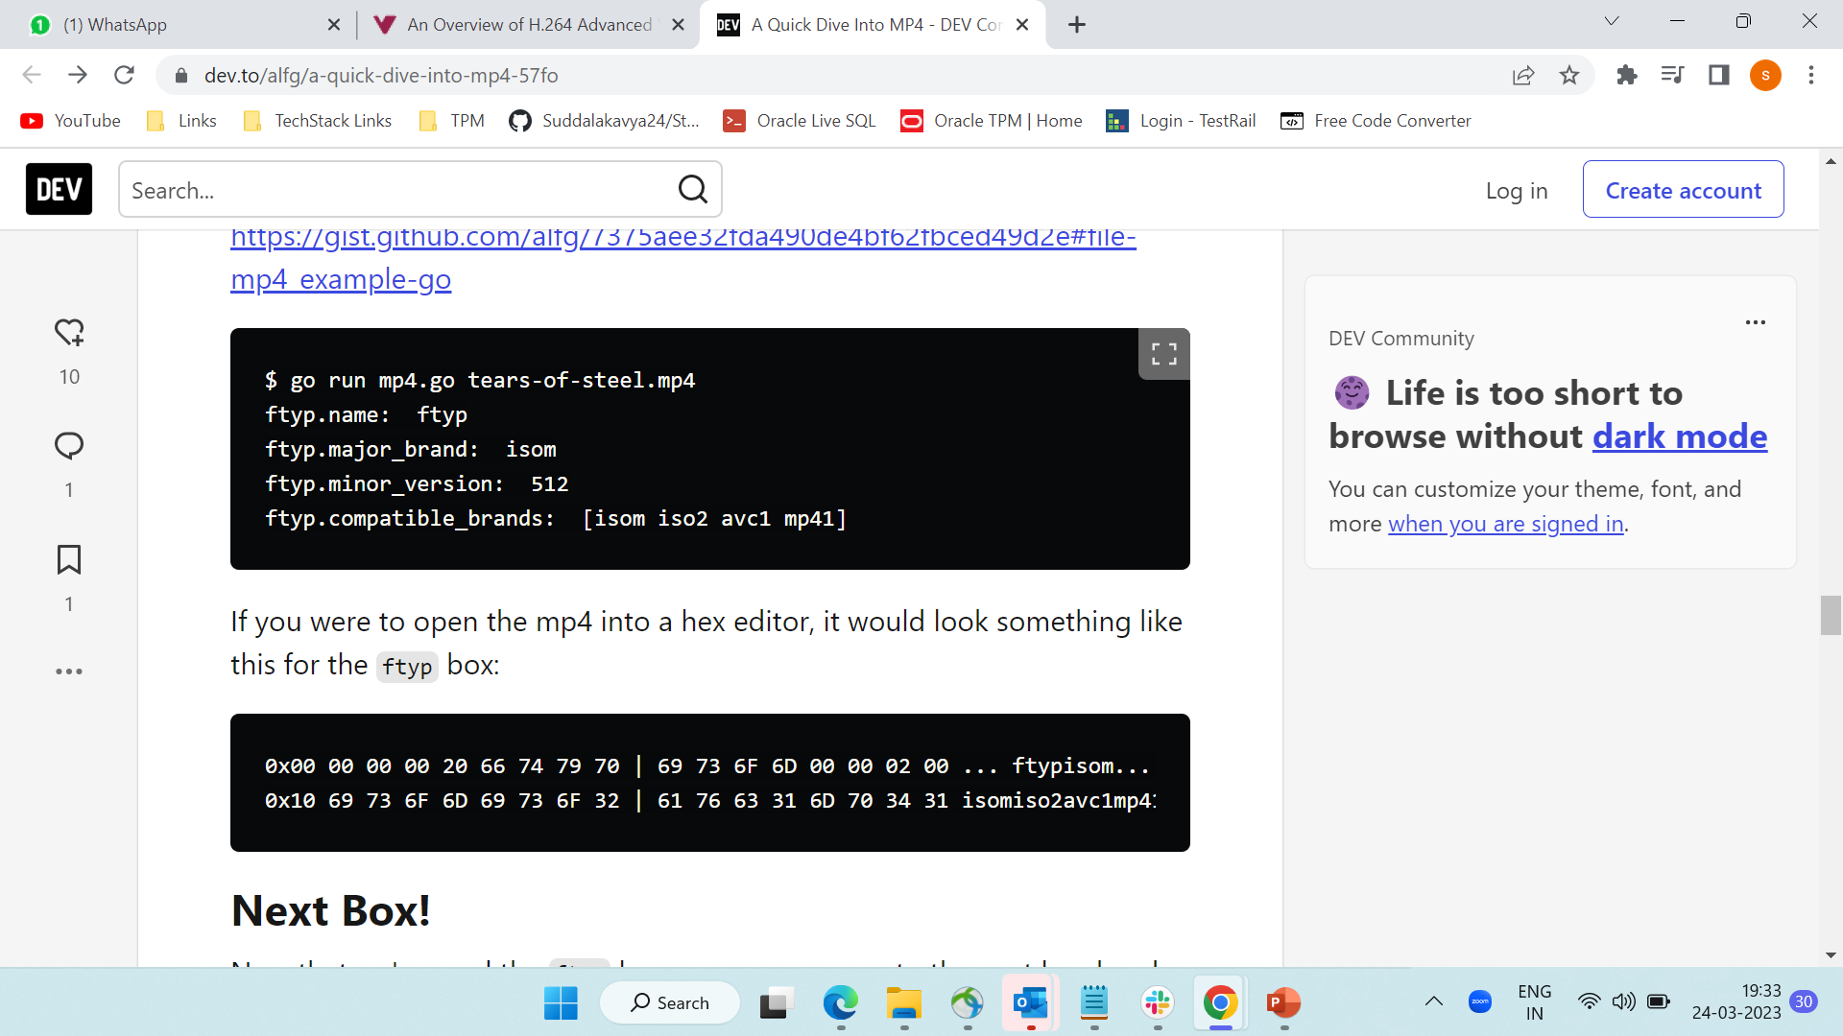

Slide 9
Interpretation
Reading the first 4 bytes of the box header as an unsigned 32 bit integer (big endian) gives us the box size: 32 bytes.
The next 4 bytes gives us: 0x66747970 in hexa decimal, or ftyp as a string.
Next 4 bytes gives us the Major Brand: 0x69736F6D in hexa decimal, or isom as a string.
Next 4 bytes gives us the Minor Version: 512
The next 16 bytes, read as uint32be (into a string) at a time gives us an array of compatible brands: isom, iso2, avc1, and mp41.
We have read a total of 32 bytes as defined in the box header.

Slide 10
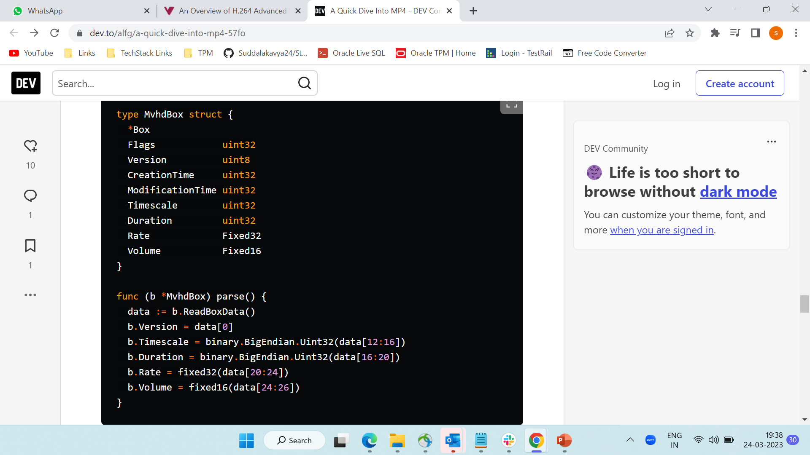
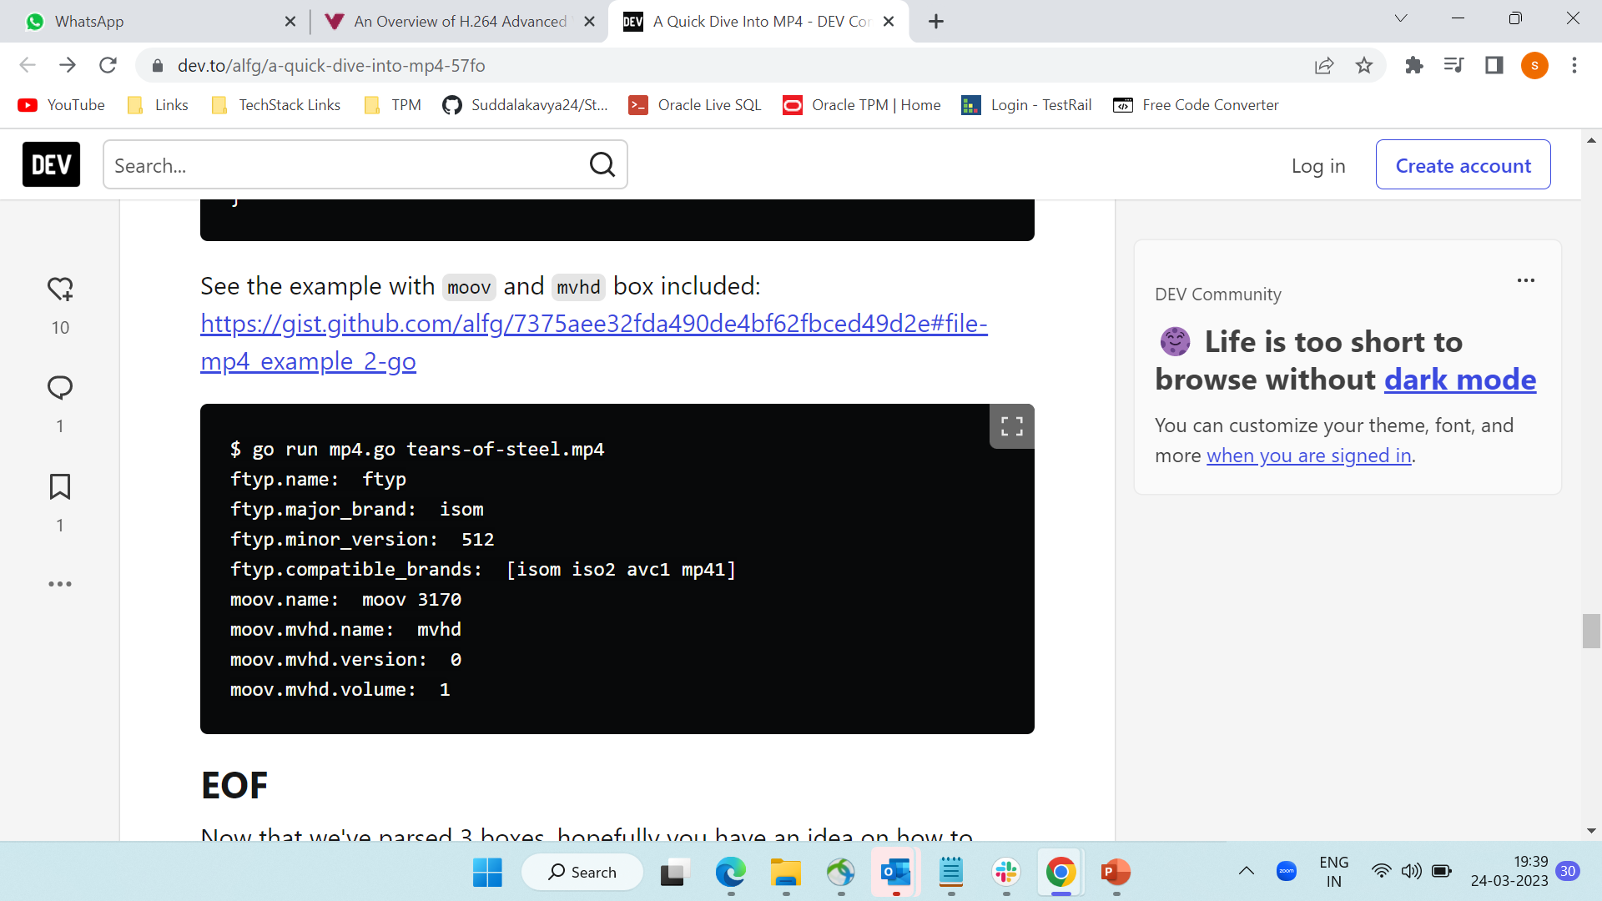

Slide 11
Interpretation
Some boxes have multiple versions, and therefore can differ in the struct and overall size of the box.
You can skip properties, but the reader must know how many bytes to skip.
There are various MP4 specifications beyond MPEG-4 Part 14 as more boxes are being added throughout the years.
Fragmented MP4 files (fMP4) are segmented as a series of moof and mdat boxes. This is more common and optimial for streaming delivery.

Slide 12
Drawbacks of existing system
The video file carving problem has long been the focus of research. Since video files are typically very large, they are very likely to be partitioned into a large number of fragments on the storage.
Motivated by this fact, the main research effort has focused on the video defragmentation problem where the goal is to reorder and combine fragments of a file to reconstruct the original videos.
Existing methods:
a. Defraser - NFI Tool
b. Header Generation
c. Header Stitching
d. Use of other file metadata (such as camera ID, location, timestamp)
e. Adjacency metrics

Slide 13
DEFRASER
Defraser, an application introduced by the Netherlands Forensic Institute (NFI), that essentially uses a library of headers extracted from previously acquired, intact H.264 coded videos and tries to decode a fragment using one of these reference headers.
An important limitation of using reference headers is that it potentially results in a very large search space as it cannot discriminate between parameters in terms of how critical they are for decoding. Further, it is hard to span all the possible headers used in practice.
More importantly, these parameters need not be fixed throughout the video as encoders dynamically determine them during encoding to achieve a target bitrate or quality.
Therefore, a more generalizable approach is to identify individual parameters needed to decode a file without failure, as it can dramatically reduce the header search space
In fact, examining the parameters that comprise H.264 video headers, they identified 13 parameters and noted that only three of them are critical for decoding.

Slide 14
HEADER GENERATION
We now describe our method for generating an SPS and PPS that can decode a given H.264 coded video file fragment based on our earlier findings.
The crux of our method lies in determining the core parameter values by avoiding a brute force search while setting the invariant parameters to their observed values and the interchangeable parameters to their most flexible and encompassing settings.
This method essentially takes as input encoded frame data and a dictionary of coding parameters and determines the critical parameters needed for decoding.
The dictionary includes parameter tuples initially sorted based on their observed frequency in the design set, which are further weighted during the search.
Exhaustive search is the main drawback.

Slide 15
HEADER STITCHING
Conventional approach of stitching the headers of all the fragments of a video file sequentially.
Bi-fragment video file – As there are only two fragments – few number of combinations possible
Time taking – exhaustive search
If fragment-fragment distance exceeds 800 blocks, inefficient in finding the subsequent block.
Results show that our header-generation method requires 54.6% fewer trials to identify the encoding parameters in comparison to a search over core parameters and 90.8% fewer trails compared to header stitching.

Slide 16
Proposed algorithm/method
Attribute Redundancy
Estimation of missing atoms based on Block information
Missing Attributes and their Values Estimation based on Video Structure
Integrity Checker Enhancement
(On Going Work)

Slide 17
PARTIAL implementation
COLLAB - PROGRESS

Slide 18
THANKYOU
.

