Slide 1
CloudStrike: Chaos Engineering for Security and Resiliency in Cloud Infrastructure
- Date of publication July 6, 2020

Slide 2
Contents:
Abstract
Introduction
Security Chaos Engineering
Risk Driven Fault Injection – RDFI
Implementation
Evaluation
Future work
Conclusion
References

Slide 3
Abstract
Most cyber-attacks and data breaches in cloud infrastructure are due to human errors and misconfiguration vulnerabilities. Therefore, we propose Risk-driven Fault Injection (RDFI) techniques to address these challenges. RDFI applies the principles of chaos engineering to cloud security and leverages feedback loops to execute, monitor, analyze and plan security fault injection campaigns, based on a knowledge base that consists of fault models designed from secure baselines, cloud security best practices, and observations derived during iterative fault injection campaigns. We have designed and implemented the RDFI strategies including various chaos engineering algorithms as a software tool: CloudStrike which was tested on AWS and GCP.

Slide 4
Introduction
Cyber-attacks against Infrastructure as a Service (IaaS) cloud platforms have increased in recent years, mostly exploiting configuration vulnerabilities. These types of vulnerabilities include misconfigured Access Control Policies (ACP), overprivileged users, and lack of audit logging. Reports on these issues suggest that cloud customers are the weakest link in the cloud ecosystem. We tackle the security challenges with a novel concept - Risk Driven Fault Injection (RDFI), a unique application of chaos engineering in cyber–security. RDFI extends the principles of chaos engineering1 to cloud security to gain security benefits, adding to the already established resiliency benefits

Slide 5
.
MAPE-K
The state-of-the-chaos engineering techniques inject faults into software systems to detect availability issues. Subsequently, these issues are resolved to improve system resilience thereby enabling confidence in the system’s capability to withstand turbulence. We propose the notion of RDFI, for injecting security faults, that detect security vulnerabilities i.e. failures that impact confidentiality, availability, and integrity. Similar to the feedback loops employed for non-security faults, we propose an adaptation of the Monitor Analyze Plan Execute over-a-shared Knowledgebase (MAPE-K) feedback loop, which has been popularly employed in complex, autonomous computing

Slide 6
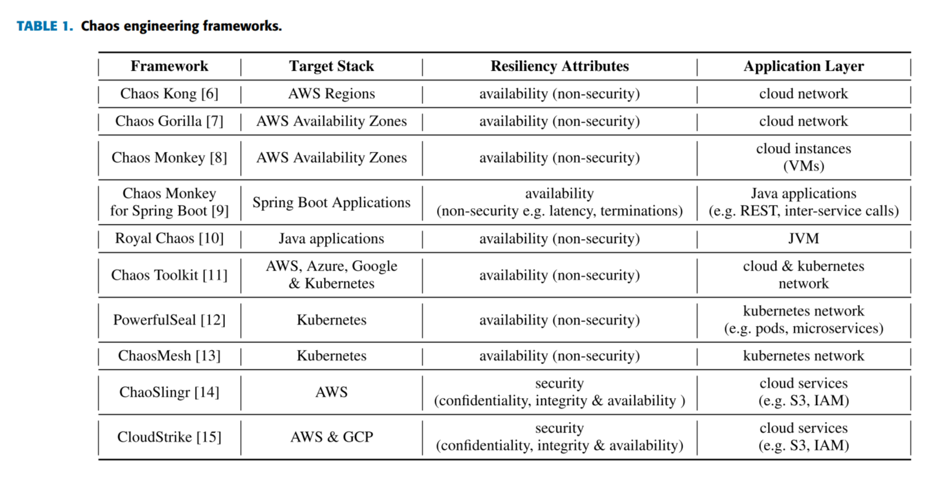
Summary of some notable chaos engineering tools
.

Slide 7
SECURITY CHAOS ENGINEERING
SCE is the identification of security control failures through proactive experimentation to build confidence in the system’s ability to defend against malicious conditions in production. Therefore, a running example based on a real data breach incident is first introduced, then the relationship between chaos engineering, dependability, security, and resiliency is highlighted. Finally, our methodology for ensuring safe experiments is presented. In the end, we discuss safety in fault injection.

Slide 8
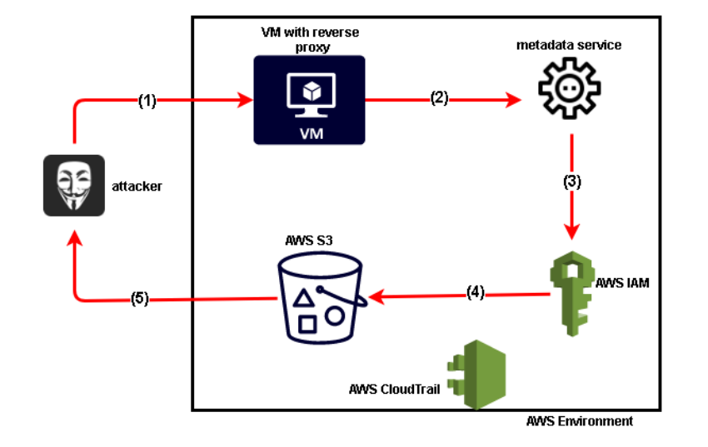
.
Running example –
An illustration of the capital one data breach
.

Slide 9
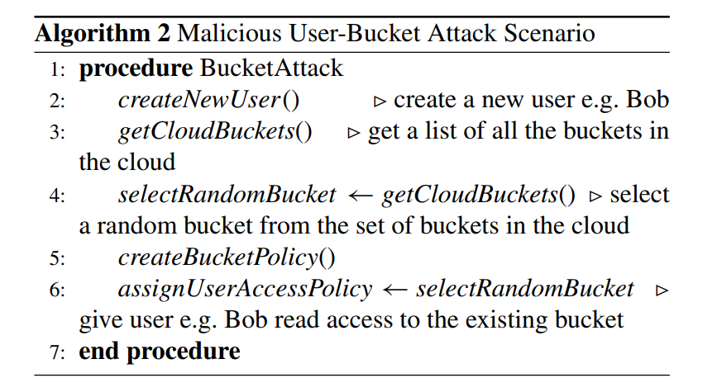
.
Procedure where a user bucket is accessed
.

Slide 10
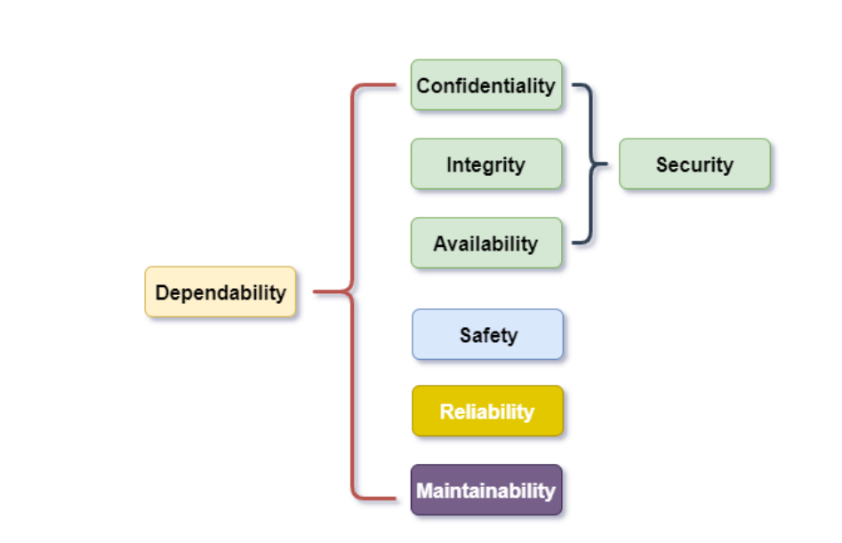
.
Dependability Tree –
Relationship between dependability and security
.

Slide 11
SAFETY IN FAULT INJECTION
Practicing chaos engineering in production requires a good measure of safety. These safety measures provide options for rolling back changes that adversely impact deployments. We leveraged the concept of state transition analysis to achieve safety. State transition analysis is an analytical model for detecting and representing malicious events in Computer Systems. By transition states what we mean is that each of our actions is stored in a particular state before committing and then we transit as per the problems we encounter.

Slide 12
RISK-DRIVEN FAULT INJECTION
RDFI implements chaos engineering from a security risk-driven perspective. CIA triad is considered while exploring the fault space. A security risk-driven approach is more helpful to security practitioners since detected vulnerabilities are analyzed and quantified, thus enabling subsequent decision-making easier and more straightforward. The outcome of fault injection campaigns are fine-grained and are computed for every security vulnerability detected during fault injection campaigns using the Common Vulnerability Scoring System (CVSS). It ranges from 1-10, 10 indicating the highest risk potential. We derive security metrics from the CVSS score.

Slide 13
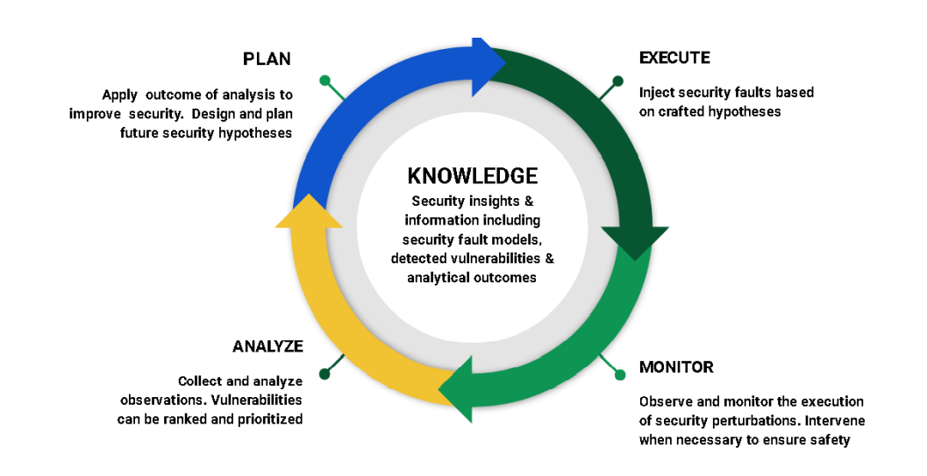
.
RDFI feedback loop - Adaptation of the MAPE-K
.

Slide 14
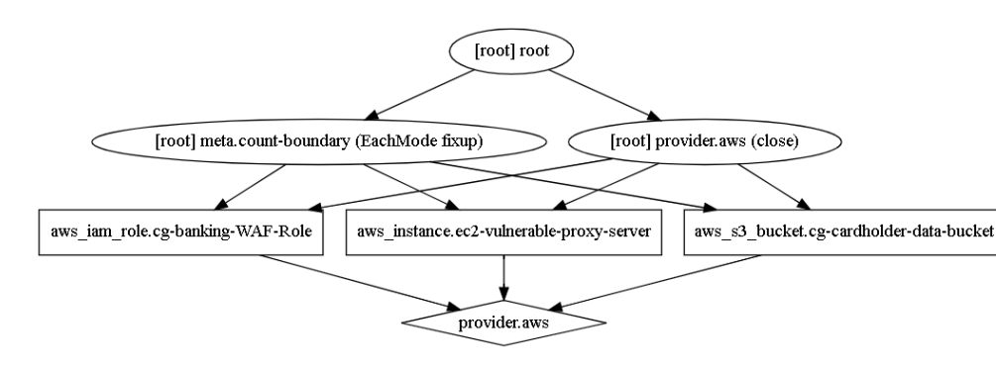
.
An attack graph of the running example
.

Slide 15
FAULT MODELS
Fault models are commonly used in traditional fault injection schemes to establish a sequence and order for conducting fault injection campaigns. In order to derive the fault models used in our scheme, several sources of security information have been synthesized. We use the below fault models:
Cloud Security Knowledge-Base (Storage point)
Cloud Pentesting Play-Book (Pre-loaded 70 test cases)
Attack Graphs (used to illustrate steps employed by attackers)

Slide 16
IMPLEMENTATION
All components of CloudStrike are implemented in Java, attacks are transmitted to the cloud platforms using APIs of AWS and GCP. Cloudstrike Architecture is implemented as follows:
Chaos Controller
Chaos Manager
Fault Engine
Fault Injector
Chaos Monitor
Chaos Analyzer

Slide 17
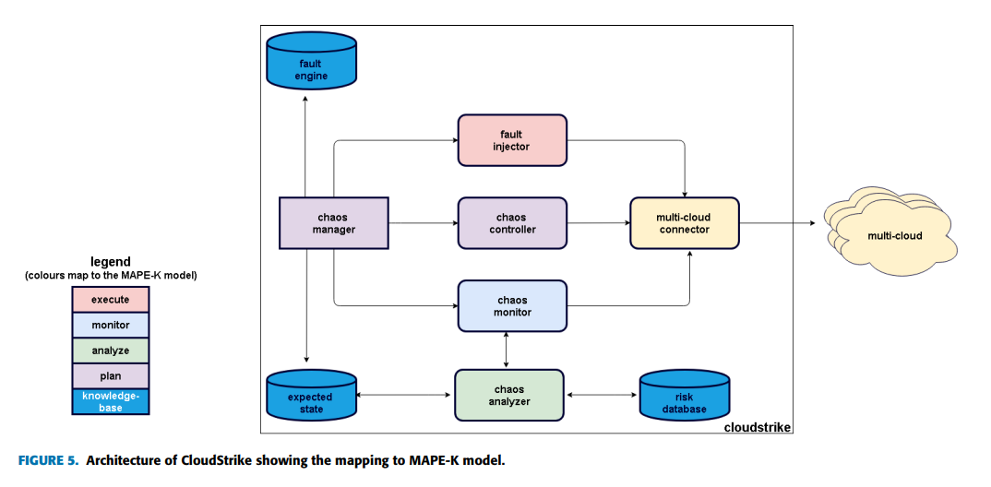
.
The architecture of CloudStrike mapping to the MAPE-K model
.
.

Slide 18
EVALUATION
They evaluated CloudStrike against a cloud infrastructure testbed that depicts an enterprise cloud environment, comprised of assets deployed on AWS and GCP. They adopted the cloud testing methodology proposed by the CSA’s Cloud Penetration Testing Playbook, which groups cloud infrastructure into three security domains:
Application Data and Business logic
Service
Account

Slide 19
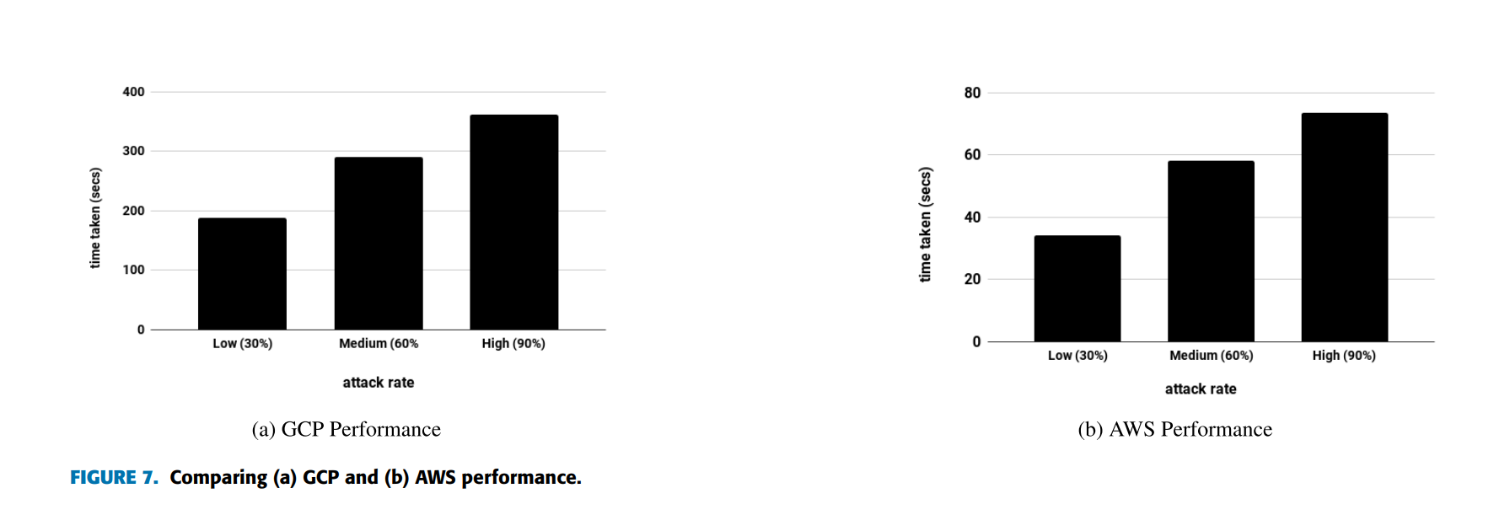
.
.

Slide 20
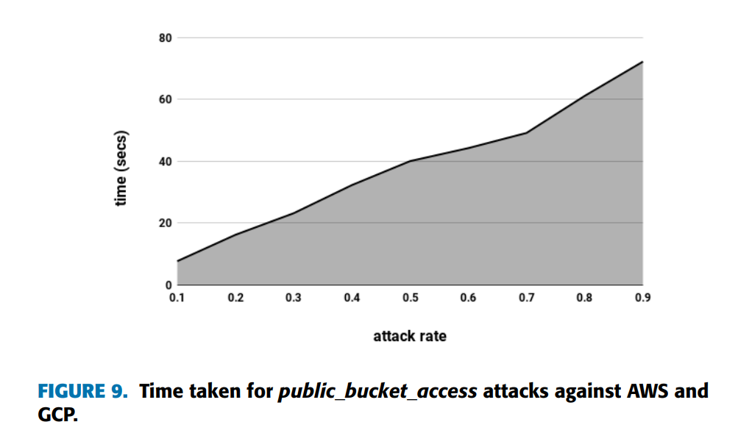
TIME PERFORMANCE
This set of experiments aimed at evaluating the performance of CloudStrike w.r.t time overhead while injecting security faults (workloads). We note that the time taken is almost linear, reflecting a linear increase of time relative to an increase in attack rates. Hence, the time taken has no significant overhead to the system, implying that the system can be easily scaled without risking the consequence of high overhead or performance challenges.

Slide 21
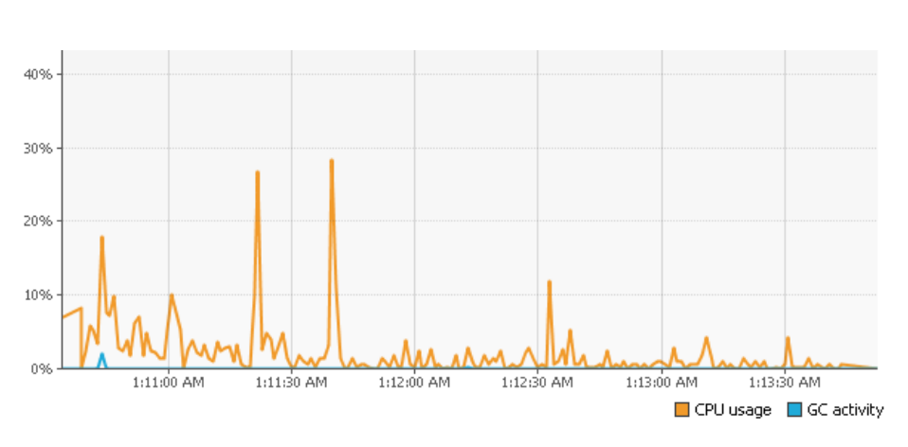
CPU CONSUMPTION
From the CPU consumption of CloudStrike, we observe that on average, the CPU consumption is less than 10 %, however, there are some spikes observed which correspond to the period when the GCP assets are attacked.

Slide 22
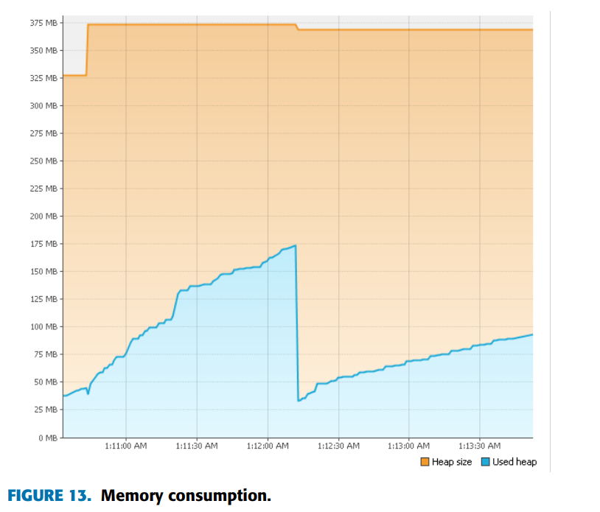
MEMORY CONSUMPTION
For memory consumption, we observe that memory consumption gradually rises from a minimum of 28MB to a maximum of 175MB, this corresponds also to the increased rate of attacks in two different attack cycles.

Slide 23
FUTURE WORK
A more intelligent recovery strategy will be implemented, that specifically takes note of the cloud assets that were changed during the security fault injection campaign. It is envisaged that this will improve efficiency by reducing the time overhead. Also, in order to improve the performance and reduce the overhead due to network issues, it will be nice to implement the CloudStrike using serverless functions such as AWS Lambda. It will be interesting to extend it to cover other cloud services and systems such as AWS EC2 and Kubernetes.

Slide 24
CONCLUSION
We have presented CloudStrike, a security chaos engineering system designed for multi-cloud security. The state-of-the-art chaos engineering systems focus on detecting non-security weaknesses, which are largely based on availability properties. CloudStrike however, extends the gains of chaos engineering to security by injecting security faults that impact confidentiality, integrity, and availability into cloud infrastructure. We have adapted the MAPE-K framework and implemented the core functionalities as components of CloudStrike. CloudStrike has been implemented and used for extensive evaluations against cloud infrastructure deployed on AWS and GCP

Slide 25
REFERENCES
Top threats to cloud computing the egregious 11, Cloud Security Alliance, Seattle, WA, USA, 2019.
2019 Cost Of a Data Breach Report, Ponemon, Michigan, MN, USA, 2019.
N. MacDonald, ‘‘Innovation insight for cloud security posture management,’’ Gartner Res., 2019.
M. Ali, S. U. Khan, and A. V. Vasilakos, ‘‘Security in cloud computing: Opportunities and challenges,’’ Inf. Sci., vol. 305
The Cloud Talent Drought Continues and is Even Larger Than you Thought. Accessed: Jun. 5, 2020. [Online]. Available: https://www.forbes. com/sites/emilsayegh/2020/03/02/

Slide 26
.
.
Thank you
- SVN. Ramakanth
1602-19-733-118

