Slide 1
Real time tracking of student’s learning outcomes and their Academic progress across schools
Title
Problem
Throughout the schools in our country, teachers follow the standard procedure of manually working on report cards to monitor students progress which is time consuming. It is often observed that some students perform well in co-circular activities and not in Academics. Being good in academics is not the only way to go ahead. Hence there is a need to monitor all the activities of the students including the academic progress and other activities

Slide 2
Solution - SCHOOLER
Web based solution that facilitates:
Registration of schools through UDISE code
Login is made available to the Admin , teachers and the students
Students can view their Attendance, Marks, Homework and non-academic activities conducted by their school

Slide 3
Why Schooler?
Progress Reports
CCA & ECA
Auto Generated
No manual effort for calculating grades
Detailed analysis
Prioritization of Non-Academic activities
Bring out the best in a child

Slide 4
Attendance
tracking
Homework Tracking
Recommendation system
Work-Made-Easy
No need of Registers
Updates once per day
Easy to track and update online
Recommends students on their blind areas
Helps in planning accordingly as per statistics
Saves a lot of teachers time
Organized Storage
Helps parents track their wards progress effortlessly
Independent of Diaries
Real-time updates
Remote Access

Slide 5
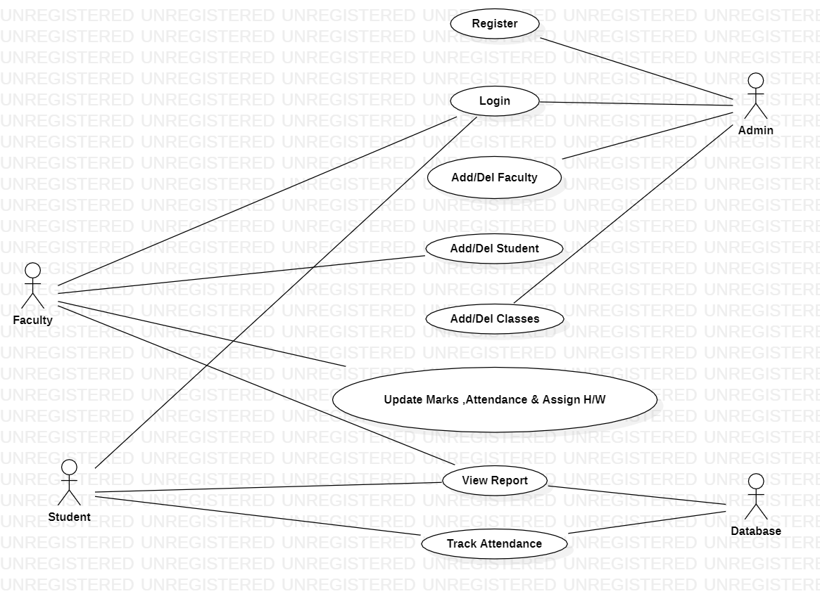
Idea/Approach Details

Slide 6
FEASIBILITY
This software can be used by any admin without having any prior knowledge of database administration.
The software can be easily integrated by any school management without any overheads.

Slide 7
Scalability
Ever since the pandemic, Virtual classrooms have taken over the learning system. Every school can use this as a platform for enhanced online activity.
AI has taken over many fields and emerged as an innovative means to understand the pulse of the users and offer relevant solutions with minimal human interventions. It can be implemented effectively in the education system for creating customized teaching solutions.

Slide 8
Conclusion
This software solution is an Efficient and Interactive way to Track students progress
Non-academic activities are prioritized
Students with talent in particular fields can easily be spotted and the management can take steps to provide them opportunities in the respective field.

Slide 9
Thank you

