Slide 1
QuadVAD vs. Baseline Models: Accuracy Comparison

Slide 2
Test setup
We evaluated QuadVAD across a range of signal levels (−15 dBFS to −60 dBFS), SNR conditions (−5 dB to 20 dB), overlapping speech scenarios, and multiple languages.
Boundary detection accuracy was compared against baseline models using manually annotated ground-truth labels. The following slides present representative examples of these evaluations.

Slide 3
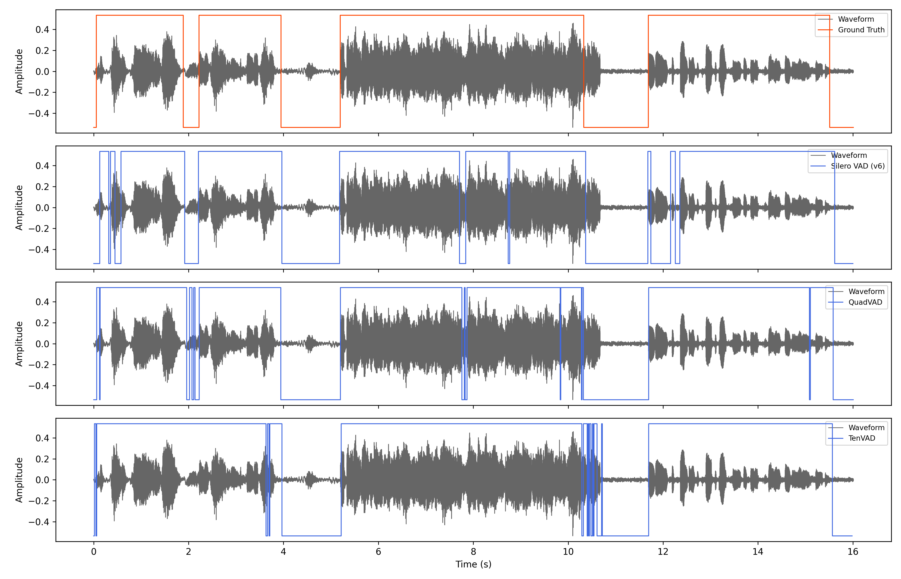

Our observation: Silero VAD has missed detecting speech segment at around 12 secs, where as, QuadVAD was able to detect it. Outperformed TenVAD in terms of FP's

Slide 4
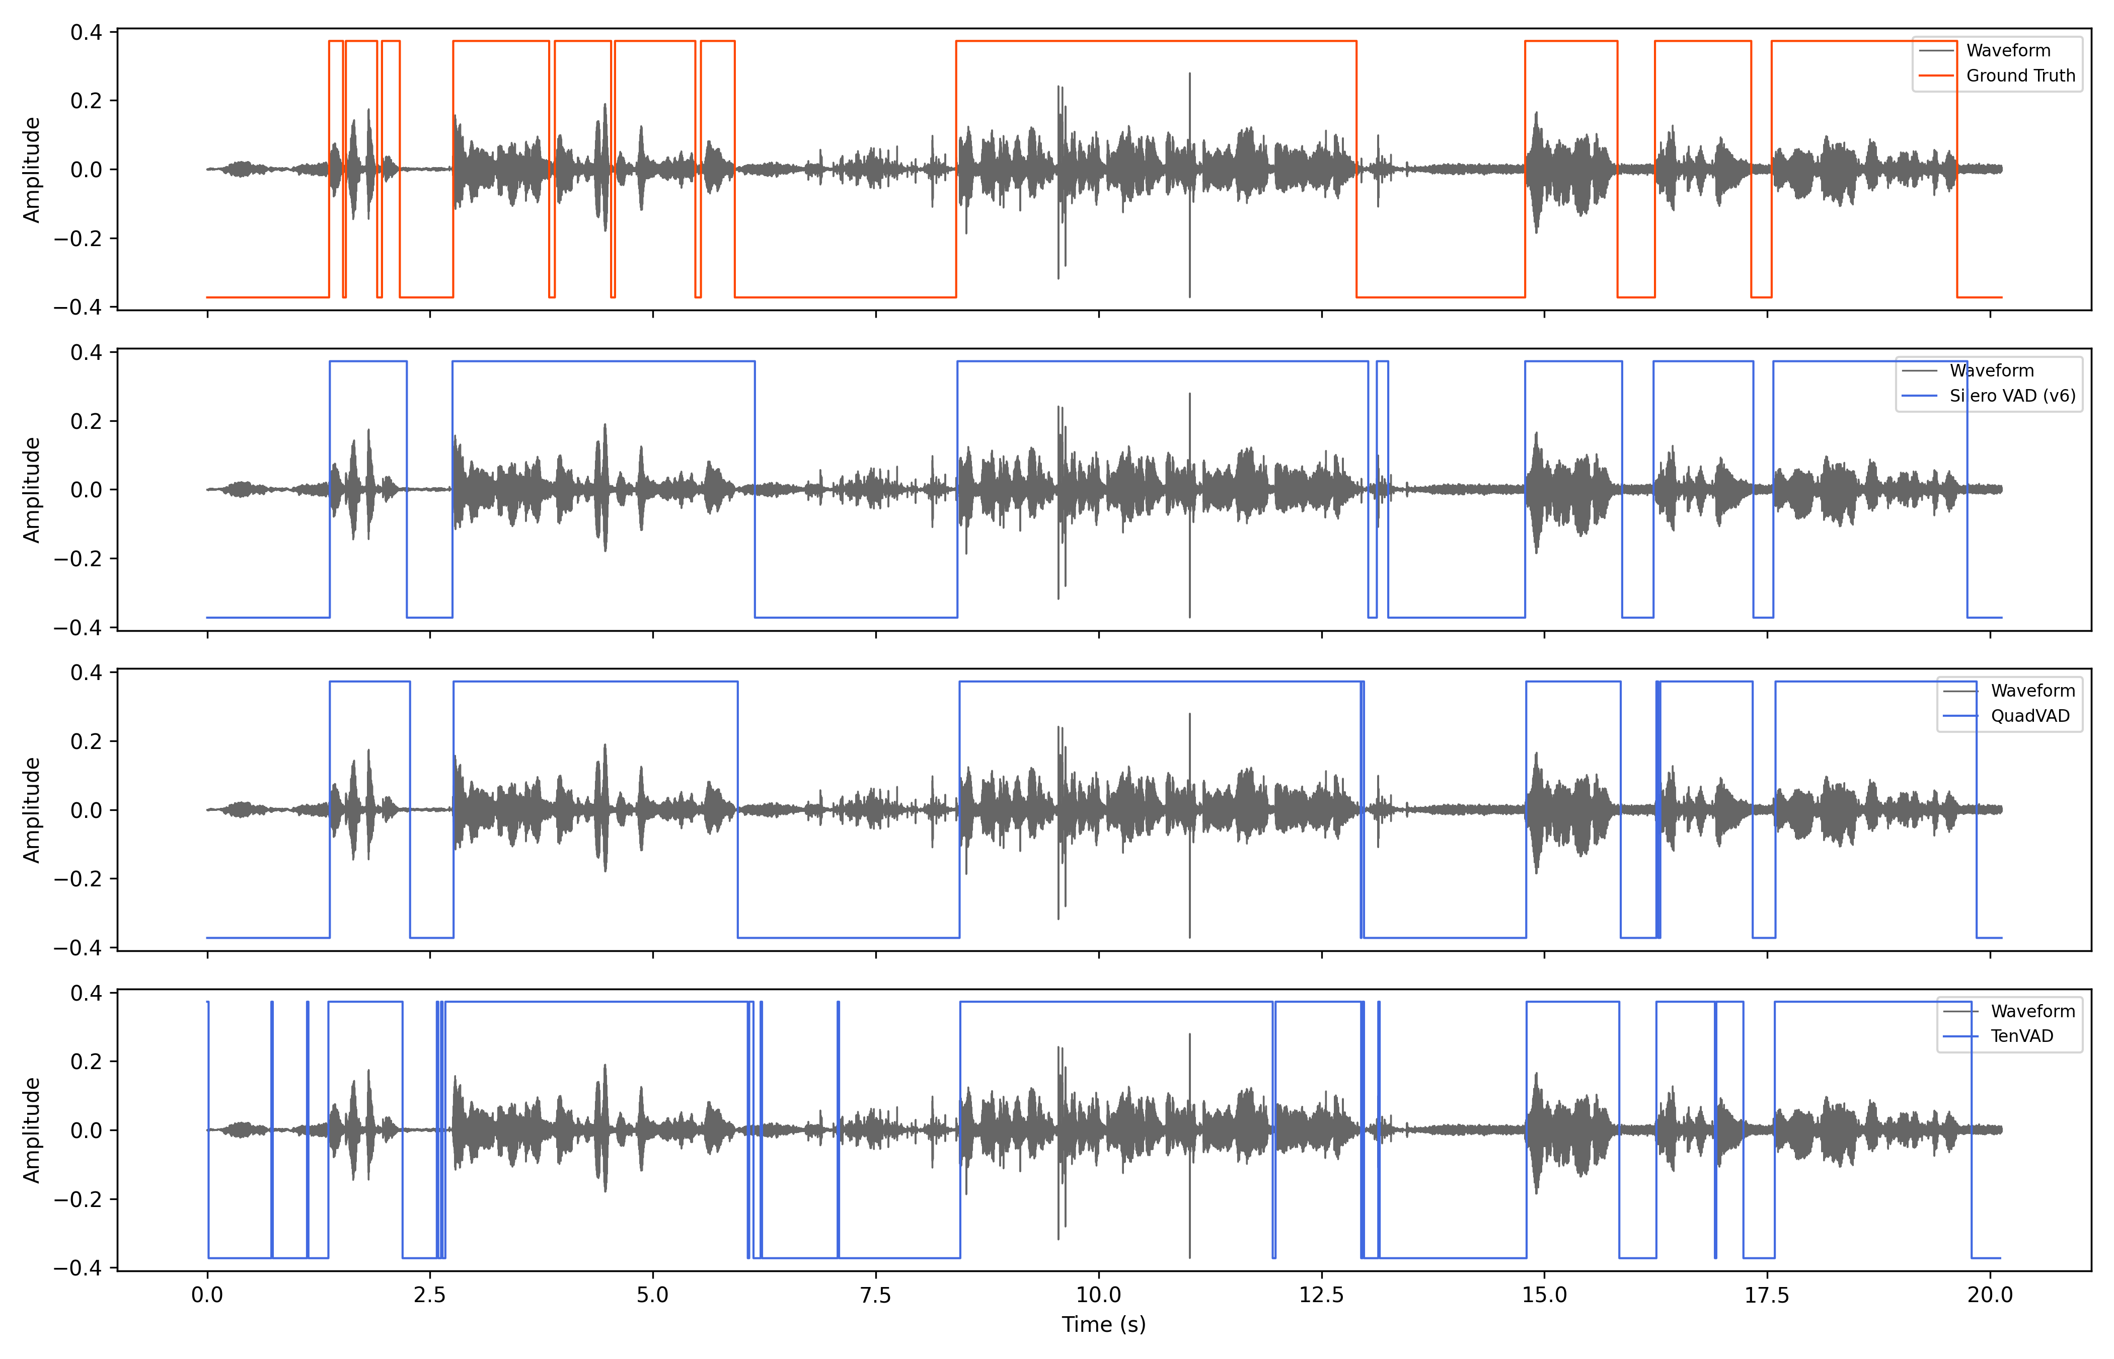
Our observation: QuadVAD outperformed both Silero VAD and TenVAD in terms of FPs (check at ~12.5 seconds)

Slide 5
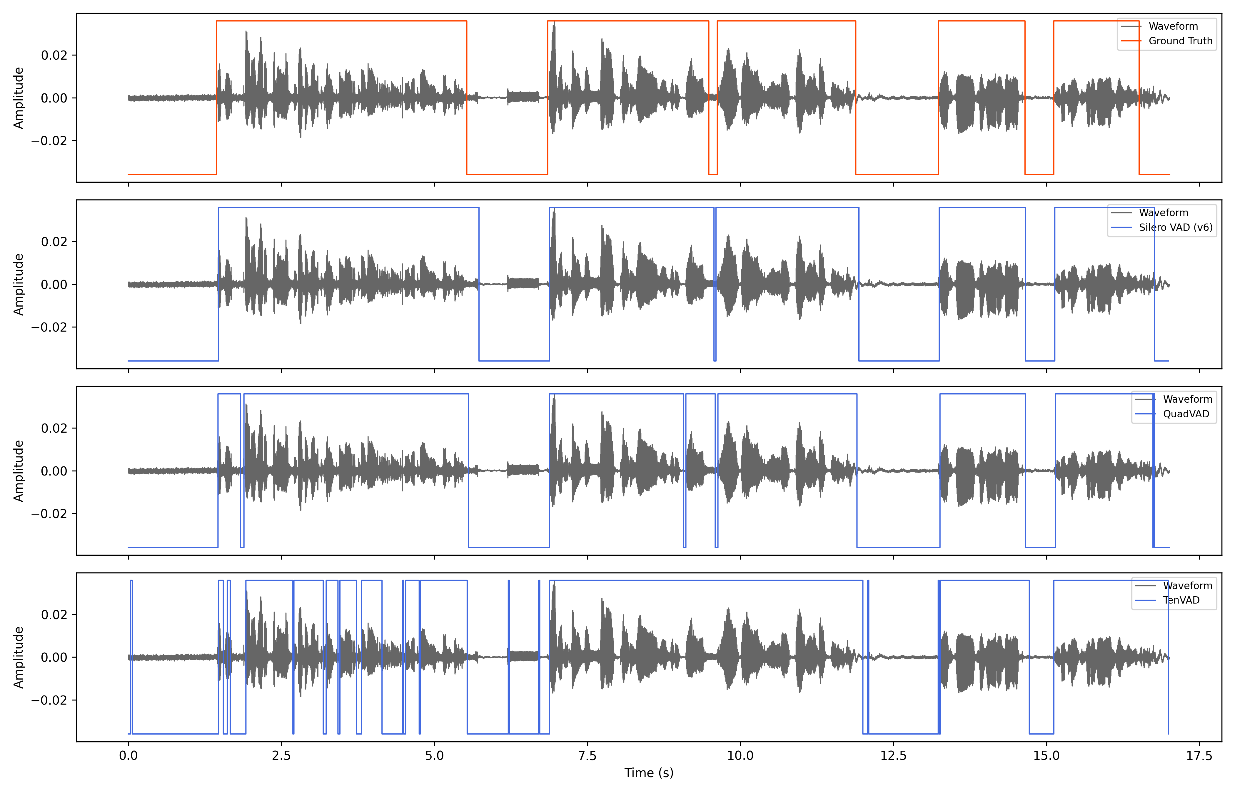
Our observation: QuadVAD outperformed TenVAD in terms of TPs and slightly better than Silero VAD in terms of FPs (check at ~5.5 seconds)

Slide 6
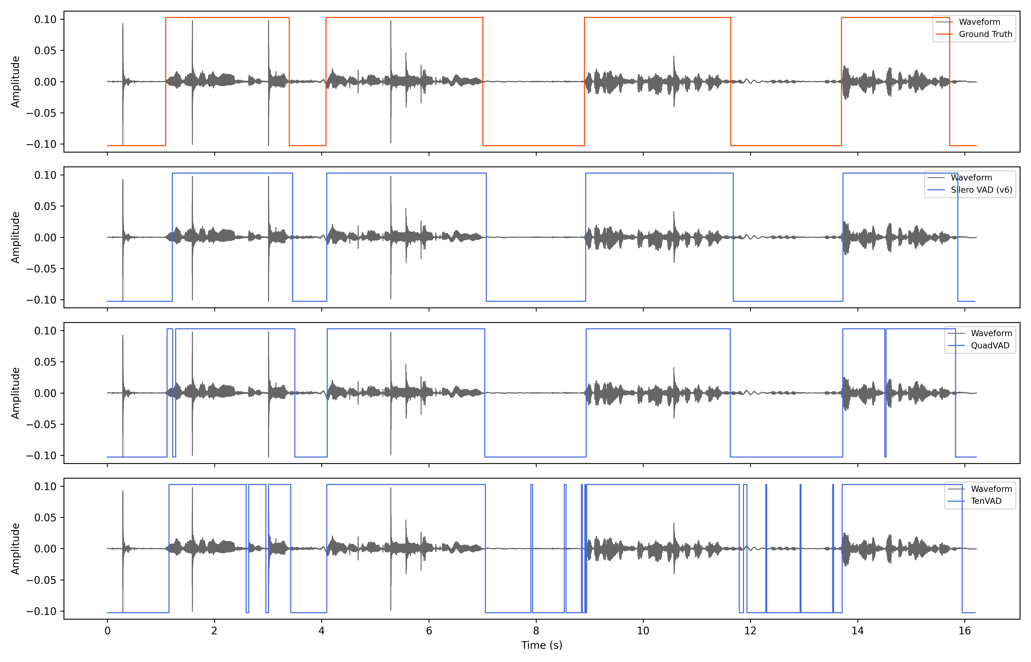
Our observation: QuadVAD outperformed TenVAD in terms of FPs and slightly better than Silero VAD in terms of TPs (check at ~1.2 seconds)

Slide 7
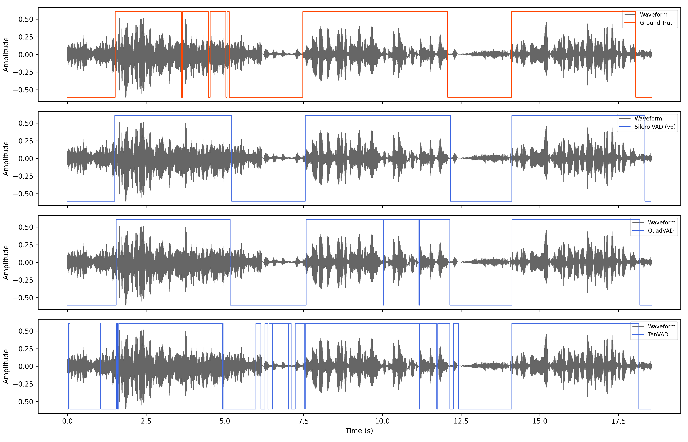
Our observation: QuadVAD outperformed TenVAD in terms of FPs and showed equivalent accuracy as Silero VAD

