Slide 1
Qualitative examples of label inaccuracies in the AVA-Speech dataset

Slide 2
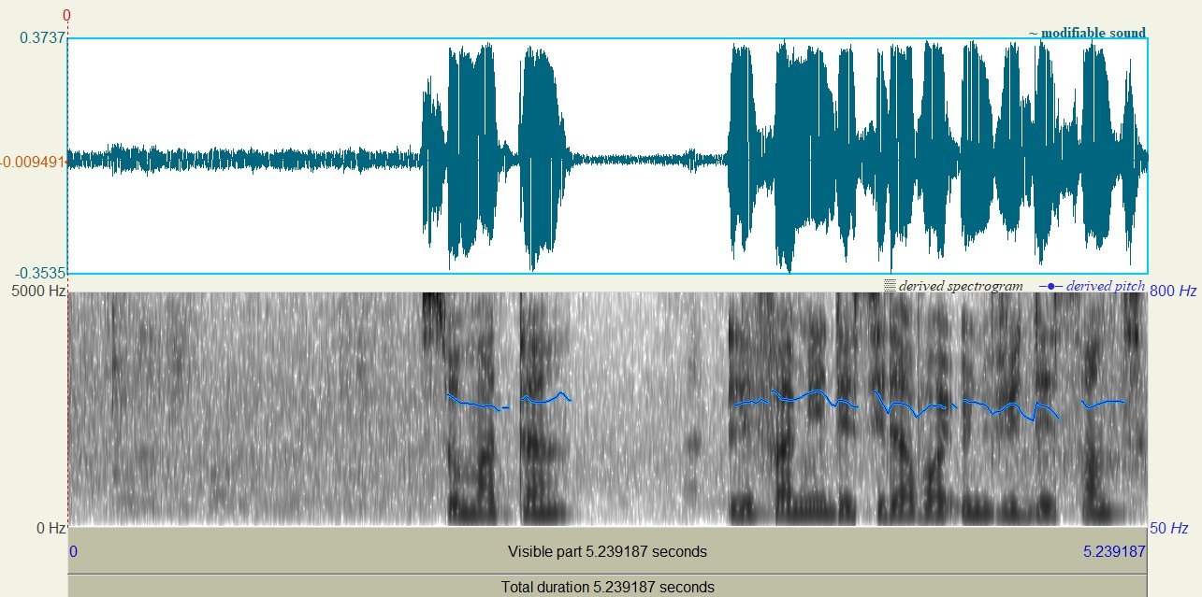

*The red colored boundary region shows inaccurate labels
Filename: 5BDj0ow5hnA.wav
chunk: 632799 to 716639
Label: SPEECH_WITH_NOISE
Our observation: There are noise-only segments as well as speech-with-noise segments

Slide 3
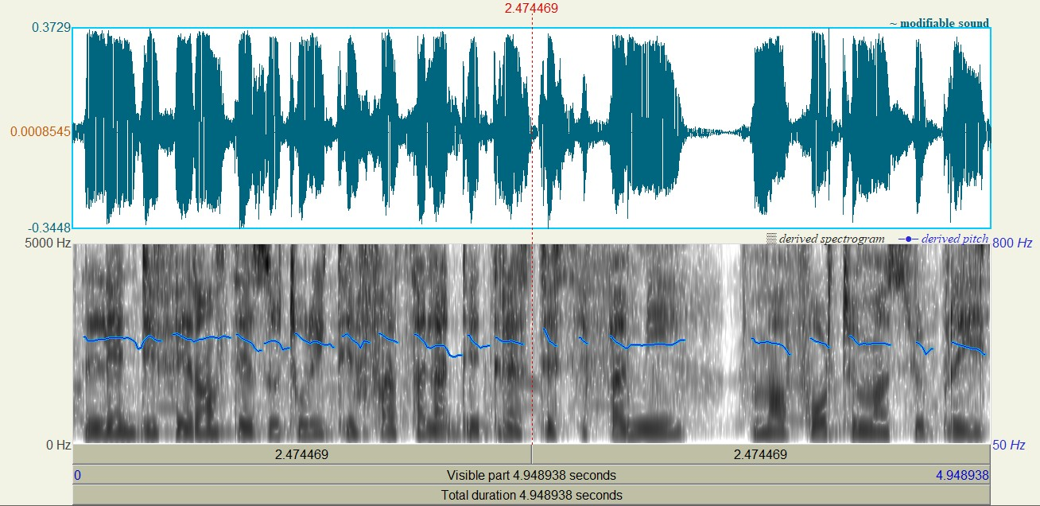
*The red colored boundary region shows inaccurate labels
Filename: 5BDj0ow5hnA.wav
chunk: 1395200 to 1474399
Label: CLEAN_SPEECH
Our observation: There is a silence segment of ~0.4 sec, starting from 3.28 sec

Slide 4
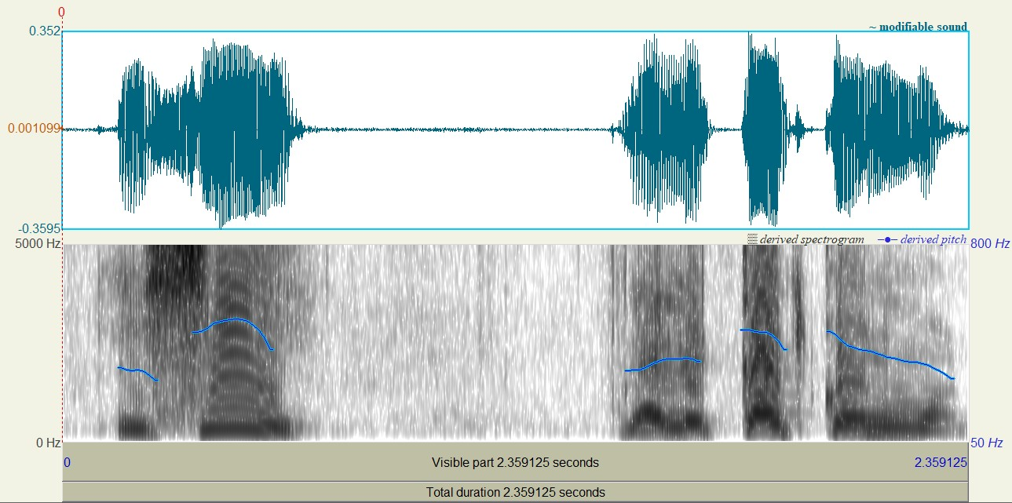
*The red colored boundary region shows inaccurate labels
Filename: 5BDj0ow5hnA.wav
chunk: 5526880 to 5564639
Label: CLEAN_SPEECH
Our observation: There is a silence segment of ~0.8 sec, starting from 0.64 sec

Slide 5
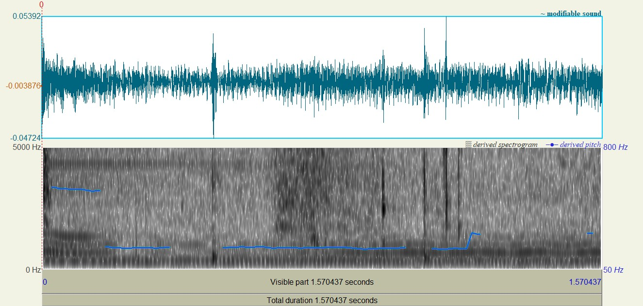
*The red colored boundary region shows inaccurate labels
Filename: 9bK05eBt1GM.wav
chunk: 13994880 to 14020480
Label: CLEAN_SPEECH
Our observation: This segment seems to be a noise segment (music) rather than a speech segment

Slide 6
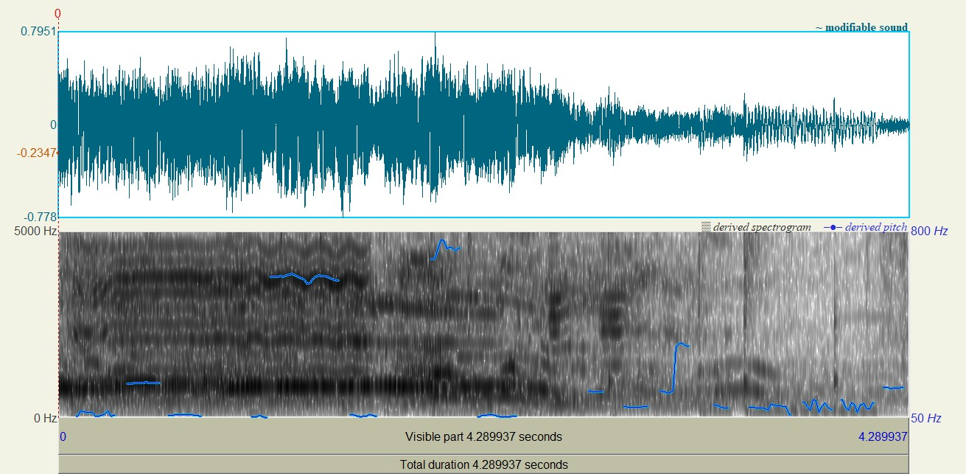
*The red colored boundary region shows inaccurate labels
Filename: 9bK05eBt1GM.wav
chunk: 25440 to 94079
Label: SPEECH_WITH_NOISE
Our observation: There are noise-only segments as well as speech-with-noise segments

Slide 7
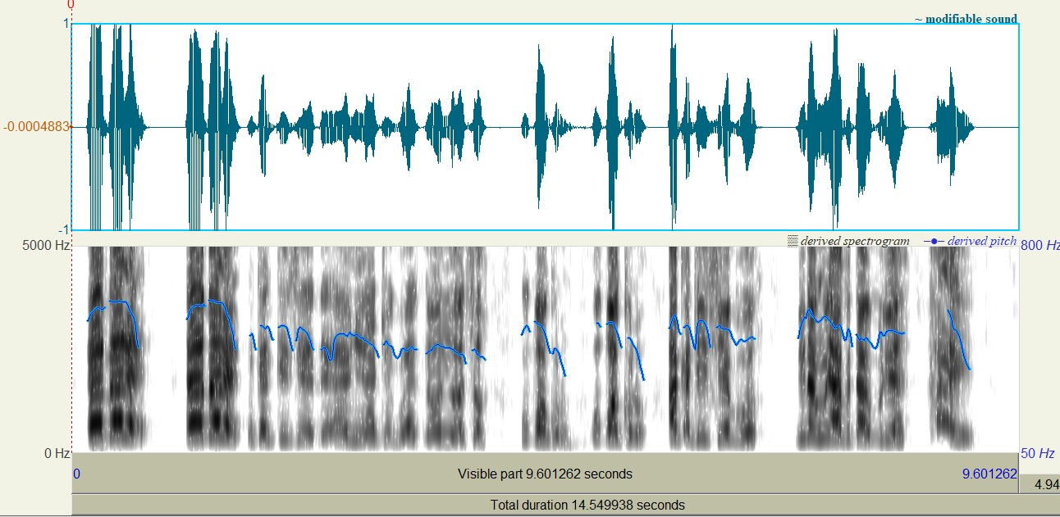
*The red colored boundary region shows inaccurate labels
Filename: 9bK05eBt1GM.wav
chunk: 4756480 to 4989279
Label: CLEAN_SPEECH
Our observation: There are several silent segments in addition to speech segments

