Slide 1
Sales Data Analysis
Data Storytelling & Statistical Validation
Data Analyst Internship – Task 4
Prepared by: Thalluri Ramakrishna Tools Used: Python, Google Colab, Power BI, Excel

Slide 2
Objective of the Project
The objective of this project is to analyze a sales dataset to understand business performance, customer behavior, and product trends.
Through data analysis and visualization, the project aims to identify key insights that can help businesses improve decision making and increase revenue.
This analysis was performed using Python for data analysis and Power BI for interactive dashboard visualization.

Slide 3
Dataset Overview
The dataset for task1 and 2 contains sales transaction data and task3 containing amazon sales data including product information, customer details, and revenue data.
Important Columns in the Dataset Task 1 and Task 2:
Important columns in the Task3
Discount
Payment_Method
Product_ID
Quantity_Sold
Region
Region_and_Sales
Sale_Date
Customer_
Sales_Amount
Sales_Channel
Sales_Rep
Unit_Cost
Unit_Price
Product_Category
Region
Country
Item Type
Sales Channel
Order Priority
Order Date
Ship Date
Units Sold
Unit Price
Unit Cost
Total Revenue
Total Cost
Total Profit
Shipping Days (Created)

Slide 4
Data Analysis Process
The analysis process involved several steps:
Data Cleaning: Removed missing values and prepared the dataset for analysis.
Exploratory Data Analysis (EDA): Used Python to explore patterns, relationships, and trends in the dataset.
Data Visualization: Created visual charts and graphs to understand the data better.
Dashboard Creation: Developed an interactive dashboard in Power BI to present insights clearly.

Slide 5
Key Insights from the Analysis
Some product categories generate significantly higher revenue compared to others.
Sales vary across different cities, indicating geographical differences in customer demand.
Monthly sales trends show certain months where sales increase significantly.
A small group of customers contributes to a large portion of total revenue.
These insights help businesses understand their strongest markets and best performing products.

Slide 6
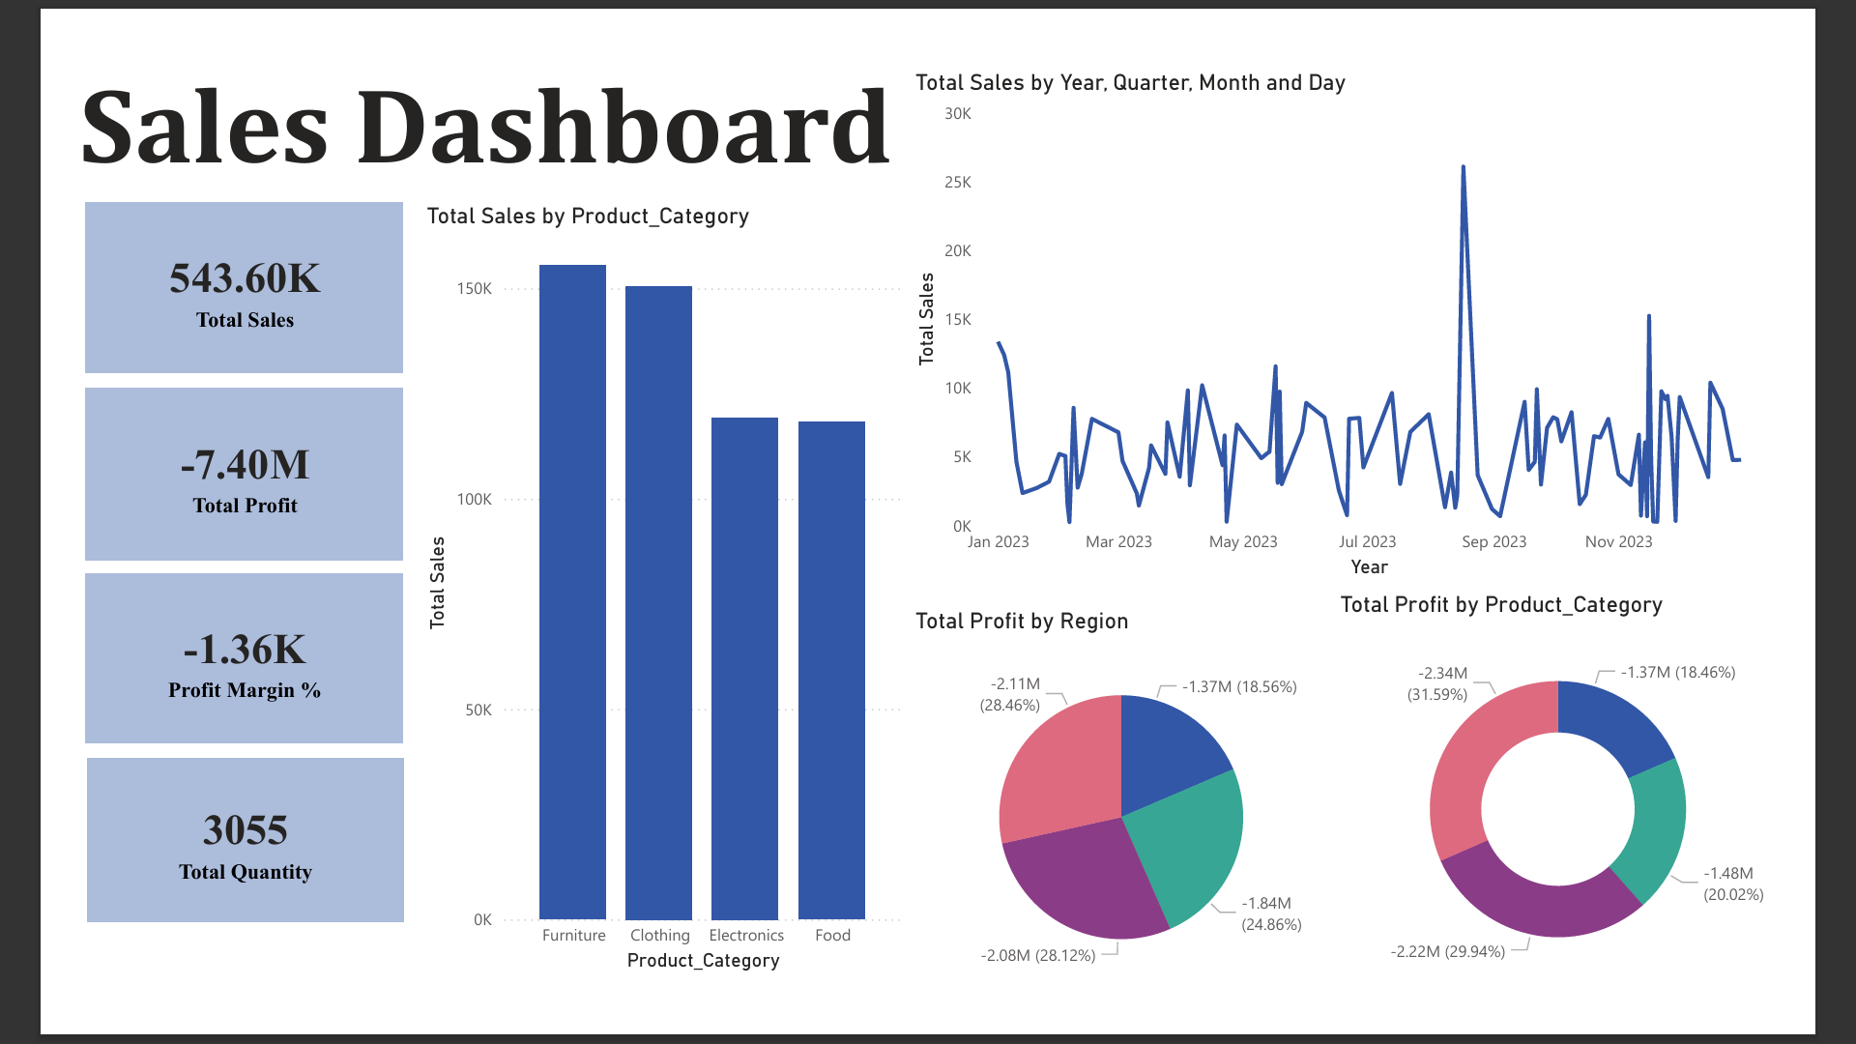
Power BI Dashboard Insights
Power BI Dashboard Insights
An interactive Power BI dashboard was created to visualize the sales data.
The dashboard includes:
• Sales by Product Category
• Monthly Sales Trend
• Total profit by Region
• Total profit by product category
These visualizations
help stakeholders quickly
understand business
performance and identify key
opportunities for improvement.

Slide 7
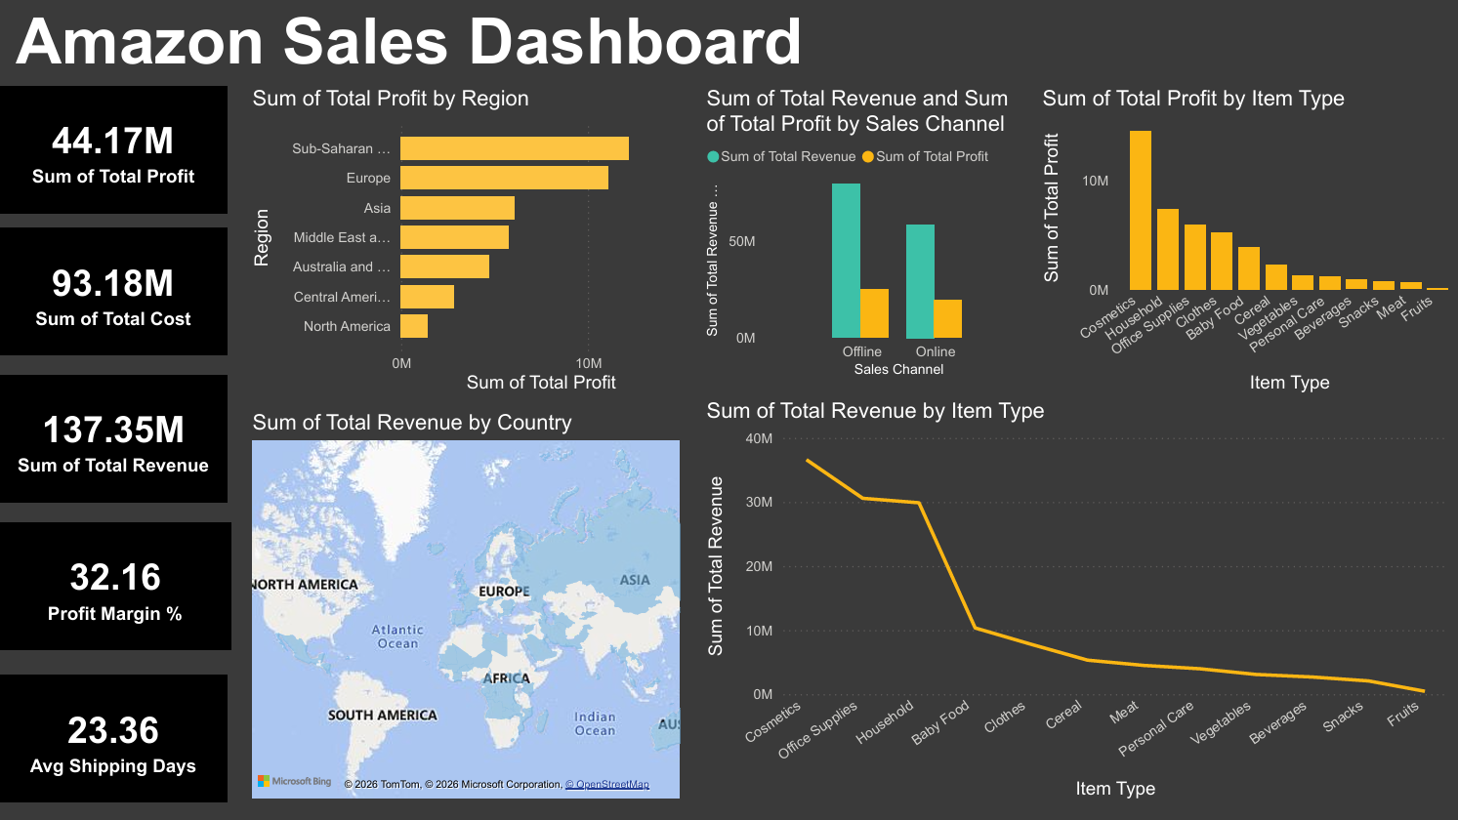
The dashboard which I created in Task3
Deep dive analysis and creating interactive dashboard

Slide 8
Hypothesis Testing
Business Question: Does product category influence sales amount?
Null Hypothesis (H0): Product category does not affect sales amount.
Alternative Hypothesis (H1): Product category significantly affects sales amount.
Statistical Test Used: ANOVA (Analysis of Variance)
Result: The ANOVA test produced a p-value less than 0.05.
Conclusion: The null hypothesis was rejected, indicating that product category has a
statistically significant impact on sales amount.

Slide 9
Business Recommendations & Conclusion
Business Recommendations
Based on the analysis, the following recommendations can help improve business performance:
• Focus marketing efforts on high-performing product categories. • Target cities with high sales potential for expansion. • Offer loyalty programs for top customers to increase retention. • Plan promotions during months with high sales activity.
Conclusion
This project demonstrates how data analysis, visualization, and statistical validation can provide valuable insights for business decision-making.

