Slide 1
Lead Scoring Case Study Group Members: Ramakrishnan Ramasamy Dinesh Rajshri Date : 04/14/2024

Slide 2
Agenda
Problem Statement
Solution Methodology
Data Manipulation
EDA
Model Building
Model Evaluation
Conclusion

Slide 3
Problem Statement
An education company named X Education sells online courses to industry professionals. On any given day, many professionals who are interested in the courses land on their website and browse for courses.
The company markets its courses on several websites and search engines like Google. Once these people land on the website, they might browse the courses or fill up a form for the course or watch some videos. When these people fill up a form providing their email address or phone number, they are classified to be a lead. Moreover, the company also gets leads through past referrals. Once these leads are acquired, employees from the sales team start making calls, writing emails, etc. Through this process, some of the leads get converted while most do not. The typical lead conversion rate at X education is around 30%.
Business Objective
Build a logistic regression model to assign a lead score between 0 and 100 to each of the leads which can be used by the company to target potential leads. A higher score would mean that the lead is hot, i.e. is most likely to convert whereas a lower score would mean that the lead is cold and will mostly not get converted.

Slide 4
Solution Methodology
Let’s approach the solution by following the below steps:
Data cleaning and data manipulation.
Check and handle duplicate data. 2.
Check and handle NA values and missing values. 3.
Drop columns, if it contains large amount of missing values
4. Imputation of the values, if necessary.
5. Check and handle outliers in data. 
EDA
Univariate data analysis: value count, distribution of variable etc.
Bivariate data analysis: correlation coefficients and pattern between the variables etc.
Feature Scaling & Dummy Variables and encoding of the data.
Classification technique: logistic regression used for the model making and prediction.
Validation of the model.
Model presentation. 
Conclusions

Slide 5
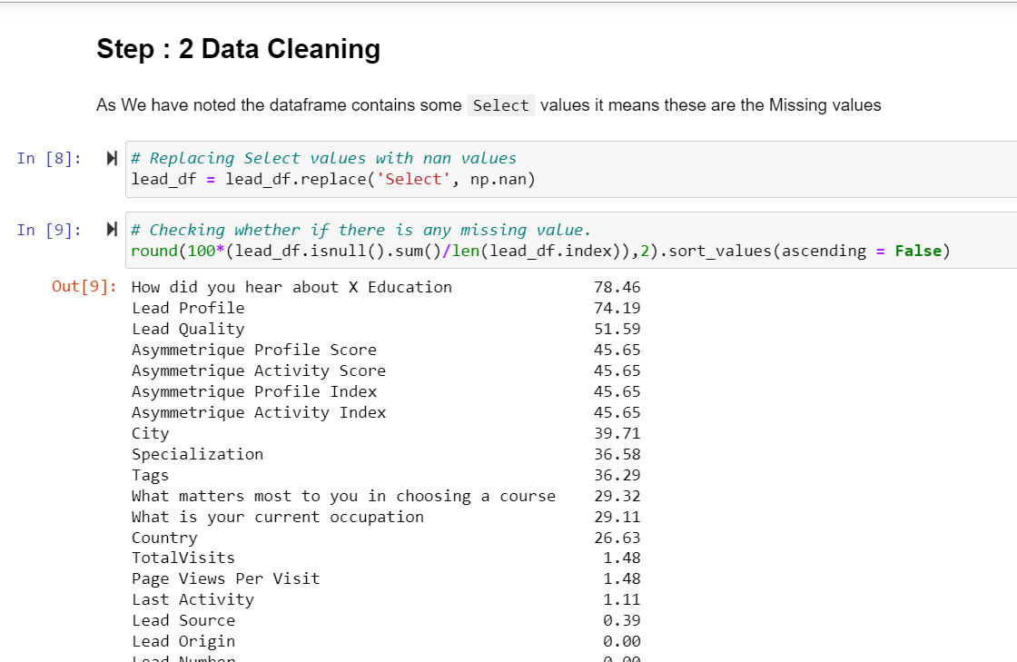
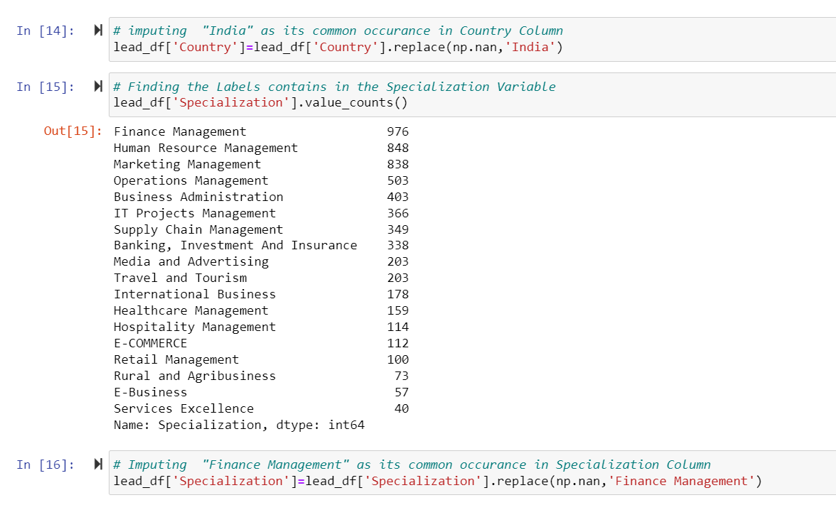
Data Manipulation:
1,Shape of the dataset : (9240, 37)

Slide 6
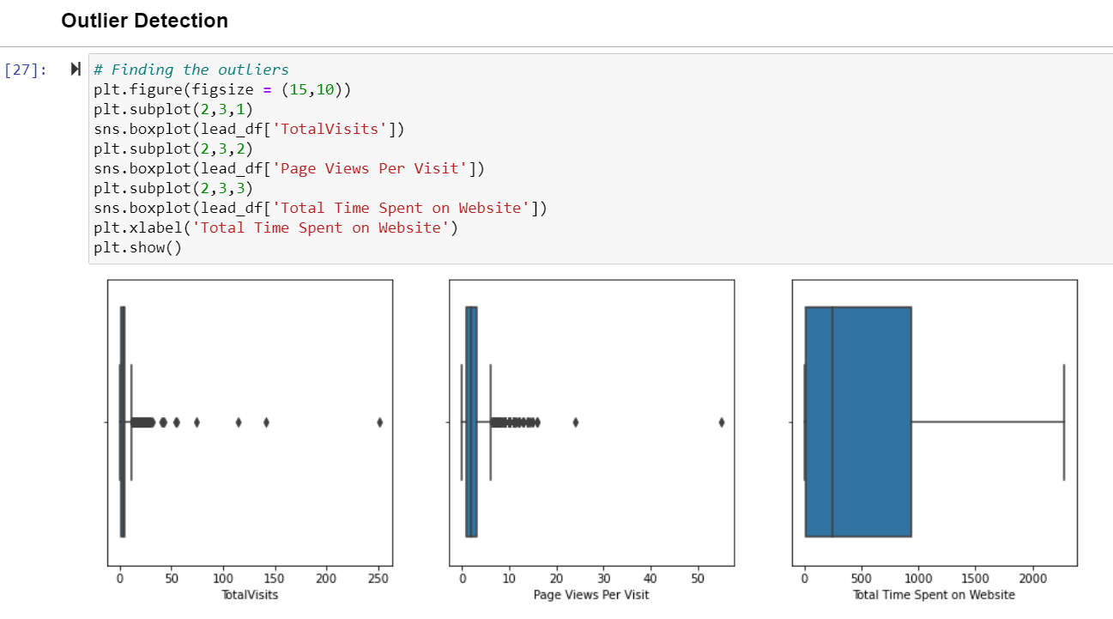
Outlier Detection

Slide 7
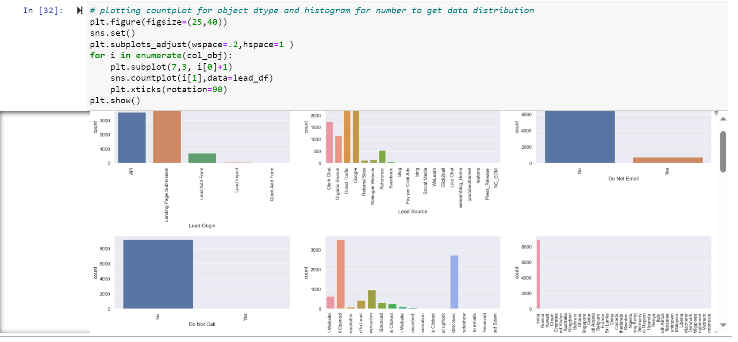

Slide 8
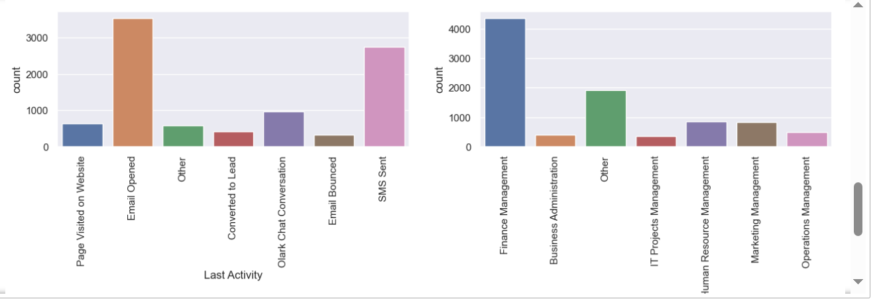
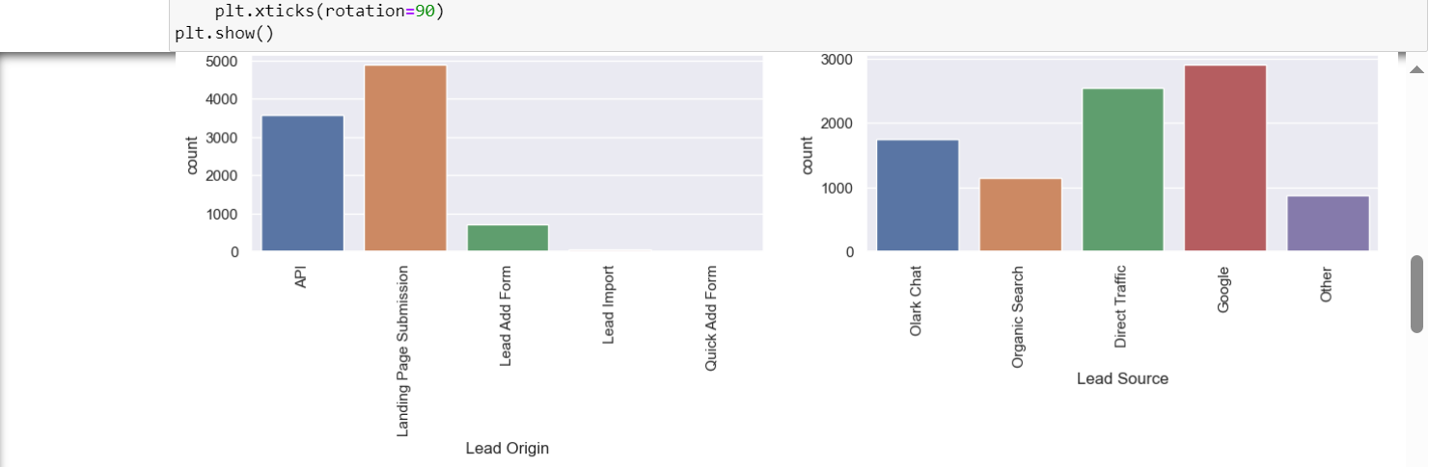
EDA
Univariate Analysis for Categorical Values
- In Lead Source Direct Traffic and Google are the two main source for Leads
- The Number of values is High in Email Opened and SMS Sent in Last Activity
- Most of the people chooses Finance Management Specialization rather than other Specialization
- The IT Project management have very lees so that most of the People not prefered this Specialization

Slide 9
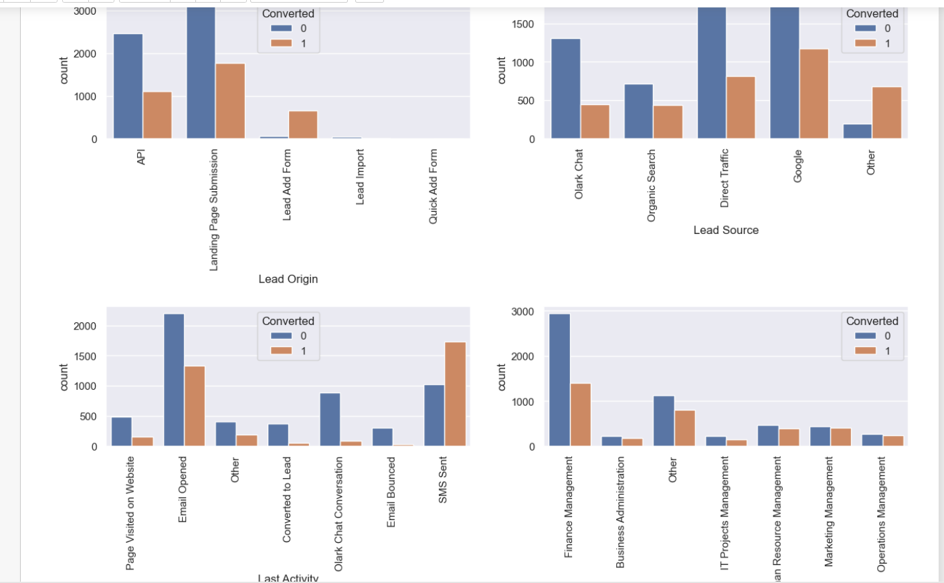
EDA
Bivariate Analysis with respect to Target Columns
In Lead Source The number of Hot leads is higher in Direct Traffic and Google less in Other Category
In Last Activity the number of Hot leads is higher in SMS and in EMAIL cold leads is higher than hot leads.
In Last Notable Activity it's mostly same as Last Activity.
In Specialization most of the leads are comes from Finance management but here Hot leads are lesser than Cold lead

Slide 10
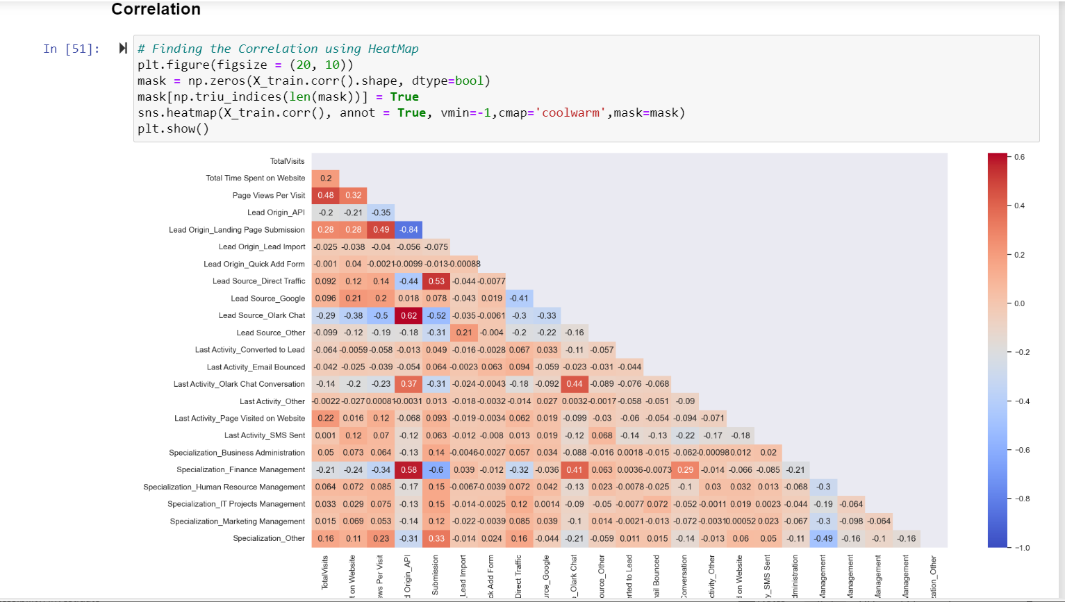
Model Creation
Split the dataset into Train and Test Data set
Identify the correlation in the train data set
FIT the Regression model with 20 cols.
Building a Logistic Regression using statsmodel, for the detailed statistic

Slide 11
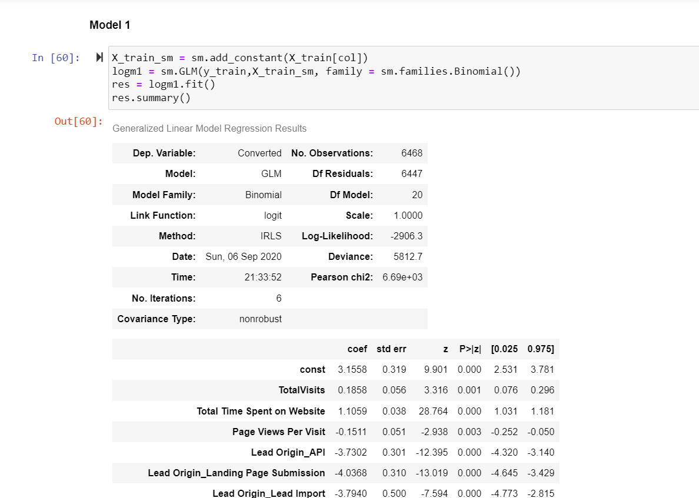
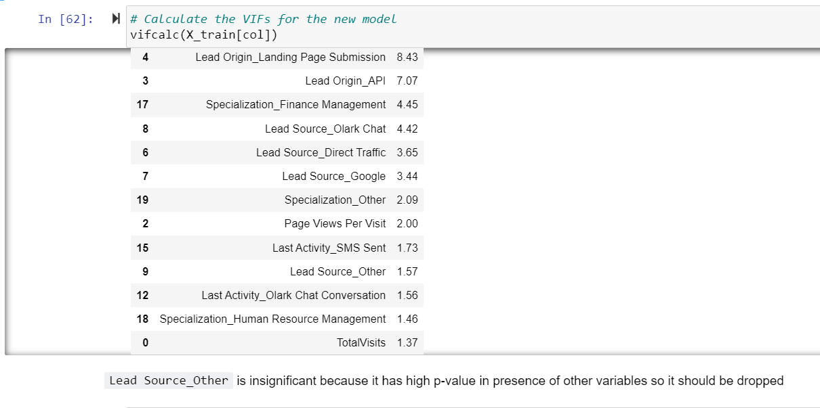
Model Creation

Slide 12
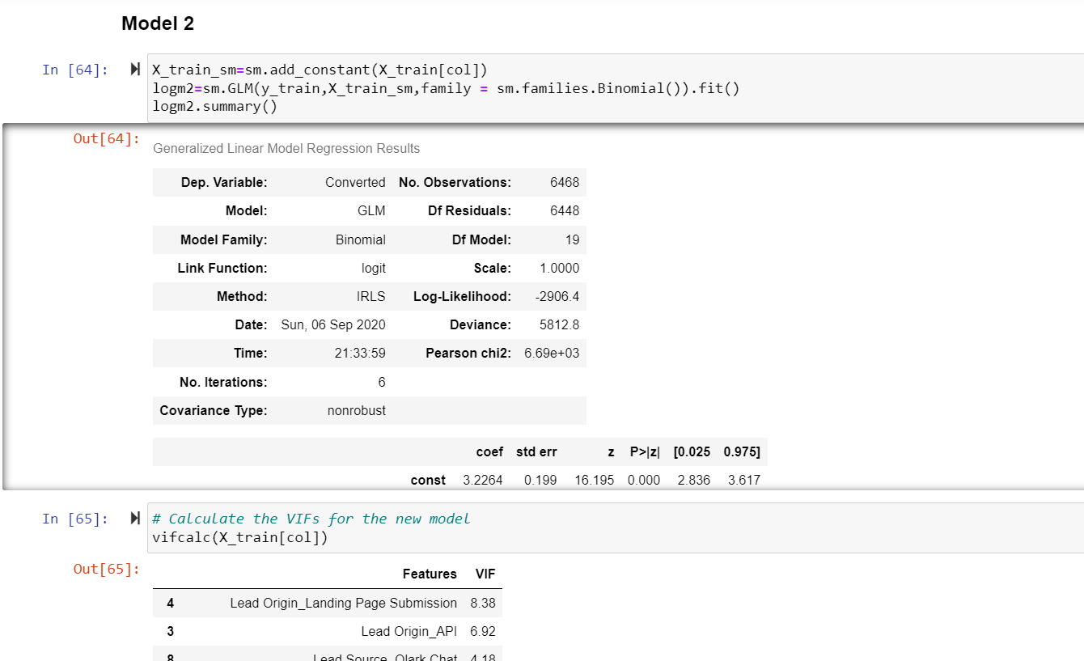
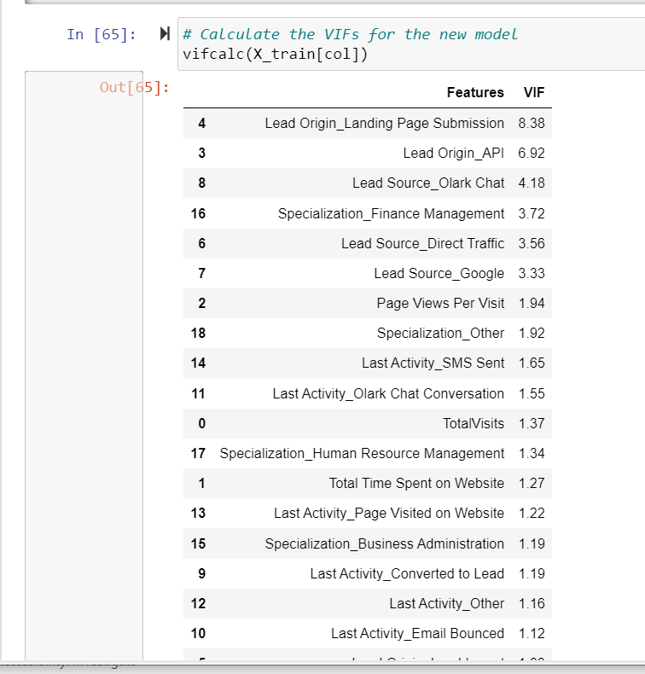
Model Creation
Model 2
Similar to this models, we have explored 6 different model with various attributes and concluded with the final model that had VIF values less than 5.

Slide 13
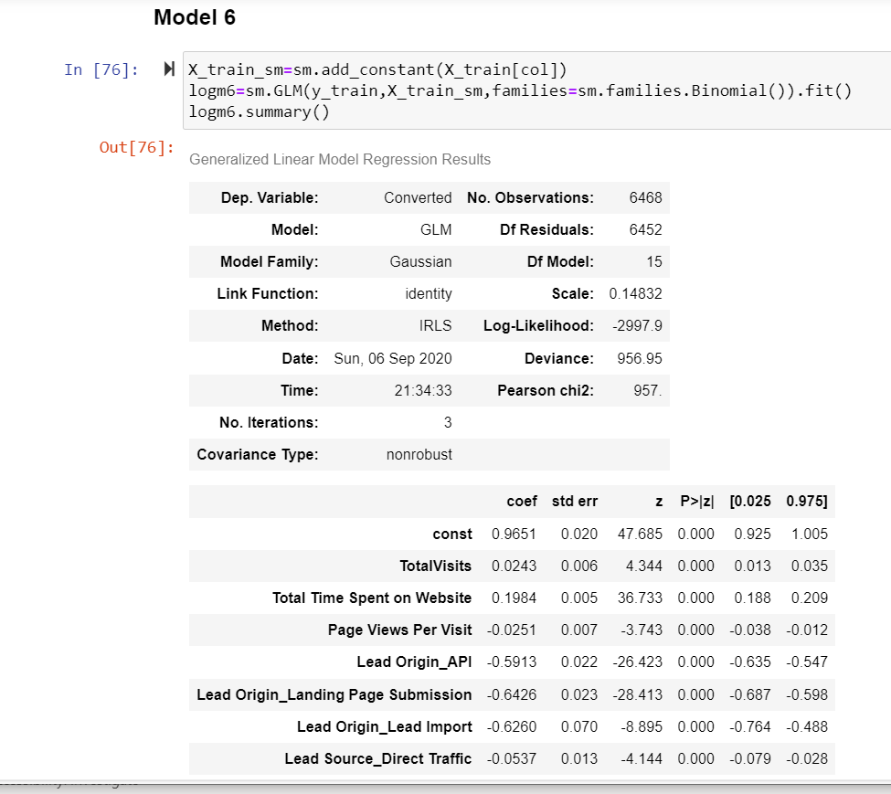
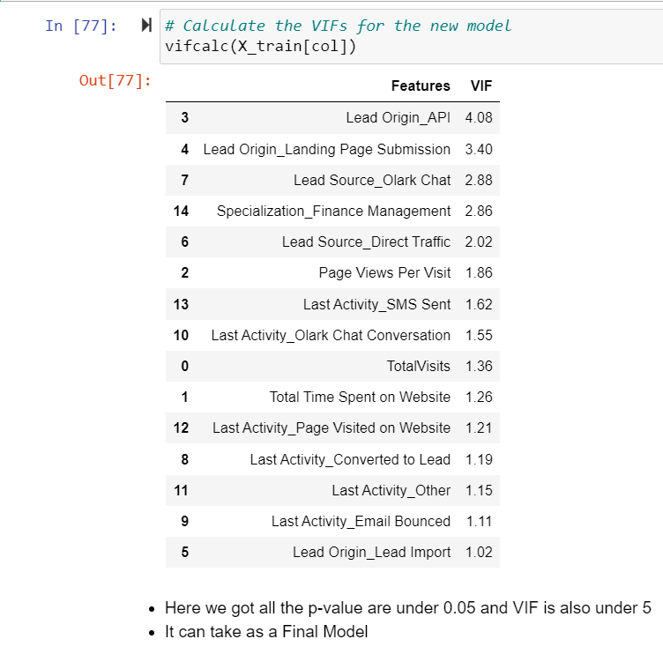
Model Creation
Final Model for validation

Slide 14
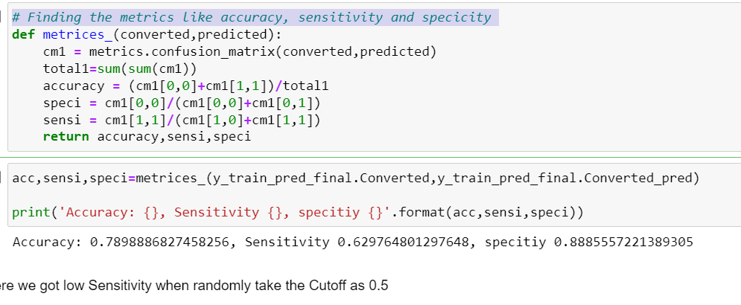
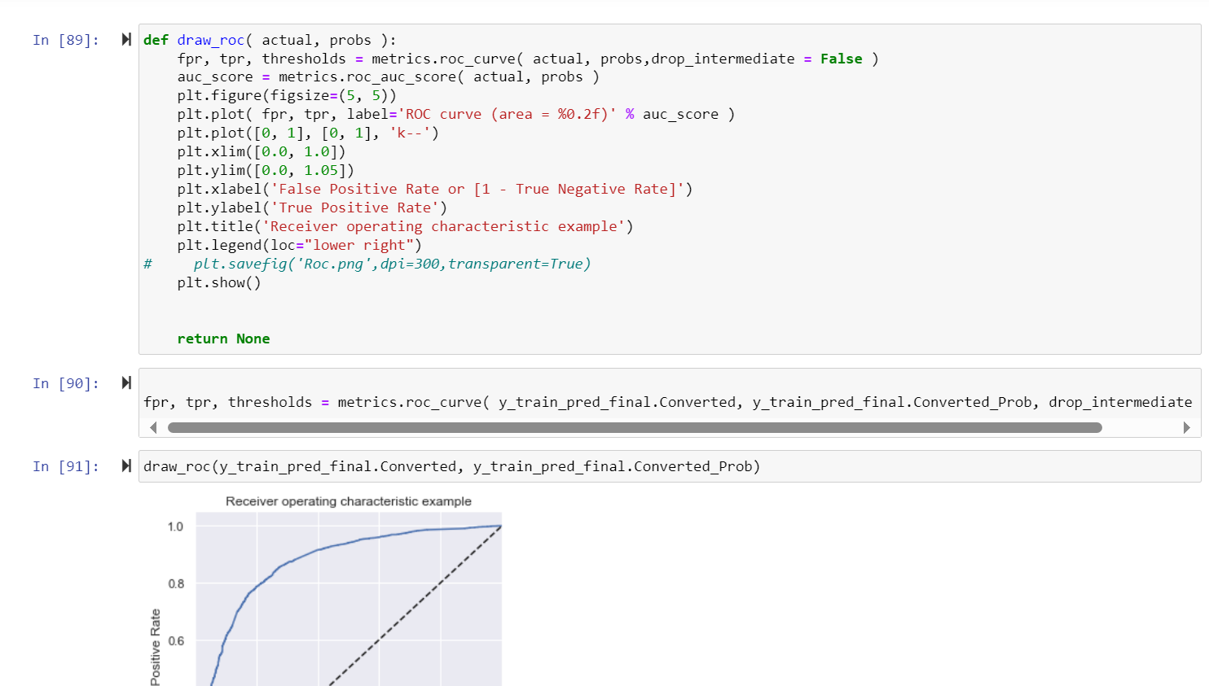
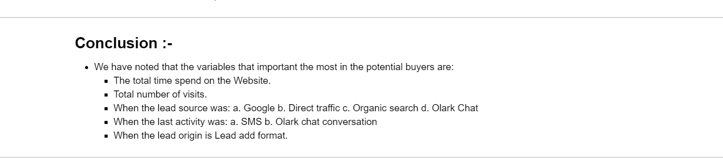
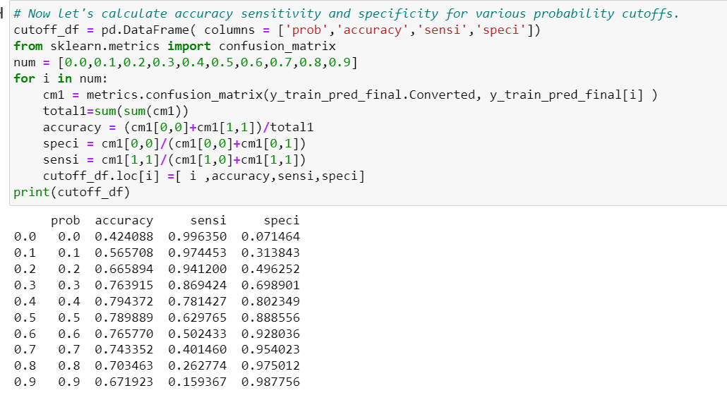
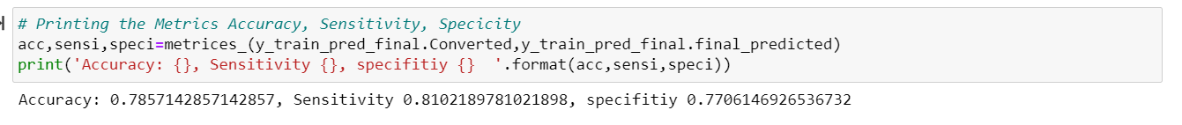
Model Evaluation
Finding the metrics like accuracy, sensitivity and specificity

Slide 15
Conclusion
The variables that mattered the most in the potential buyers are (In descending order) :
The total time spend on the Website.
Total number of visits.
When the lead source is a. Google b. Direct traffic c. Organic search d. Olark website
When the last activity is a. SMS b. Olark chat conversation
When the lead origin is Lead add format.
Keeping these in mind the X Education can flourish as they have a very high chance to get almost all the potential buyers to change their mind and buy their courses

Slide 16
Thank you

