Slide 1
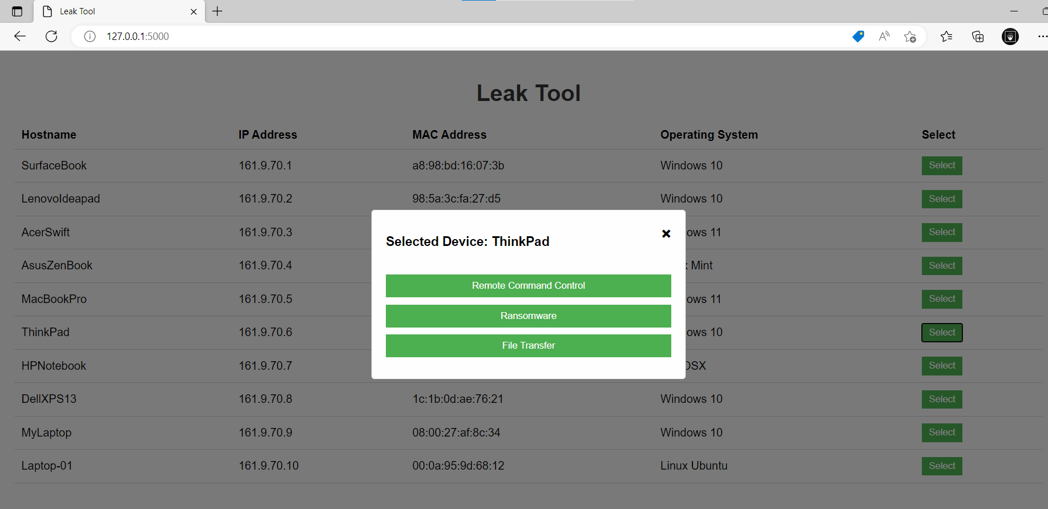
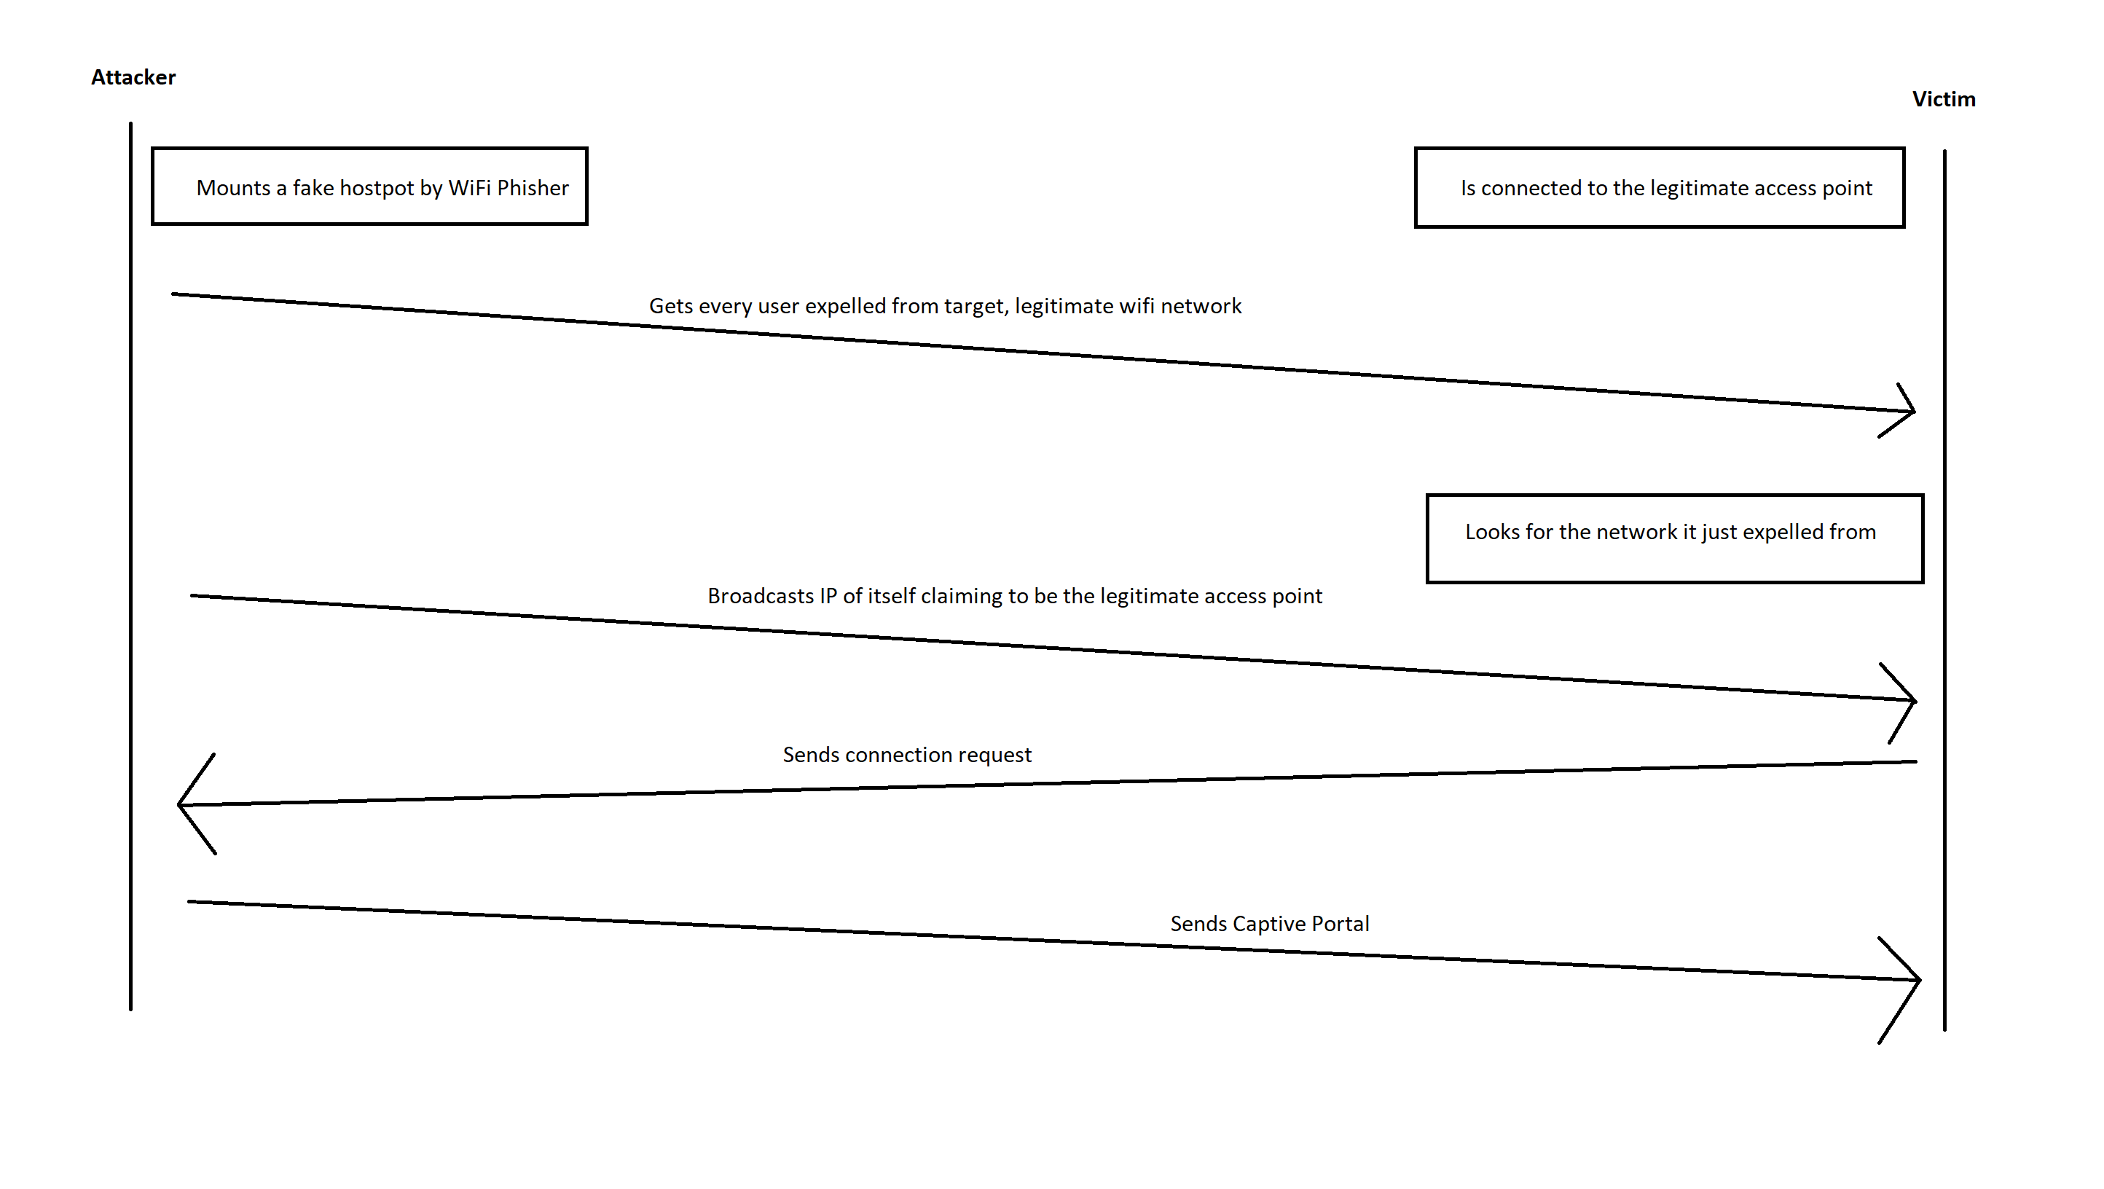
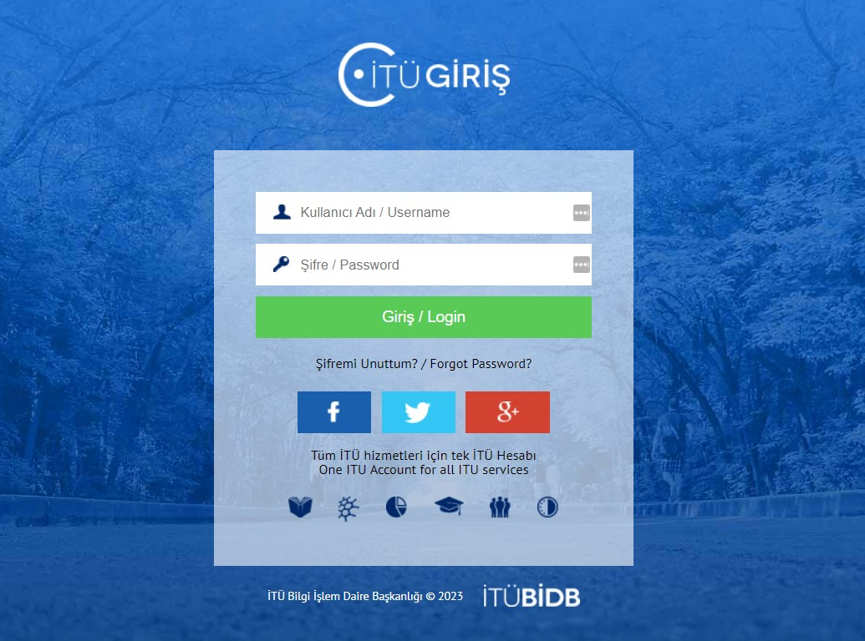
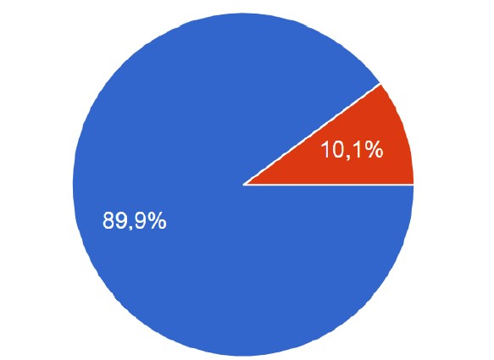
Security Awareness Analysis of ITU Students
Ramal Seyidli, Yasin Enes Polat
Introduction
Social engineering has become a significant concern within online communities and represents an effective method for targeting information systems [1]. This project evaluates the information security awareness of ITU students using a multifunction application and social engineering tactics. It includes stages such as creating a fake network and captive portal to gather credentials, and testing users' awareness through exploits, ransomware attacks, and file transfers.
Further functions:
Once “certificate.exe” is clicked by victim:
The Leak Tool is able to run any asked command on victim devices by regular user permissions. Output of the command run gets sent to server where it gets stored to database for information gathering usage.
One using Leak Tool can perform ransomware attack and can encrypt any files on file system of target operating system since the clients inform the server about files, the devices contain. A pentester can negotiate for ransom and analyse further behaviour of students by this function. The tool decrypts encrypted files on command as well.
The tester is able to transfer any file from victim device for information gathering purposes. While this feature works both ways, it can be used for further exploitation by transfering any additional payload to the victims. This function enables different kind of security awareness analysis skill because it is a brand new attack vector in this case.
Technology
Graphical User Interface (GUI):
We have developed a web app to provide easy intercation with clients from the server side using Leak Tool:
GUI of Leak Tool
The Figure below represents communication between server and client during WiFiPhisher operation:
Functionality
The project contains two stages to maintain social engineering tactics and to interact with subjects. The first one is called WiFiPhisher which is an open source technology modified by us, and the second one is Leak Tool developed completely by us:
WiFiPhisher:
WiFiPhisher performs “Evil Twin” attack on a target acces point, and make every end point device expelled from the legitimate network.
It provides a captive portal, to access fake and evil network looks like exactly same with legitimate one, and asks subjects to enter their credentials.
Once subjects enter their credentials, our application stores them and asks the subjects to download “certificate.exe”. Leak Tool comes to spotlight when the victim devices download and run the executable file.
Leak Tool:
The first act operated by the Leak Tool is creating a socket connection between the subject devices and the server side.
Through Leak Tool one is able to perform Remote Command Control attack, Ransomware attack and file transfer both ways.
Leak Tool is able to manage multiple client device and save all of their data to a database [2].
Survey results about entering credentials to the fake portal
Question about downloading evil executable file called certificate.exe is also raised where students tend to download it as well once it looks like directed by BIDB. Below chart shows percentage that say yes to downlading the file
Survey results about downloading certificate.exe
Almost every subject who downloaded the executable agreed to run it as well while it is commanded by legitimate authority. Some portion of students even accepted to run the file in spite of “Unknown Source” warning made by the operating system. Below statistic shows rate of subjects said yes to proceed despite the alarm:
Survey results about running and ignoring the warning
Evil Twin On activation WiFiPhisher drops users connected to the target wireless network from it. Then broadcasts its IP address, via fake DHCP server mounted, claiming itself to be legitimate network. Users connect to the fake network, since they are searching for WiFi connection [3], they have just lost, at the same time. A captive portal greets them which looks like exactly same with legitimate one (ITU Giriş screen in this case).
Conclusion Lacking cyber security awareness exposes individuals and organizations to numerous dangers. It increases the risk of falling victim to cyber attacks such as phishing, malware infections, and data breaches [5]. Without awareness, people may unknowingly disclose sensitive information, compromise their online accounts, or become targets of social engineering tactics. It is crucial to prioritize cyber security awareness to mitigate these risks and safeguard personal and organizational information. Cybersecurity awareness training is of utmost importance as it empowers individuals and organizations to recognize and mitigate potential cyber risks.
Results, Statistics, Evaluation
In the pie chart below one can see rate of subjects trying to reconnect eduroam network manually after WiFiPhisher operation, where blue stands for they would try and red stands for against:
Survey results about reconnecting network manually
To be able to connect evil network subjects need to try it manually. The chart above shows how high is the rate of manual trying in real terms.
Security awareness training would be ideal mitigation to the addressing danger [4]. This is not the only mistaken step taken by the students. In fact most of them claim to enter their credentials when the fake captive portal asks them to. Below charts shows results of the survery, where blue means subjects enter their credential, and red stands for agaisnt:
References
Katharina Krombholz, Heidelinde Hobel, Markus Huber, Edgar Weippl, Advanced social engineering attacks, Journal of Information Security and Applications, Volume 22, 2015, Pages 113-122, ISSN 2214-2126.
“What is phishing: Attack Techniques & Scam examples: Imperva,” Imperva, 17-Jun-2020. [Online]. Available: https://www.imperva.com/learn/application-security/phishing-attack-scam/. [Accessed: 03-Jan-2023].
Cheng, X. Oscar Wang, W. Cheng, P. Mohapatra, and A. Seneviratne, “Characterizing privacy leakage of public WIFI Networks for users on Travel,” 2013 Proceedings IEEE INFOCOM, 2013.
Bulgurcu, Burcu, et al. “Information Security Policy Compliance: An Empirical Study of Rationality-Based Beliefs and Information Security Awareness.” MIS Quarterly,
vol. 34, no. 3, 2010, pp. 523–48. JSTOR.
5. J. Ophoff and M. Robinson, “Exploring end-user smartphone security awareness within a South African context,” 2014 Information Security for South Africa, 2014.
Evil Captive Portal seviced by WiFİPhisher
Credential Dumping Users enters their credentials while they are asked. Our application takes and stores them into a database called Pickle.
Social Engineering
Subjects to the experiments gets asked to download a new “certificate” on request of BİDB, after they enter their credentials. This “certificate” is an executable file that runs Leak Tool on click. Our research conducts informatin on behaviour of subjects in this step and provides students’ awareness statistics.

