Slide 1
THE FLAGSHIP MIC HACKATHON OF TECHNOVIT
IDEA SUBMISSION — TEMPLATE
01
RECURSION
EDITION II
to understand recursion, first understand recursion
PROJECT TITLE
TEAM
ClimateRoute Intelligence
Aracnids
Ramalingam A S (Team lead)
ONE-LINE PITCH
Bharat R J
A hyperlocal climate engine that predicts and explains multi-hazard risk along your specific travel route, continuously updating as conditions change.
Dayashankar M B
R S Arjunkeshav
TRACK
S K Jegan
Sustainability & Climate
full contact sheet → frame 09
FRAME 01 / 09
Notes:
Cover: fill TRACK, PROJECT TITLE, ONE-LINE PITCH and TEAM names. Phone & email for each member goes on the last slide, frame 09. Keep layout, colours & logos as-is. RECURSION is TechnoVIT's flagship hackathon.

Slide 2
RECURSION - EDITION II
02
PROBLEM DEFINITION
answer in 2–3 lines · readable outside your track
01
WHO & HOW OFTEN
02
TODAY'S WORKAROUND
Residents, commuters, and disaster authorities face rapidly changing dangers (floods, heatwaves) during climate events, despite city-level warnings.
Users rely on district weather forecasts, static maps, and disconnected emergency reports, manually guessing if their specific route is safe.
03
WHY IT FALLS SHORT
04
EVIDENCE
District warnings don't explain risk to specific travel routes. Fragmented data leads to monitoring without action, and conditions change faster than static response plans can handle.
"Warnings are too broad... Conditions change faster than response plans... maps may show danger without ranking... evacuation decisions" (Official Problem Statement PS2).
TECHNOVIT'S FLAGSHIP HACKATHON
FRAME 02 / 09
Notes:
Answer each question in 2–3 plain lines. Someone outside your track should understand every answer.

Slide 3
RECURSION — EDITION II
03
PROPOSED SOLUTION
name it plainly · connect straight back to frame 02
PRODUCT / SYSTEM NAME
01
WHAT A USER DOES
ClimateRoute Intelligence
1. Enters origin, destination, and departure time. 2. System retrieves environmental data and maps it to spatial route segments. 3. User views a time-aware, multi-hazard risk profile spanning their journey. 4. System provides an actionable recommendation.
02
WHY IT BEATS THE WORKAROUND
ClimateRoute is a multi-hazard intelligence platform that fuses broad weather forecasts with street-level terrain data to generate a time-aware risk profile for a specific travel route.
Current: Broad weather warning -> user interprets risk -> guesses safety of their route. ClimateRoute: Multi-source environmental data -> multi-hazard assessment per segment -> time-aware risk profile -> actionable recommendation.
03
WHAT'S GENUINELY DIFFERENT
A. Hyperlocal route segment profiling instead of city-wide warnings. B. Time-aware profiling Risk(t) that forecasts how conditions will change during travel. C. Action layer (recommending delays or caution) rather than just a static hazard map.
TECHNOVIT'S FLAGSHIP HACKATHON
FRAME 03 / 09
Notes:
Name the product plainly. The three answers should connect directly back to the problems on frame 02.

Slide 4
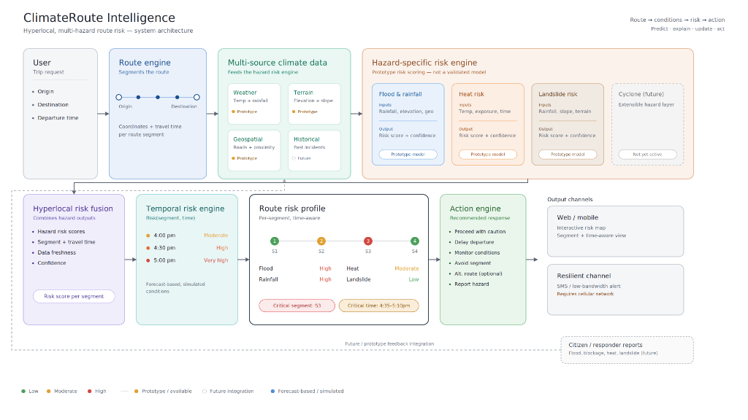
RECURSION — EDITION II
04
SYSTEM ARCHITECTURE
walk the full flow · name real services & models
FIG. 04-A — SYSTEM FLOW
01
KEY TECHNICAL DECISION
02
HARDEST PART TO BUILD
03
HOW YOU KNOW IT WORKS
We process multi-hazard risk using transparent, explainable heuristic models mapped to spatial route segments, avoiding unvalidated black-box ML.
Fusing broad weather forecasts with hyperlocal data (like elevation grids), and projecting that combined risk forward in time along a dynamic travel window.
Route successfully segments spatially. Injected hazard accurately increases risk solely on affected segments. Risk profile dynamically updates across the travel time window. System correctly identifies the critical segment/time.
TECHNOVIT'S FLAGSHIP HACKATHON
FRAME 04 / 09
Notes:
Replace the placeholder flow with your real architecture diagram. Name real services and models, then answer the three questions.

Slide 5
RECURSION — EDITION II
05
FEASIBILITY & SCOPE
a working slice with a known limit beats an over-promised demo
01
SCOPE
02
RUNNING COST
In: CORE PLATFORM: Multi-hazard route-risk intelligence. MVP DEMONSTRATION: Flood risk proof-of-concept with interactive scenario injector.
Free / Open Source: Python, FastAPI, NetworkX, OSMnx, Leaflet, Local DEM. Optional Services: OpenWeatherMap, Twilio.
Out: Fully validated scientific forecasting, live IoT sensor networks, trained ML prediction model in MVP.
03
RISKS & FALLBACK
04
AFTER THE HACKATHON
Internet/API failure -> Cached local OSM graph + local DEM (elevation) + local weather JSON. Lack of real-time hazard data -> Scenario Injector tool.
Phase 1: Flood prototype (Current MVP) Phase 2: Integrate remaining multi-hazard layers Phase 3: Real-time sensor (IoT) data fusion Phase 4: ML-based predictive modeling
TECHNOVIT'S FLAGSHIP HACKATHON
FRAME 05 / 09
Notes:
Be honest about scope. A working slice with a known limit beats an over-promised demo.

Slide 6
RECURSION — EDITION II
06
IMPACT METRICS
01
WHAT MEASURABLY IMPROVES
show how the figure was measured, an estimate is fine
< 2 sec
Resolution & Performance: Evaluate fine-grained 50-100m route segments instead of city-wide estimates. Compare predicted vs. observed conditions (MAE/RMSE) for: Rainfall | Heat | Flood | Landslide
02
WHO ELSE COULD USE IT
Emergency services, logistics fleets, public transport, municipal planners, delivery networks and outdoor-event planners.
ROUTE-LEVEL CLIMATE RISK UPDATE
03
WHAT COULD GO WRONG / BE MISUSED
HOW IT WAS MEASURED
A predicted low/moderate risk could be mistaken for an absolute safety guarantee by the user.
Target: <2 seconds to generate an updated temporal risk profile for a 10 km route using locally cached environmental and geospatial data.
04
HOW YOU'D HANDLE THAT
Display: Risk level + confidence + data timestamp + contributing factors. "Prototype climate-risk assessment — not an official emergency guarantee."
TECHNOVIT'S FLAGSHIP HACKATHON
FRAME 06 / 09
Notes:
Pick one primary metric. Show how it was measured — an estimate is fine if you show your working.

Slide 7
RECURSION — EDITION II
07
REFERENCES & ATTRIBUTION
one source per line · uncredited work is disqualifying
TABLE 07-A — SOURCES & LICENCES
TYPE | SOURCE (AUTHOR, TITLE, YEAR) | WHAT IT GAVE YOU | BORROWED / YOURS | LICENCE
Official PS2 | Microsoft Innovation Club | Core requirements | Borrowed | Internal
OpenStreetMap | openstreetmap.org | Street network | Borrowed | ODbL
OSMnx | osmnx.readthedocs.io | Graph extraction | Borrowed | MIT
NetworkX | networkx.org | Spatial segmentation | Borrowed | BSD
Leaflet | leafletjs.com | Map rendering | Borrowed | BSD-2-Clause
TECHNOVIT'S FLAGSHIP HACKATHON
FRAME 07 / 09
Notes:
One source per line — papers, repos, docs, datasets, model weights. Uncredited work is disqualifying.

Slide 8
RECURSION — EDITION II
08
BROAD SIGNAL TO HYPERLOCAL ACTION
1. User selects route at 4:00 PM. Overall multi-hazard risk profile shows "Moderate". 2. Scenario Injector advances time (+30m). Rain band intersects with low-elevation road segments. 3. System highlights Critical Segment 17 at 4:35 PM due to high flood exposure.
BEFORE YOU SUBMIT
[ ] every bracket filled
[ ] diagram replaced
[ ] all sources credited
TECHNOVIT'S FLAGSHIP HACKATHON
FRAME 08 / 09
Notes:
Optional space: demo links, screenshots, GitHub, QR codes, anything extra that strengthens the submission. Delete the checklist sticker and the hint line once you're done.

Slide 9
RECURSION — EDITION II
09
TEAM & CONTACT
one line per member · so organisers can reach you after submission
Aracnids
TABLE 09-A — TEAM CONTACT SHEET
NAME | PHONE | EMAIL
Ramalingam A S | 6385137682 | ramalingam1299@gmail.com
Bharat R J | 7904922643 | mailtorjb@gmail.com
Dayashankar M B | 8925201536 | dayashankar1729@gmail.com
R S Arjunkeshav | 8939170789 | arjunkeshav@gmail.com
S K Jegan | 9342292164 | jegan.sk2007@gmail.com
TECHNOVIT'S FLAGSHIP HACKATHON
FRAME 09 / 09
Notes:
List every member's phone and email so organisers and judges can follow up after the round. This slide is for the submission file — remove it if presenting live on stage.

