Slide 1
CAN Protocol
(Control Area Network)

Slide 2
List of Contents :
CAN introduction.
Properties of CAN.
Frame formats (Standard & Extended).
Bit Stuffing.
CAN frames.
Error detection.
Synchronization.
Bit timing with shortening & lengthening of phase segments..
Fault confinement

Slide 3
1. CAN Introduction :
Message Oriented protocol.
Invented by Robert Bosch in 1885.
Initially this was implemented for automobiles. Later this was entered into industrial, marine etc.
Three types of CAN are available.
CAN 2.0A – 11 bit – 125 KBPS - 500m.
CAN 3.0B – 29 bit – 1 MBPS – 40m.
CAN FD – 15 MBPS – 10m (flexible Data rate).

Slide 4
2. Properties of CAN:
Prioritization of messages.
Guarantee of latency times.
Configuration flexibility.
Multicast reception with time synchronization.
System wide data consistency.
Multi master.
Error detection & Signaling.
Distinction between temporary & permanent failure of nodes & autonomous Switching off defect nodes.
Automatic transmission of corrupted messages as soon as the bus is idle again.

Slide 5
3.Frame formats :
Standard Frame:
SOF : Start of frame one – dominant bit(0).
Arbitration field: 11 bits with one RTR bit (remote transmission request)
Control filed : one IDE( Identifier extension – “0” for standard), one reserve, 4 (DLC0-DCL3) bits.
Data field : Max 8 bytes of data.
CRC field : 15 bits of CRC & one CRC delimiter.(delimiter always “1”).
ACK field : one bit is for ACK & one is for ACK delimiter.
EOF : End of frame 7 recessive(1) bits.
SOF | Arbitration field | Control field | Data field | CRC field | ACK field | EOF
1-Bit. | 11+1 bits. | 6- bits. | 1-8 bytes | 16- bit | 2- bits | 7- bits

Slide 6
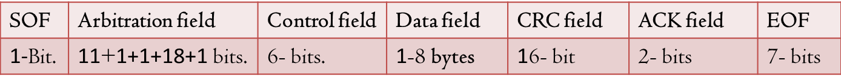
3.Frame formats :
Extended Frame:
SOF : Start of frame one – dominant bit(0).
Arbitration field: 11 bits base id + one SRR bit (substitute remote request)+ IDE (Identifier extension - “1” for extended) + 18 bits extended id + one RTR(remote transmission request).
Control filed : 2 Bits reserved, 4 (DLC0-DCL3) bits.
Data field : Max 8 bytes of data.
CRC field : 15 bits of CRC & one CRC delimiter.(delimiter always “1”).
ACK field : one bit is for ACK & one is for ACK delimiter.
EOF : End of frame 7 recessive(1) bits.

Slide 7
Arbitration:
CSMA/CD (Carrier Sense Multiple access/Collision Detection) + AMP (Arbitration on Message priority)
 | SOF | 1 | 2 | 3 | 4 | 5 | 6 | 7 | 8 | 9 | 10 | 11
TX of NODE A | 0 | 0 | 1 | 0 | 1 | 0 | 1 | 0 | 0 | 1 | 0 | 1
Rx of NODE A | 0 | 0 | 1 | 0 | 1 | 0 | 1 | 0 | 0 | 1 | 0 | 1
TX of NODE B | 0 | 0 | 1 | 0 | 1 | 1
Rx of NODE B | 0 | 0 | 1 | 0 | 1 | 0 | Miss match is occurred.
Bus Line | 0 | 0 | 1 | 0 | 1 | 0 | 1 | 0 | 0 | 1 | 0 | 1
Bus is owned by Node A Due to wired “&” Logic.

Slide 8
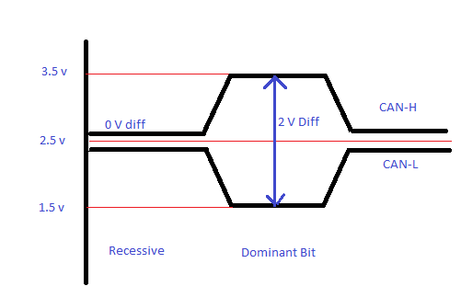
Dominant & Recessive Bits :
CAN is worked on twisted wire pair.
Binary values are read by Every ECU as voltage difference on CAN buses(CAN-H & CAN-L).
“0”- called as Dominant & “1”-called as Recessive.

Slide 9
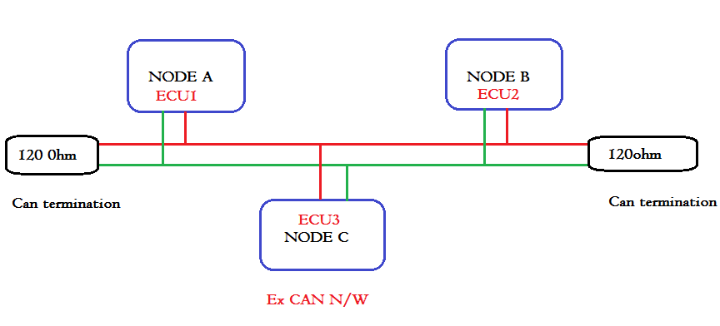
Example CAN network with 3 nodes:
CAN - H
CAN - L

Slide 10
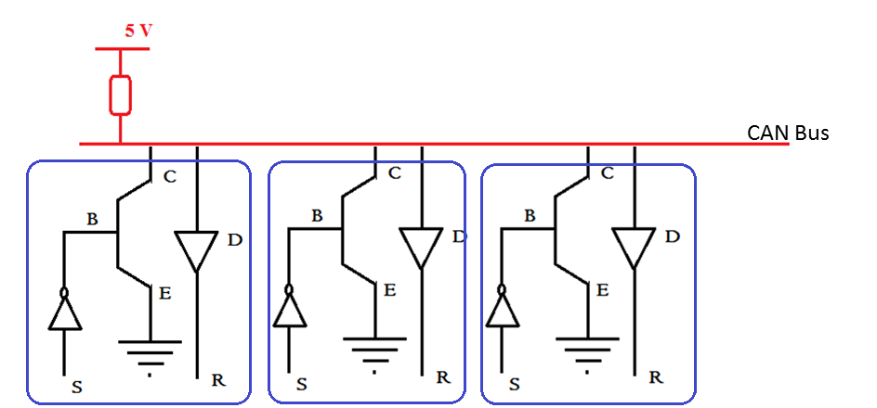
Wired AND Logic:
CAN Bus
NODE 1
NODE 2
NODE 3

Slide 11
4. Bit Stuffing:
Can uses NRZ coding with bit Stuffing after 5 consecutive Bits.
NRZ having problem with long transmission with same polarity.
 | 1 | 2 | 3 | 4 | 5 | 6 | 7 | 8 | 9 | 10 | 11 | 12 | 13
Stream | 0 | 0 | 0 | 0 | 0 | 1 | 1 | 1 | 1 | 0 | 0 | 0 | 1
Stuffing | 0 | 0 | 0 | 0 | 0 | 1 | 1 | 1 | 1 | 1 | 0 | 0 | 0 | 0 | 1
De-stuff | 0 | 0 | 0 | 0 | 0 | 1 | 1 | 1 | 1 | 0 | 0 | 0 | 1

Slide 12
5. CAN frames:
CAN frames are classified into 5 types
Data frame.
Remote frame.
Error frame.
Overload frame.
Inter frame space.
Data & Remote frame:
IDE | RTR | Frame
0 | 0 | Standard data frame
0 | 1 | Standard remote frame
1 | 0 | Extended data frame
1 | 1 | Extended remote frame

Slide 13
5. CAN frames:
Error frame:
Depends upon TEC (Tx error counter) & REC (Rx error counter) errors classified as 3 types.
Active error frame (TEC & REC <= 127).
passive error frame (TEC & REC >127).
Bus off (only TEC > 255).

Slide 14
5. CAN frames:
Active Error frame:
Passive Error frame:
DATA (OR) REMOTE frame | 6 – Dominant bits | 0-6 super position of error flags | 8- Error delimiters (8 recessive bits) | INTER FRAME SPACE
DATA (OR) REMOTE frame | 6 – Recessive bits | 0-6 super position of error flags | 8- Error delimiters (8 recessive bits) | INTER FRAME SPACE

Slide 15
5. CAN frames:
Overload frame:
Inter frame Space:
Inter Frame Space | 6 – Dominant bits | 0-6 super position of over load flags | 8- over load delimiters (8 recessive bits)
Data//Remote//Overload//Error frame | 3 bits Intermission | 0-? Bus Idle | Data // Remote

Slide 16
6. Error Detection
Bit Error
Stuff error
CRC error
Form error – CRC del, ACK del, EOF & IFS Should be recessive.
ACK error

Slide 17
7. Synchronization in CAN:
There is no separate clock signal in CAN bus to synchronize. CAN frame it self used for synchronization of clocks on all the nodes.
There are two types of synchronizations in CAN.
HARD synchronization.
SOFT (or) RE synchronization.
Hard synchronization held on at the time of SOF(Start of Frame).
Soft synchronization is happening for every recessive to dominant bit edge.
Start of frame
For every recessive to dominant bit edge

Slide 18
8. Bit Timing :
Bit time: The time it takes to transmit one bit (either Recessive or Dominant).
Bit time =(1 /System Frequency).
Bit time is divided into 4 Segments.
Sync Segment.
Propagation Segment.
Phase Segment-1.
Phase Segment-2.
Sync Segment | Propagation segments | Phase- Segment 1 | Phase- segment 2

Slide 19
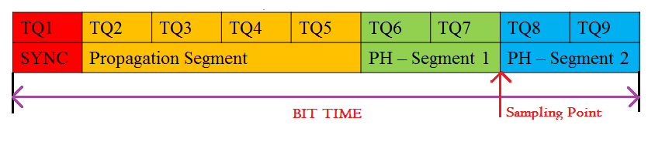
8. Bit Timing :
One bit time is divided into 9 quantum times.
Quantum Time(tq)= Baud Rate pre-scalar/F sys.
Sample point: It is the point of time at which bus value is read & interpreted as one.

Slide 20
8. Bit timing with shortening & lengthening of phase segments:
Sync-Segment:
Edge phase error (e)
Case1: e=0 , no error in propagation edge time.
Case2: e>0 , Before Sync Segment.
Case3:e<0 , After Sync Segment.
Propagation Segment:
To compensate physical delay time with in CAN.
PH- SEG1:
Compensate edge phase errors (if e>0) in CAN by lengthening PH-SEG 1.
PH- SEG2:
Compensate edge phase errors (if e<0) in CAN by shortening PH-SEG 2.

Slide 21
9. Fault Confinement in CAN:
Mechanism for preventing defective node in CAN.
Need: Preventing repetitive Sending's of error frames.
It switching off the defective node.
TEC: keep tracking of Successful & un-successful Tx’s.
REC: keep tracking of Successful & un-successful Rx’s

Slide 22
Thankyou -Ramalingeswar

