Slide 1
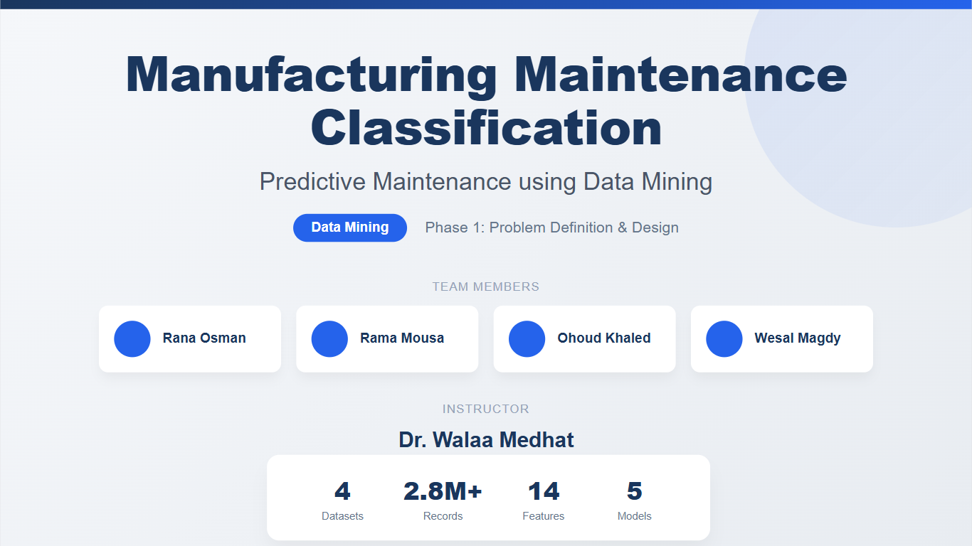

Slide 2

PROBLEM DEFINITION
Before (Reactive Maintenance):
After (Predictive Maintenance):
Equipment runs → Suddenly breaks → Emergency repair → Production stops → Loses money
Equipment runs → Sensors detect warning signs → Predict failure → Schedule maintenance → No surprise downtime
Goal
Build an integrated predictive maintenance system that uses machine learning on unified sensor data to predict equipment failures 24-48 hours in advance, enabling proactive maintenance that reduces unplanned downtime by 50% and maintenance costs by 30%.

Slide 3




MULTI-SOURCE INDUSTRIAL DATASET
AI4I 2020
SCANIA COMPONENT X
METROPT-3
INDUSTRIAL PUMP
Synthetic dataset representing predictive maintenance in a digital twin environment.
Real-world data from heavy trucks focusing on air pressure system failures.
High-frequency sensor data from railway compressor systems.
Specialized sensor readings for hydraulic pump health monitoring.
DIGITAL TWIN
AUTOMOTIVE
TRANSPORTATION
HYDRAULICS
10,000 Row
14 Col
Labeled (5)
Class imbalance (3% failure)
1 machine
1,122,452 Row
107 Col
Labeled binary
23,550 vehicles
Relative time (time_step)
1,516,948 Row
17 Col
Weakly labled
6 months (2020)
1 compressor
0.1 Hz (10 seconds)
20,000 Row
8 Col
Labeled binary
2024
5 pumps
1 min

Slide 4





DATA CHARACTERISTICS AND COMPLEXITY
DATASET SCALE
KEY FEATURES & SENSORS
UNIFIED LABELS
2.7M
Temperature
NORMAL
TOTAL SAMPLES
Pressure
Vibration
MAINTENANCE
Multivariate time-series data collected across diverse industrial environments.
Torque & RPM
FAILURE
Electrical Signals
Mixed numerical and categorical data types.
Standardized target variables for multi-class classification.
Sampling Rate:
Seconds → Minutes → Hours

Slide 5

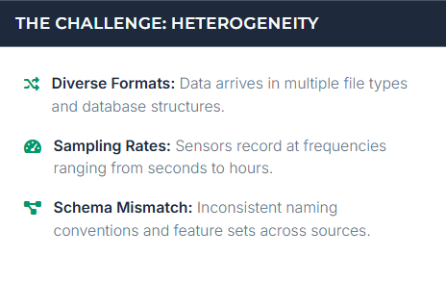
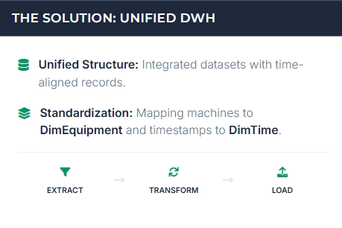
DATA WAREHOUSE ARCHITECTURE
THE CHALLENGE: HETEROGENEITY
THE SOLUTION: UNIFIED DWH

Slide 6



GALAXY SCHEMA DESIGN
WAREHOUSE STRUCTURE
SQL IMPLEMENTATION EXAMPLE
Centralized storage for multi-source industrial sensor data.
CREATE TABLE maintenance.DimEquipment ( equipment_key SERIAL PRIMARY KEY, equipment_type VARCHAR(50), manufacturer VARCHAR(100), source_system VARCHAR(20) ); CREATE TABLE maintenance.FactPump ( pump_id BIGSERIAL PRIMARY KEY, equipment_key INTEGER, temperature FLOAT, is_failing BOOLEAN );
Fact Tables (Sensor Data)
AI4I, SCANIA, MetroPT3, and Pump measurements.
Dimension Tables
DimEquipment: Machine metadata & source.
DimTime: Standardized temporal keys.
DimFailureType: Unified failure labels.

Slide 7
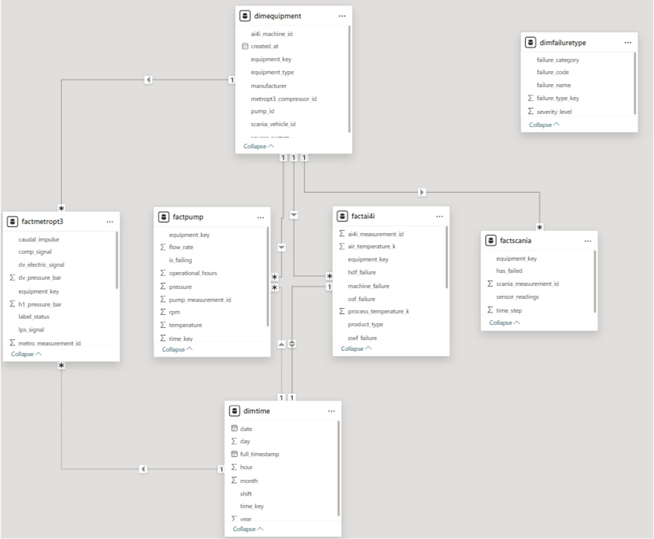
GALAXY SCHEMA DESIGN

Slide 8




PROPOSED CLASSIFICATION MODELS
ENSEMBLE METHODS
BASELINE MODELS
Random Forest & XGBoost
Logistic Regression
Handles complex nonlinear relationships and is robust to noise and missing data in industrial sensor streams.
Provides a simple, highly interpretable baseline to establish performance benchmarks for failure prediction.
SIMILARITY-BASED
EFFICIENCY-FOCUSED
k-Nearest Neighbors (k-NN)
Naive Bayes
Captures failure patterns by identifying similarities between current sensor readings and historical failure states.
Fast and computationally efficient, making it suitable for processing large-scale, high-frequency industrial datasets.
Key Consideration: Models must handle imbalanced data effectively, as failure events are rare compared to normal operations.

Slide 9






METHODOLOGY PIPELINE
STEP 01
STEP 02
STEP 03
STEP 04
STEP 05
DATA PREPARATION
FEATURE ENGINEERING
MODEL TRAINING
EVALUATION
DEPLOYMENT
Rigorous cleaning to remove noise and handle missing values from industrial sensors.
Creating rolling statistics and time-window aggregations to capture temporal patterns.
Implementing robust train/test splits to ensure generalizability across machines.
Prioritizing Recall to ensure all potential failure cases are detected accurately.
Integrating model outputs into dashboards for real-time maintenance alerts.

Slide 10




EVALUATION METRICS FOR IMBALANCED DATA
RECALL (CRITICAL)
PRECISION
Prioritized to ensure all potential failure cases are detected. In predictive maintenance, missing a failure is more costly than a false alarm.
Balanced to avoid "alarm fatigue" and unnecessary maintenance costs caused by frequent false positives.
F1-SCORE
ROC-AUC
Provides a single harmonic mean of precision and recall, offering a balanced view of model performance on imbalanced classes.
Measures the model's ability to distinguish between classes across all thresholds, independent of the class distribution.
THE IMBALANCE CHALLENGE
Failure events are rare compared to normal operations. Accuracy alone is misleading; a model could achieve 99% accuracy by never predicting a failure.

Slide 11


CONCLUSION AND NEXT STEPS
PROJECT ACHIEVEMENTS
NEXT PHASE: IMPLEMENTATION
Data Integration: Successfully unified multi-source industrial datasets into a single framework.
Model Training: Implementing and comparing the proposed classification algorithms.
Hyperparameter Tuning: Optimizing model performance with a focus on Recall.
DWH Design: Established a robust Star Schema for scalable industrial analytics.
Validation: Real-world testing and integration into maintenance dashboards.
ML Pipeline: Designed a complete end-to-end pipeline from raw data to deployment.

