Slide 1

ADVANCED COMPUTER NETWORKS · CSE DEPARTMENT
Enterprise University Campus Network Infrastructure
Scalable, resilient, dual-stack architecture designed, implemented, and verified in Cisco Packet Tracer.
CORE STACK
SCOPE & SERVICES
802.1w Rapid-PVST · 802.1Q ROAS · RIPv2 · PAT/NAT Overload · SLAAC
3 Routers · 5 Switches · 4 Servers · 10 PCs · DNS · Intranet Web · DHCP
PRESENTER: STUDENT ID / DEPARTMENT OF CSE
Notes:
Introduce the project: a complete campus network infrastructure simulated and verified in Cisco Packet Tracer. Highlight the enterprise scope: core-distribution hierarchy, 9 VLANs, dual-stack IPv4/IPv6, and centralized campus services.

Slide 2
ARCHITECTURE HIERARCHY
Three tiers isolate departments under central control
Internet Server
203.0.113.10
Fa0
R-ISP Gateway
Design Principles
NAT/PAT Overload
Three-tier design: removes broadcast bottlenecks and isolates admin, academic, server and residential traffic.
Independent routing: at the hostel keeps guest mobile devices away from core academic databases.
WAN 200.1.1.0/30
WAN 10.0.0.4/30 (RIPv2)
802.1Q Trunk
R-CAMPUS Core
ROAS Gateway
R-HOSTEL
SW-CORE
Branch Router & DHCP
Rapid-PVST Root Bridge
802.1Q Trunk
Trunk 10,60,99
Trunk 70,99
SW-HOSTEL
SW-ADMIN
SW-SERVER
VLAN 50 & 80
Admin & Security
Web & DNS Farm
Trunk 20,30,40,99
Redundant Trunk Fa0/23 (STP BLK)
AP-HOSTEL
SW-ACADEMIC
SSID: CAMPUS-WIFI (Port 0)
CSE, IoT & Library
Notes:
Walk through the three-tier hierarchy: Core, Distribution, and Access. Highlight the separation between the academic core and the residential hostel branch router to isolate mobile client broadcasts.

Slide 3
PHYSICAL INFRASTRUCTURE
Layer 1: every link has a defined cable and role
Link | Interfaces · cable type · role
ISP WAN | R-ISP Gi0/0 to R-CAMPUS Gi0/0 · Cross-over · Public edge, 200.1.1.0/30
Hostel WAN | R-CAMPUS Gi0/2 to R-HOSTEL Gi0/0 · Cross-over · Interconnect, 10.0.0.4/30
Campus uplink | R-CAMPUS Gi0/1 to SW-CORE Fa0/1 · Straight-through · 802.1Q trunk for VLANs 10,20,30,40,60,70,99
Hostel uplink | R-HOSTEL Gi0/1 to SW-HOSTEL Gi0/1 · Straight-through · Trunk for VLANs 50,80,99
Core distribution | SW-CORE to SW-ADMIN/ACADEMIC/SERVER · Cross-over · 802.1Q trunks
Redundant link | SW-ADMIN Fa0/23 to SW-ACADEMIC Fa0/23 · Cross-over · Standby managed by Rapid-PVST
Access point | AP-HOSTEL Port 0 to SW-HOSTEL Fa0/11 · Straight-through · Port 0 is wired Ethernet; Port 1 is the 2.4GHz radio
Notes:
Explain physical layer selection: DTE-to-DTE links (like router-to-router and switch-to-switch) utilize cross-over cabling in Packet Tracer, while router-to-switch and host links use straight-through cabling.

Slide 4
Nine VLANs enforce strict broadcast boundaries
Each VLAN gets its own IPv4 /24 (gateway .1) and IPv6 /64 (gateway ::1), 2001:db8:acad:<VLAN>::/64. VLAN 99 management is IPv4-only, out-of-band, on switch SVIs.
VLAN 10 · Admin 192.168.10.0/24 2001:db8:acad:10::/64 SW-ADMIN Fa0/1-3
VLAN 20 · CSE Academic 192.168.20.0/24 2001:db8:acad:20::/64 SW-ACADEMIC Fa0/1-2
VLAN 30 · IoT & Research 192.168.30.0/24 2001:db8:acad:30::/64 SW-ACADEMIC Fa0/6-8
VLAN 40 · Library 192.168.40.0/24 2001:db8:acad:40::/64 SW-ACADEMIC Fa0/11
VLAN 50 · Hostel Wired 192.168.50.0/24 2001:db8:acad:50::/64 SW-HOSTEL Fa0/1-2
VLAN 60 · Security 192.168.60.0/24 2001:db8:acad:60::/64 SW-ADMIN Fa0/11-12
VLAN 70 · Server Farm 192.168.70.0/24 2001:db8:acad:70::/64 SW-SERVER Fa0/1-2
VLAN 80 · Hostel Wi-Fi 192.168.80.0/24 2001:db8:acad:80::/64 SW-HOSTEL Fa0/11 (AP uplink)
VLAN 99 · Management 192.168.99.0/24 n/a (IPv4 out-of-band) Switch SVIs (SW-CORE to SW-HOSTEL)
Notes:
Note how VLAN IDs directly align with third-octet IPv4 addressing and fourth-hextet IPv6 addressing for administrative clarity. VLAN 99 is dedicated solely to switch SVIs for out-of-band management.

Slide 5
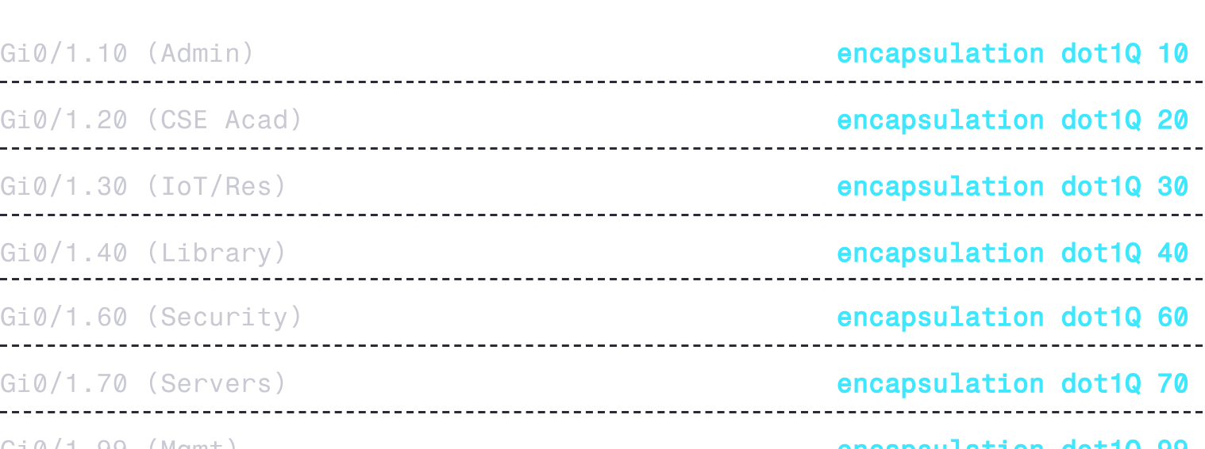
LAYER 2 & INTER-VLAN ROUTING
Router-on-a-stick and Rapid-PVST give fast, loop-free switching
802.1Q Router-on-a-Stick (ROAS)
802.1w Rapid-PVST Spanning Tree
One physical trunk interface (R-CAMPUS Gi0/1) carries tagged frames across 7 logical subinterfaces:
Root Primary: SW-CORE forced as root bridge via priority 24576.
Loop Resolution: Redundant cross-over link between SW-ADMIN Fa0/23 and SW-ACADEMIC Fa0/23.
Blocking State: Because SW-ACADEMIC has the lower base MAC address, SW-ADMIN Fa0/23 transitions to Alternate Blocking.
Sub-second Failover: Proposal-agreement handshakes bypass 802.1D listening/learning delays.
Notes:
Detail how ROAS multiplexes multiple VLANs across a single gigabit link to R-CAMPUS, while Rapid-PVST maintains sub-second reconvergence if the primary distribution links fail.

Slide 6
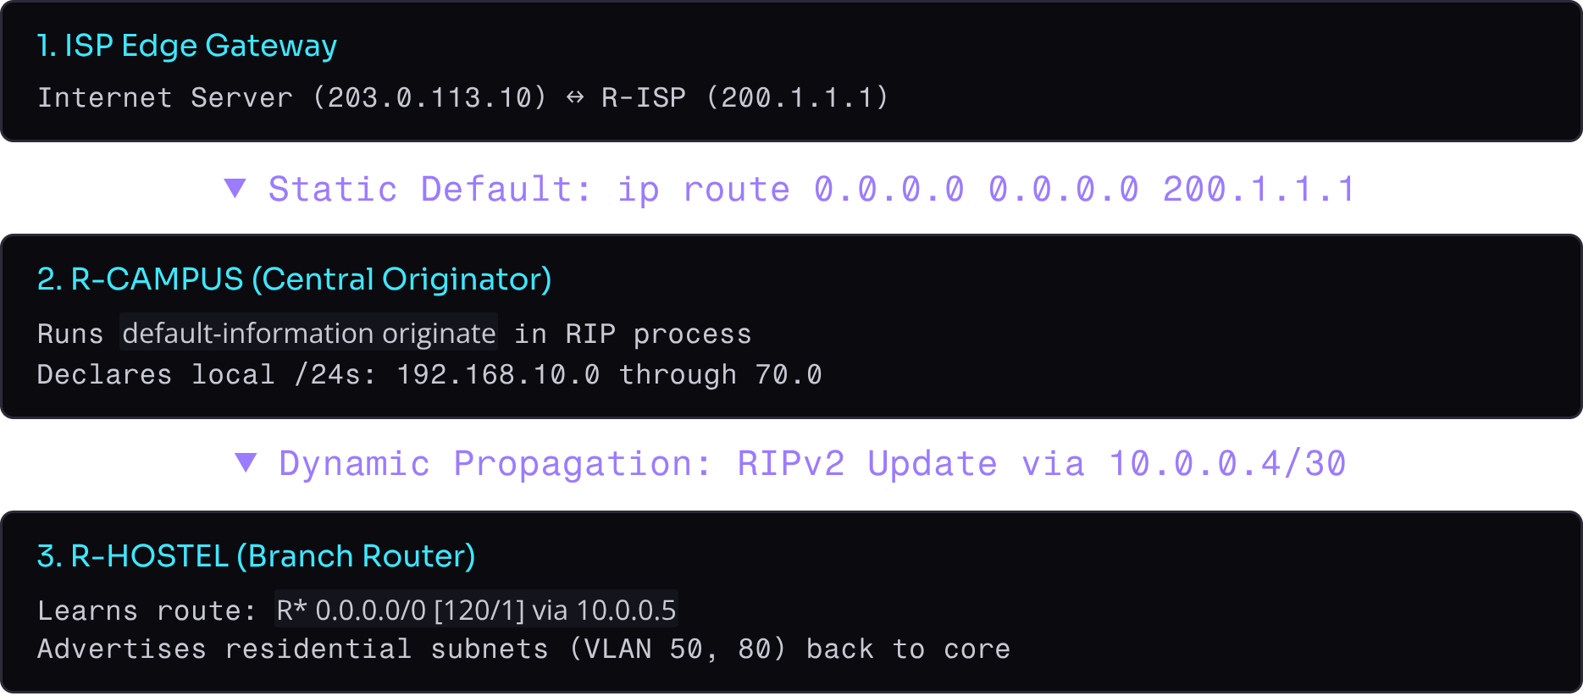
DYNAMIC ROUTING & PROPAGATION
RIPv2 discovers routes and passes down a default route
Routing Characteristics
Classless operation: version 2 with no auto-summary stops contiguous /24 networks from collapsing into invalid /16 Class C boundaries.
Subinterface binding: Explicit network statements bind routing updates to the ROAS subinterfaces without needing separate physical ports.
Deterministic exit: All outbound packets from academic and hostel departments resolve to R-CAMPUS then traverse R-ISP via PAT.
Notes:
Explain why no auto-summary is mandatory in RIPv2: without it, subnets of 192.168.0.0/16 collapse into classful boundaries. Show the propagation flow of the 0.0.0.0/0 default route.

Slide 7

WIRELESS & CLIENT ONBOARDING
Students join Wi-Fi and get an address with zero configuration
01
02
03
1. Access Point Radio
2. Central DHCP Lease
3. Instant Verification
AP-HOSTEL: 2.4 GHz channel 6, SSID CAMPUS-WIFI, secured with WPA2-PSK (AES), key Campus@123.
R-HOSTEL Pool WIFI: 192.168.80.0/24. Excluded range .1–.20 reserves gateway .1 and AP uplink.
Laptops auto-negotiate DORA, lease 192.168.80.21+, and configure DNS 192.168.70.11 to reach intranet portal.
Notes:
Describe student user journey: mobile and laptop clients associate with the WPA2-PSK SSID on AP-HOSTEL, lease their IP from R-HOSTEL's local DHCP server, and immediately resolve campus services.

Slide 8
EDGE TRANSLATION & CORE SERVICES
PAT shares one public IP; local DNS and web serve the campus
PAT / NAT overload on R-ISP
Intranet web and DNS
Inside Gi0/0, outside Gi0/1. All 192.168.0.0/16 hosts translate to 203.0.113.1 via Layer 4 ports.
DNS 192.168.70.11: www.campus.local maps to 192.168.70.10.
Web server 192.168.70.10 hosts the intranet portal over HTTP/HTTPS for every department.
Inside Local | Inside Global
192.168.50.11:1028 | 203.0.113.1:1028
Confirmed with show ip nat translations.
Notes:
Show how PAT conserves public IPv4 addresses while providing full egress to the simulated internet server at 203.0.113.10. Emphasize that internal queries for www.campus.local stay local to the server farm.

Slide 9
IPv6 runs alongside IPv4 with no disruption
2001:db8:acad::/48
ipv6 unicast-routing
Split into /64s matching VLAN IDs (Admin 10, CSE 20, Servers 70).
On all routers; IPv4 configs untouched.
SLAAC
Dual-stack pings
R-HOSTEL sends Router Advertisements on VLAN 80; laptops self-configure with no DHCPv6.
100% ICMPv6 success across WAN routers and inter-VLAN subinterfaces.

Slide 10
All 16 acceptance tests passed; next up is redundancy and security
Verified (16/16)
Roadmap
Inter-VLAN routing across Admin, CSE, IoT, Library, Security and Servers, 0% loss
Cross-router RIPv2 peering, Hostel-PC1 to Admin-PC1
DNS resolution of www.campus.local and intranet page loading
Live NAT/PAT translations on R-ISP to 203.0.113.10
Rapid-PVST root on SW-CORE, blocking port on SW-ADMIN
End-to-end dual-stack IPv6 communication
HSRP/VRRP for first-hop redundancy
Migrate RIPv2 to multi-area OSPFv2/OSPFv3
Stateful firewalls and departmental ACLs
Notes:
Summarize results: all 16 acceptance test criteria were satisfied in Cisco Packet Tracer. Outline next steps for production deployment, including HSRP for gateway redundancy and migration from RIPv2 to multi-area OSPF.

