Slide 1
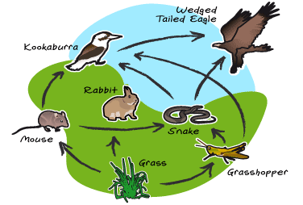
Food web
Intermixing of food chains

Slide 2
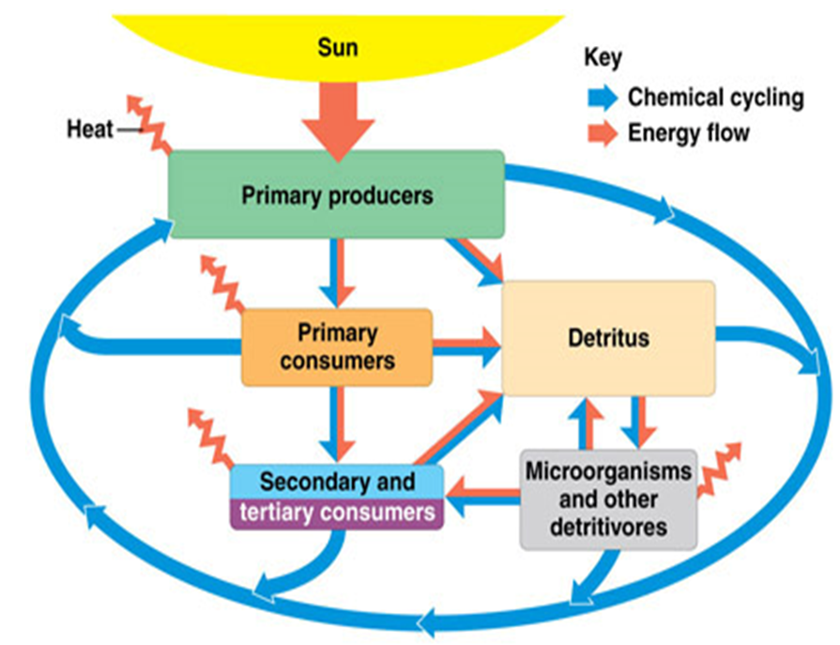
Energy Flow in Ecosystems
First Law of Thermodynamics energy can neither be created nor destroyed but only is transformed from one form to another.
10 Percent Rule of Energy
As a rule of thumb, 90 percent of the energy involved is degraded at each trophic transfer and only 10 percent of the energy is conserved in the organism's tissue.

Slide 3
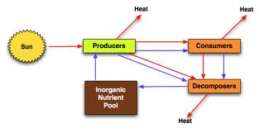
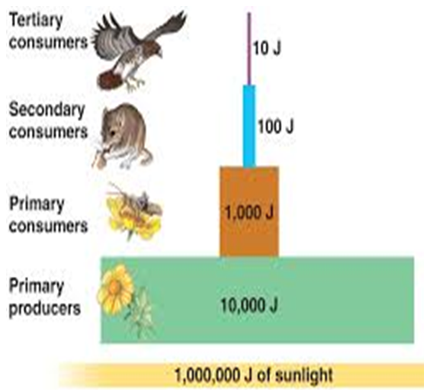
Energy flow in ecosystem and 10% Rule

Slide 4
Ecological Pyramid
The graphical representations of different trophic levels in an ecosystem where producers occupy the base and the top consumer occupy the apex of the pyramid, is known as ecological pyramid .
They are used to illustrate the feeding relationships between organisms.
Food chains and food webs do not give any information about the numbers of organisms involved.
This information can be shown through ecological pyramids.
Types of Ecological Pyramids
  Pyramid of number
  Pyramid of biomass
  Pyramid of energy

Slide 5
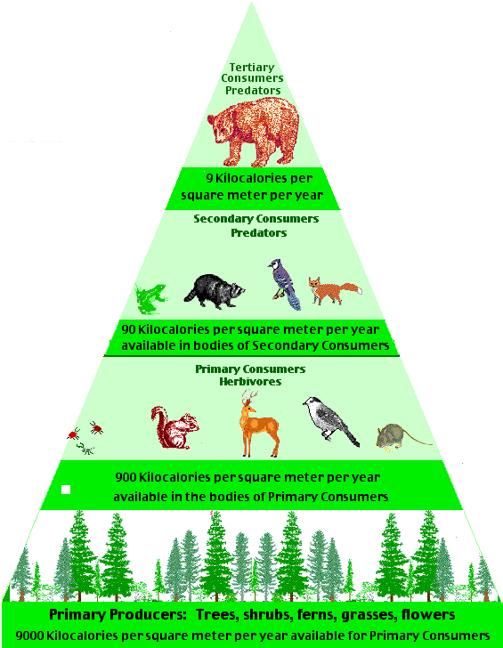
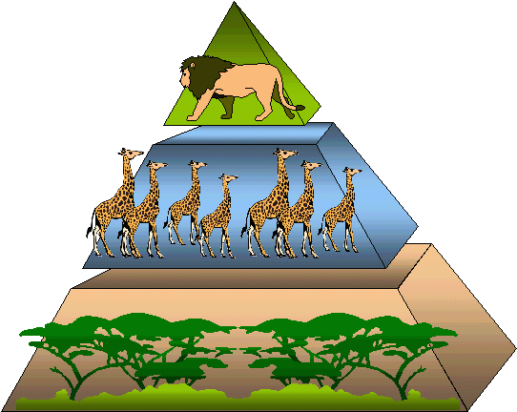
Pyramid of Number
Pyramid of number is used to show the number of individuals in each trophic level.
It is upright in case of grassland and pond ecosystems.

Slide 6
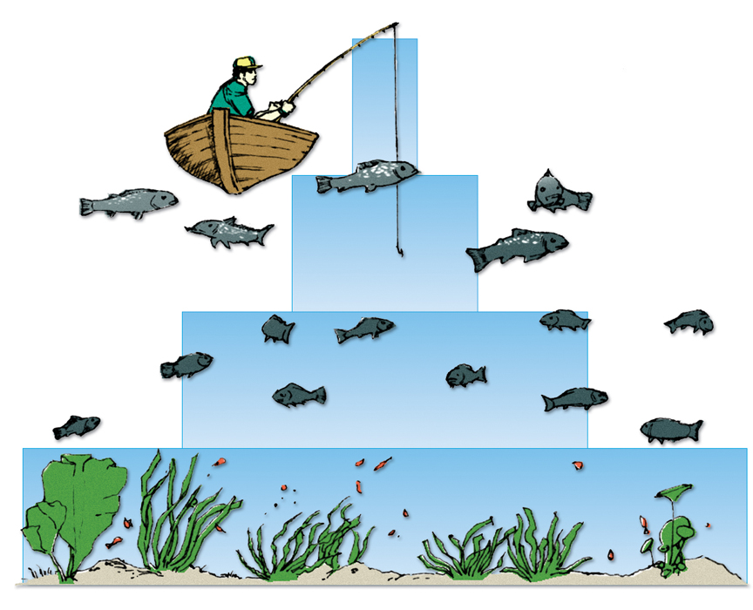
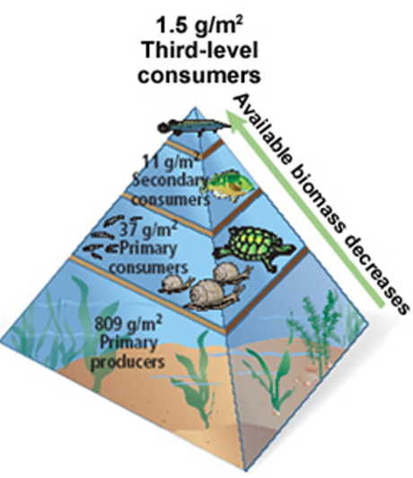
Pyramid of Biomass
tertiary
consumers
75 g/m2
Pyramid of biomass records the total dry organic matter of organisms at each trophic level in a given area of an ecosystem.
The pyramid of biomass is used to show the total biomass of individuals at each trophic level.
It is better than the pyramid of number for showing the relationships between organisms.
secondary
consumers
150g/m2
primary
consumers
675g/m2
producers
2000g/m2

Slide 7
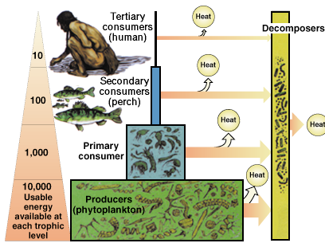
Pyramid of energy
Pyramid of energy is used to show the amount of energy transferred between trophic levels.
It provides the best representation of the overall nature of an ecosystem.
The pyramid of energy flow is always upright because there is always loss of energy while moving from lower trophic level to higher trophic level.
Therefore, the energy reaching the next trophic level is always less compared to that in the previous trophic level.

Slide 8
Ecological Succession
Ecological succession is the gradual process by which ecosystems change and develop over time. It is therefore a series of predictable temporary communities or stages leading up to a climax community. Each stage/temporary community is called a successional stage. Each step prepares the land for the next successional stage. All habitats are in the state of constant ecological succession.
Environment is always kept on changing over a period of time due to
variations in climatic and physiographic factors, and
the activities of the species of the communities themselves.
Ecological Succession is an orderly sequence of different communities over a period of time.

Slide 9
Types of ecological succession
Primary Succession Secondary Succession
Primary succession is the process by which an area first changes from bare rock into a functioning ecosystem.
Secondary succession is the process by which an already existing plant community is replaced by another plant community.

Slide 10
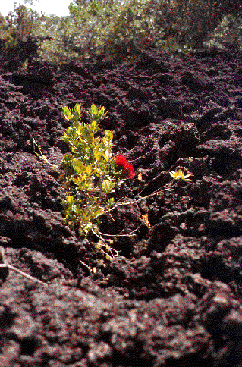
Primary Succession
The development of an ecosystem in an area that has never had a community living within it occurs by a process called PRIMARY SUCCESSION.
An example of an area in which a community has never lived before, would be a new lava or rock from a volcano that makes a new island.

Slide 11
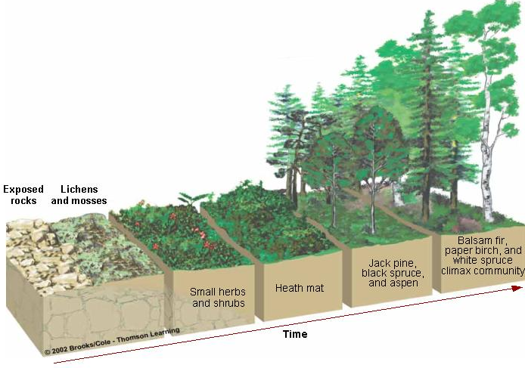
Continue…
Primary succession is the process by which an area first changes from bare rock into a functioning ecosystem.

Slide 12
Secondary Succession
SECONDARY SUCCESSION begins in habitats where communities were entirely or partially destroyed by some kind of damaging event.
When an existing community has been cleared by a disturbance such as a fire, tornado, etc...and the soil remains intact, the area begins to return to its natural community.
Because these habitats previously supported life, secondary succession, unlike primary succession, begins on substrates that already bear soil. In addition, the soil contains a native seed bank.
Since the soil is already in place, secondary succession can take place five to ten times faster than primary succession.

Slide 13
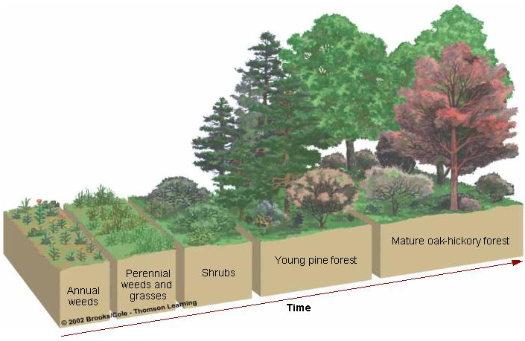
Continue…
Secondary succession is the process by which an ecosystem that has been destroyed gradually returns to its previous state.

Slide 14
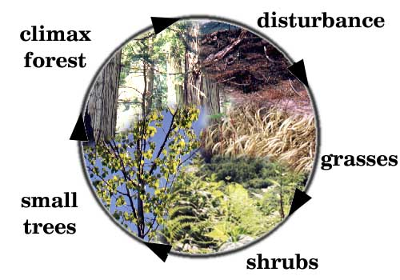
The Circle of Life in Secondary Succession

Slide 15
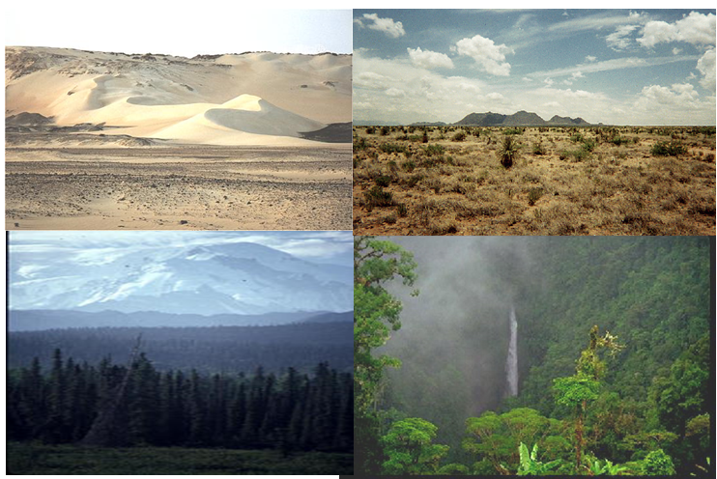
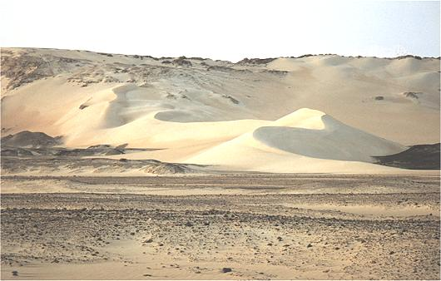
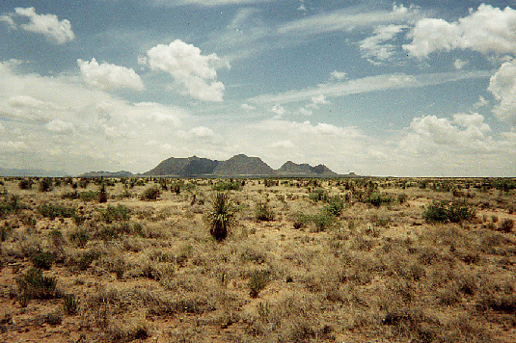
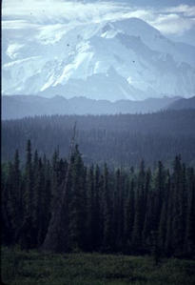
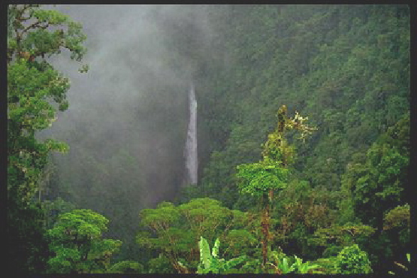
The Climax Community
A climax community is a mature, stable community that is the final stage of ecological succession.
In an ecosystem with a climax community, the conditions continue to be suitable for all the members of the community.
Any particular region has its own set of climax species, which are the plants that are best adapted for the area and will persist after succession has finished, until another disturbance clears the area.

Slide 16
Process / Stages of Ecological Succession
Nudation- Succession begins with the development of a bare site, called Nudation (disturbance).
Invasion
Migration- It refers to arrival of propagules (seeds), dispersion.
Ecesis- It involves establishment and initial growth of vegetation.
Aggregation- It involves increase in number of species.
Competition- As vegetation became well established, grew, and spread, various species began to compete for space, light and nutrients. This phase is called competition.
Stabilization- Reaction phase leads to development of a climax community.

Slide 17
Study of some common ecosystems
Terrestrial ecosystem
Grassland ecosystem
Desert ecosystem
Forest ecosystem
Aquatic ecosystem
Pond ecosystem
Ocean ecosystem

Slide 18
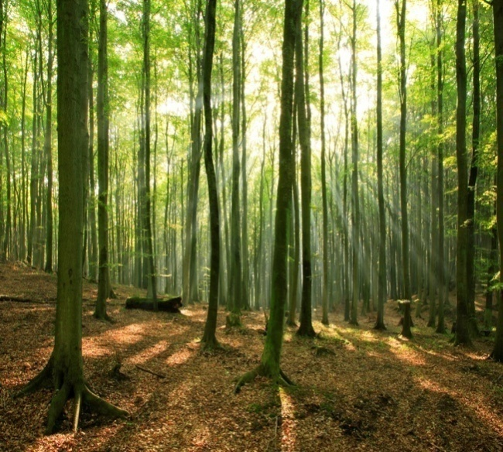
Forest Ecosystem
Abiotic Components
Inorganic and organic substances found in the
soil, climatic factors, e.g., temperature,
humidity, rainfall, and light.
Biotic Components
Producers
Different kinds of trees depending upon the climate
Consumers
Different kinds of primary, secondary, and tertiary consumers, e.g., deer,
elephant, moles, snakes, lizards, lion, and tiger
Decomposers
These are various kinds of bacteria and fungi

Slide 19
Grassland ecosystem
All grasslands in the world are categorize into the following two types:
Tropical grasslands- closets to equator and are hot throughout the year.
Temperate grasslands - farther from the equator and have both hot summers and harsh winters.

Slide 20
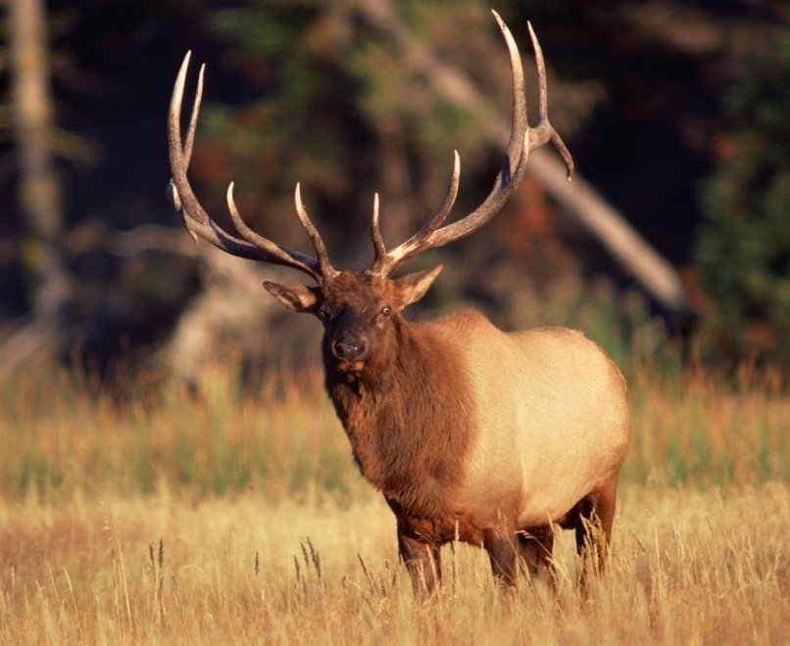
Grassland Ecosystem
Abiotic Components
Inorganic elements (C, H, O, N, P, S), climatic components,
temperature, rainfall, light, etc.
Biotic Components
Producers
Mainly grasses with a few scattered trees
Consumers
Deer, rabbit, giraffe, etc., are herbivores,
while wolf, leopard, etc., are carnivores
Decomposers
Mainly bacteria and fungi

Slide 21
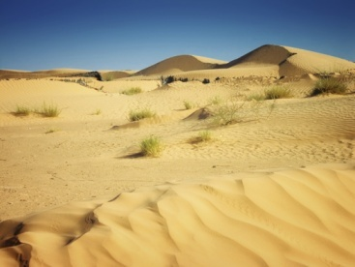
Desert Ecosystem
Abiotic Components
Low rainfall, high temperature, and
sandy soil
Biotic Components
Producers
Predominantly thorny shrubs, cactus, opuntia, etc.
Consumers
Different insects, lizards, reptiles, nocturnal rodents, birds, etc.
Decomposers
Various bacteria and fungi

Slide 22
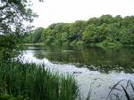
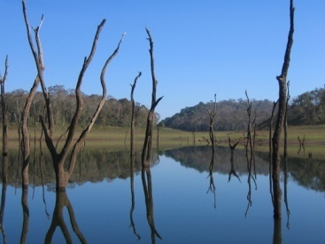
Pond Ecosystem
Abiotic Components
It includes organic and inorganic substances,
atmospheric gases dissolved in water, minerals
found in dissolved state, etc.
Biotic Components
Producers
Submerged floating and emergent aquatic plants
For example, nelumbo, hydrilla, chara, etc.
Consumers
May be primary, secondary, or tertiary, e.g., small fishes, beetles, mollusca, crustaceans, etc.
Decomposers
Chiefly bacteria, actinomycetes, fungi, etc.

Slide 23
Ocean Ecosystem
Abiotic Components
It includes organic and inorganic substances,
atmospheric gases dissolved in water, minerals
found in dissolved state, etc.
Biotic Components
Producers
Submerged floating and emergent aquatic plants
For example, nelumbo, hydrilla, chara, etc.
Consumers
May be primary, secondary, or tertiary, e.g., small fishes, beetles, mollusca, crustaceans, etc.
Decomposers
Chiefly bacteria, actinomycetes, fungi, etc.

