Slide 1
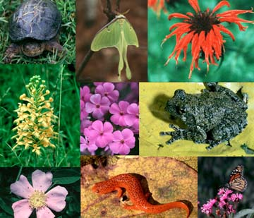
CHAPTER 4
BIODIVERSITY

Slide 2
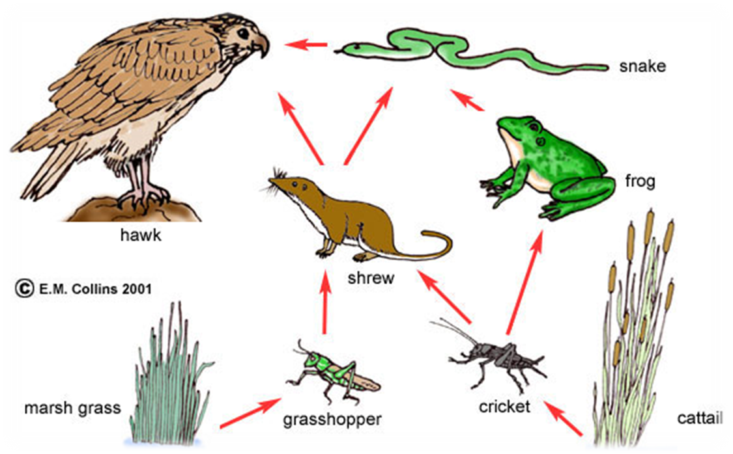
Biodiversity and food web

Slide 3
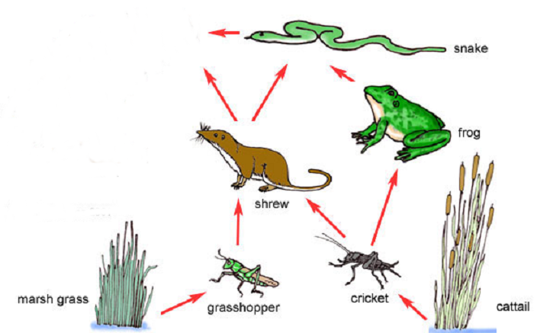
What would happen if a disease killed off many of the hawks?

Slide 4

There will be nothing to eat the snakes, so their numbers will increase.

Slide 5
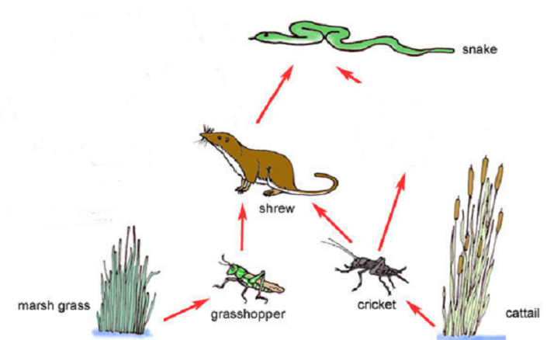
All the frogs get eaten

Slide 6

No frogs.
More Cricket (insect)

Slide 7
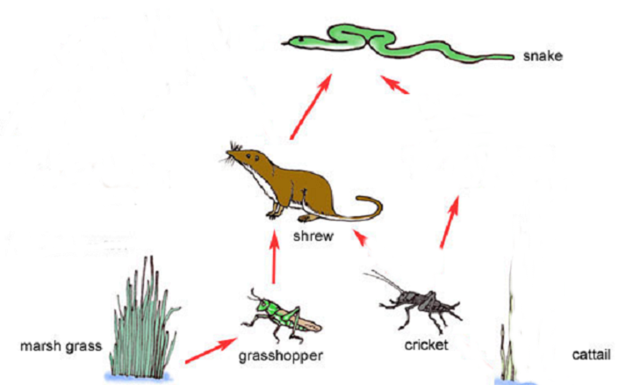
Most of the cattail (Typha)gets eaten by the crickets

Slide 8
Now the crickets don’t have enough food so their numbers go down

Slide 9
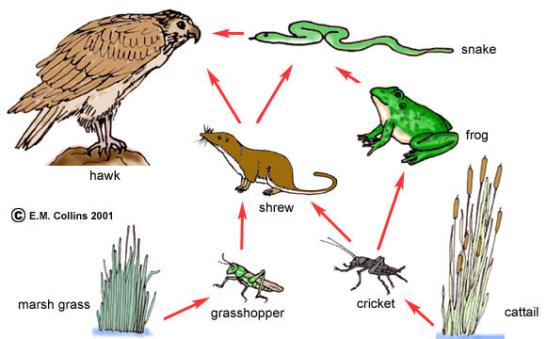
..and so on. Numbers of each species have an effect on the numbers of the other species in the web.

Slide 10
Hotspots of Biodiversity
Hotspots are the richest and the most threatened reservoirs of plant and animal life on earth.
Hotspots are classified on the basis of three criteria :
The number of species present
The number of those species that exist exclusively in the given ecosystem
The degree of threat they face
Hotspots of India
Western Ghats
North–East Himalaya
Indo-Burma
A biodiversity hotspot is a biogeographic region with a significant reservoir of biodiversity that is under threat from humans

Slide 11

India – A Megadiversity nation
India is one of the four mega diversity nations of Asia
Geographical diversity
Climatic diversity
Biological diversity
Habitat diversity
Cultural diversity

Slide 12
Endangered species
Plant or animal species which are at the verge of their extinction are called endangered species.
Flying squirrel, Gir lion, Crocodile, Flamingo, Wild ass, Desert cat, desert fox, Asiatic elephant, Orangutans , Great indian Rhino etc. are some endangered animal species of India.
Endangered plant species - Sandal, Guggal, Sarpgandha, pitcher plant etc.

