Slide 1
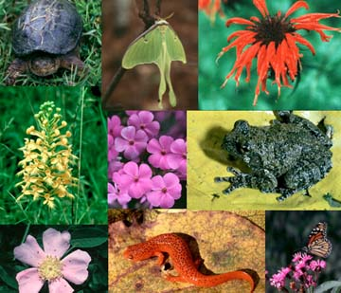
CHAPTER 4
BIODIVERSITY

Slide 2

India – A Megadiversity nation
India is one of the four mega diversity nations of Asia
Geographical diversity
Climatic diversity
Biological diversity
Habitat diversity
Cultural diversity

Slide 3
Endangered species
Plant or animal species which are at the verge of their extinction are called endangered species.
Flying squirrel, Gir lion, Crocodile, Flamingo, Wild ass, Desert cat, desert fox, Asiatic elephant, Orangutans , Great indian Rhino etc. are some endangered animal species of India.
Endangered plant species - Sandal, Guggal, Sarpgandha, pitcher plant etc.

Slide 4
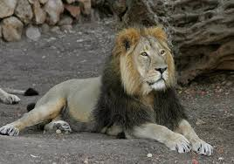
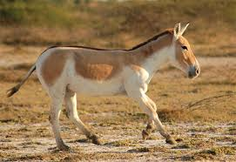
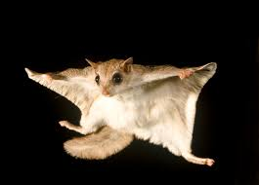
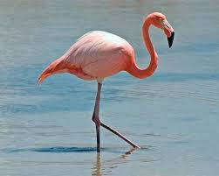

Slide 5
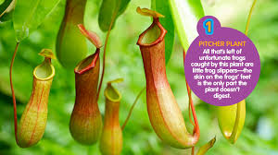
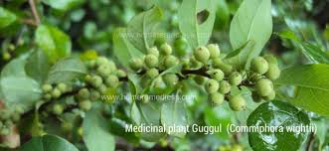
Gu
Pitcher Plant
Guggul Plant

Slide 6
Endangered black buck
The black buck is also known as kala hiran in India.
Earlier, it was found all over India except in the north-eastern regions of the country.
Due to large scale-poaching and destruction of habitat, its existence now restricted in some parts of Punjab, Gujarat, Rajasthan, Uttaranchal and Haryana.
The black buck does not require dense forests, even it is usually found in open plains in herds. So, open plains need to be conserved in order to enable the black buck to move freely.

Slide 7
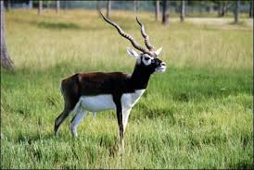
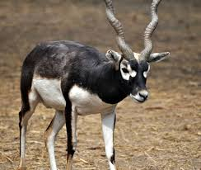

Slide 8
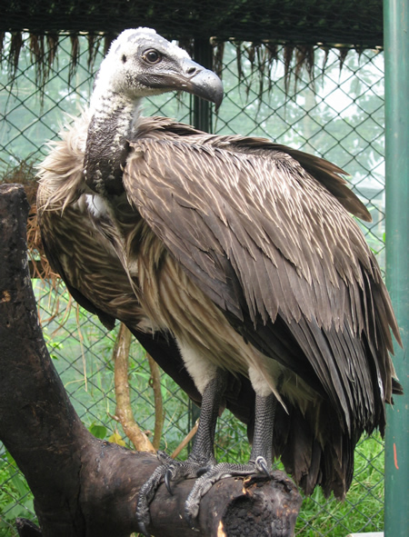
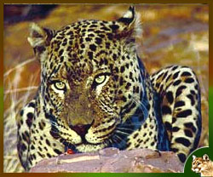
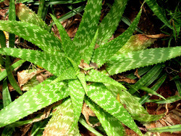
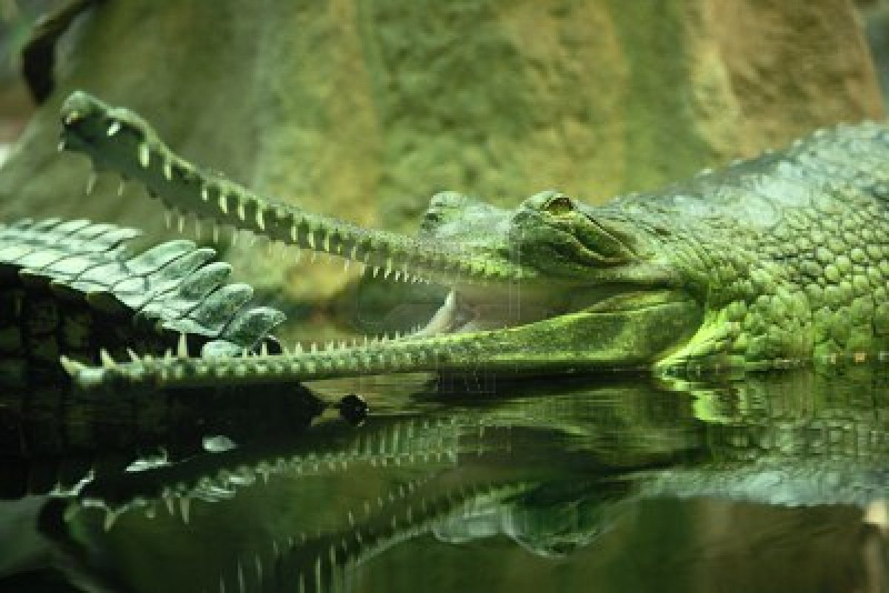
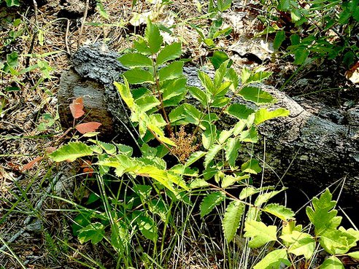
Endangered plant and animal species of India

Slide 9
Endemic Species
The plant or animal species confined to a particular region and having originated there or a species which occur continuously in that area are known as endemic species.
Restriction of species or taxa in small region is known as endemism. Eletaria repens, Ficus religiosa, Butea monosperma, Ficus bengalensis, etc. are some of the endemic plants of India.

Slide 10
Edge species
Evolutionarily Distinct and Globally Endangered (EDGE) species represent a disproportionate amount of unique evolutionary history.
They have few close relatives, are often the only surviving member of their genus, and sometimes the last surviving genus of their evolutionary family.
Some EDGE species, such as elephants and pandas, are well known.
Bumblebee bat (the world’s smallest mammal) is also a less known EDGE species.
Extremely distinct in their looks, lifestyle and Behavior.

Slide 11
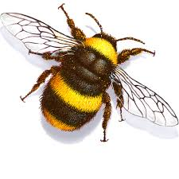
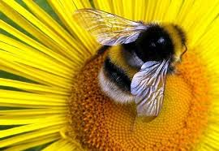
bumble bee bat -- Edge species
- the world’s smallest mammal

Slide 12
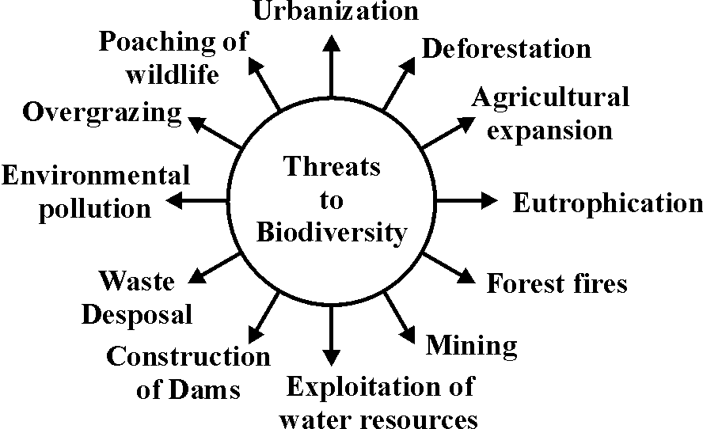
Threats to biodiversity

Slide 13
Conservation of biodiversity
Biodiversity conservation is the scientific management at its optimum level and derives sustainable benefit for both the present and the future.
There are two major approaches for conservation of biodiversity – in situ (on site) and ex situ (off site).

Slide 14
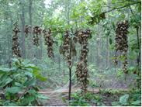
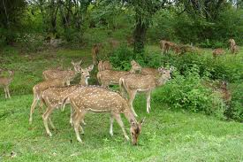
In situ conservation – In situ means the natural or the original place. In situ conservation includes National parks, Wildlife sanctuaries, Biosphere reserves, etc.

