Slide 1


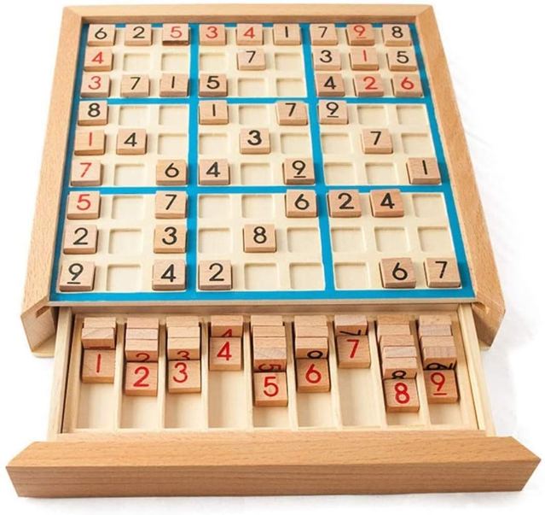

Introduction to Sudoku Solver Visualizer
Sudoku is a beloved logic puzzle that challenges players to fill in a 9x9 grid with digits 1-9, with each row, column, and 3x3 sub-grid containing unique numbers. A Sudoku solver visualizer is a powerful tool that can help players understand and solve these intricate puzzles step-by-step.
by Raman Goyal
12216883

Slide 2

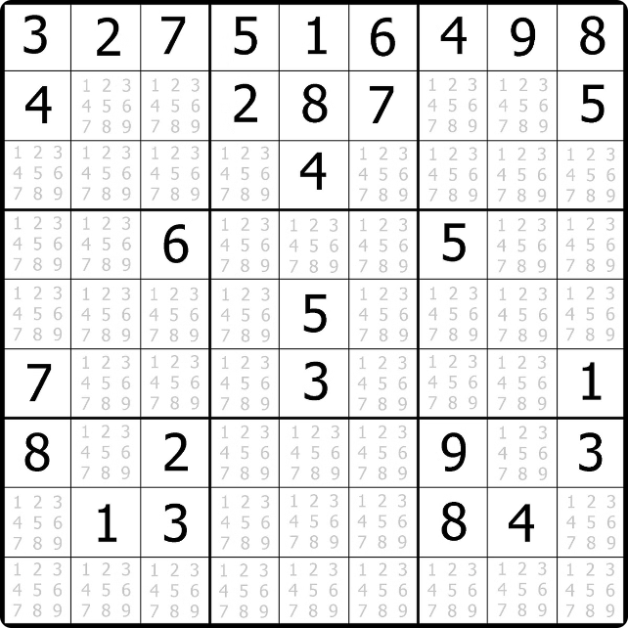
Overview of the Sudoku Puzzle
1
Objective
Fill a 9x9 grid with digits 1-9 such that each row, column, and 3x3 sub-grid contains unique numbers.
2
Difficulty Levels
Sudoku puzzles range from easy to fiendishly difficult, challenging players' logic and deduction skills.
3
Variations
While the classic Sudoku format is the most popular, there are also variations like Diagonal Sudoku and Jigsaw Sudoku.

Slide 3
Importance of Sudoku Solver Visualizer
Learning Tool
Problem-Solving
Efficiency
The visualizer can help beginners understand the step-by-step logic behind solving Sudoku puzzles.
It allows users to experiment with different strategies and techniques, improving their problem-solving abilities.
The visualizer can quickly solve complex puzzles, saving time and effort for players.

Slide 4

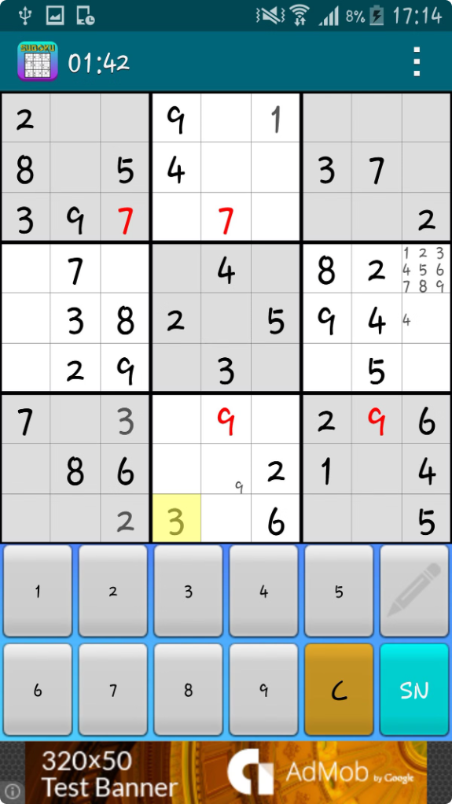
Java Implementation of Sudoku Solver
Data Structures
The solver uses a 2D array to represent the Sudoku board and a set to track available numbers.
Backtracking Algorithm
The solver employs a recursive backtracking algorithm to systematically try all possible solutions.
Optimization
The implementation includes techniques like constraint propagation to speed up the solving process.
Flexibility
The solver can handle both complete and partially filled Sudoku boards as input.

Slide 5

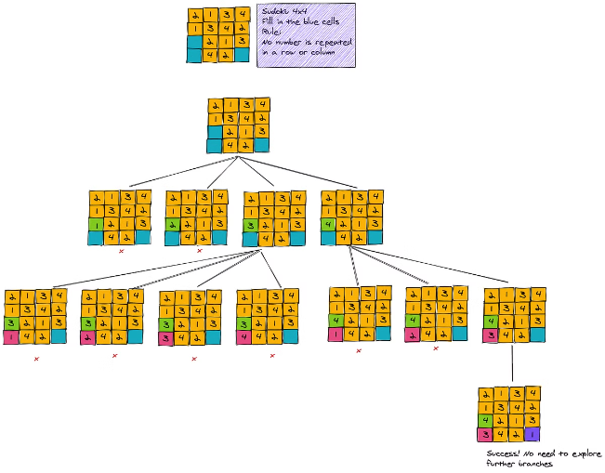
Backtracking Algorithm Explanation
1
Explore
The algorithm tries to fill in the next empty cell with a valid number.
2
Check
It checks if the current number placement is valid, considering the row, column, and 3x3 sub-grid constraints.
3
Backtrack
If the placement is invalid, the algorithm backtracks and tries a different number in the same cell.

Slide 6
Visualization Techniques
Step-by-Step Highlighting
Animated Transitions
Feedback and Explanations
The visualizer highlights the current cell being processed and the valid number options.
Smooth animations between steps help users follow the algorithm's progress.
The visualizer provides real-time feedback and explanations for each step of the solving process.

Slide 7
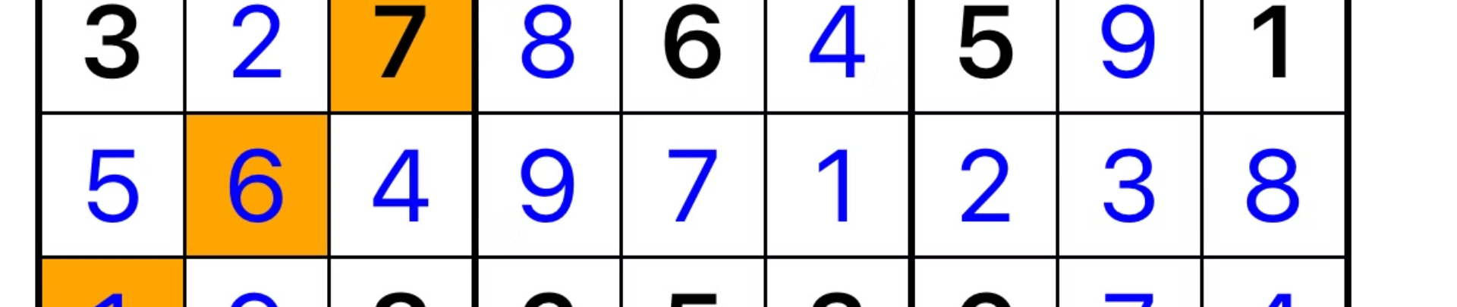




User Interface Design
Start Solver
Pause/Resume
Reset Board
Zoom Controls
Allows users to initiate the solving process with a single click.
Enables users to pause the visualization and resume at any point.
Provides an easy way for users to clear the board and start a new puzzle.
Lets users zoom in and out to better observe the solving process.

Slide 8

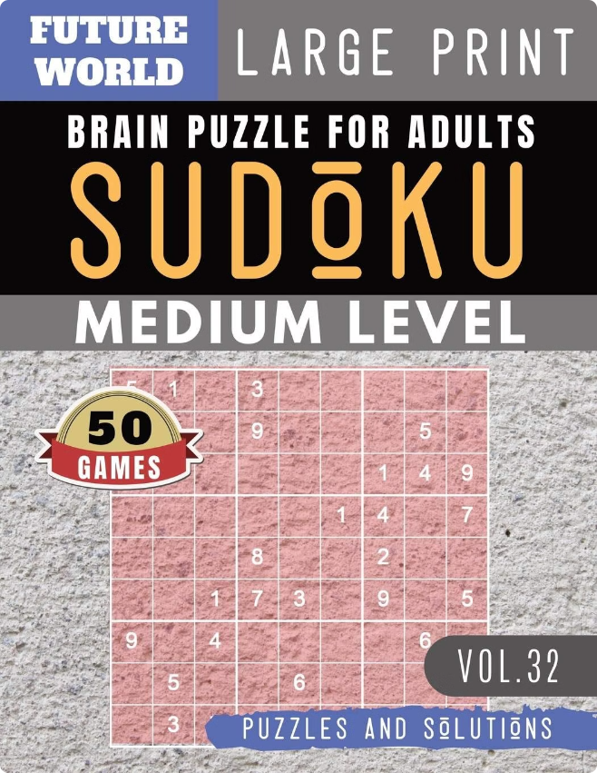



Conclusion and Future Enhancements
Conclusion
The Sudoku Solver Visualizer is a powerful tool that helps users understand and solve Sudoku puzzles with ease.
Future Enhancements
Potential improvements include support for more Sudoku variations, integration with mobile devices, and the ability to import and solve user-generated puzzles.
Wider Applications
The underlying algorithms and visualization techniques can be applied to other problem-solving domains, making the Sudoku Solver Visualizer a versatile educational and problem-solving tool.

