Slide 1
Full Stack Project Student Portfolio Hosting Site
Submitted by –
Jaya Shukla (181500294)
Nitya Shukla (181500438)
Raman Shukla (181500554)
Rishik Mishra (181500569)
Under the Guidance of
Mr. Pankaj Kapoor

Slide 2
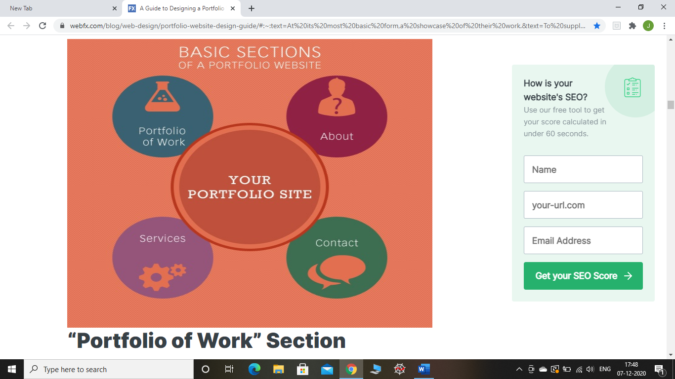
INTRODUCTION
A portfolio website is a unique way to showcase your work and let others know about you and your work. Having your own website means other persons are always able to find you and if interested, reach out for you.
In today’s digital world, a portfolio is arguably more important than a resume, no matter what industry you work in. Whether you are a freelance journalist, a recent college graduate looking for a job, or even an accountant.
In a nutshell, you need a portfolio website to showcase your work. Whether you’re an individual, a small team of two or a company of hundred people, it’s crucial that you have a unique online approach.
Basic Sections of a Portfolio

Slide 3
TECHNOLOGY USED FOR THE PROJECT
Various Front-end technologies used for the project are:
HTML (Hypertext Markup Language)
CSS (Cascading Style Sheet)
JavaScript
Bootstrap
jQuery
Different software used for the project are:
vsCode
GitHub
Git

Slide 4
ABOUT THE PROJECT
MOTIVATION
The main motivation behind creating the student portfolio hosting site is to overcome the problem that is faced by most of the young generation or the skilled people who cannot showcase their talent due to lack of the resources.
PROBLEM STATEMENT
As seeing the present scenario, skilled individuals in various fields are suffering from a lack of interactive and pleasing ways to present their skills. We have tried our best to present an alternative for people to communicate or showcase their talent, projects and other works with a wide audience via a portfolio hosting site. We are trying to expand their skills from just a paper of resume to an online platform like this site.

Slide 5
OVERVIEW OF THE SITE
This is a project in which we created a portfolio hosting website where users can host their portfolios. The home page would ask the user to choose an option whether the user is looking to hire someone or is looking forward to host their portfolio. Here onwards, the hiring section of the site would be referred to as ‘A’ and the one for hosting as ‘B’.
In A, the user will have the option to search for profiles based on the requirements (like designing, programming, python specialist, web developer, ML specialist etc.), so that they can hire people according to their need while being able to see their projects along with other complete details.
In the page B, the user will have the option to either login or register and enter their personal information like their educational details, work experience skills, project details, certifications and profile photo etc. using an intuitive GUI (Graphical User Interface).
Afterwards, they would be asked to pick from pre-made templates and all their details will be arranged according to the template chosen.

Slide 6
HARDWARE AND SOFTWARE REQUIREMENT
The particular software and hardware requirements are:
Software Requirements:
• Any Web Browser
• GitHub
• VS Code
2. Hardware Requirements:
• Windows10
• Ubuntu anyone from these
• Mac
• i3 or higher
• 4GB RAM or higher

Slide 7
POSSIBLE FUTURE WORK
The improvements that can be made or the possible future work that can be done in this field can be using back – end technologies as well along with the front – end, so that the data or the information of a particular user can be stored in the database that will make it easy for them to access or edit their information with time.
We could add a testimonial section where we should get into the habit of requesting a testimonial from every client or user we work with, and showcase our best testimonials on the homepage using sliders or rows.
We can introduce a FAQ section which can be a great place to address all questions and concerns, and it can even cut back on the number of questions and comments we receive from potential clients or users.

Slide 8
CONCLUSION
We tried to solve the problem of jobless people and freshers by creating a website which provides users with a facility to host their portfolios with different attractive layout design available.
User can enter the information about their education details, works, projects, and other skills so that they can be easily hired and also the recruiters or the recruiting companies or those who want to hire can have the options to choose from a bunch of portfolios as par their need and according to their requirements.

Slide 9
IMPLEMENTATION
Using HTML, CSS, JavaScript, jQuery, Bootstrap, we have implemented registration, login and logout sections.
On the log in page, we need a form with username and password, a button with the main action (log in) and a back to home page link.
On the sign up page, we should have a form with four fields: username, email address, password, and name. The user should also be able to reach the log in page.

Slide 10
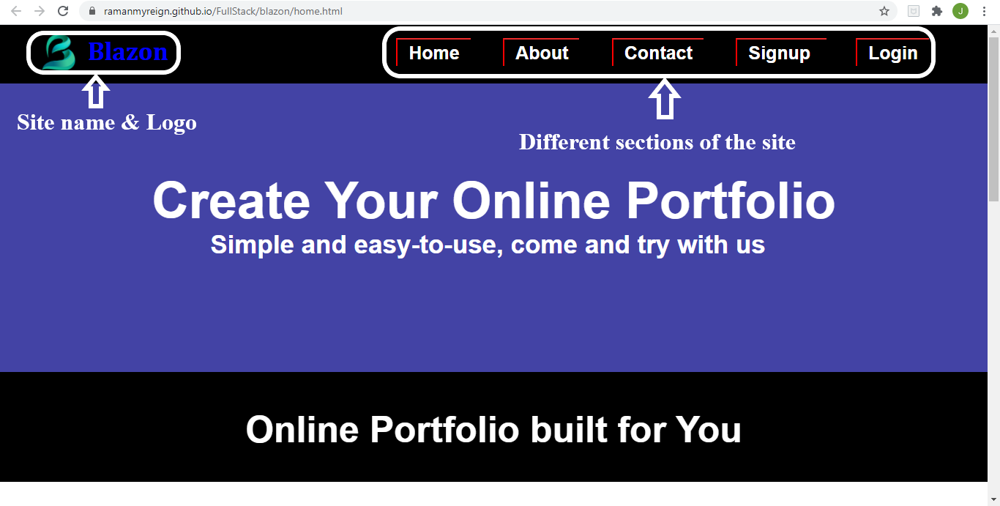
Home Page of Blazon

Slide 11
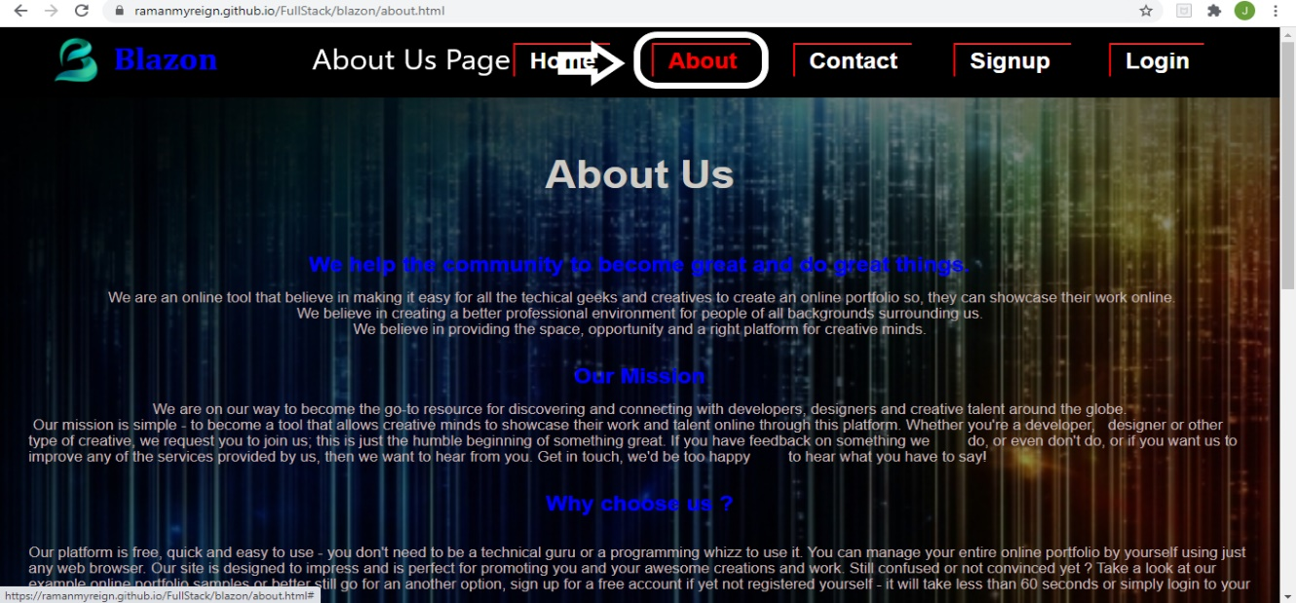
About Us section of Blazon

Slide 12
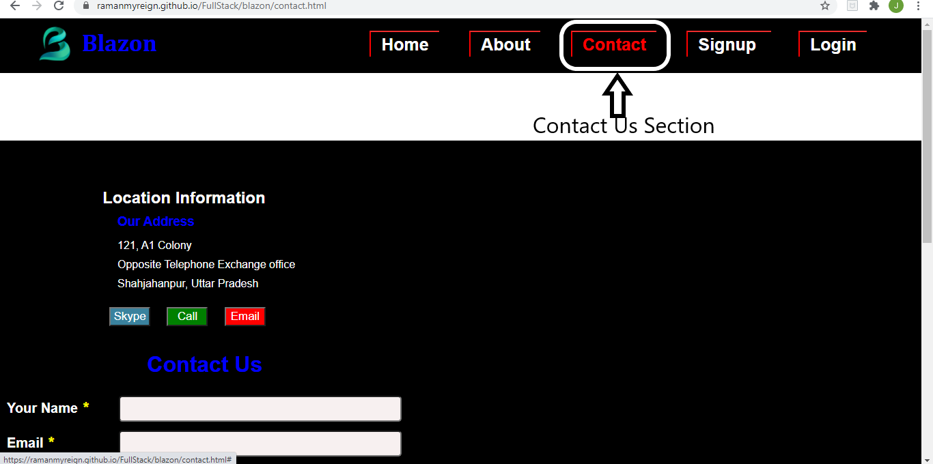
Contact Us section of Blazon

Slide 13
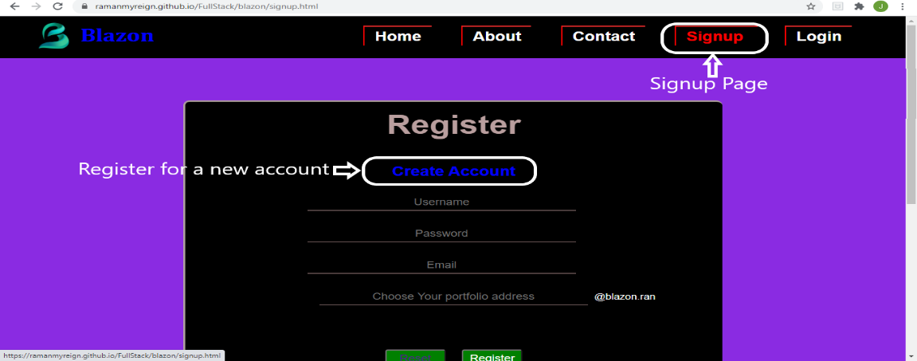
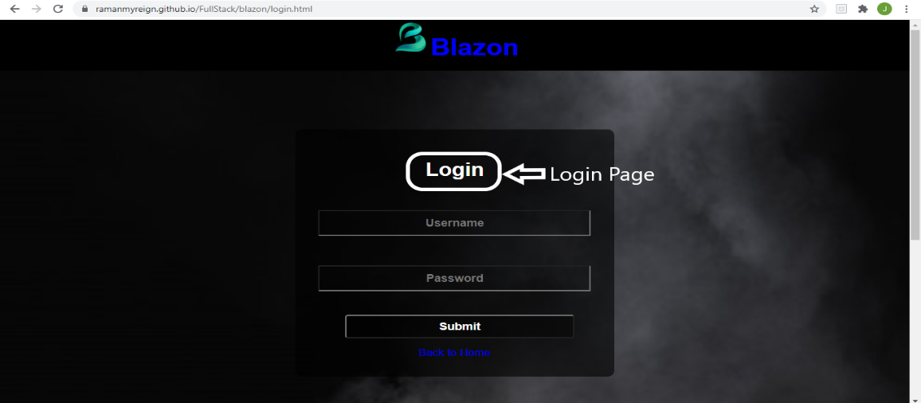
Signup and login page

Slide 14
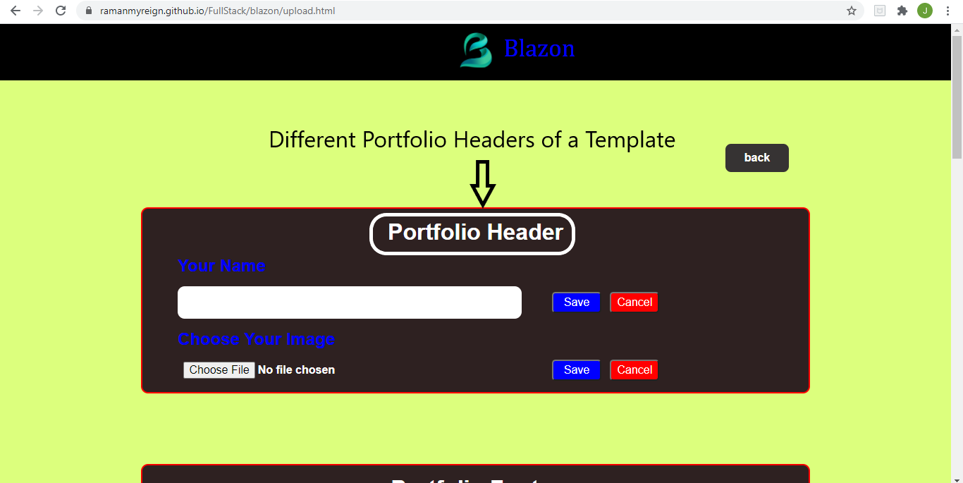
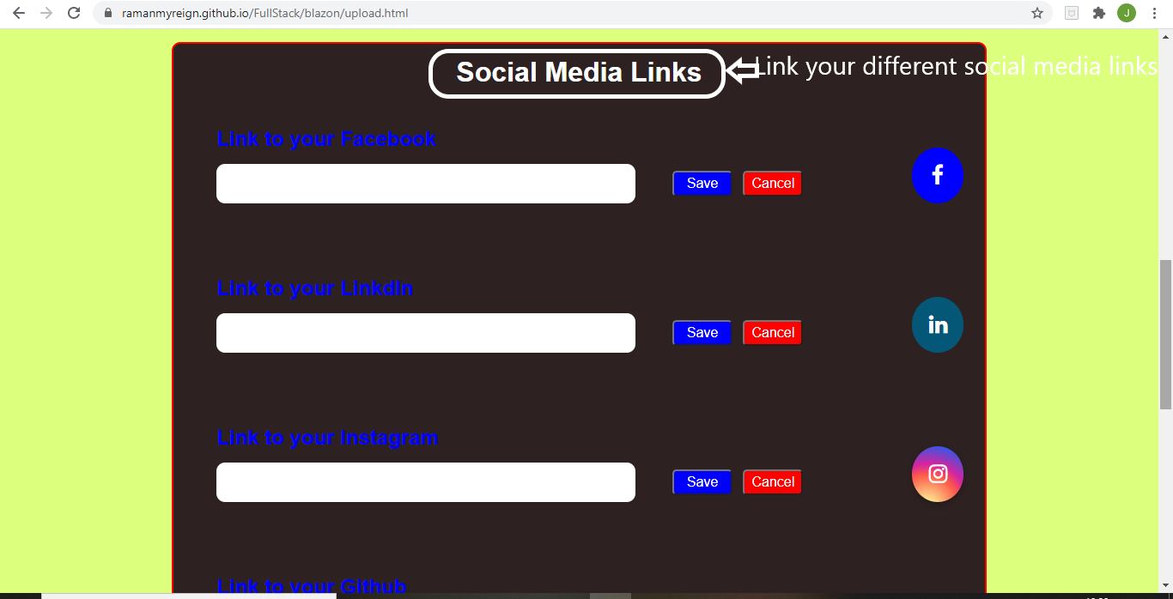
Portfolio template

Slide 15
REFERENCES
Git-Hub Repository Link for the source code:
https://github.com/RamanMyreign/BLAZON_Portfolio_Hosting
Git-Hub Repository Link for the live page:
https://ramanmyreign.github.io/BLAZON_Portfolio_Hosting/index.html

Slide 16
THANK YOU!

