Slide 1


Easy start for web UI testing using Selenide
by Raman Patsiayuk
March 1, 2018

Slide 2
AGENDA
1
What is Selenide?
2
Pros and cons
3
Small demo
4
Q&A

Slide 3

What is Selenide?
Selenide is a wrapper for Selenium WebDriver that allows you easier and faster writing of UI Tests. With Selenide you can concentrate on business logic instead of solving all these endless browser/ajax/timeouts problems.

Slide 4


Quick start
It's extremely easy to start using Selenide. Definitely not a rocket science.
Just add selenide.jarsto your project and you are done.
For Maven users:
Add these lines to file pom.xml:
<dependency>
<groupId>com.codeborne</groupId>
<artifactId>selenide</artifactId>
<version>4.10</version>
<scope>test</scope>
</dependency>
For Gradle users:
Add these lines to file build.gradle:
dependencies {
testCompile 'com.codeborne:selenide:4.10'
}

Slide 5
Pros and cons
Pros:
1
Concise API inspired by jQuery
2
Automatic handling of most problems with Ajax, waiting and timeouts
3
Automatic handling of browser lifecycle
4
Automatic screenshots on test failures
5
Multifunctional selectors
6
Actively supported by authors

Slide 6
Pros and cons
Cons:
1
The driver runs in a single thread
2
Based on static methods

Slide 7
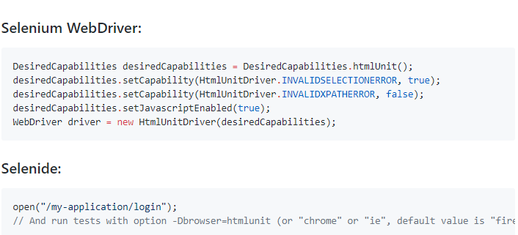
Create a browser

Slide 8
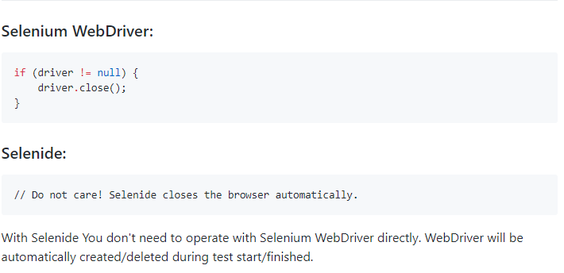
Shutdown a browser

Slide 9
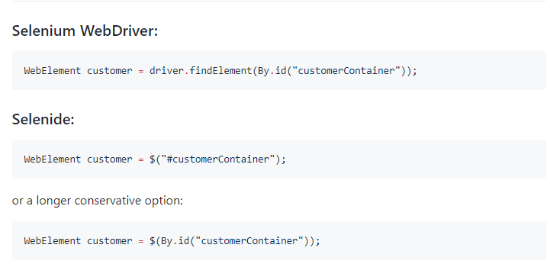
Find element by id

Slide 10
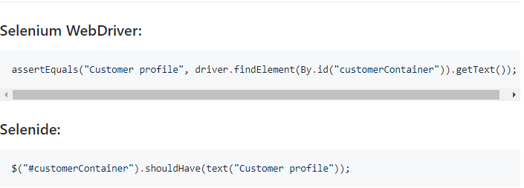
Assert that element has a correct text

Slide 11
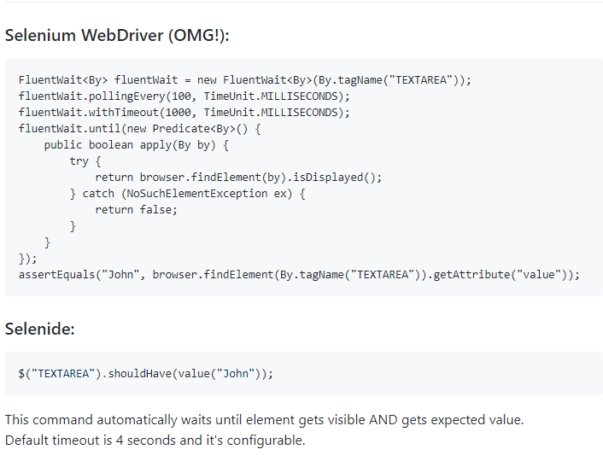
Ajax support (waiting for some event to happen)

Slide 12
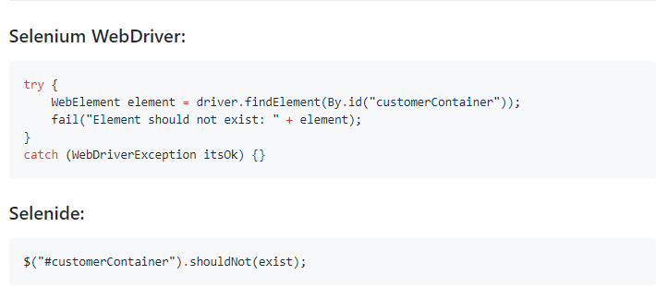
Assert that element does not exist

Slide 13
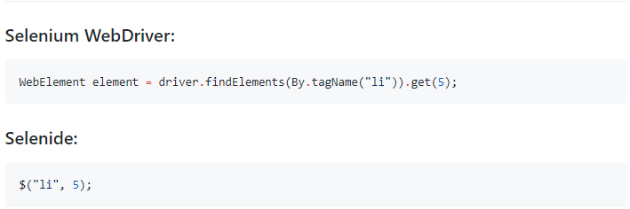
Looking for Nth element

Slide 14
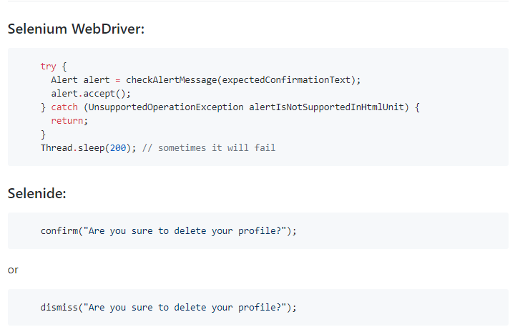
Click "Ok" in alert dialog

Slide 15
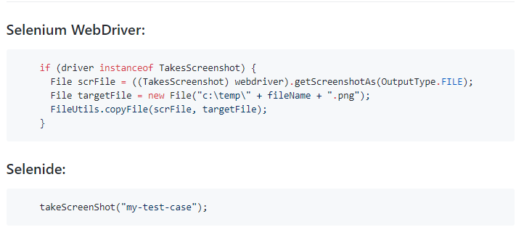
Take a screenshot

Slide 16
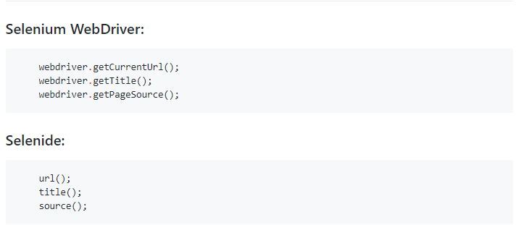
Get the current page URL, title or source

Slide 17
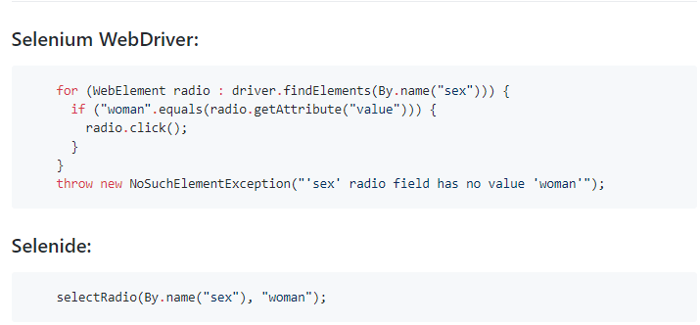
Select a radio button

Slide 18

It’s time to demo

Slide 19


