Slide 1


Carbon Trading Emission
Prem kumar S
Aravindhan M
Abilash S
Arun kumar C
Ramana K
Notes:
Let's delve deeper into the exciting world of sustainability and AI.
In this chapter, we'll explore how artificial intelligence can be a powerful tool for addressing environmental challenges and promoting sustainable practices. We'll discuss specific applications of AI in various sectors and analyze its potential to drive positive change.
Get ready to discover the innovative ways AI is contributing to a more sustainable future!

Slide 2

Project Objectives
Problem Statement
Project Overview – Introduction
End Users
Wow Factor in Project
Modelling/Block Diagram/Flow of Project
Result/outcomes
Conclusion
Future Perspective
Notes:
Let's outline what you'll learn in this presentation.
By the end, you'll be able to:
Understand how AI helps solve problems like climate change, resource depletion, and biodiversity loss.
Identify key AI uses in energy efficiency, waste management, and climate change.
Analyze AI's role in sustainable agriculture and cities.
Evaluate AI's use in environmental monitoring using satellites, real-time data, and predictions.
Apply AI strategies in logistics and transportation to make them more sustainable.
Get ready to discover how AI can help create a greener future!

Slide 3
Track company performance against limits.
Problem Statement
Rising CO₂ emissions are harming the environment.
Companies often exceed their carbon limits.
Lack of a simple tool to:
Predict emissions from energy use.
Track company performance against limits.
Trade carbon credits effectively.
Notes:
Sustainability and AI
Sustainability is important because it helps meet our needs now and in the future. It includes protecting the environment, reducing pollution, and improving economic and social well-being.
AI can help us achieve sustainability. AI can process data, make predictions, and optimize systems to solve problems like resource management, environmental conservation, and energy efficiency.
Examples:
Smart grids: Reduce energy consumption.
Agriculture: Optimize water and fertilizer use.
Biodiversity: Monitor wildlife to protect biodiversity.
AI is a powerful tool for creating a more sustainable future.

Slide 4
Project Overview - Introduction
carbon emissions are a major cause of climate change.
companies need tools to predict and manage emissions.
This project
Predicts CO₂ emissions using machine learning.
Provides a dashboard to monitor emissions.
Simulates carbon credit trading.
Notes:
Sustainability and AI
Sustainability is important because it helps meet our needs now and in the future. It includes protecting the environment, reducing pollution, and improving economic and social well-being.
AI can help us achieve sustainability. AI can process data, make predictions, and optimize systems to solve problems like resource management, environmental conservation, and energy efficiency.
Examples:
Smart grids: Reduce energy consumption.
Agriculture: Optimize water and fertilizer use.
Biodiversity: Monitor wildlife to protect biodiversity.
AI is a powerful tool for creating a more sustainable future.

Slide 5
End Users
Manufacturing Companies – monitor & reduce emissions.
Energy & Utility Providers – track fuel/electricity usage.
IT & Service Companies – manage sustainability reporting.
Government / Regulators – oversee compliance with carbon policies.
Investors & Stakeholders – evaluate companies’ green performance.
Notes:
Sustainability and AI
Sustainability is important because it helps meet our needs now and in the future. It includes protecting the environment, reducing pollution, and improving economic and social well-being.
AI can help us achieve sustainability. AI can process data, make predictions, and optimize systems to solve problems like resource management, environmental conservation, and energy efficiency.
Examples:
Smart grids: Reduce energy consumption.
Agriculture: Optimize water and fertilizer use.
Biodiversity: Monitor wildlife to protect biodiversity.
AI is a powerful tool for creating a more sustainable future.

Slide 6
Wow Factors in Project
ML-based Prediction – Accurate CO₂ emission forecasting.
Interactive Dashboard – Real-time company emission monitoring.
Carbon Credit Trading Simulation – Buyers & sellers trade surplus/deficit credits.
Visual Insights – Color-coded tables, charts & graphs for easy understanding.
Sustainability Focus – Supports companies in achieving carbon neutrality.
Notes:
Sustainability and AI
Sustainability is important because it helps meet our needs now and in the future. It includes protecting the environment, reducing pollution, and improving economic and social well-being.
AI can help us achieve sustainability. AI can process data, make predictions, and optimize systems to solve problems like resource management, environmental conservation, and energy efficiency.
Examples:
Smart grids: Reduce energy consumption.
Agriculture: Optimize water and fertilizer use.
Biodiversity: Monitor wildlife to protect biodiversity.
AI is a powerful tool for creating a more sustainable future.

Slide 7
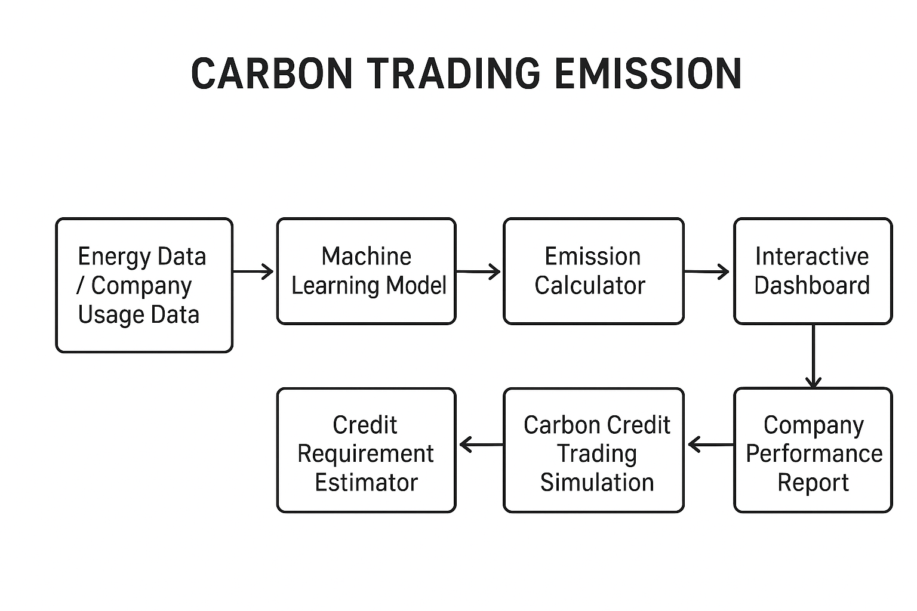
Modelling/Block Diagram/Flow of Project
Notes:
Sustainability and AI
Sustainability is important because it helps meet our needs now and in the future. It includes protecting the environment, reducing pollution, and improving economic and social well-being.
AI can help us achieve sustainability. AI can process data, make predictions, and optimize systems to solve problems like resource management, environmental conservation, and energy efficiency.
Examples:
Smart grids: Reduce energy consumption.
Agriculture: Optimize water and fertilizer use.
Biodiversity: Monitor wildlife to protect biodiversity.
AI is a powerful tool for creating a more sustainable future.

Slide 8
Result/Outcomes
Accurate prediction of CO₂ emissions using ML.
Carbon credit requirement calculated automatically.
Dashboard view of company emission performance.
Trading simulation balances surplus & deficit credits.
Helps companies move towards carbon neutrality.
Notes:
Sustainability and AI
Sustainability is important because it helps meet our needs now and in the future. It includes protecting the environment, reducing pollution, and improving economic and social well-being.
AI can help us achieve sustainability. AI can process data, make predictions, and optimize systems to solve problems like resource management, environmental conservation, and energy efficiency.
Examples:
Smart grids: Reduce energy consumption.
Agriculture: Optimize water and fertilizer use.
Biodiversity: Monitor wildlife to protect biodiversity.
AI is a powerful tool for creating a more sustainable future.

Slide 9
Conclusion
CO₂ emissions can be predicted effectively using ML.
The dashboard makes monitoring company performance simple
.
Carbon credit trading simulation shows how deficits and surpluses can be balanced.
The project supports companies in moving towards sustainability and carbon neutrality.
Notes:
Sustainability and AI
Sustainability is important because it helps meet our needs now and in the future. It includes protecting the environment, reducing pollution, and improving economic and social well-being.
AI can help us achieve sustainability. AI can process data, make predictions, and optimize systems to solve problems like resource management, environmental conservation, and energy efficiency.
Examples:
Smart grids: Reduce energy consumption.
Agriculture: Optimize water and fertilizer use.
Biodiversity: Monitor wildlife to protect biodiversity.
AI is a powerful tool for creating a more sustainable future.

Slide 10
Future Perspective
Integrate real-time IoT data for live emission tracking.
Add dynamic carbon credit pricing to simulate real markets.
Store trade history in a database for analytics.
Expand platform to global carbon markets.
Support policy makers & regulators with actionable insights.
Notes:
Sustainability and AI
Sustainability is important because it helps meet our needs now and in the future. It includes protecting the environment, reducing pollution, and improving economic and social well-being.
AI can help us achieve sustainability. AI can process data, make predictions, and optimize systems to solve problems like resource management, environmental conservation, and energy efficiency.
Examples:
Smart grids: Reduce energy consumption.
Agriculture: Optimize water and fertilizer use.
Biodiversity: Monitor wildlife to protect biodiversity.
AI is a powerful tool for creating a more sustainable future.

Slide 11
Thank You
Notes:
Thank You !!

