Slide 1
AMCAT EDA PROJECT Exploratory Data Analysis
Here is where your presentation begins

Slide 2
Data analysis
Collection
Cleaning
Exploratory
Statistical
Visualization
Hypothesis

Slide 3
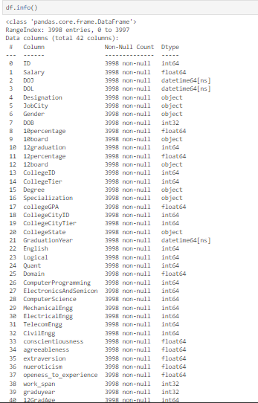
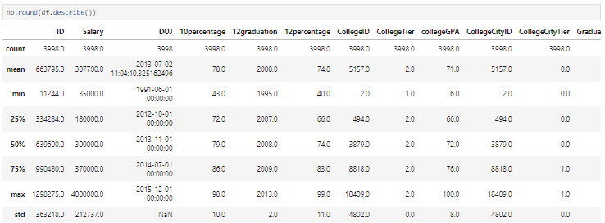
Overview of the data

Slide 4
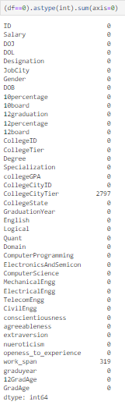
Cleaning data

Slide 5
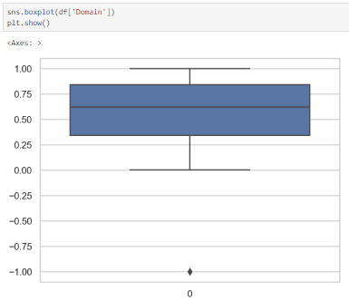
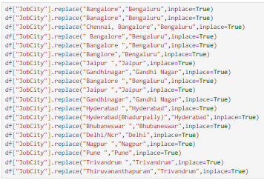

Slide 6
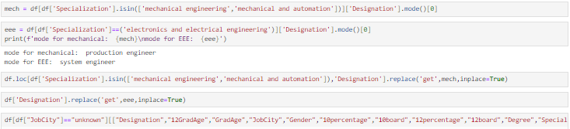

Slide 7
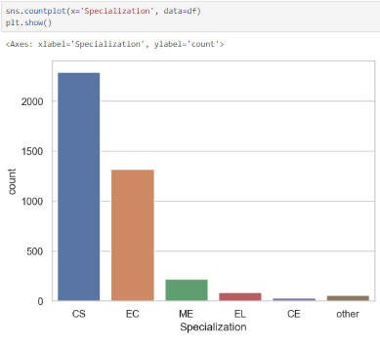
UNIVARIATE ANALYSIS
Computer science students are the most employed

Slide 8
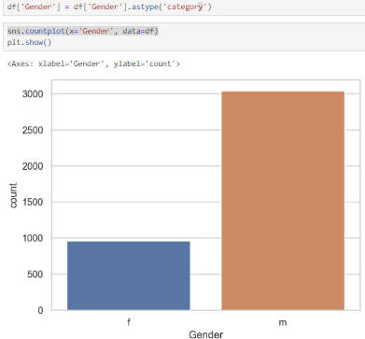
Men are more employed than women.

Slide 9
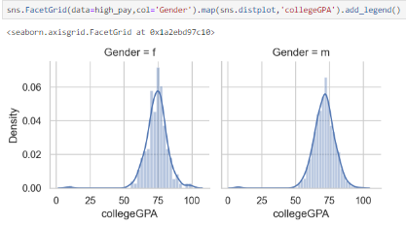
BIVARIATE ANALYSIS
Women have slightly more or equal cgpa compared to men

Slide 10
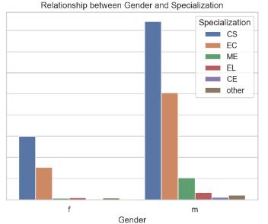
Is there a relationship between gender and specialization? (i.e. Does the preference of Specialization depend on the Gender?
More number of men are employeed with a degree in Computer Science

