Slide 1



Intel Unnati Training Program
Smart Product Labeling and Traceability System

Slide 2


Introduction
This presentation briefs the Intel Unnati training program focused on creating an automated labeling and traceability system. It emphasizes the importance of efficiency and traceability in product labeling. The program uses advanced technologies like AI for inspection, ensuring various standards are maintained while enhancing operational efficiency.

Slide 3

Automated Labeling System and Tracebility System

Slide 4


Design Principles
The design of the automated labeling system is centered around functionality and compliance. It must meet the regulations such as RoHS, ensuring that all materials are safe and sustainable. Main design aspects include user-friendly interfaces, modular components, and adaptability for various product sizes.

Slide 5

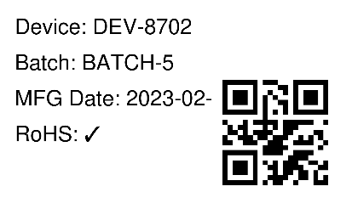
Code Developed
Conveyor Belt and Label generation :
This is the link to the complete code : https://colab.research.google.com/drive/1PTK9P4NTbBkZI6yEhSNHZDXRE0ndIRbk#scrollTo=vr3cbsTfdpLh
Sample Output : Terminal showing product details printed every 2 seconds
Sample label generated

Slide 6


Code Developed
Fresh vs Rotten Fruit Detection:
This is the link to the complete code : https://colab.research.google.com/drive/1Y5aS2oXVnpM2KqBC6HBPh64eOy2tW3D3?usp=sharing
Sample Output :
Fresh
Rotten
97.8%
94.1%

Slide 7
Code Developed
Smart Product Traceability:
This is the link to the complete code : https://colab.research.google.com/drive/1QRugiNGdjPtFn-UuZO2QA-HjjDPghsXn?usp=sharing
Sample Output : Shows the summary and the generated output of 4 products

Slide 8
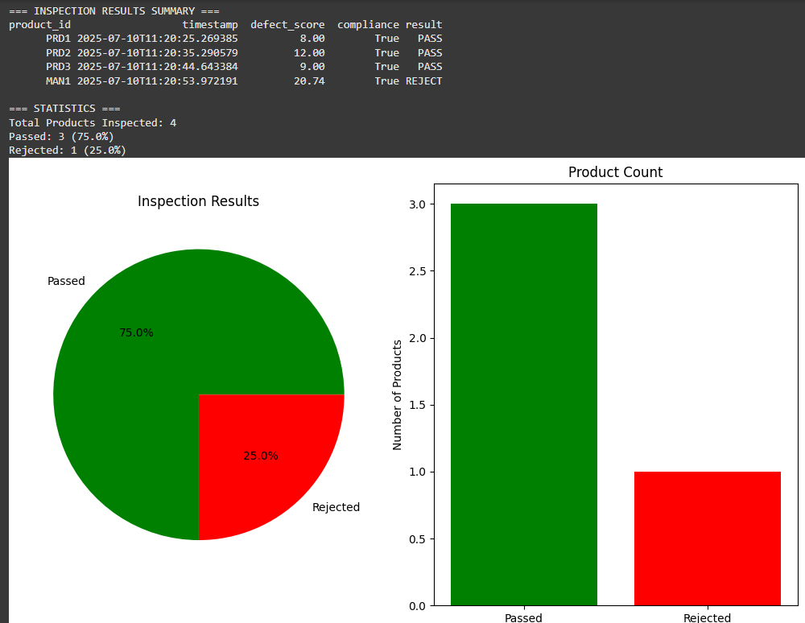

Slide 9
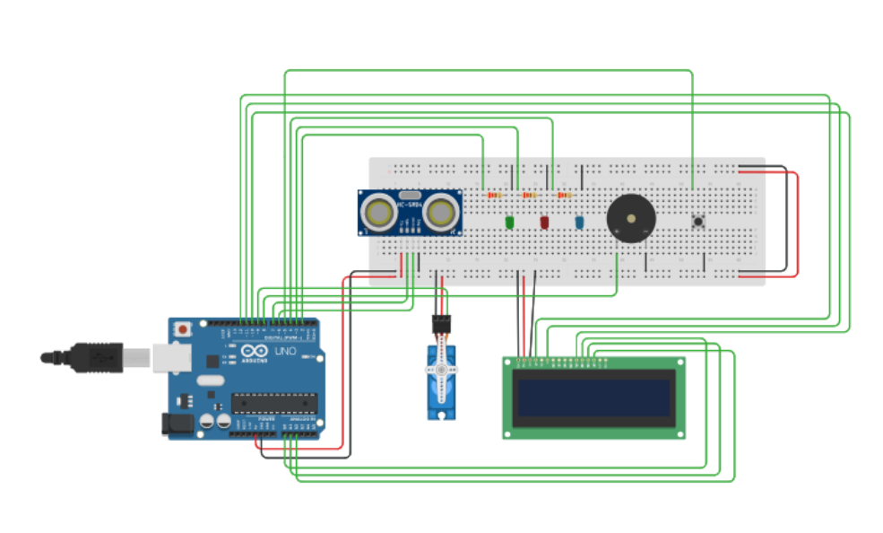
Also, we developed a circuit for the simulation
https://www.tinkercad.com/things/1swFNVQqdLB-smartlabelingsystem

Slide 10

Conclusion
In conclusion, the idea of AI-driven inspection and automated labeling in the Intel Unnati training program sets up businesses for increased operational effectiveness. Businesses can guarantee high standards of product quality and accountability by placing a strong hold onto design principles, compliance verification, and reliable data management. This exclusive strategy increases market competitiveness while also encouraging innovation.

Slide 11

Thank you!
Do you have any questions?
Team Members :
From MIT
Ramanaa Vijaykumar
Vivan Jain
Under the guidance of our mentor:
Dr. Mahesh Anil Inamdar
+00 000 000 000

