Slide 1
Employee Data Analysis using Excel
STUDENT NAME: BHARATH.N
REGISTER NO: 312211591
DEPARTMENT: B.COM(GENERAL)
COLLEGE: THIRUTHANGAL NADAR COLLEGE

Slide 2
PROJECT TITLE
Employee Performance Analysis using Excel

Slide 3


AGENDA
Problem Statement
Project Overview
End Users
Our Solution and Proposition
Dataset Description
Modelling Approach
Results and Discussion
Conclusion
3/21/2024 Annual Review

Slide 4

PROBLEM STATEMENT
Objective:
Create an efficient and scalable Excel solution to centralize employee data, monitor crucial metrics, and produce self-updating reports and visualizations.
Data Cleanup and Structuring:
Harmonize data formats (such as dates and numbers) for consistency. Purge or rectify errors and discrepancies. Categorize data into logical groups (including Personal Details, Employment Information, and Remuneration) for easy access and analysis.
Analytical Tools:
Construct calculations to extract vital statistics (like total staff and mean salary). Create dynamic pivot tables to synthesize and dissect data across multiple dimensions (such as team, location, and role).

Slide 5

PROJECT OVERVIEW
This project aims to assess and benchmark employee performance across multiple departments, including Human Resources, Marketing, Research and Development, Legal, Support, and Engineering. Through the use of visualizations such as graphs and pie charts, this project will culminate in a robust, intuitive Excel dashboard that can be periodically refreshed and leveraged by HR and management to inform data-driven decisions and drive performance enhancements throughout the organization.

Slide 6

WHO ARE THE END USERS?
Employees:
Employees will have the ability to securely access their own performance data and metrics, enabling them to conduct self-assessments and pinpoint opportunities for personal growth and development.
Business Organisation:
Recruitment teams utilize data analysis to uncover key skill sets and performance patterns, enabling them to make informed hiring decisions and identify top talent.

Slide 7

OUR SOLUTION AND ITS VALUE PROPOSITION
1. Comprehensive Performance Tracking :
Centralizes and tracks performance data for individuals and teams across essential metrics, consolidating information from various sources into a cohesive, easy-to-navigate Excel platform.
2. Dynamic Dashboards and Visualizations :
Delivers dynamic, real-time analytics through interactive visualizations and pivot tables, offering tailored views for diverse stakeholders, including managers, HR professionals, and other key users.
3. Automated reporting :
Automates data collection and report generation, eliminating manual drudgery and guaranteeing that insights remain current, precise, and actionable through regular updates.

Slide 8
Dataset Description
The dataset for employee performance analysis typically includes various metrics that reflect
an employee's productivity, quality of work, attendance, and overall contribution to the
organization. Below is a description of the key columns that would be included in a Actionable Insights which Include recommendations or action items based on the analysis, such as training needs or performance improvement plans.
Excel dataset:
EmpID: A unique identifier for each employee.
Employee Name: The employee’s given name.
Gender Code: A code representing the gender of the employee (e.g., M for Male, F for Female, etc.)
Business Unit: The department or division within the company where the employee works.
Employee salary: the amount of salary that the employee gets for their work.
Employee Type: Classification of the employee, such as full-time, part-time, contractor, etc.
Employee location: location of the employee where he works.

Slide 9

THE "WOW" IN OUR SOLUTION
combined 'wow' features create a cutting-edge, user-friendly, and highly efficient Excel-based solution that surpasses expectations in employee performance management and analysis. This innovative tool includes an AI-powered module that identifies trends and recommends actionable enhancements, empowering managers to develop data-driven strategies that drive productivity and employee engagement. By providing a comprehensive view, the solution enables informed, strategic decision-making that fosters improvement and growth.
3/21/2024 Annual Review
9

Slide 10
MODELLING
Modeling employee performance in Excel involves creating a systematic approach to evaluate, analyze, and visualize the performance data of employees.
EMP. NAMES | SALES
BABU
 | ₹ 35,000.00
KARTHI
 | ₹ 65,000.00
KEVIN
 | ₹ 25,000.00
MOHAN
 | ₹ 58,000.00
RAJAN
 | ₹ 32,000.00
RAJU
 | ₹ 35,000.00
RAM
 | ₹ 27,000.00
SAKTHI
 | ₹ 28,000.00
SUGAN
 | ₹ 65,000.00
SUJITHA
 | ₹ 36,000.00
VANI
 | ₹ 41,000.00
VIJI
 | ₹ 42,000.00
Grand Total
PIVOT TABLE
10

Slide 11
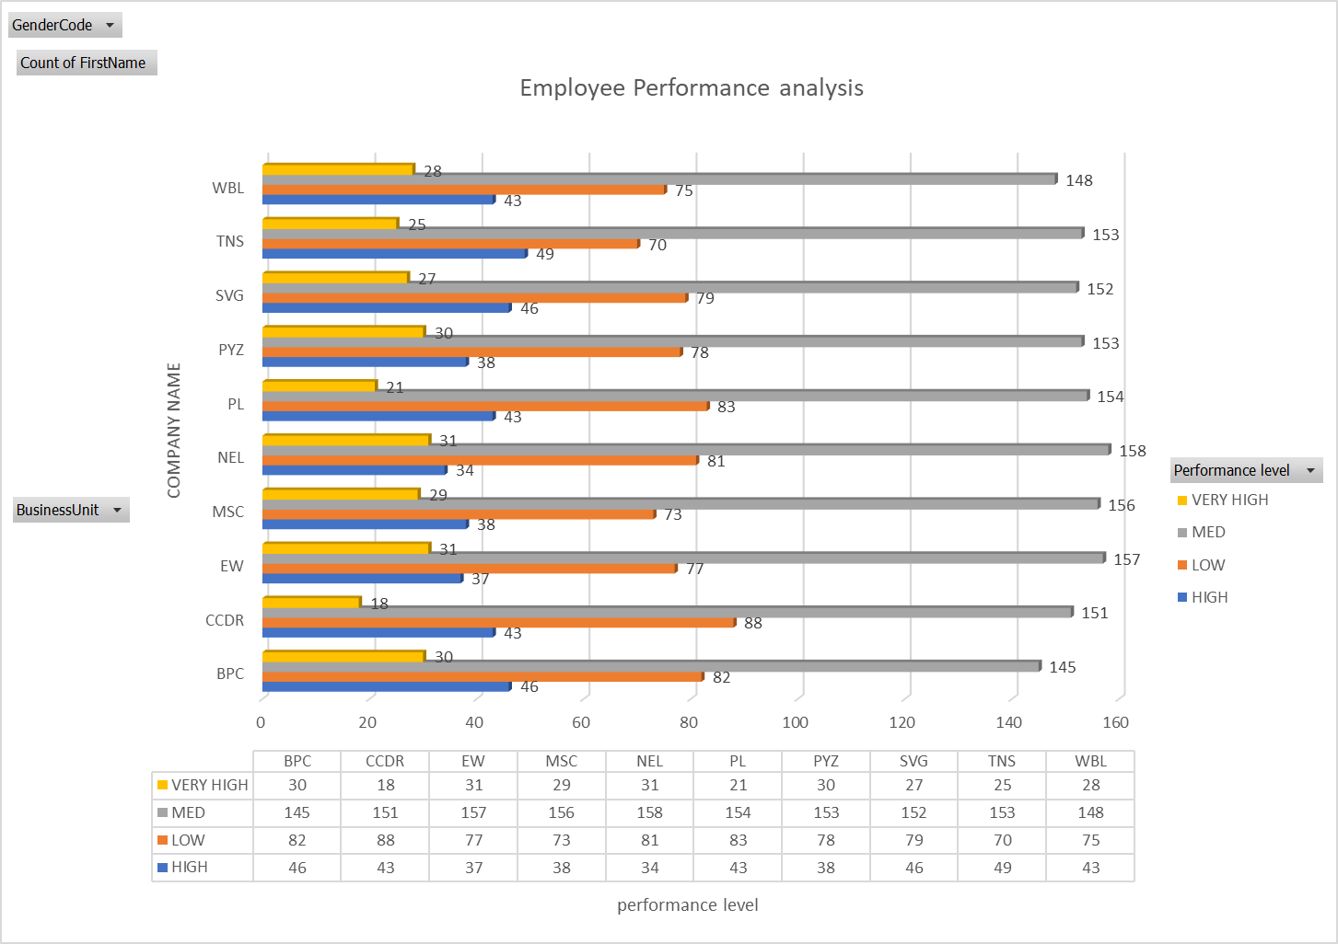
RESULTS
To present employee performance results in Excel, you can create a structured and visually appealing report. Below are steps to organize and display the results effectively.
11

Slide 12
conclusion
Utilizing Excel for employee performance analysis provides a structured framework for assessing and optimizing workforce performance. By harnessing Excel's capabilities in data management, calculation, and visualization, you can uncover trends, monitor key metrics, and identify opportunities for growth. This in-depth analysis yields actionable insights into employee competencies and areas for development, informing strategic decisions on promotions, training, and development initiatives that align with organizational objectives. To ensure the integrity and relevance of the performance evaluation process, it is essential to regularly update and thoughtfully interpret the data.

