Slide 1

Project
Flight fare prediction system using machine learning.
By Radharaman Sharma

Slide 2


Introduction
In the present aviation space, we have seen how traffic has been raised significantly. Nowadays the price fares of flights even domestic as well as international are quite unpredictable. The prices does not have any pattern which can be seen by our naked eyes but its so hard to predict what will be the price of a flight next month even after following up the prices it changes drastically in a single day or two.
This project is all about resolving this issue and finding insights and patterns in the dataset provided so that we can see a pattern and find out a suitable way to predict the flight fares and create machine learning model based on that.

Slide 3


Understanding the problem and its primary solution.
Problem: we need to create a machine learning model which can predict the fare of flights according to certain parameters which our model will learn and optimize.
What kind of problem is this model is ?
Answer : This is based on supervised machine learning model and problem which we are solving is a regression problem statement which hold continuous dataset.

Slide 4

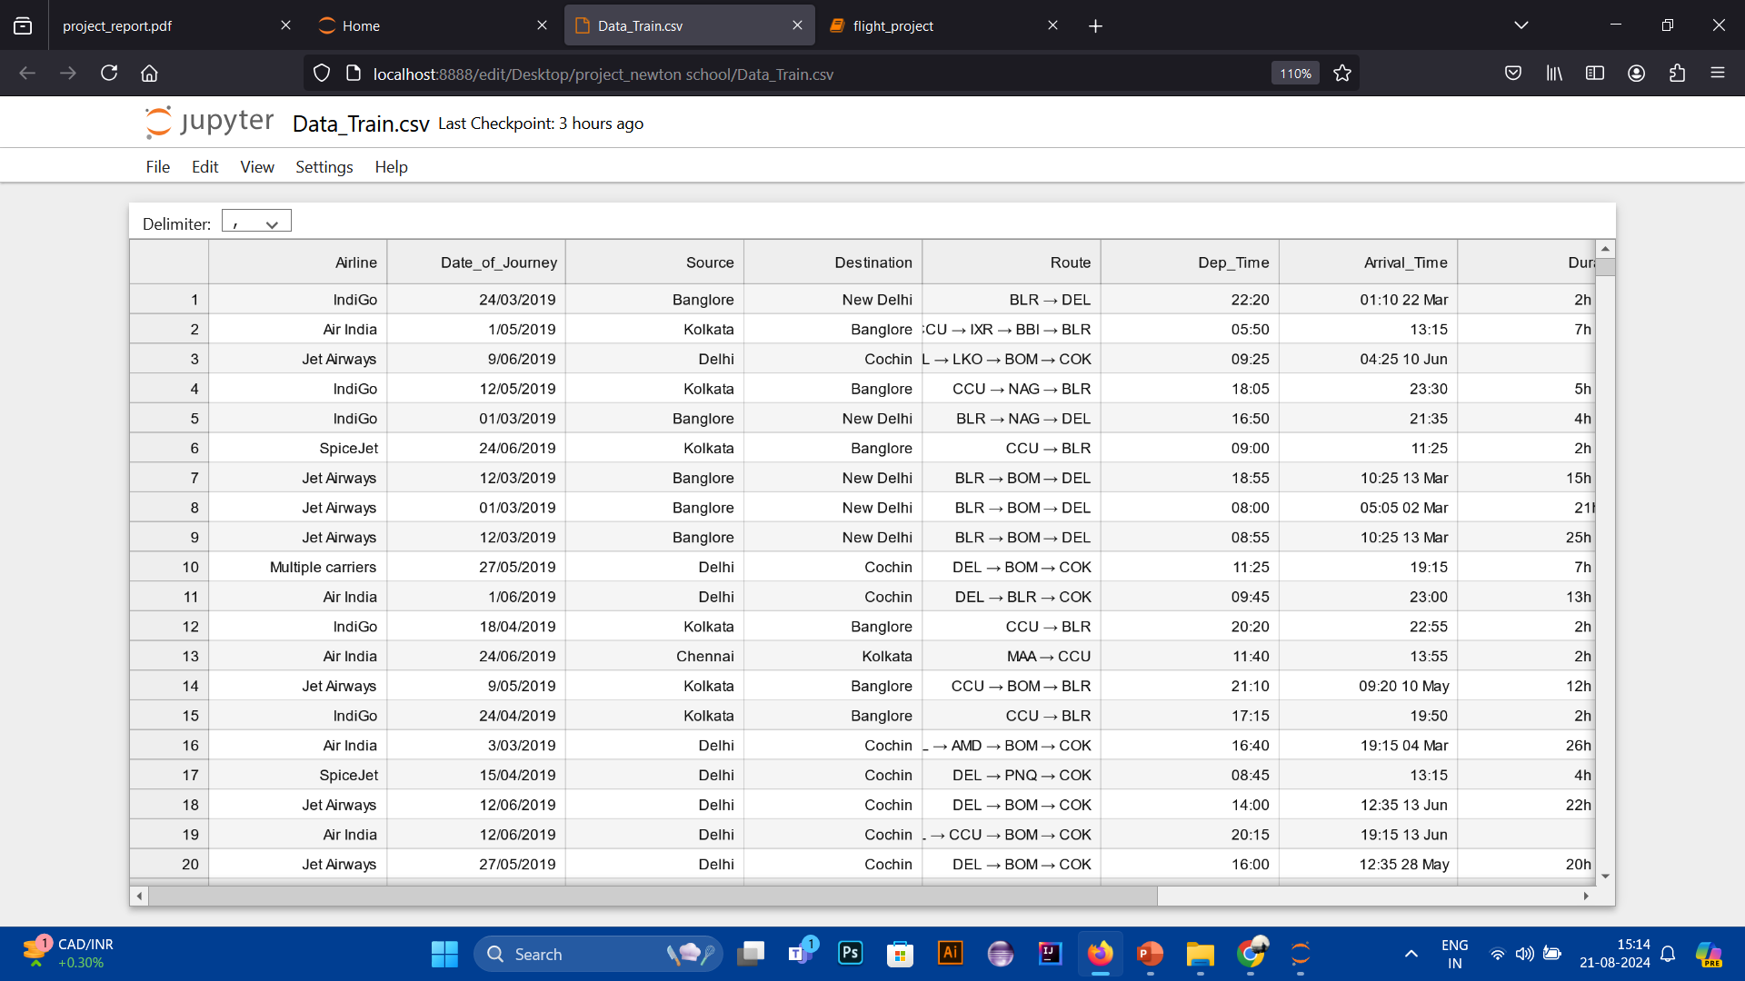
Solving this problem statement
First step towards solving this problem was to find the dataset which will help us give the details required so that we can apply different methods and approaches to gain data insights and use it further.
A small glimpse of dataset which is used in this project.

Slide 5

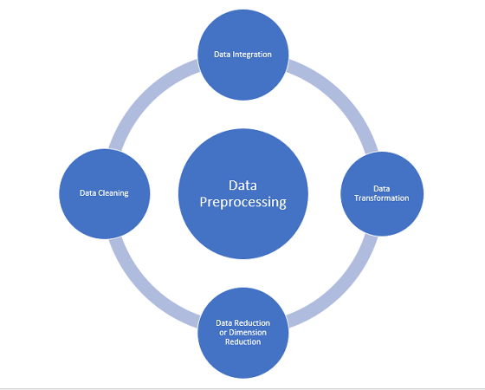
Approach to Solve.
Objective : Predict the fares based on airline, source, destination, arrival time and departure time.
Data collection: We have a dataset with all the data required.
Data pre-processing: This is the first and most import part to solve any problem in data science.
In this project I have handled missing data values, null values, and converted the data columns in the required format so we can work on them.

Slide 6

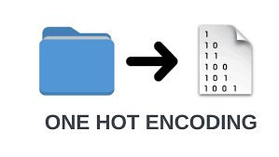
Handling Categorical Data and Visualizations
Categorical Data is information that can be grouped into categories, but doesn't have an inherent order or hierarchy. Categorical data can include things like colors, age groups, food cuisines, sports, genders, shapes, and more.
We have used one-hot encoding for the categorical data present in the dataset using scikit-learn.
One-hot encoding: One-hot encoding is a technique that we use to represent categorical variables as numerical values in a machine learning model.
We have plotted the data using seaborn.

Slide 7

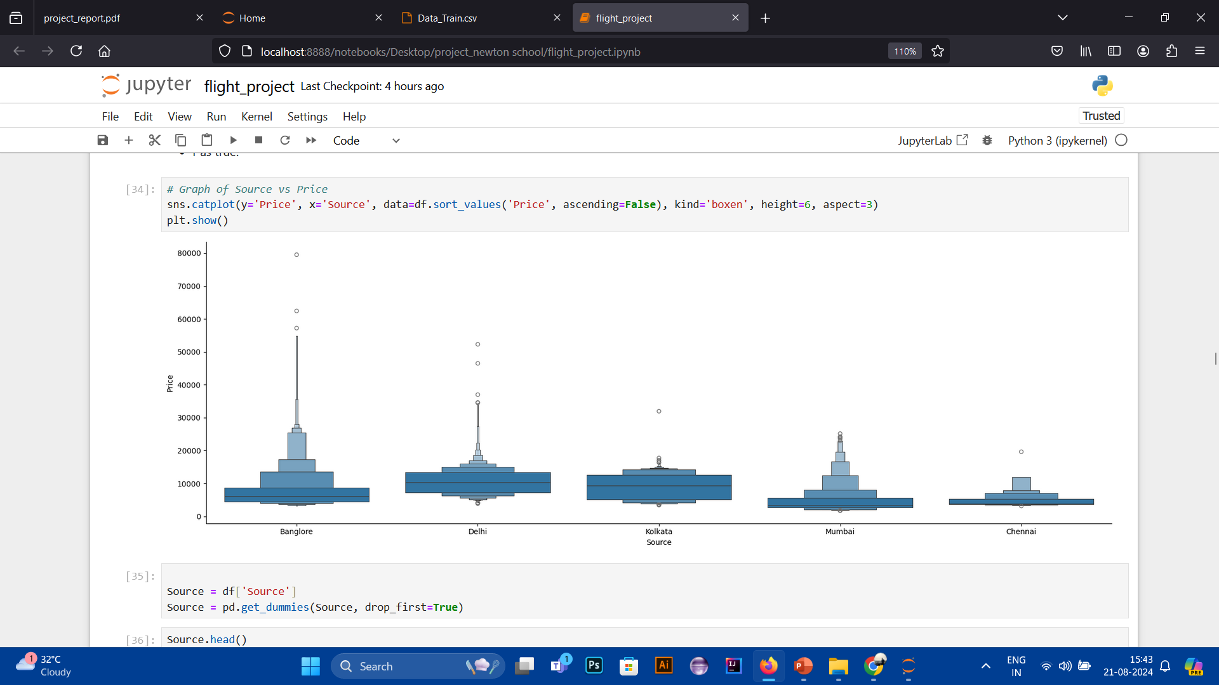
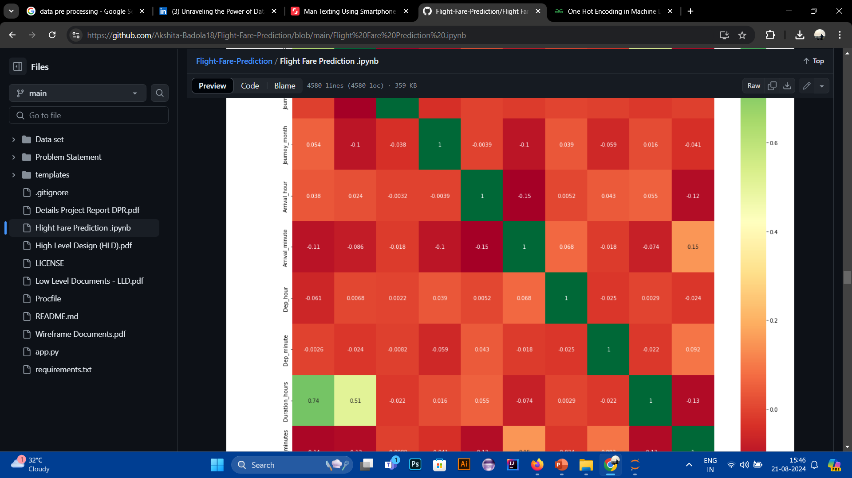
Heatmap and graphs using seaborn

Slide 8


Feature engineering and model fitting
Feature engineering is the process of selecting, manipulating and transforming raw data into features that can be used in supervised learning. It can tell which feature we can select so that our model can predict in a better way.
we pre-processed the test dataset with the similar methods which we have done previously using EDA to transform dataframes.
We used ExtraTreesRegressor() which is a ensemble learning method of decision trees where each tree is trained on a random subset of training data.

Slide 9

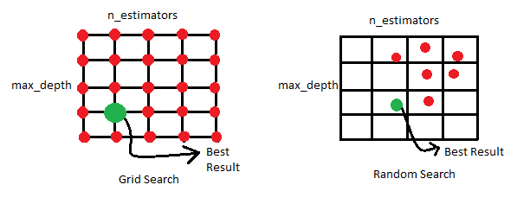
Algorithms
Random Forest Regressor is used in the model fitting.
After that I used RandomSearchCV and GridSearchCV as the hyper-parameter tuning of the model and to test the r2_score and prediction of the model.
Loss function used are MSE,RMSE,MAE.

Slide 10


Insights
While performing data pre-processing the dataset contained multiple columns.
In the model fitting the arrival time and departure time played an important role in the change of fare in the flights.
Source and destination showed how many people or traffic is generating from which source so that prices are increasing in those sources.

Slide 11

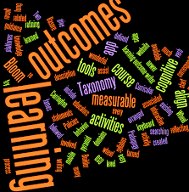
Learning Outcomes and Possible Optimizations.
We can use boosting techniques such as XG-Boost and Gradient boosting techniques to improve the prediction capacity of our model.
Loss functions plays an important role in deciding the model quality.
This model was a balanced model with r2 score nearing 80 and 85 in training and testing respectively.
Hyperparameter training improves the model accuracy drastically.

Slide 12


Possible Errors and Problems Faced.
Not able to plot the heatmap of categorical data due to problem in matplotlib and seaborn, able to plot once but afterwards failed.
%matplotlib inline was not working in the system.
Cross-validation method was taking so much time to complete and after few attempts it gives 40 values but not able to give the remaining 10 data points.
Environment was causing problem due to which few problems occurred.

