Slide 1

Highradius (Highway to Highradius) Internship Program
ETP CSH301
Radharaman sharma(HRC70686W)

Slide 2

CERTIFICATE

Slide 3
Highradius is a Fintech enterprise Software-as-a-Service (SaaS) company that leverages Artificial Intelligence-based Autonomous Systems to help companies automate Accounts Receivable and Treasury processes.
About the organization

Slide 4
Roles and responsibility
My role was of full stack developer
Designing Backend API
Designing ML Model for prediction clear date of invoices
Designing Web UI using react

Slide 5
AI-Enabled FinTech B2B Invoice Management Application.
The Web Application Development internship project's goal was to create a full-stack invoice management application using Reacts, JDBC, Java, and Servlets.
In predefined templates, user should be able to delete data from chosen rows, add and edit data in the grid's editable fields.
On the bills, user should be able to perform searching operations. Receivables Dashboard should friendly. Grids can be used to visualize data.

Slide 6
Model used in our project
XGBoost, which stands for Extreme Gradient Boosting, is a scalable, distributed gradient-boosted decision tree (GBDT) machine learning library. It provides parallel tree boosting and is the leading machine learning library for regression, classification, and ranking problems.

Slide 7
PANDAS
Pandas is an open-source,Python library providing high-performance, easy-to-use data structures and data analysis tools for the Python programming language.
Based on the features available in pandas we can say pandas is best for handling data. It can handle missing data, cleaning up the data and it supports multiple file formats. This means it can read or load data in many formats like CSV, Excel, SQL, etc.,

Slide 8
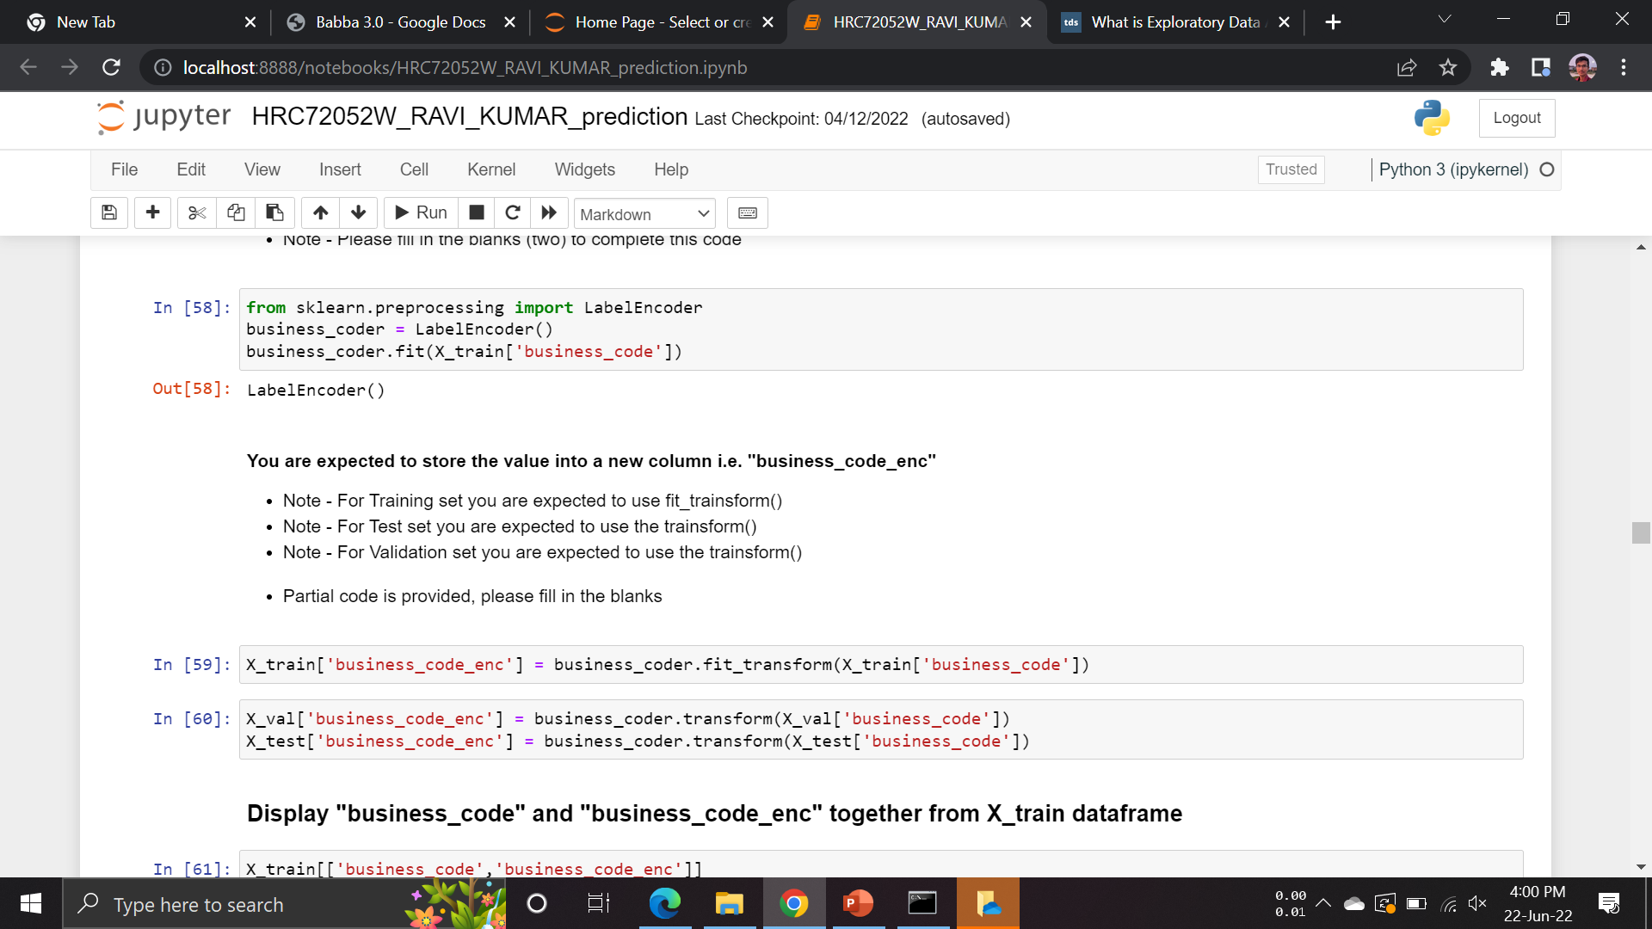
Feature Engineering
Feature engineering is the pre-processing step of machine learning, which is used to transform raw data into features that can be used for creating a predictive model using Machine.
Higher efficiency of the model.
Easier for Algorithms to detect patterns in the data.

Slide 9
Modelling
Model Name | MSE Score | R2 Score
Linear Regression | 5892217736457.772 | 0.04
Support Vector Regression | 6158583195817.059 | -0.00
Decision Tree Regressor | 9950439885575.129 | -0.62
Random Forest Regressor | 5204471668252.681 | 0.15
XGB Regressor | 4886939138791.15 | 0.20
Choose model with less Mean Square Error score and high r2 score

Slide 10
Learning Outcomes
Learned to Build ML Model Using Real World Dataset
Learned To Work With Frontend And Backend Technologies
Learned To Understand Dataset• Learned To Build API

Slide 11
Thank YOU!

