Slide 1
6G
By Ramanand Kachhia

Slide 2

What is 6G?
6th generation of wireless network
Maximum data rate up to 9.6 Gb/sec
Deliver 1000 times faster then 5G

Slide 3
Expectation
Terabit per second
Communication will be short range.
Core Networking

Slide 4
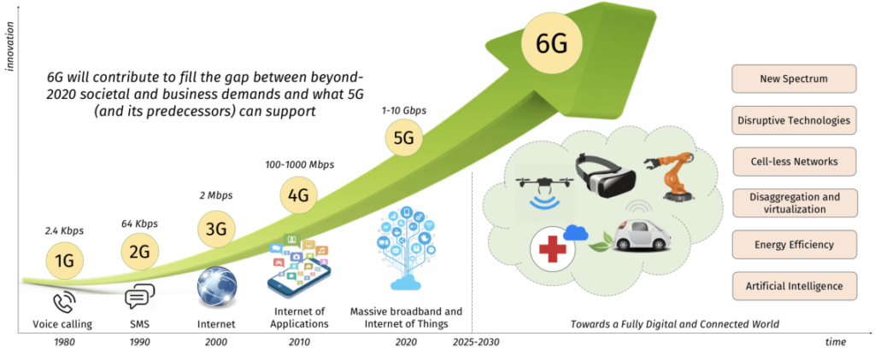
https://images.app.goo.gl/8jTy8Cczyjgh7y8h9

Slide 5
When 6G will be in Public
As per report, it will be implemented by 2030.
Technology need to be tested before it is launch
South Koreas Electronic and Telecommunication

Slide 6
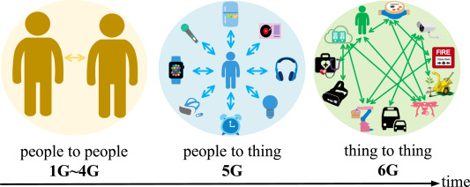
Advantages
Supports a greater number of mobile connections
faster data rates
Healthcare Will Be Revolutionized
Frequencies that are separate from each other
Large Areas of Coverage
https://www.google.com/search?q=features+of+6g+technology&tbm=isch&hl=en&sa=X&ved=2ahUKEwit8ca4naX2AhVKyxQKHRahClIQrNwCKAB6BQgBEOwB&biw=1903&bih=933#imgrc=PND4G-M6NDISwM

Slide 7
Disadvantages
It's a hassle to use.
Issues with Privacy and Compatibility.
Expensive
Affects plane connectivity.

Slide 8
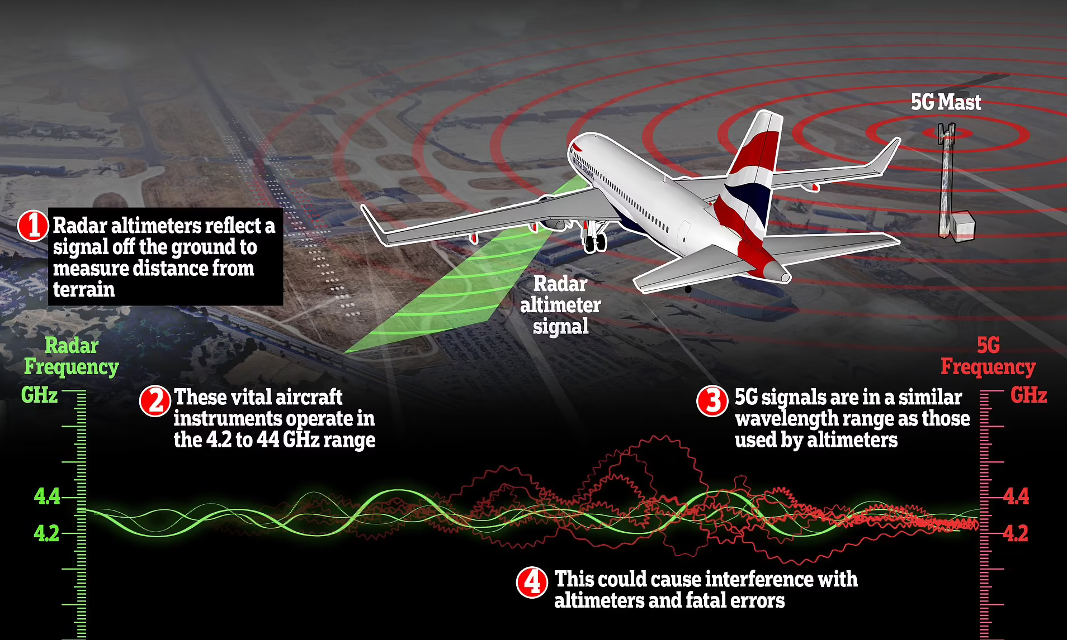
https://www.google.com/search?q=5g+plane+interference&sxsrf=APq-WBvCODm-w6sfqujK4IFUipYKNFyhUQ:1646148491287&source=lnms&tbm=isch&sa=X&ved=2ahUKEwiDisiAnaX2AhXNO-wKHaB9B2gQ_AUoBHoECAEQBg&biw=1920&bih=933&dpr=2#imgrc=e9Bk9zl30SX2dM

Slide 9
Sources:
https://www.techtarget.com/searchnetworking/definition/6G#:~:text=6G%20networks%20will%20be%20able,%2D%2D%20than%20one%20millisecond%20throughput.
https://www.maketecheasier.com/what-is-6g/
https://www.highspeedinternet.com/resources/6g-internet

Slide 10
Thank you

