Slide 1

Basic Details of the Team and Problem Statement
Ministry: Department of Empowerment of Persons with Disabilities (Divyangjan), Ministry of Social Justice and Empowerment
PS Code: RK759
Problem Statement: Enabling alternative accessible strategies for persons with speech impairment.
Team Name: Team SignBes
Team Leader: Ramanand Anand Mohare
Institute Code (AISHE): C-15688
Institute Name: Nagesh Karajagi Orchid College of Engineering and Technology, Solapur
Theme Name: Smart Education

Slide 2
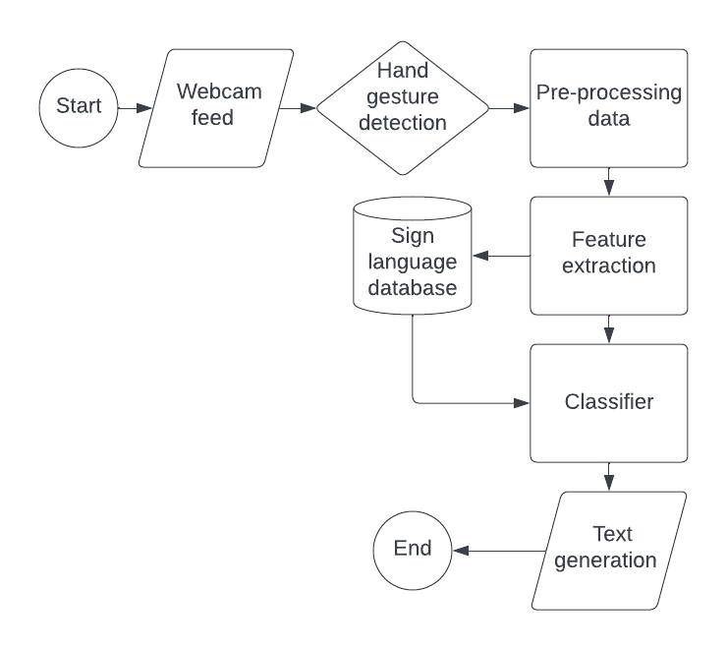
Approach Details
Process Flow Chart:
Idea: To build a web application where users can make use of various facilities to overcome their speech impairment.
Web application makes use of ML-based text prediction for sign language gestures.
Predicted text can be used to generate its voice output and the user can save it for future use, for smooth communication.
Speech can be converted into text and translated into any language with the help of a web speech API.
The application can be used as an AAC (Augmentative and Alternative Communication) device that makes use of virtual picture boards to communicate in public/private places.
Users can build flexible communication boards as they want for better communication.
Virtual picture boards will make use of NLP to generate sentences that can be converted to speech.
Based on the user location identified by the application it will suggest user some sentences which can be used for most of the scenarios based on location.
For Example, frequently used sentences to communicate in a restaurant
The application will provide users with 100+ 3D models to learn sign language. Fun questions can be used in common phrases and everyday greetings.
For Example, Thank You, Good Morning
Technology stack:
Programming language: Python
Framework: Flask, Scikit-learn, TensorFlow, OpenCV
Front-end tools: HTML5, CSS3, Bootstrap, JavaScript
Database: MySQL
Server: Gunicorn

Slide 3
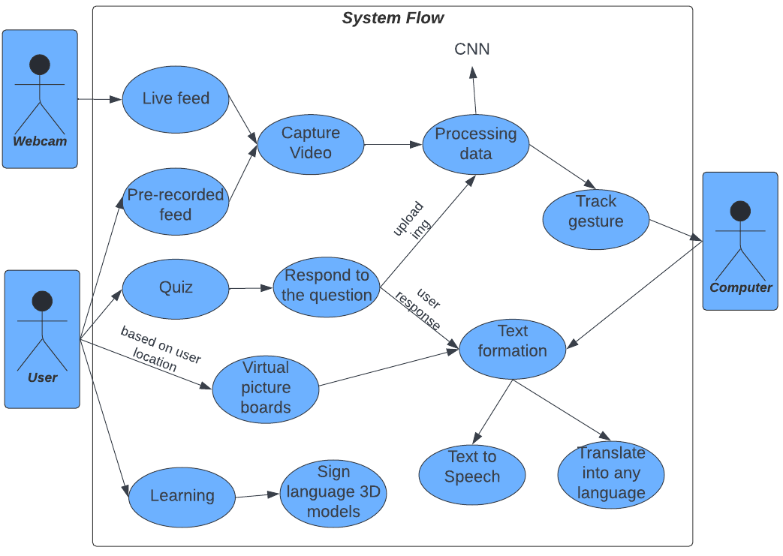
Approach Details
Use Cases:
Dependencies:
Internet connectivity
Latest browser
Smartphone/Desktop with web camera
Show Stopper:
Old graphics card
New sign language gesture

Slide 4
Team Member Details
Team Leader: Ramanand Anand Mohare
Branch: B.Tech Stream: CSE Year: III
Team Member1: Pranoti Saudagar Pawar
Branch: B.Tech Stream: CSE Year: III
Team Member2: Zeba Akhtar Mohd.Iqbal Bagban
Branch: B.Tech Stream: CSE Year: III
Team Member3: Sampada Sanjay Tikale
Branch: B.Tech Stream: CSE Year: II
Team Member4: Rachana Ravishankar Mangalaram
Branch: B.Tech Stream: CSE Year: II
Team Member5: Pruthvi Suresh Rathod
Branch: B.Tech Stream: CSE Year: II
Team Mentor1: Prof. M. S. Otari
Category: Academic Expertise: ML Domain Experience: 12 years
Team Mentor2: Girish Arun Patil
Category: Industry Expertise: AI/ML Domain Experience: 3 years

