Slide 1
Presentation on Fashion Redefined with Virtual Grooming and Shopping Assistant Presented by- 1. Ramanand Anand Mohare(Leader) 2. Pranoti Saudagar Pawar 3. Rohit Rajendra Shriram 4. Shruti Manohar Potraj

Slide 2
Contents
Introduction
Objective
Uniqueness
Social impact
Applications
Technology Stack

Slide 3
Introduction
In this modern era, everybody wants to be dress-up in a way that reflects their personality. Nowadays, fashion has become a standard statement. But it's quite difficult to choose one perfect outfit from the millions of outfits available out there.
To overcome up this problem we came up with the solution where the machine will analyze your physical appearance and the event details and suggest you the best outfits. So through this Web Application, we are aiming to provide your favorite style at your fingertips.

Slide 4
Objective
Our Salient features are :
To provide you assistant which will interact with the user and suggest the best available outfits.
Take user’s picture and recognize their skin tone and suggest the outfits.
And also recommend suitable accessories according to their outfits.

Slide 5
Uniqueness
Chatbot will continuously throw unique patterns of questions to users and keep them engaged to gain access to user details about their choices.
Recommend trending outfits, which are suitable to their skin tone.
Under add to Wish list button users can add the outfits which they liked.

Slide 6
Social Impact
Various fashion designers can collaborate with us to grow their business.
More reliable for the dealer to export the outfits in a particular region according to the data analysis.
It makes users more reliable to buy the outfits.
It also consumes the human workforce.

Slide 7
Applications
It can easily study the patterns from the interaction that the chatbot made with a user.
It performs image analysis to recommend the suitable outfit according to the user’s physique and style preferences.
Its time consuming as a user don’t have to surf on any site for a long nor visiting the shop physically to choose their outfits.
Webpage serves the user’s as their personal stylist.

Slide 8
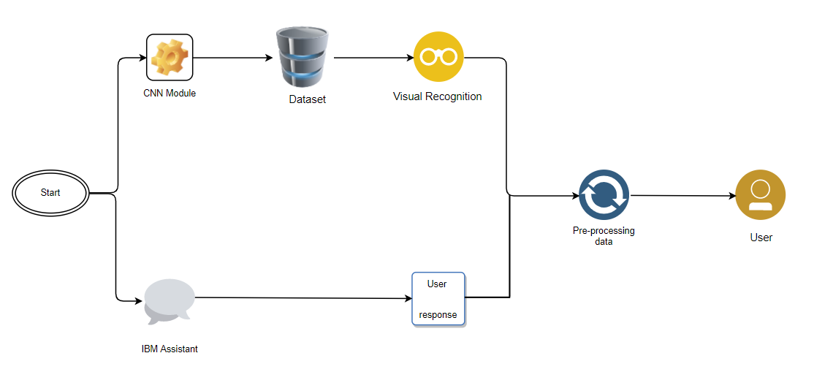
Technology Stack

Slide 9
Scope of Work
The scope of the study is vast; the study aims to understand the skin tones and the outfits suitable for the events.
Improving the outfit recommendations by training machine algorithm.
It is extremely important that machine should provide and give the good outfit recommendations and set a user-friendly environment in the module.

Slide 10
Thank You

