Slide 1
Expense Tracker App
Visit site: https://ramandeepchamba.github.io/expense-tracker-react/
Source code: https://github.com/RamandeepChamba/expense-tracker-react

Slide 2
Technologies Used
React
Styling: Styled Components
Vite
Using useReducer + ContextAPI for state.

Slide 3
File Structure
/src: has all source code.
/src/styles: has Global styles and mixins for styled components.
Mixins stores breakpoints mixins that we use for responsive media queries in our styled components.
/src/ui: has generic reusable components that we are using throughout the app like: Button, Select etc.
/src/App.jsx: our main component, has useReducer and our state context.
/src/categoriesOptions.js: stores categories constants that we are using for income and expenses.

Slide 4
State
Lives in /src/App.jsx and is provided using useReducer + Context API.
Contains:
transactions: array containing all our income and expenses.
showForm: whether to show add/update transaction form.
typeToAdd: "income" or "expense", used by form to determine what type of transaction we are adding, so to display relevant categories options for select.
transactionToUpdate: will be set to transaction object when we'll be updating one.

Slide 5
justAddedUpdatedTransaction: object that holds id of transaction that was just added or updated and status: "added" or "updated". Using it to animate newly added or updated transaction.
incomeFilters: object containing filters to apply on incomes.
expenseFilters: object containing filters to apply on expenses.

Slide 6
How app works

Slide 7
Adding an income
User clicks Add income button
Action of type: "openAddTransactionForm"with payload: "income" is dispatched
Following state is updated:
showForm: true
typeToAdd: "income"
Hide form, add transaction to transactions, set justAddedUpdatedTransaction to newly added transaction, so it will be animated, reset typeToAdd to "", Stats are updated reflecting state changes.
On submit, make transaction object using data in form fields with unique id and dispatch action of type: "addTransaction" and payload: transaction object
Form is displayed in a modal window. As typeToAdd is income, shows income categories as category select field options. transactionToUpdate is null so we'll be adding not updating.

Slide 8
Adding an expense
User clicks Add expense button
Action of type: "openAddTransactionForm"with payload: "expense" is dispatched
Following state is updated:
showForm: true
typeToAdd: "expense"
On submit, make transaction object using data in form fields with unique id, amount to negative as it is an expense and dispatch action of type: "addTransaction" and payload: transaction object
Hide form, add transaction to transactions, set justAddedUpdatedTransaction to newly added transaction, so it will be animated, reset typeToAdd to "", Stats are updated reflecting state changes.
Form is displayed in a modal window. As typeToAdd is expense, shows expense categories as category select field options. transactionToUpdate is null so we'll be adding not updating.

Slide 9
Updating an income/expense
Action of type: "openUpdateTransactionForm" with payload: transaction to update, is dispatched
User clicks Update button of transaction
Following state is updated:
showForm: true
transactionToUpdate: payload
Hide form, modify transaction in transactions, set justAddedUpdatedTransaction to newly updated transaction, so it will be animated, transactionToUpdate to null, Stats are updated reflecting state changes.
On submit, make transaction object using data in form fields with transactionToUpdate id and dispatch action of type: "updateTransaction" and payload: updated transaction object
Form is displayed in a modal window. Type is determined from transactionToUpdate and fields are pre-filled using the same. We are updating

Slide 10
Deleting an income/expense
Dispatch "deleteTransaction" action with payload: id of transaction to be deleted, after 400ms using setTimeout
User clicks Delete button of transaction
Add "deleting" class to the selected transaction element, so it can be animated.
Transaction is deleted from the state, Stats and other UI reflects these changes

Slide 11
Filter incomes/expenses by categories
User selects categories from select input filter on income or expense section, can select more than one
"addIncomeFilter" or "addExpenseFilter" action is dispatched depending on what was selected, payload: {category: values}
As state changes, derived state visibleIncomeTransactions or visibleExpenseTransactions is recalculated by applying category filters to transactions in state.
This change in visible transactions is reflected in Stats and transactions list whether incomes or expenses, depending on what was filtered.

Slide 12
Animating transaction on add, update
On "addTransaction" or "updateTransaction" action dispatch
Set justAddedUpdatedTransaction in state to {id: id of said transaction, status: "added" or "updated"}
As state updates, each <Item> component (one for each transaction) will render or re-render.
On mount or on state change it will check if it is the just added or updated one by matching it's id with id in justAddedUpdatedTransaction. If it is, relevant class is added based on justAddedUpdatedTransaction.status, and the animation starts.
After 3 seconds, using setTimeout, this class is removed and "finishedAddingUpdatingAnimation" action is dispatched which sets justAddedUpdatedTransaction to null in state, so that animation classes are not added again.

Slide 13
How to use the app

Slide 14
Adding an income or expense

Slide 15
Adding Income or Expense:
Click Add Income or Add Expense button.
Form will open in a modal window and will show different categories to select depending on what is being added.
Fill the form with date, description, amount and category and submit.
Form will close, new transaction will slide-in in UI and stats will update.

Slide 16
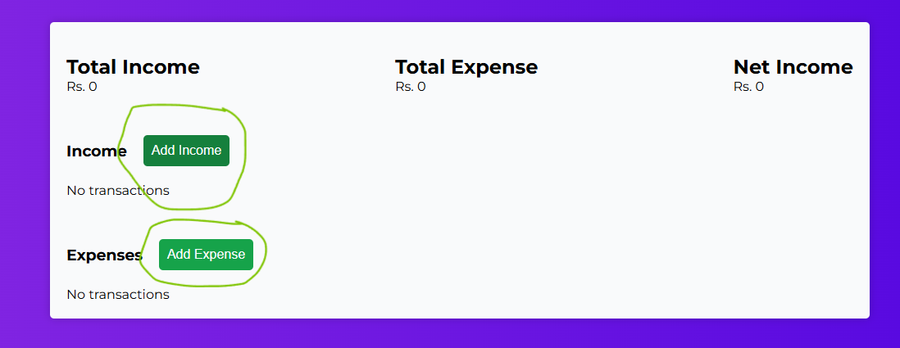

Slide 17
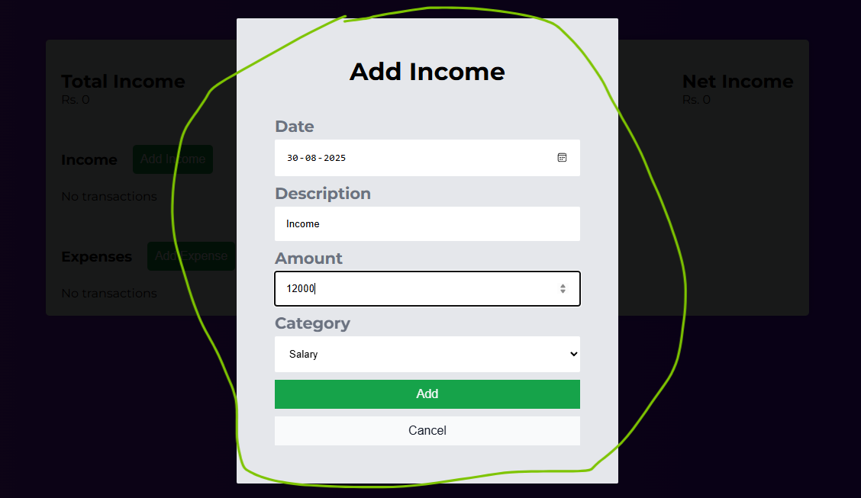

Slide 18
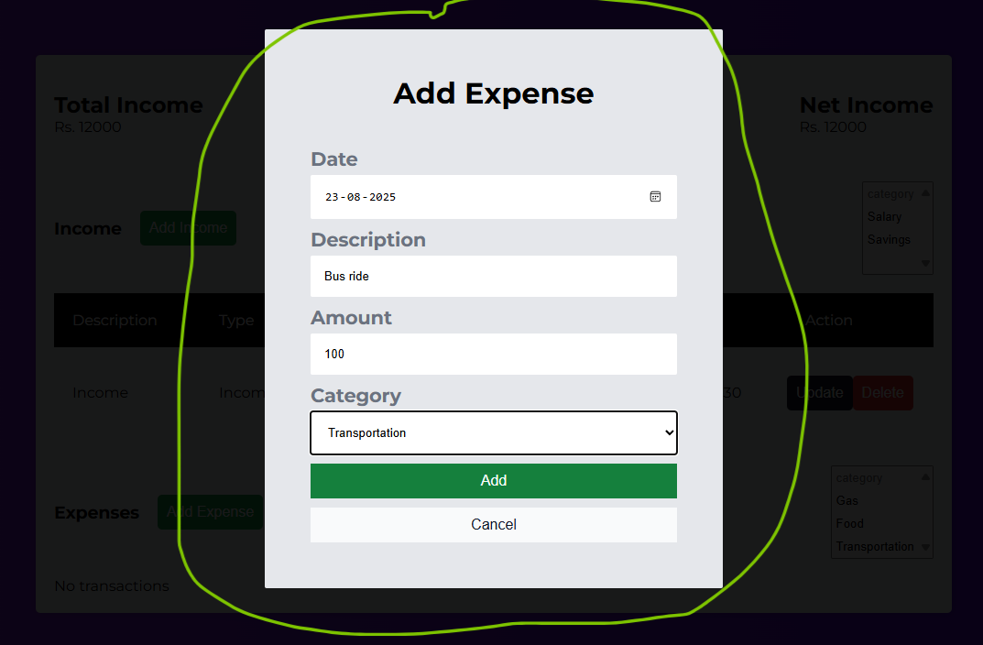

Slide 19
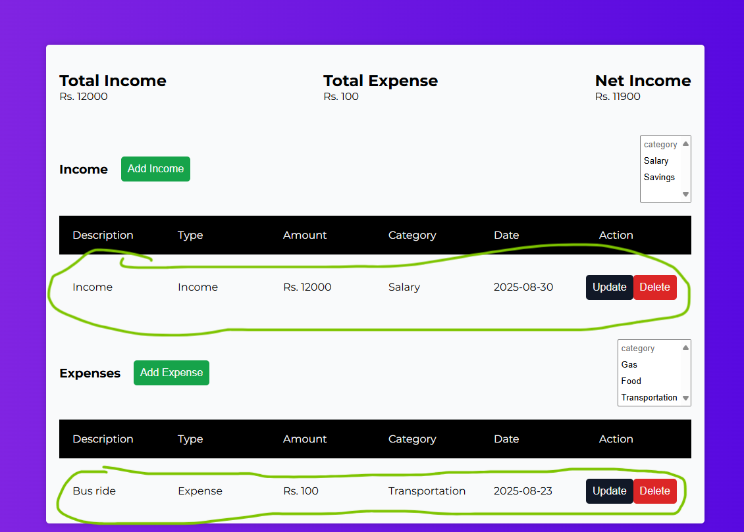

Slide 20
Updating an income or expense

Slide 21
Updating Income or Expense:
Click update button from a transaction.
Form will open in a modal window with pre-filled data of the transaction.
Modify/Update data and submit the form.
Form will close, updated transaction will animate and Stats will update.

Slide 22
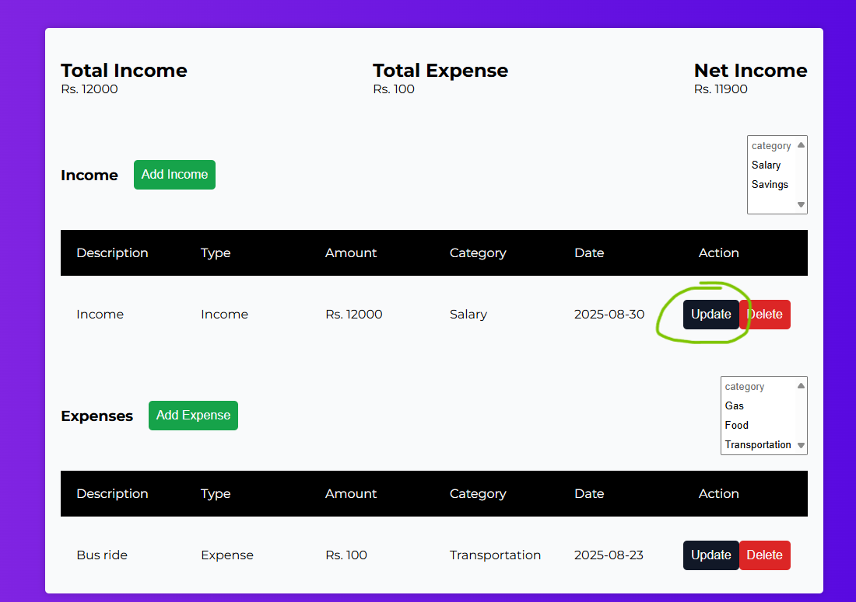

Slide 23
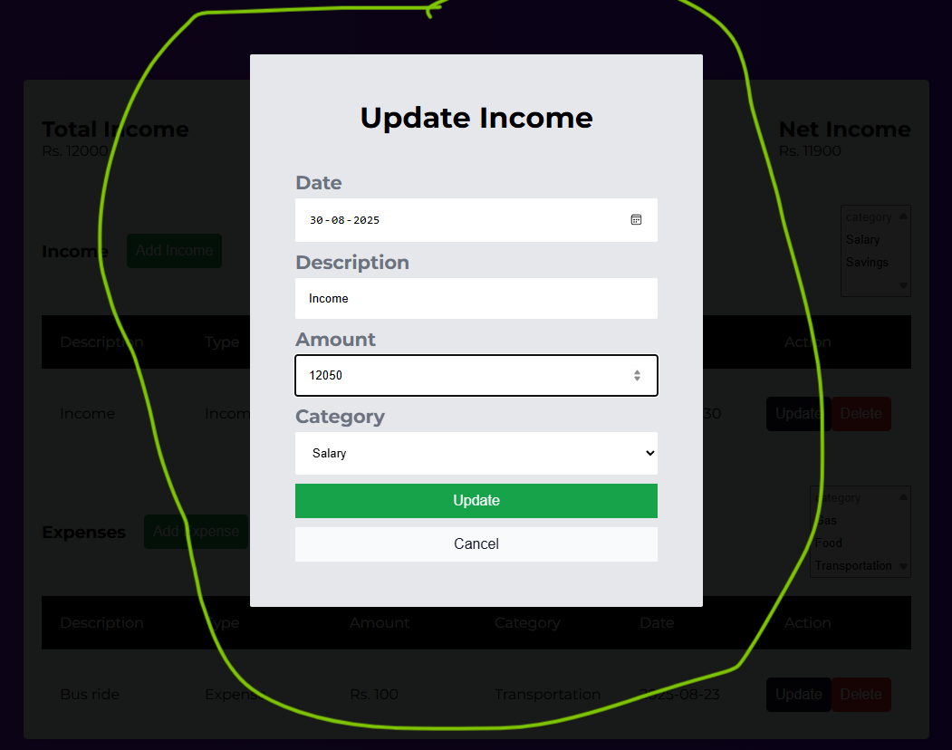

Slide 24
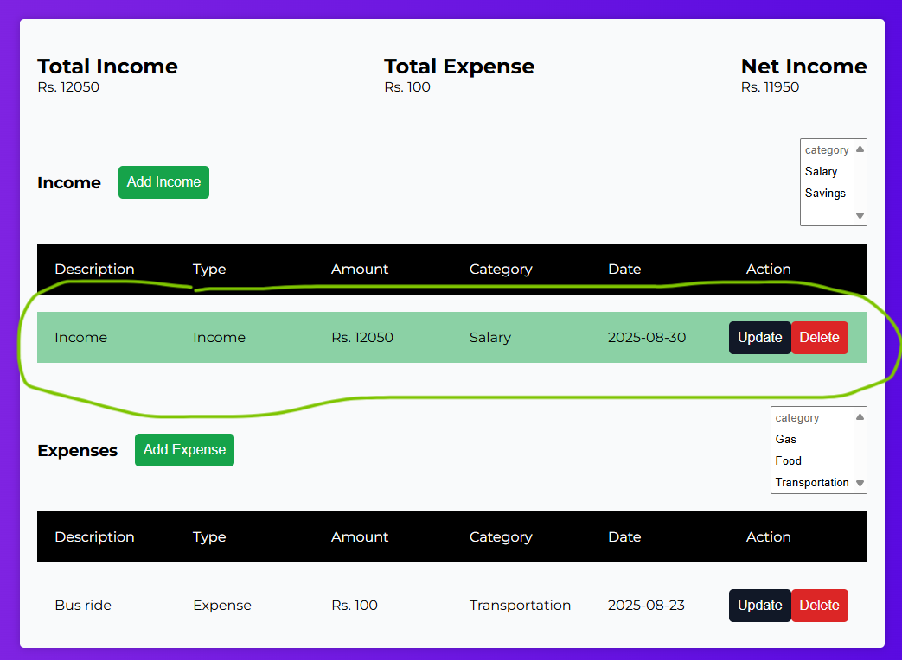

Slide 25
Delete an income or expense

Slide 26
Deleting an income/expense:
Click delete button from a transaction.
Transaction will slide-out and will be deleted, Stats will be updated.

Slide 27
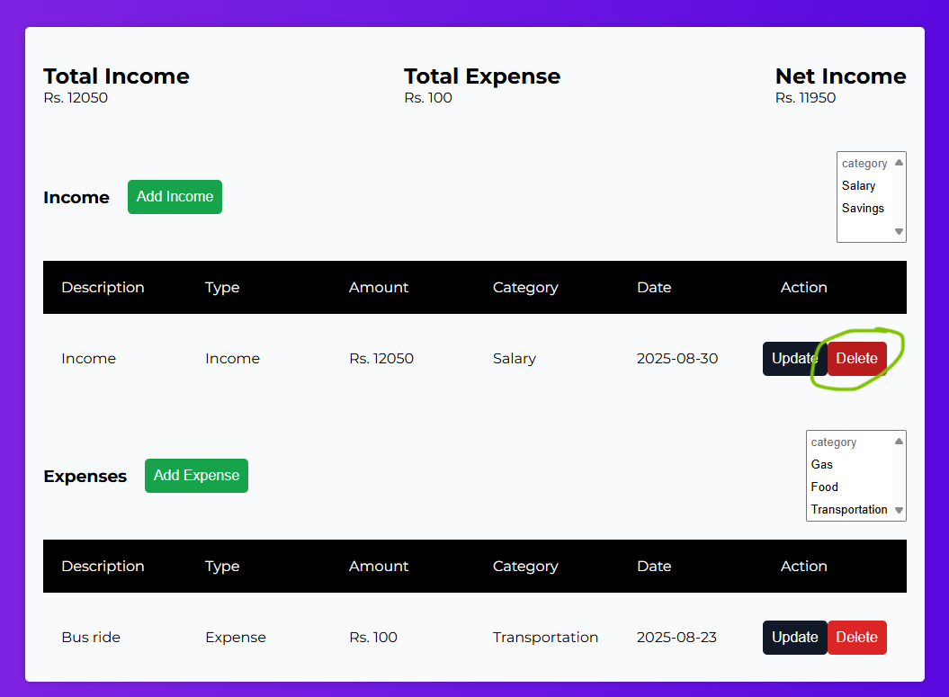

Slide 28
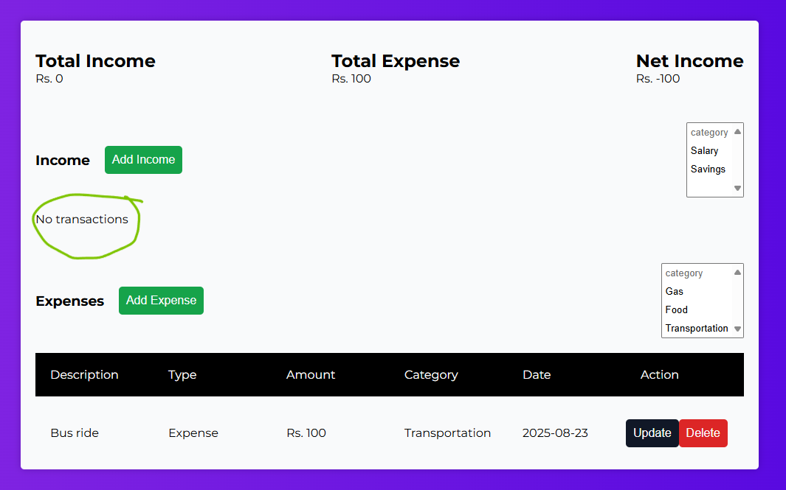

Slide 29
Filter incomes and/or expenses by category

Slide 30
Filter income and expenses by category:
Select one or more categories from select menu in Income or/and Expense areas.
Transactions will be filtered based on the categories selected and UI will only show filtered categories.
Stats will update based on visible (filtered) transactions.

Slide 31
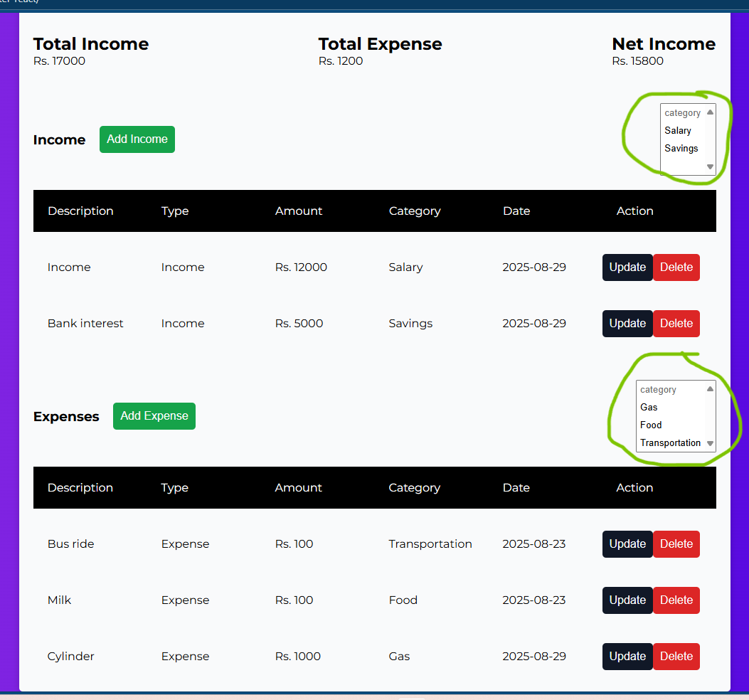

Slide 32
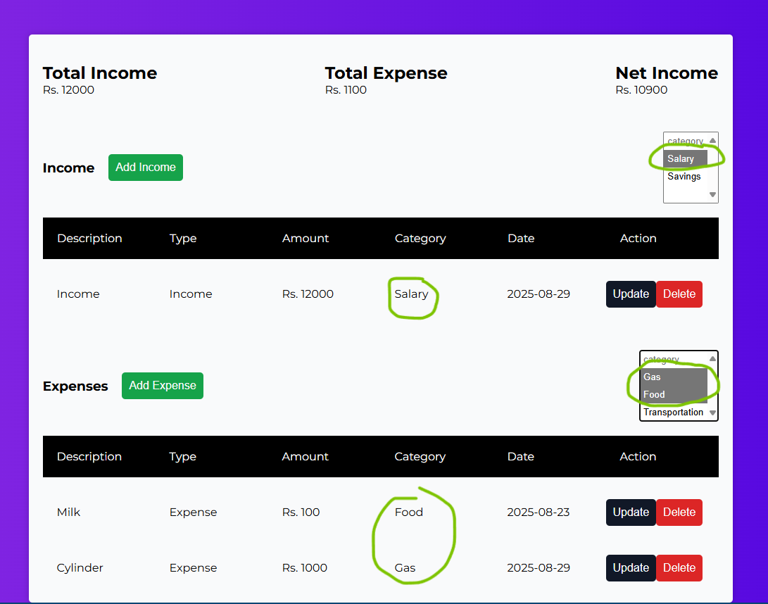

Slide 33
THE END

