Slide 1
Memory Card Game
Visit site: https://ramandeepchamba.github.io/memory-game-react/
Source code: https://github.com/RamandeepChamba/memory-game-react

Slide 2
Technologies used
React
Styling: styled components
Vite
Using useReducer + ContextAPI for state.

Slide 3
File Structure
/src: has all source code.
/src/styles: has Global styles and mixins for styled components.
Mixins stores breakpoints mixins that we use for responsive mediaqueries in our styled components.
/src/contexts/GameContext.jsx: has our reducer and game context, all our state lives here.
/src/assets: has images for our cards.
/src/components: has components used in our app.
/src/utils/helpers.js: has helper functions used in our app.

Slide 4
State
Lives in /src/contexts/GameContext.jsx and is provided using useReducer + ContextAPI.
Contains:
status: game status at current time.
movesCount: number of moves user has made.
timer: object that contains reference to setInterval tick and time elapsed since game started, in seconds.
firstCardClicked: Boolean, set to true when very first card is clicked, timer starts when first card is clicked.
cards: array that stores our card objects, card: {value: 1, isFacedUp: false}.
previousCard: stores the last turned card which is looking to pair.
tempCurrentCard: using when cards not matched and have to show clicked card for a second before facing it down.

Slide 5
How to play
Click New Game button.
Cards will be laid out faced-down, shuffled (random every game).
Click a card to face it up.
Clicking your first card will start the timer.
This card is now faced-up and is looking for a pair.
Click another card.
Move count is increased by 1, no matter if it matches or not.
If this new card matches our previous card, both cards remain faced-up.
If this new card is not a match, both this card and previous one will be faced-down.
Game ends when all cards are matched.

Slide 6
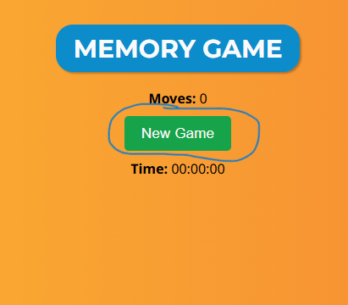
Start game

Slide 7
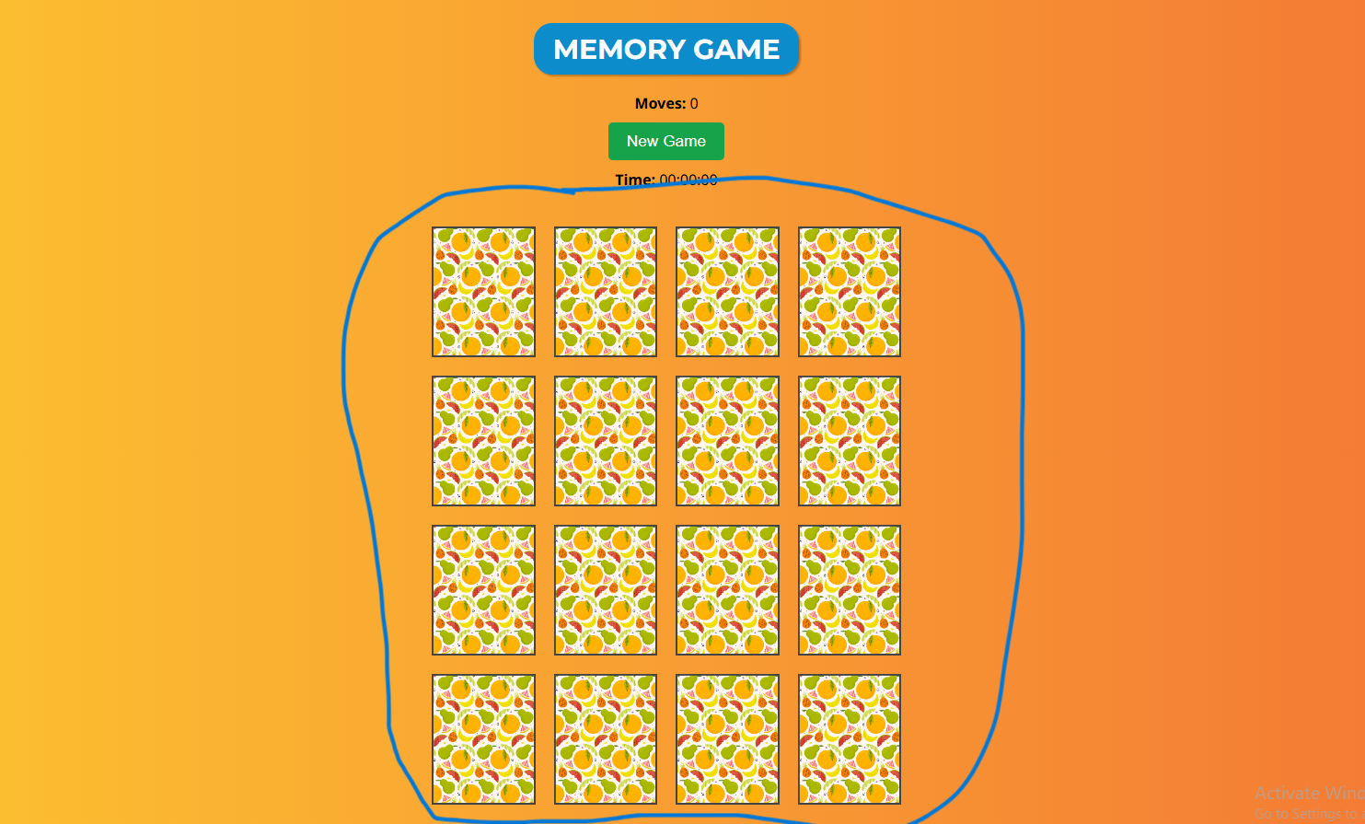
Cards are laid out (shuffled every game)

Slide 8
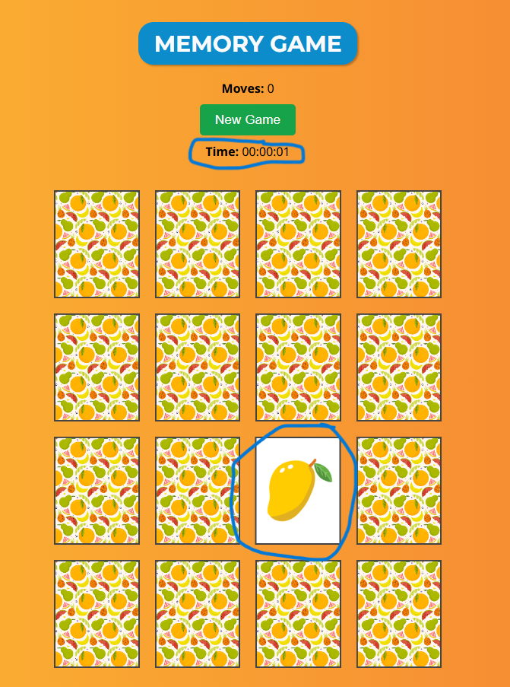
First card clicked, timer starts

Slide 9
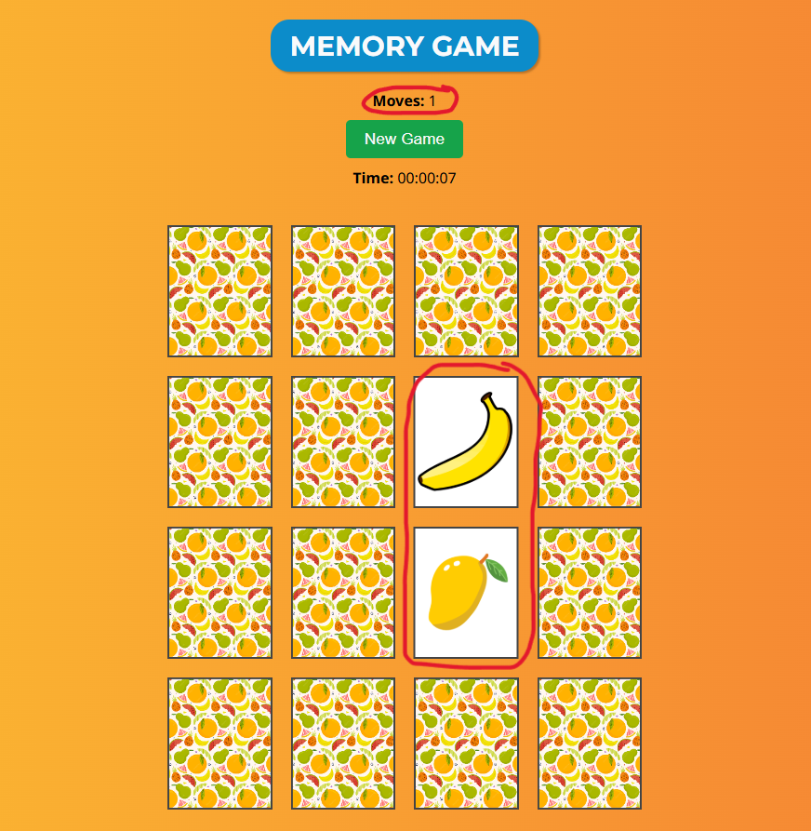
Cards did not match

Slide 10
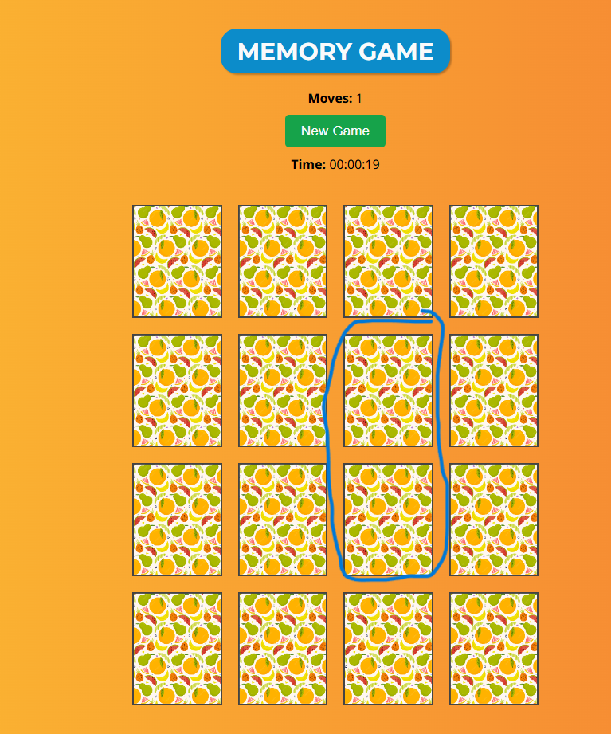
Face down unmatched cards

Slide 11
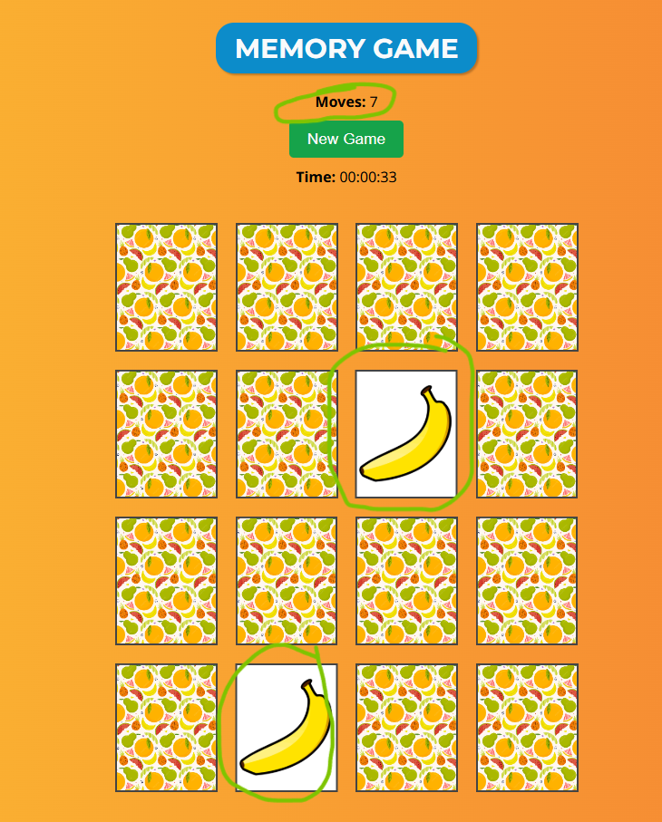
Cards matched

Slide 12
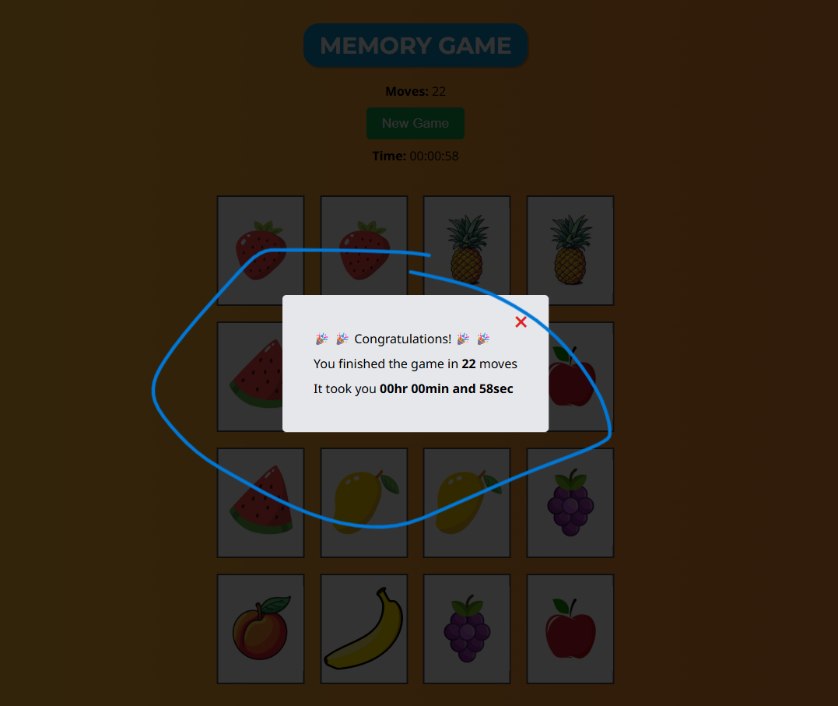
All cards matched, game ends

Slide 13
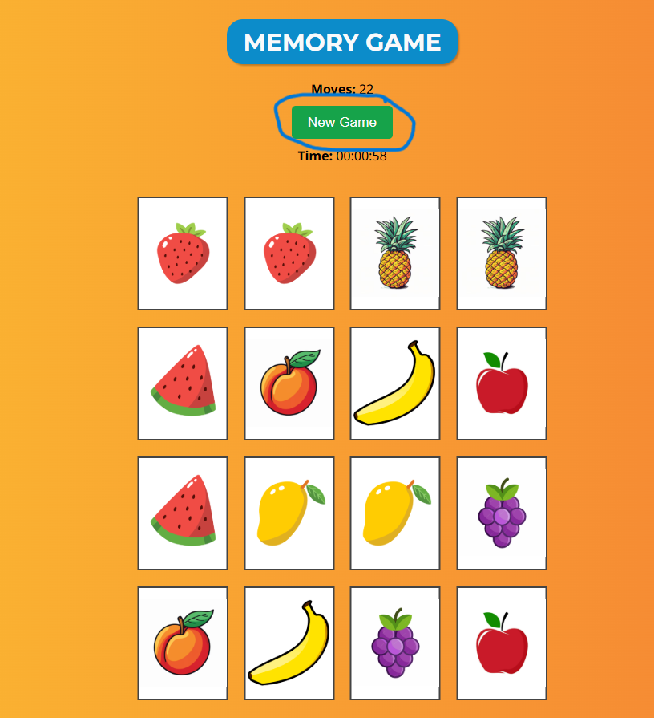
Start new game

Slide 14
How app works

Slide 15
How are cards placed randomly on every new game
There's an unshuffled array that contains pair of numbers from 1 to 8 e.g. [1,1,2,2...8,8], so that there are 16 cards and 8 pairs.
On every new game, an array is made containing the above numbers randomly placed.
We map this array to create cards in our state.
For every number – 1 we have an image e.g. 0: Apple, 1: Banana etc.
Logic to shuffle array is in /src/utils/helpers.js

Slide 16
How Timer works
When a card is clicked and it is the very first card clicked, create a setInterval which will dispatch "increaseTimer" action every second.
Store this interval reference in state (dispatch "timerStarted" action with this reference as payload).
On game end, clear this interval using reference, so the time will stop.
On new game, clear this interval and set time to 0 (initState).

Slide 17
New game started
Make shuffled array by shuffling original array (1,1,2,2...8,8).
Make cards array by mapping over shuffled array.
remove timer setInterval.
reset state to initState.
store our cards array in state.
change status to "playing"
As state updates, cards are rendered, faced-down.
New game button clicked​

Slide 18
Card Clicked
Card already faced up
There's a previous card, looking for pair
A card is clicked
No
Yes
Yes
No
Do nothing
Set this card as previous card and face it up

Slide 19
Face up current card for 500ms and then face it and the previous card down.
Increase move count. Achieving this by setting state status to "cardsDidNotMatch", tempCurrentCard to current card.
useEffect will react to this and will dispatch "cardsNotMatched" action after 500ms which will face down both tempCurrentCard and previous card. When status is "cardsDidNotMatch", no cards will be clickable because if they are it can break the game.
Does the current card matches prev. card
No
Yes
Did all cards matched, game ended?

Slide 20
Face up current card
Increase move count
Set previous card to null.
No
Yes
Face up this last current card.
Increase move count
Stop timer.
Change status to "ended"
Show game end screen
Game ended

Slide 21
THE END

