Slide 1
Student Teacher Booking App
Visit site: https://student-teacher-booking.netlify.app/
Source code: https://github.com/RamandeepChamba/student-teacher-booking

Slide 2
Technologies
Using React Router.
Using remote state and React Query.
For styling, using Styled Components.
react-hot-toast for alert messages.
Supabase: as a backend.

Slide 3
Routes
“/login”: To login as admin, student or teacher.
“/register”: To register as student.
All other routes are protected, via ProtectedRoute component,and only user with allowed role can access them.

Slide 4
Roles and routes they can access:
admin:
“/teachers”: displays teacher list, add teacher, update or delete.
“/students”: displays list of students that are waiting for approval for registration, can approve or reject.
teacher:
“/teacher/appointments”: views calendar with teacher’s appointments, can schedule appointments by selecting time slot on calendar.

Slide 5
student:
“/student/appointments”: shows logged in student’s appointments on calendar.
“/student/bookAppointment”: can search for a teacher and book an appointment with them.

Slide 6
File Structure
/src: has all the source code.
/src/contexts: contexts of our app.
/src/features: each feature (e.g. appointment, student, teacher etc.) have their own folder.
E.g. /src/features/student: will have all components and custom hooks related to student.
/src/pages: all components which are used as elements in our routes.
/src/services: Has supabase client setup and all calls to supabase.

Slide 7
/src/styles: has global styles and mixins for Styled Components.
/src/ui: contains all generic reusable components like Button, Modal etc.
/src/utils: contains helper functions used throughout the app.
/src/App.jsx: defines routes and is our main component.

Slide 8
State
AuthContext: stores our logged in user and provides this user, along with options to login, logout, to our entire app. ProtectedRoute component consumes this user and checks if they are authorized, otherwise redirect to login page.
All of our other state is remote, in supabase-as-backend, and is managed by React Query.

Slide 9
Components Documentation
Most documentation of components is under “/lld_docs”, map it to “/src”

Slide 10
How to use the app

Slide 11
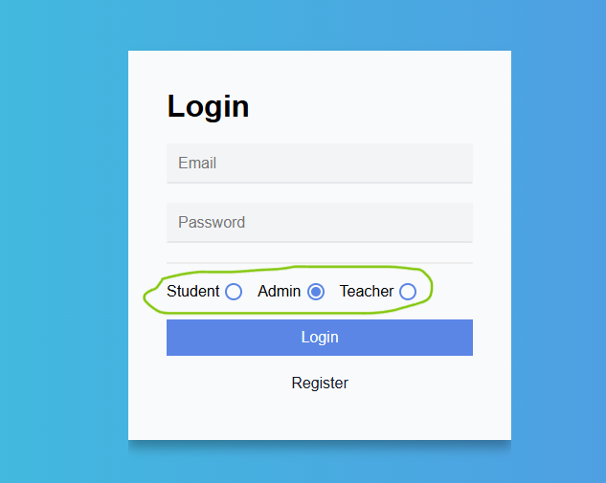
Login
you can login as different role i.e. admin, student, teacher.
Accounts you can use if you want to test:
Admin:
Email: admin@test.com
Password: 123
Student:
Email: vishal@test.com
Password: 123
Teacher:
Email: john@test.com
Password: 123

Slide 12
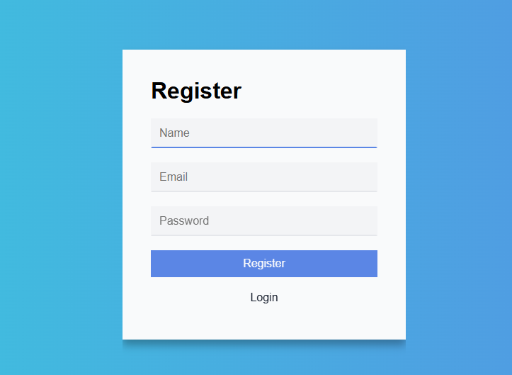
Registering a student
“/register”: this will register a student but you’ll need approval from admin before you can login.

Slide 13
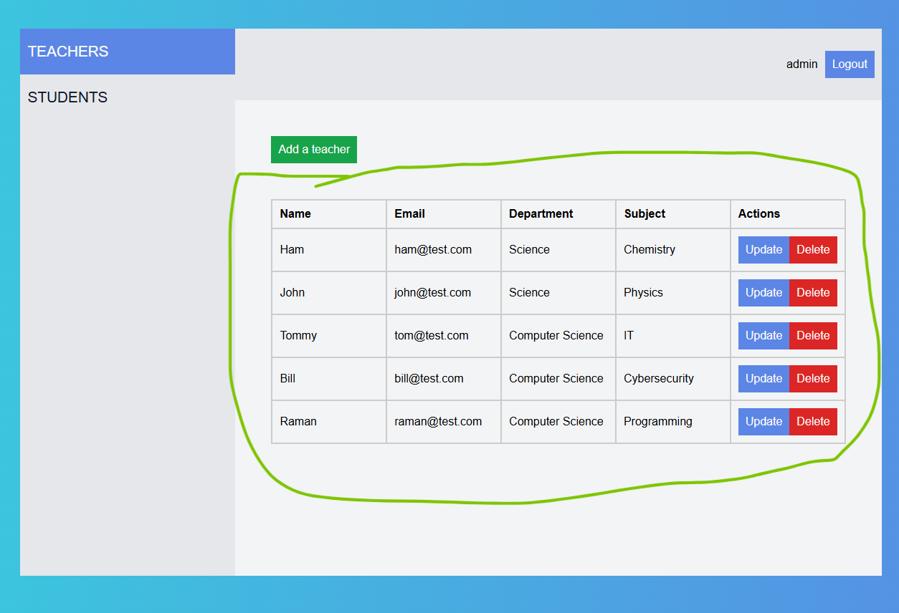
Admin Dashboard
View all teachers:

Slide 14
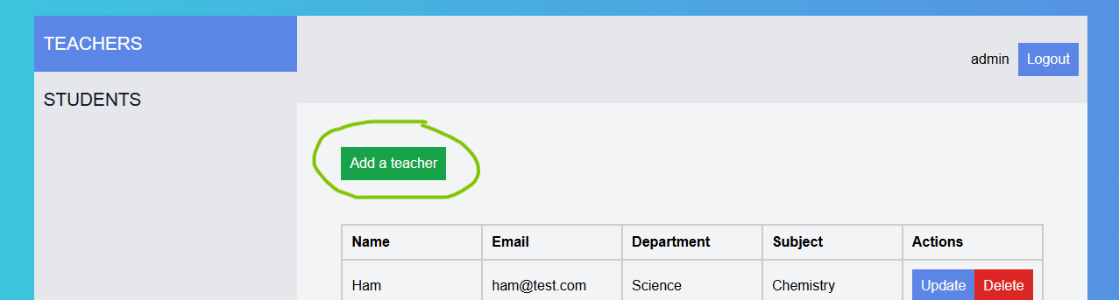
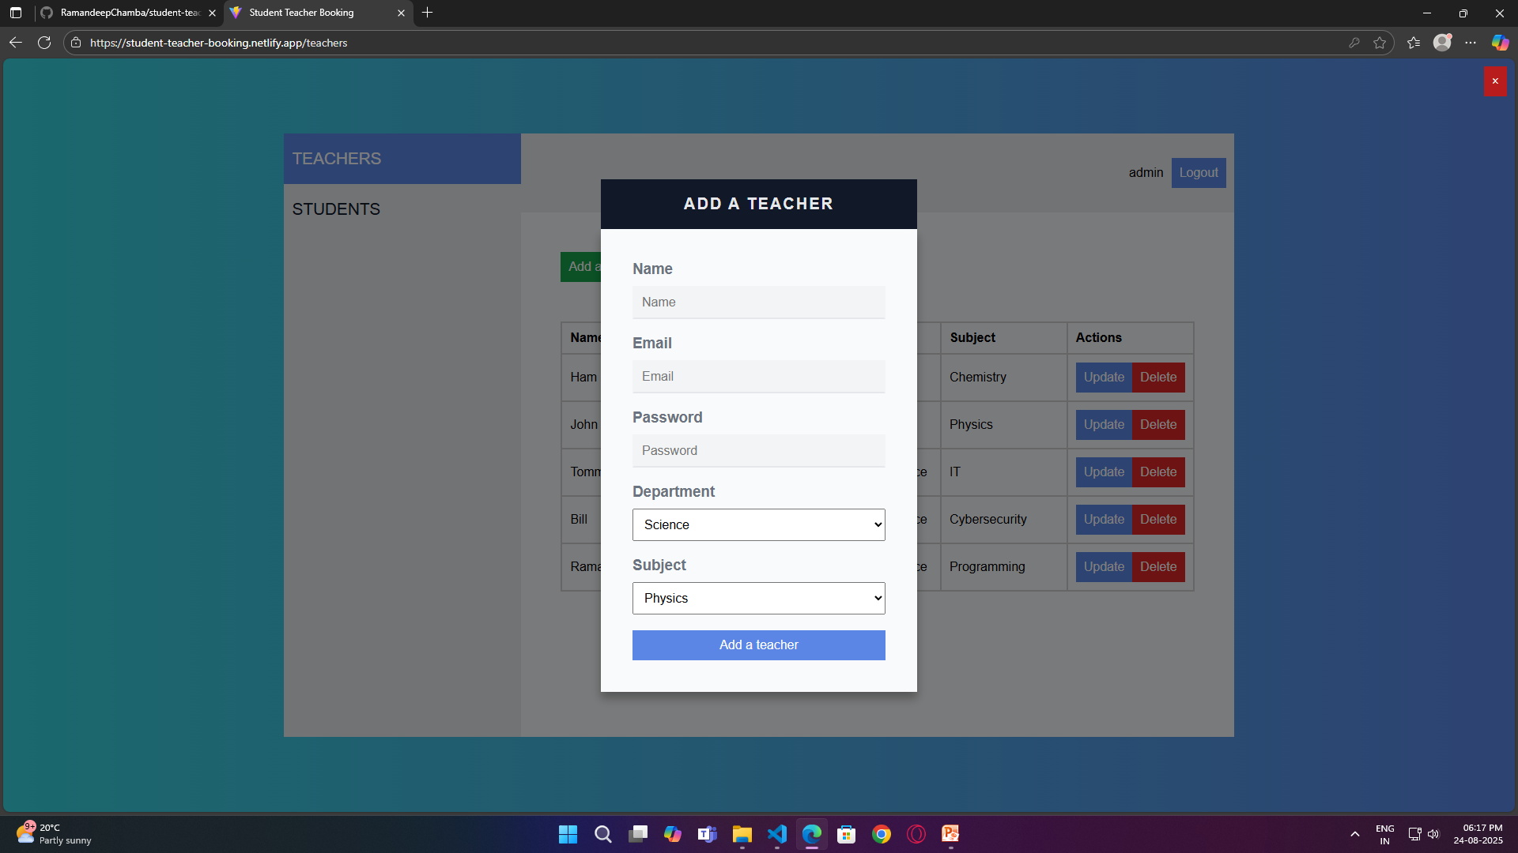
Add a teacher:

Slide 15
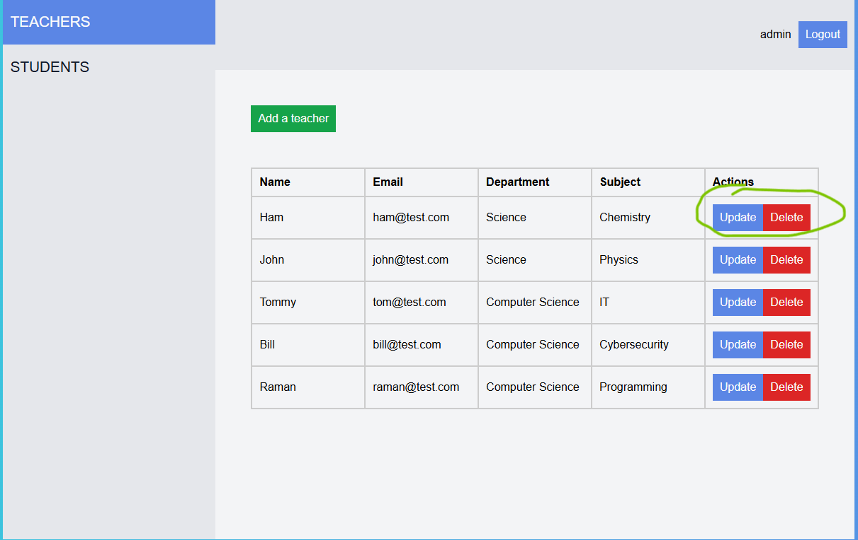
Update or delete a teacher:

Slide 16
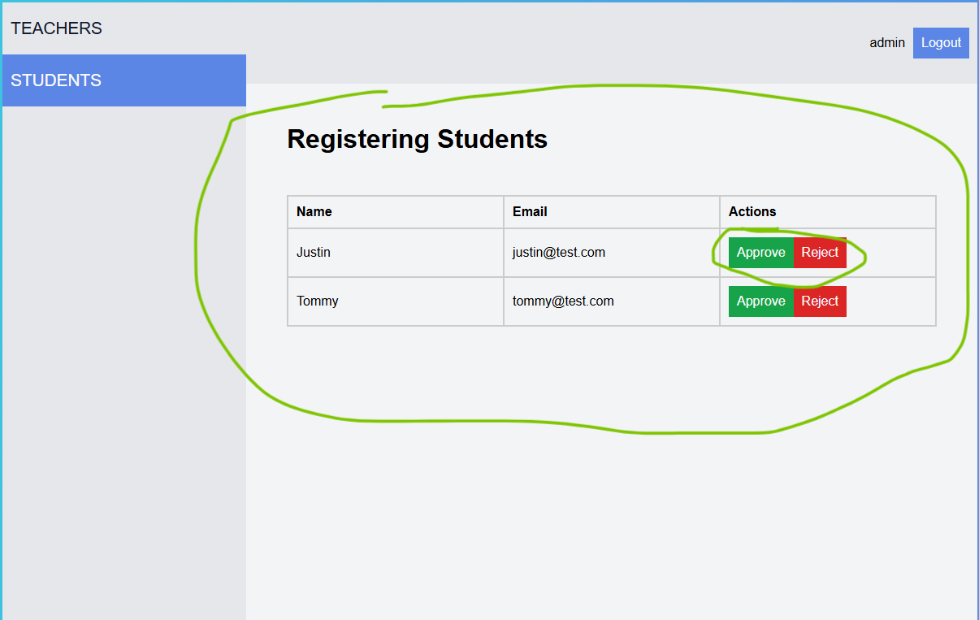
View, approve, reject registering students:

Slide 17
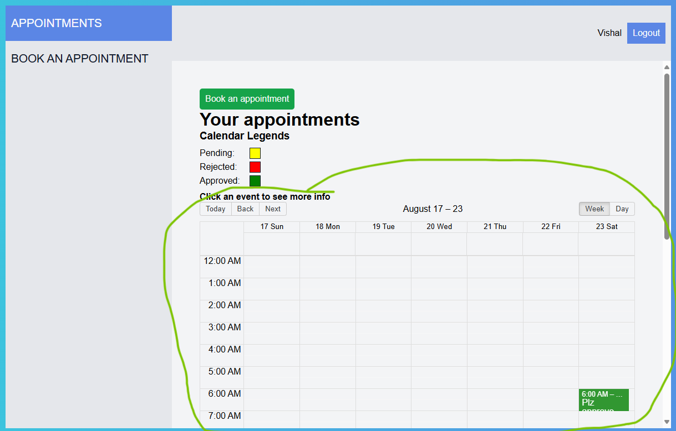
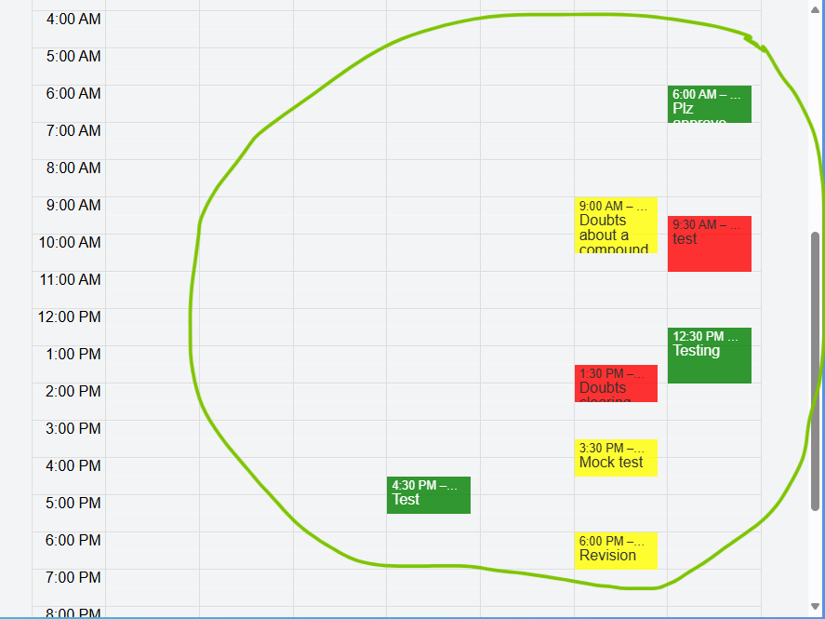
Student Dashboard
View appointments:

Slide 18
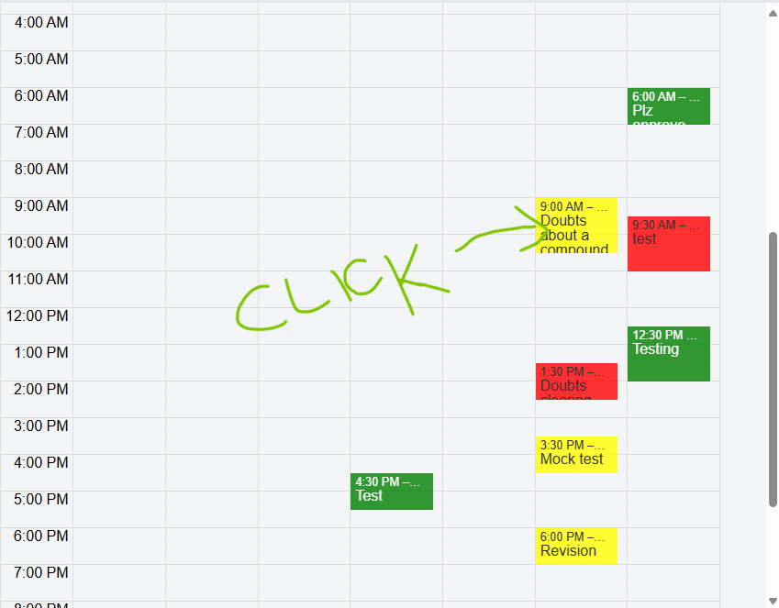
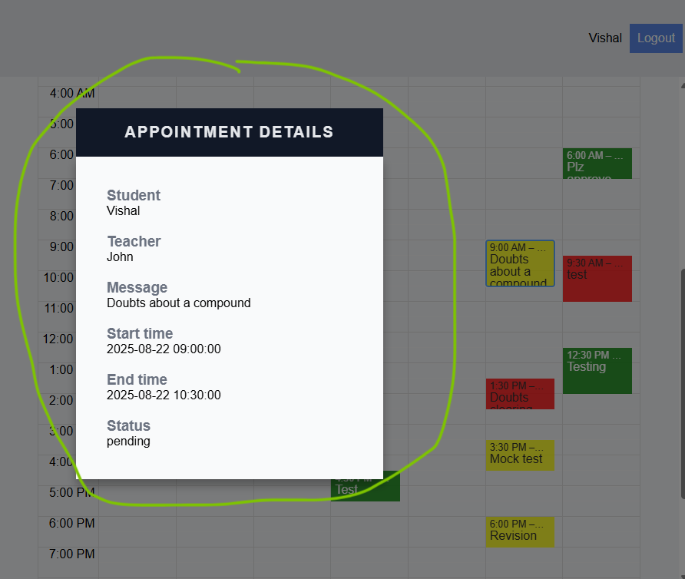
View appointment details:

Slide 19
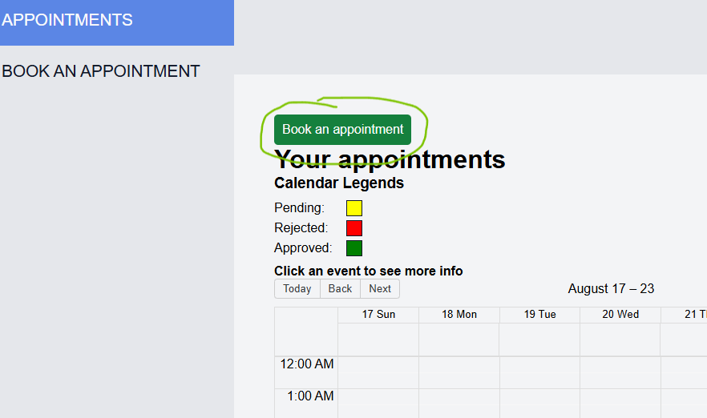
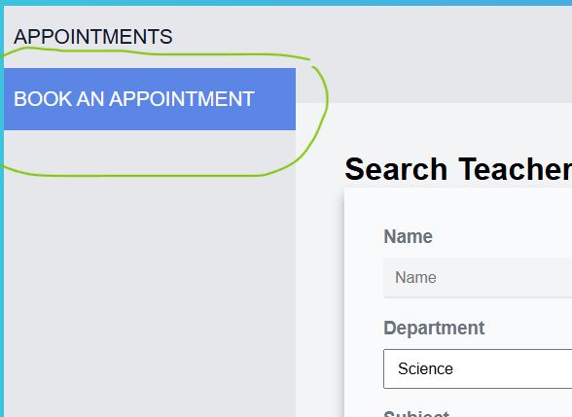
Book an appointment:
#1. Click Button or select tab from sidebar.
OR

Slide 20
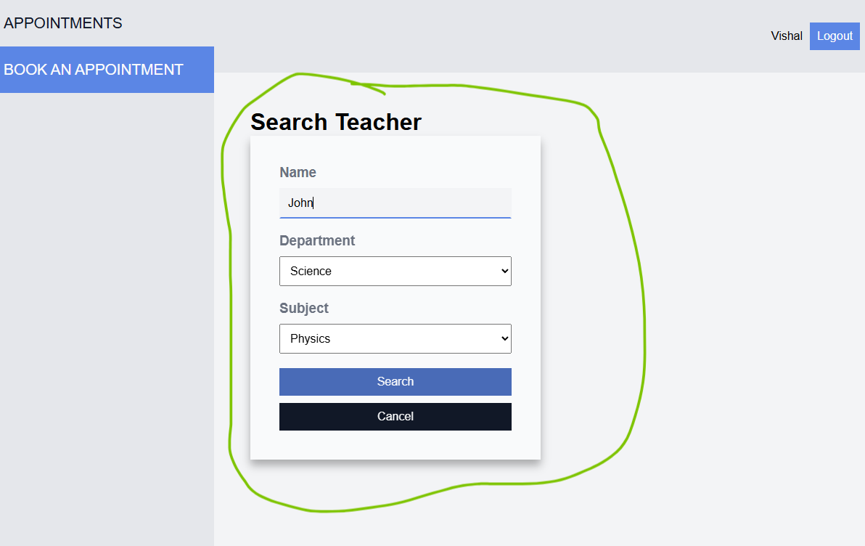
#2. Search for teacher to book appointment with:

Slide 21
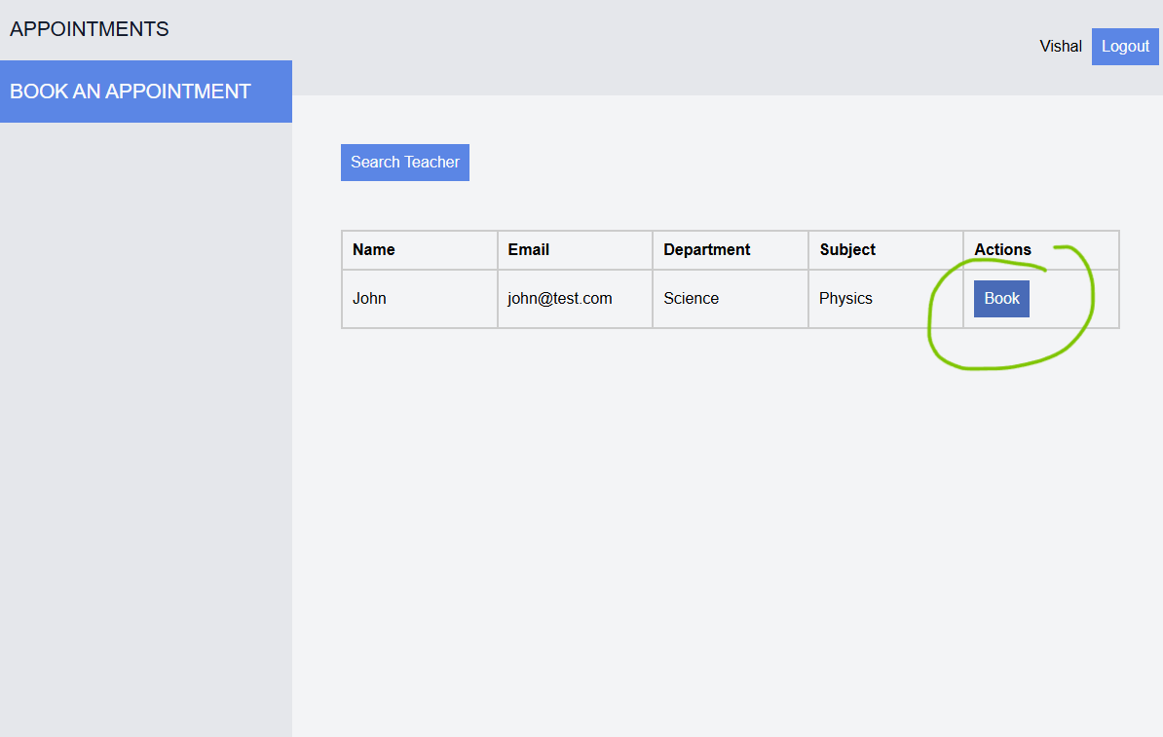
#3. Click Book Button of required teacher

Slide 22
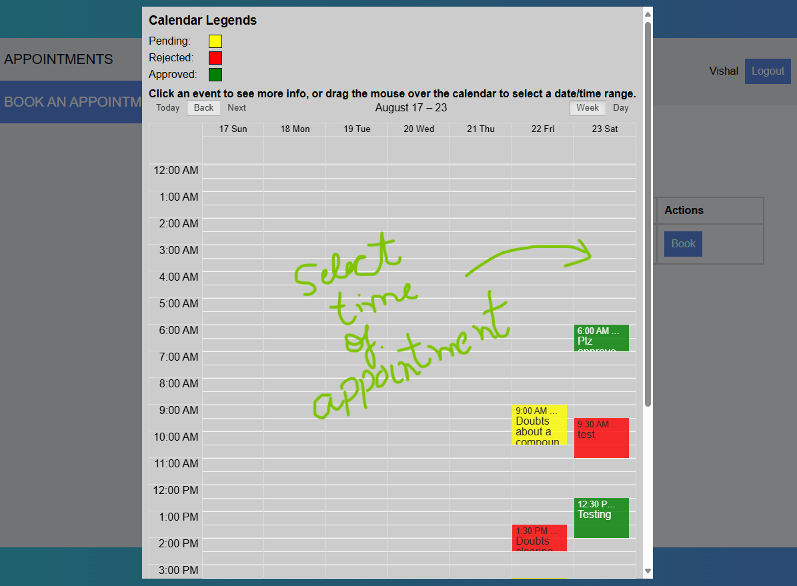
#4. Select time of appointment (click or drag the cells)

Slide 23
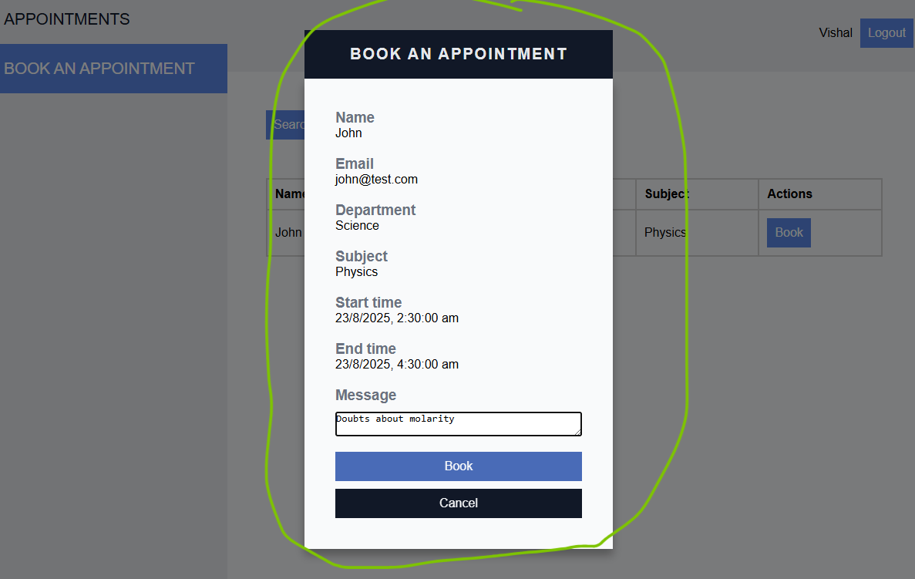
#5. Fill book appointment form and book it.

Slide 24
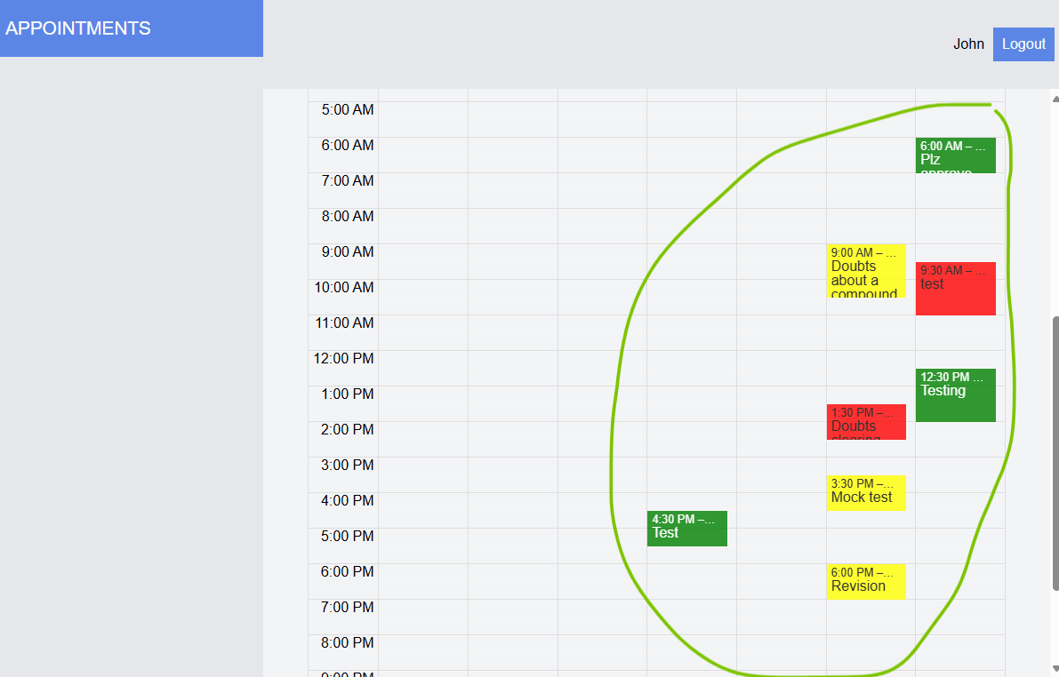
Teacher Dashboard
View appointments:

Slide 25
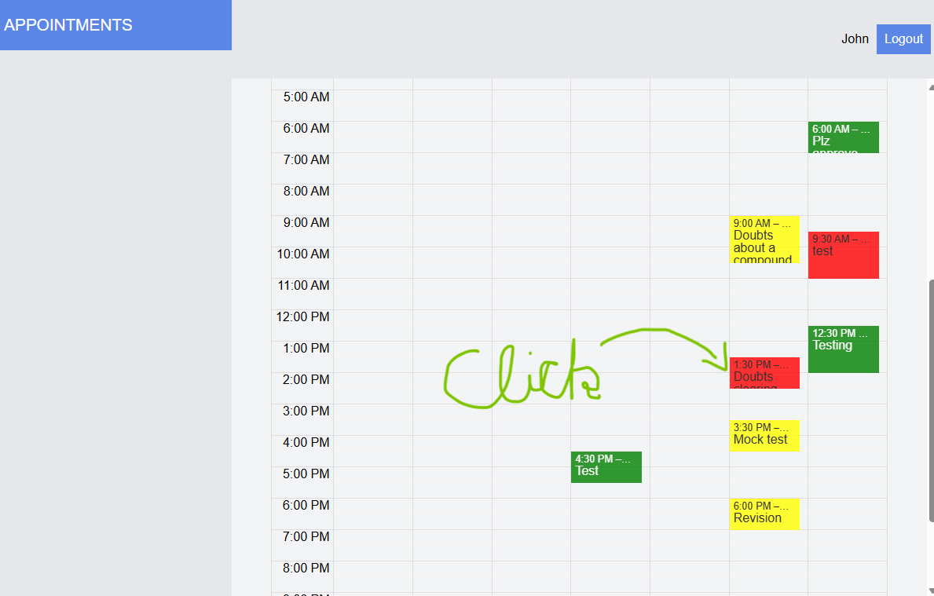
View appointment details:

Slide 26
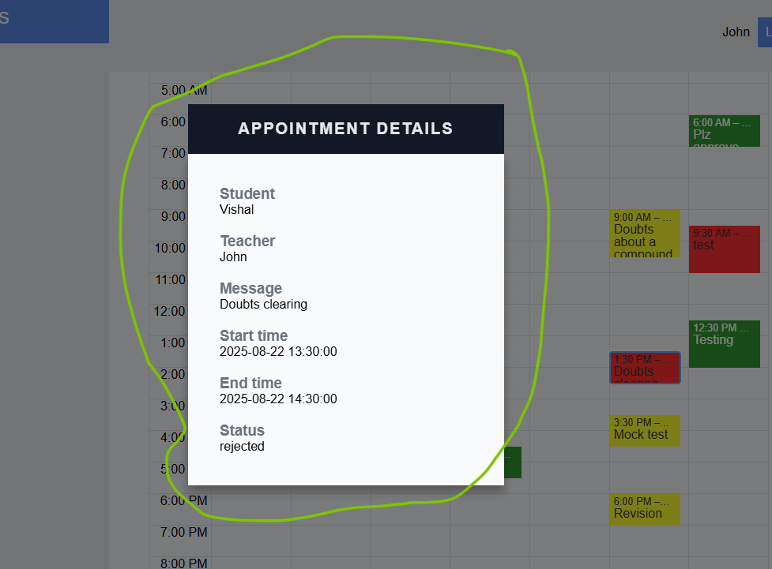

Slide 27
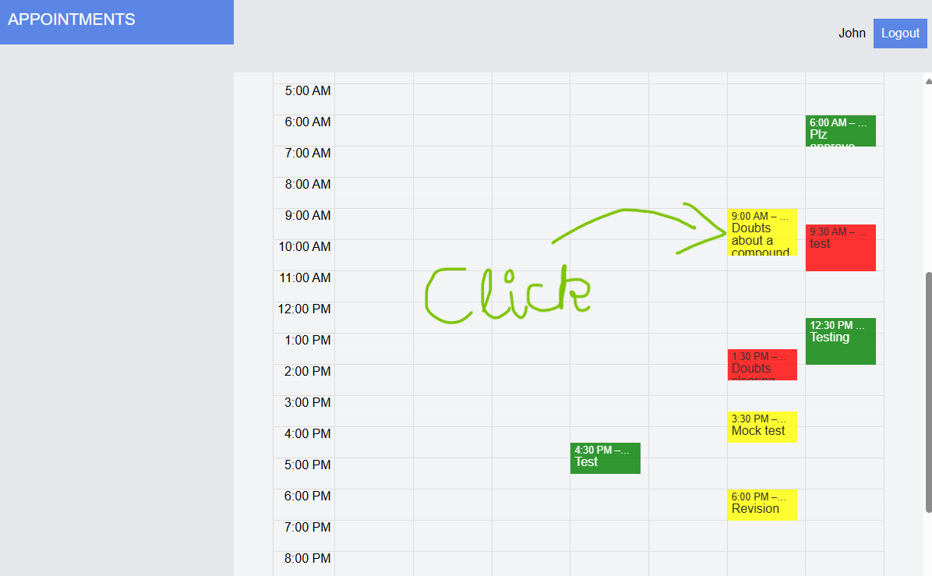
Approve or reject pending(yellow) appointments.

Slide 28
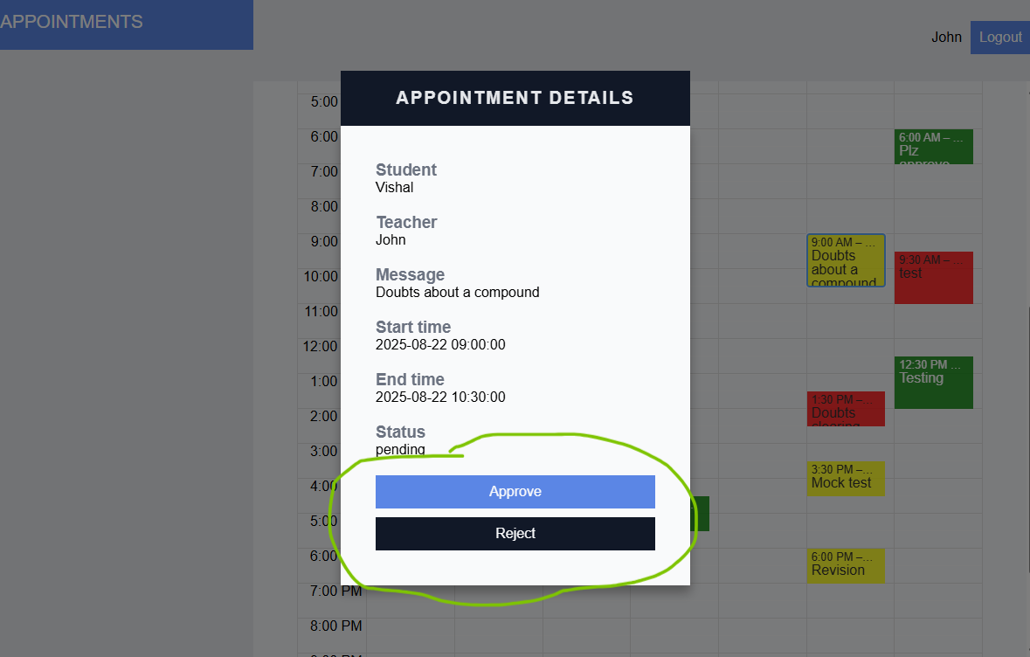

Slide 29
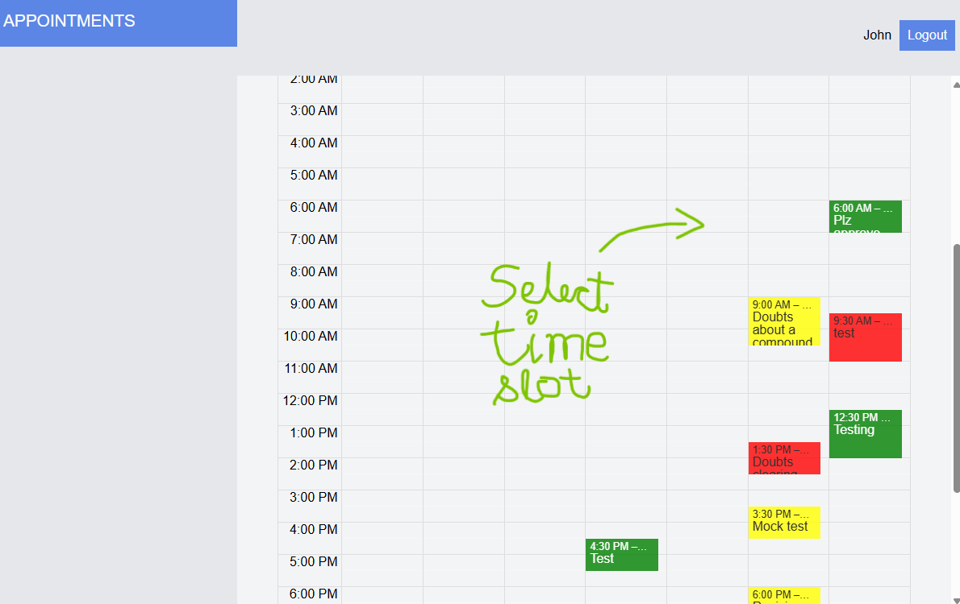
Schedule an appointment:
#1. Select time of appointment

Slide 30
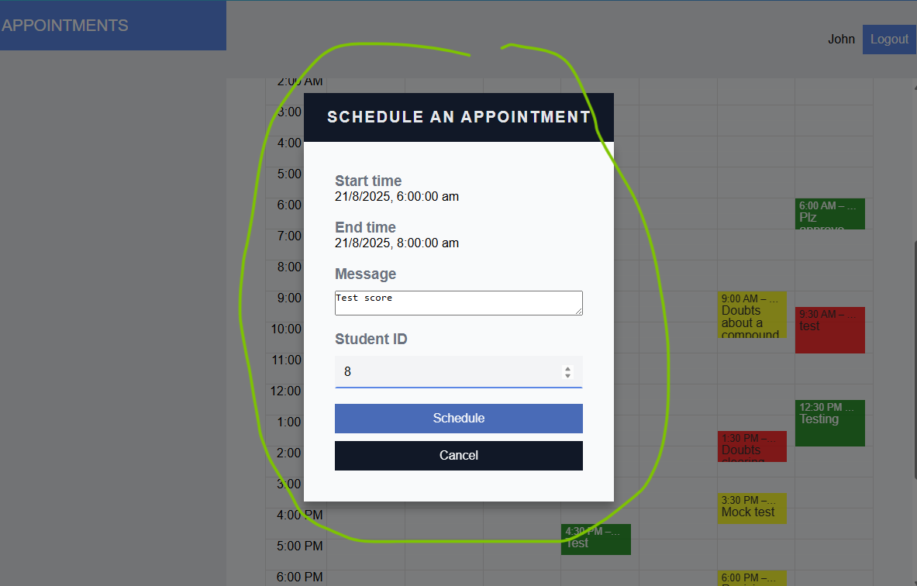
#2. Fill schedule appointment form and submit.

Slide 31
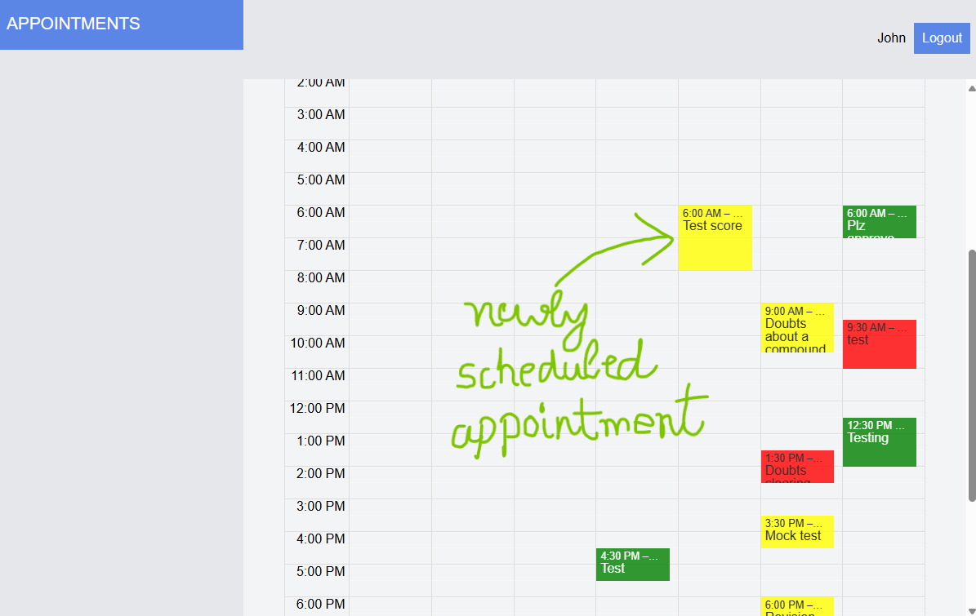

Slide 32
How app works

Slide 33
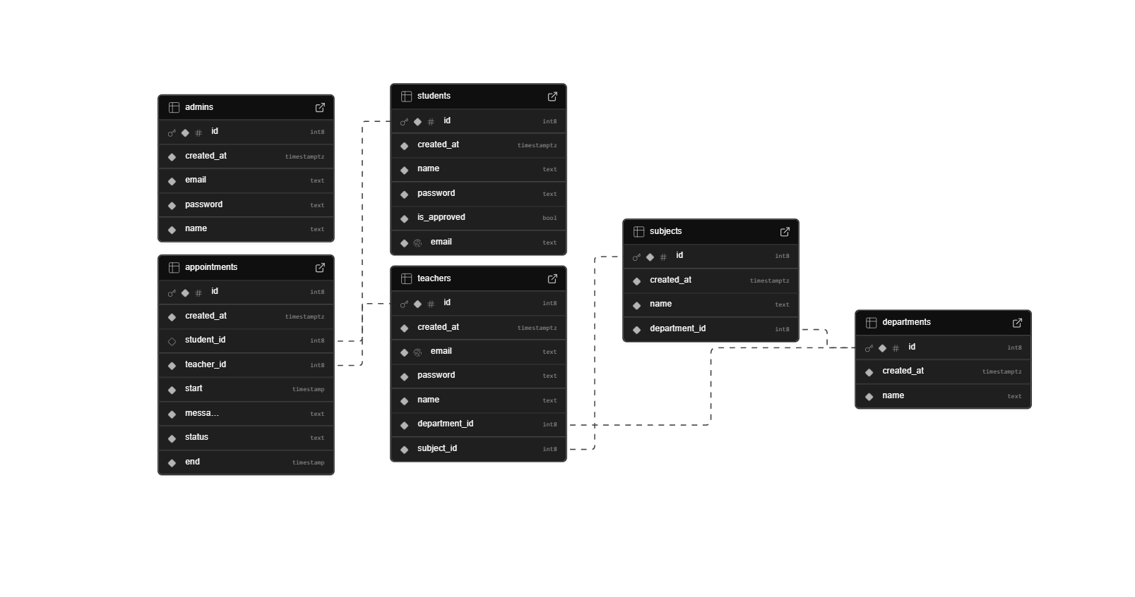
Supabase Database

Slide 34
Logging In
login function
fetches user (admin, student, teacher)
from supabase
User submits
Login form
AuthContext login
function called
with role and credentials
useEffect in AuthContext reacts to the change in user
And redirects to a route based on role
Set user in AuthContext to the user found
User
found
Yes
NO
Display error

Slide 35
Registering a student
Register form submitted
React query mutation, to add a student to supabase,
runs.
Email
Already registered
YES
Show error
NO
Add student
Note: Student who registered will need admin approval before they can login.

Slide 36
Admin

Slide 37
List all teachers (Admin)
Admin selects a teachers tab on sidebar, or just logged in
React Query fetches and caches all teachers from supabase
TeacherList is displayed

Slide 38
Add a teacher (Admin)
Admin clicks on add teacher button (Modal.Open button)
Modal window containing AddUpdateTeacherForm opens
Departments and subjects are fetched from supabase or cache using RQ and are filled in AddUpdateTeacherForm
On addition, form modal window closes, teachers in cache are invalidated and fetched again, showing newly added teacher in teachers list.
Add teacher RQ mutation runs, adding a teacher or throwing an error
On form submit

Slide 39
Update a teacher (Admin)
Admin clicks update teacher button
AddUpdateTeacherForm
Is shown and is passed the clicked teacher object
On submit, teacher is updated using updateTeacher
mutation
Teachers cache is refreshed showing all teachers along with the updated one

Slide 40
Delete a teacher (Admin)
Admin clicks delete teacher button
Opens ConfirmDelete as
Modal window
On confirm, deletes a teacher using deleteTeacher
mutation
Teachers cache is refreshed showing all teachers except the deleted one

Slide 41
View all registering students (Admin)
Admin clicks students tab from sidebar
Go to route “/students”
Fetch and cache all registering students using useGetRegisteringStudents
Display all registering students
In a table using RegisteringStudentList

Slide 42
Approve or Reject student registration (Admin)
Admin clicks approve / reject button
Open
ApproveRejectRegistrationWindow
Modal window
On confirm approve / reject run approveStudentRegisteration
Or deleteStudent
mutations respectively
Refresh registering students cache, so student list shows updated results

Slide 43
Student

Slide 44
View student appointments (Student)
Student logs in and is redirected to “/student/appointments” or clicks “Appointments” tab from sidebar
StudentAppointmentsCalendar
is displayed along with other components
StudentAppointmentsCalendar
fetches and caches all appointments of the logged in student
These appointments are displayed using AppointmentsCalendar

Slide 45
Show appointment details from StudentAppointmentsCalendar (Student)
An appointment is clicked on AppointmentsCalendar in StudentAppointmentsCalendar
Pass that appointment object to AppointmentDetailed
Fetch and cache that appointment details along with student and teacher name
Display appointment details in AppointmentDetailed modal window

Slide 46
Book an appointment (Student)
Student clicks Book an appointment button from appointments tab or student selects Book an appointment tab from sidebar
Render search teacher form

Slide 47
#1. Searching a teacher
On search teacher form submit
Fetch all teachers which matches search queries
Close form
List search results for teachers in using TeachersList

Slide 48
#2. Selecting a teacher from results
From searched teachers results list click Book button from teacher row that we want to book an appointment with.
Will open SearchedTeacherAppointmentsCalendar
Filled with selected teacher’s appointments and ready for booking of new appointments in a modal window

Slide 49
#3. Book an appointment with the selected teacher
Time slot for appointment is selected from SearchedTeacherAppointmentsCalendar
BookAppointmentForm
Is shown as it is passed start time,end time and teacher as props.
On BookAppointmentForm
submit, new appointment is added using addAppointment
mutation.
SearchedTeacherAppointmentsCalendar
Is shown as it displays all of the selected teacher’s appointments including this newly added one
BookAppointmentForm is closed and selected teacher’s appointments are refreshed in cache.
On mutation success

Slide 50
#Misc. View appointment details from SearchedTeacherAppointmentsCalendar
An appointment is clicked on SearchedTeacherAppointmentsCalendar
Pass that appointment object to AppointmentDetailed
Fetch and cache that appointment details along with student and teacher name
Display appointment details in AppointmentDetailed modal window

Slide 51
Teacher

Slide 52
View teacher appointments (Teacher)
Teacher logs in and is redirected to “/teacher/appointments” or clicks “Appointments” tab from sidebar
TeacherAppointmentsCalendar is displayed.
TeacherAppointmentsCalendar fetches and caches all appointments of the logged in teacher
These appointments are displayed using AppointmentsCalendar

Slide 53
Show appointment details from TeacherAppointmentsCalendar (Teacher)
An appointment is clicked on AppointmentsCalendar in TeacherAppointmentsCalendar
Pass that appointment object to AppointmentDetailed
Fetch and cache that appointment details along with student and teacher name
Display appointment details in AppointmentDetailed modal window

Slide 54
Approve or Reject pending appointments (Teacher)
A pending appointment (yellow) is clicked on AppointmentsCalendar in TeacherAppointmentsCalendar
Pass that appointment object to AppointmentDetailed
Fetch and cache that appointment details along with student and teacher name
Close the AppointmentDetailed modal window, refresh teacher’s appointments cache so that TeacherAppointmentsCalendar
Shows all appointments including the updated one.
On approve or reject, update appointment status using updateAnAppointment
mutation
Display appointment details in AppointmentDetailed modal window. As it is pending, it will also show approve and reject buttons

Slide 55
Schedule an appointment (Teacher)
Time slot for appointment is selected from TeacherAppointmentsCalendar
ScheduleAppointmentForm
Is shown as it is passed start time,end time as props.
On ScheduleAppointmentForm
submit, new appointment is added using addAppointment
mutation.
TeacherAppointmentsCalendar displays all of the teacher’s appointments including this newly added one
ScheduleAppointmentForm
is closed and teacher’s appointments are refreshed in cache.
On mutation success

Slide 56
Logout
Logout button in Header is clicked
Logout function from AuthContext is called,
It sets current user to null
Redirects to "/login"

Slide 57
THE END

