Slide 1

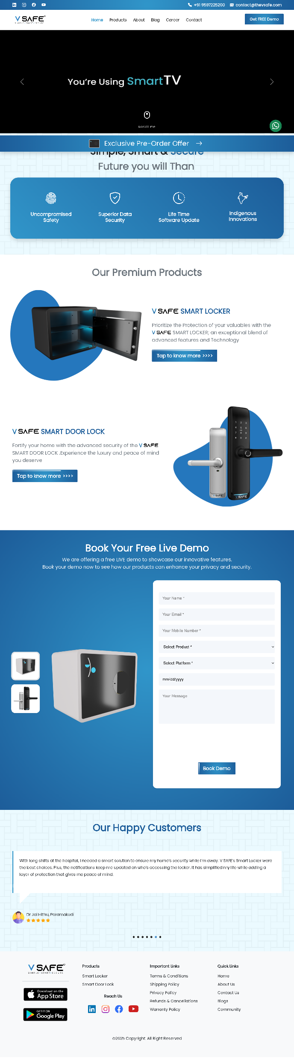
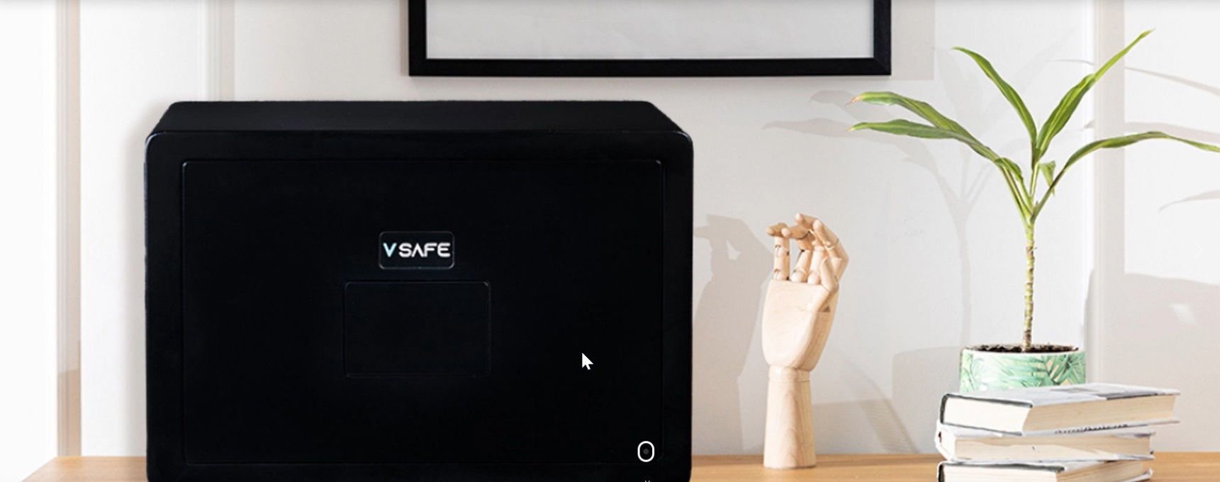
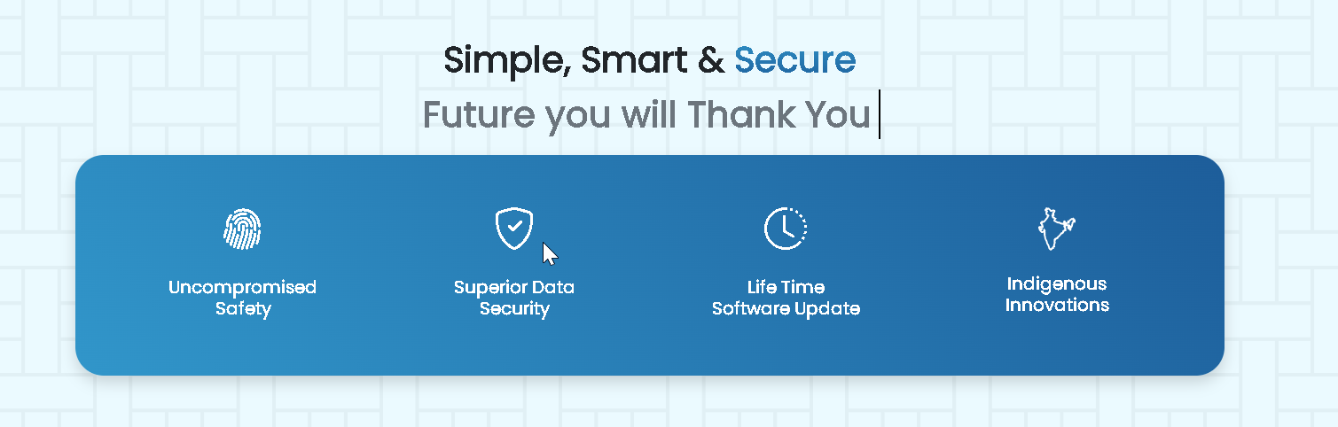
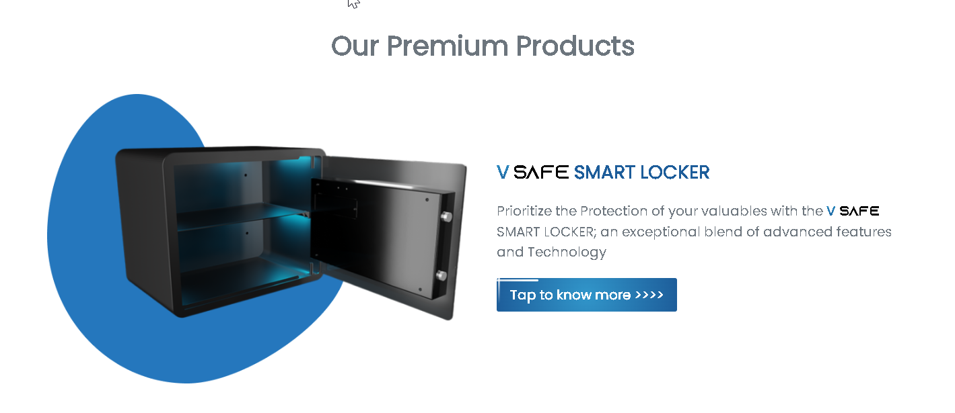
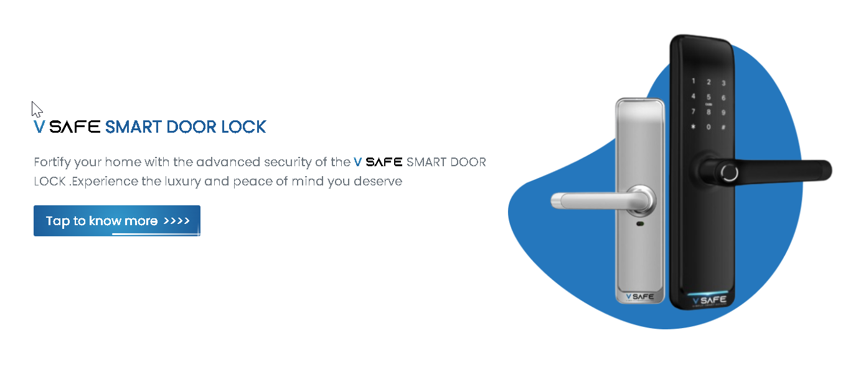
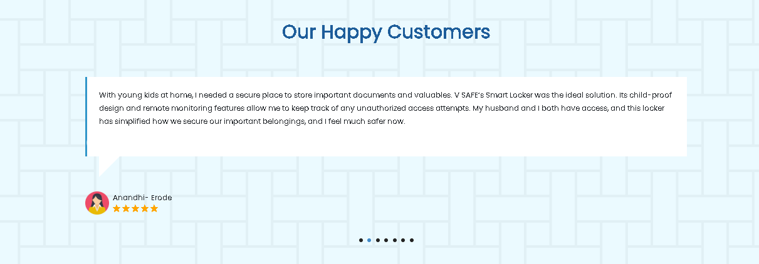
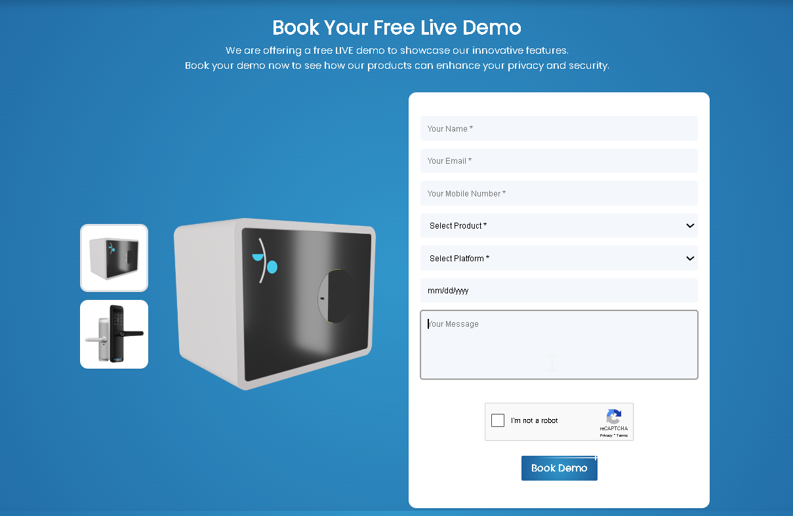
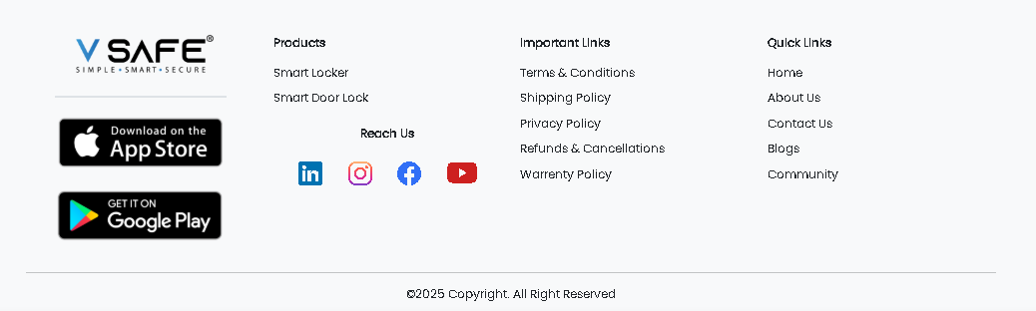
vsafe_website (Components)
1_navBar
8
2_hero
3_smart
5_doorLock
4_products
7_customers
6_booking
8_contact

Slide 2
college_website (Components)
1_navBar
component

Slide 3
college_website (Components)
1_navBar
row

Slide 4
college_website (Components)
1_navBar
column

Slide 5
college_website (Components)
1_navBar
subColumn

Slide 6
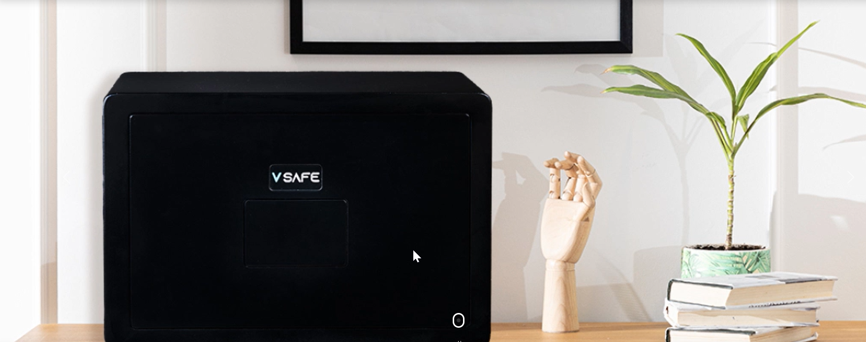
college_website (Components)
2_hero
component

Slide 7
college_website (Components)
2_hero
row

Slide 8
college_website (Components)
2_hero
column

Slide 9
college_website (Components)
2_hero
subColumn

Slide 10
college_website (Components)
3_smart
component

Slide 11
college_website (Components)
3_smart
row

Slide 12
college_website (Components)
3_smart
column

Slide 13
college_website (Components)
3_smart
subColumn

Slide 14
college_website (Components)
4_products
component

Slide 15
college_website (Components)
4_products
row

Slide 16
college_website (Components)
4_products
column

Slide 17
college_website (Components)
4_products
subColumn

Slide 18
college_website (Components)
5_doorLock
component

Slide 19
college_website (Components)
5_doorLock
row

Slide 20
college_website (Components)
5_doorLock
column

Slide 21
college_website (Components)
5_doorLock
subColumn

Slide 22
college_website (Components)
6_booking
component

Slide 23
college_website (Components)
6_booking
row

Slide 24
college_website (Components)
6_booking
column

Slide 25
college_website (Components)
6_booking
subColumn

Slide 26
college_website (Components)
7_customers
component

Slide 27
college_website (Components)
7_customers
row

Slide 28
college_website (Components)
7_customers
column

Slide 29
college_website (Components)
7_customers
subColumn

Slide 30
college_website (Components)
8_contact
component

Slide 31
college_website (Components)
8_contact
row

Slide 32
college_website (Components)
8_contact
column

Slide 33
college_website (Components)
8_contact
subColumn

