Slide 1
WEPLACM
Workflow Management Winter Term 25/26
Surya Surendran – 224201307
Jisna Joy – 224201487
Ravi Ramani – 225100150
Kenil Sohaliya – 224201315
Denisbhai Kathiriya – 224201723
Pranit Narendra Muttha – 225200854
Mohit Dangariya – 225100007

Slide 2
Agenda
Technology
Exchange of the Data objects between both company
Process Diagram
Message Types

Slide 3
Technology
User Tasks : Camunda Forms
Programming Language & Library : Python, Pyzeebe
Messages : JSON
Database : PostgreSQL / Docker

Slide 4
Exchange of data objects between both company :
Receiving from WBIG | sending to WBIG
Receive hiring request | Send missing requirements to WBIG
Receive request for additional candidates | sent no applicant found info
Receive hiring results (positions filled) | Send shortlisted candidate profiles to WBIG
Receive invoice rejection | sent invoice
 | Notify client of payment error

Slide 5
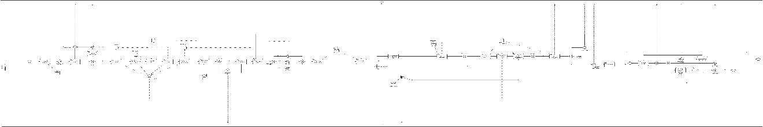
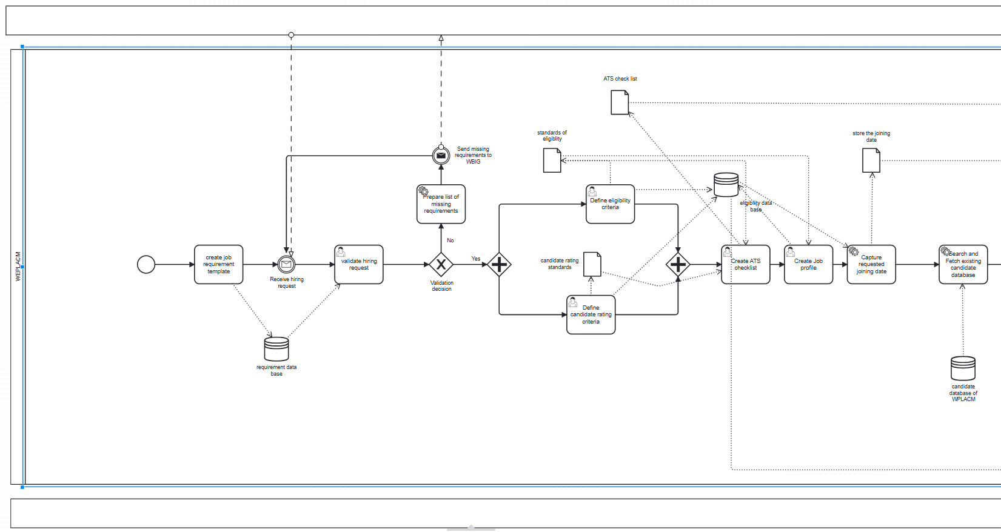
The WEPLACM Process

Slide 6
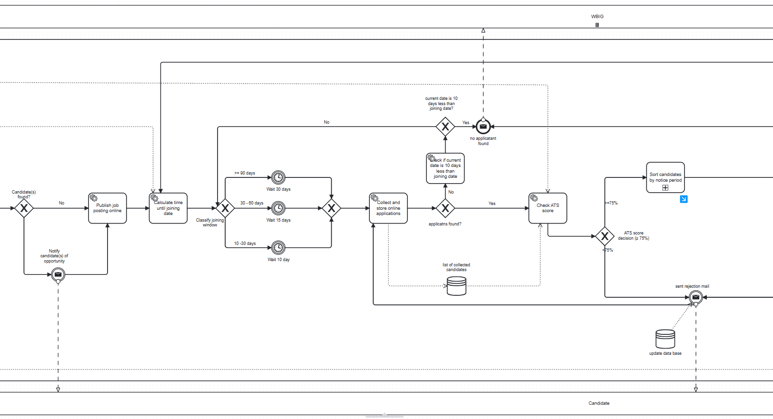
The WEPLACM Process

Slide 7
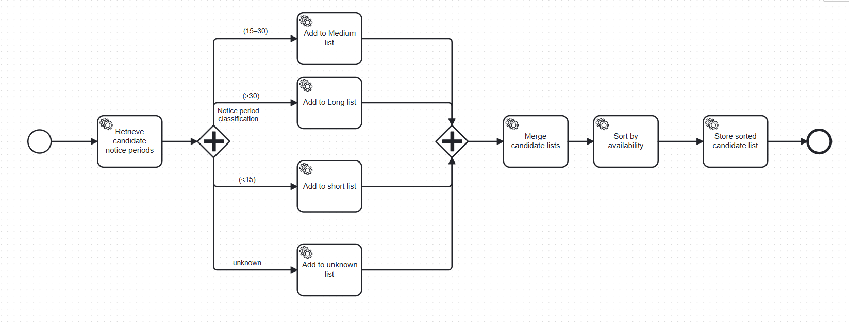
The WEPLACM Process

Slide 8
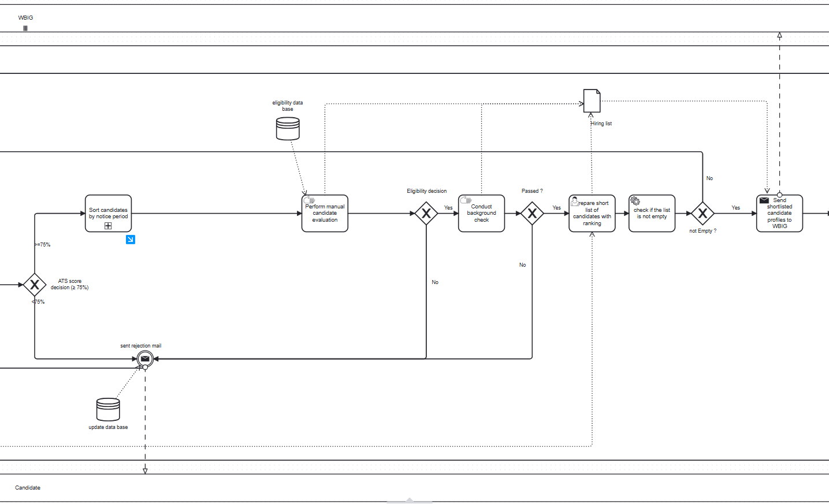
The WEPLACM Process

Slide 9
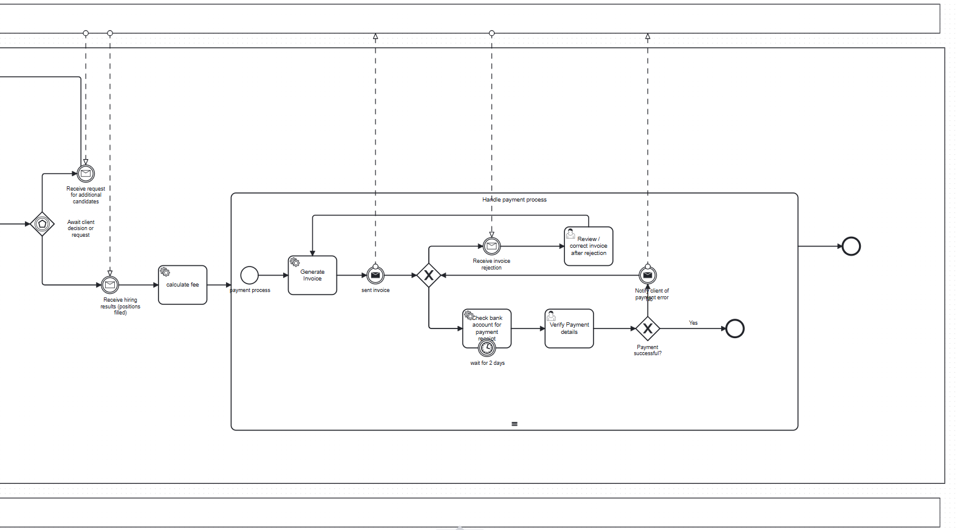
The WEPLACM Process

Slide 10
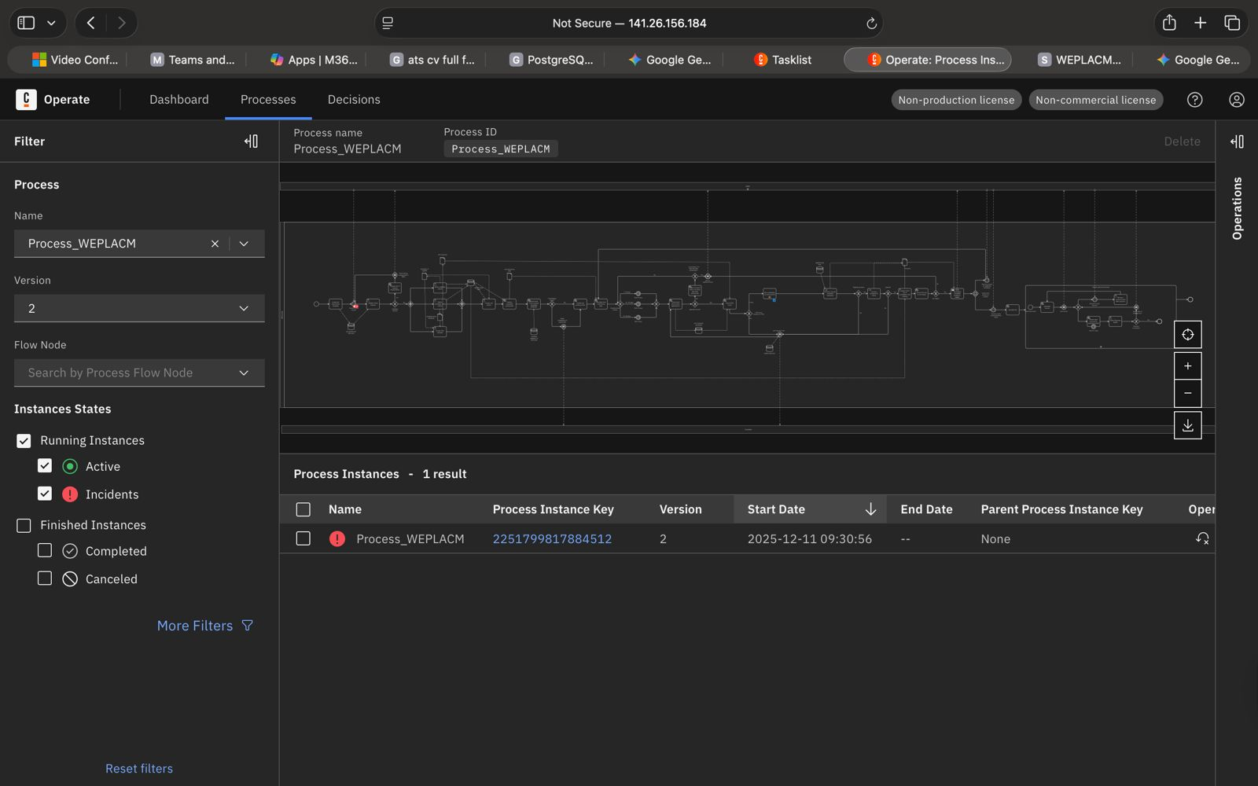
The WBIG Process – Deployed

Slide 11
Message Types
No candidates found
Hiring results
Field | Data Type | Description
JobID | Integer | Unique Job ID
NoCandidates | Boolean | Shows if no candidates are found
Field | Data Type | Description
JobID | Integer | Unique Job ID
CandidateID | Integer | Unique Candidate ID
Result | [“positive”, “negative”] | Show results
Job opening information change request
Field | Data Type | Description
JobID | Integer | Unique Job ID
Note | String | Change request information
Request more CV’s
Field | Data Type | Description
JobID | Integer | Unique Job ID
RequestNr | Integer | Amount of new CV’s

Slide 12
Message Types
Opening Job Information
Candidate List
Field | Data Type | Description
MessageType | String | "JobOpening" Opening job information
CompanyID | String | ID of WBIG
JobID | Integer | Unique Job ID
JobTitle | String | Title of the job
NumberOfOpenings | Integer | Number of vacancies for this job
Description | String | Job summary
Requirements | Array(string) | List of all requirements
Field | Data Type | Description
Candidate | Array | List of Candidates informations like experience, degree etc.
JobID | Integer | Unique Job ID

Slide 13
Message Types
Invoice
Invoice Rejection and Payment Error
Field | Data Type | Description
Invoice_number | String | Unique ID for identification of invoices
Dates | String (DD-MM-YYYY) | Invoice date and due date
Contractor | Multiple strings | Contractor details like name, adresse etc.
Client | Multiple strings | Client details like name, address etc.
Items | String and number | Description, quantitiy, rate etc.
Payment terms | String | Payment details
Note | String | Notes
Field | Data Type | Description
Invoice_number | String | Unique ID for identification of invoices
Dates | String (DD-MM-YYYY) | Invoice date and due date
Contractor | Multiple strings | Contractor details like name, adresse etc.
Client | Multiple strings | Client details like name, address etc.
Note | String | Notes

Slide 14
Thank you for your Attention!
Any Questions?

