Slide 1
INCOME_EVALUATION_DATA
Puli. Ramanjaneya Reddy

Slide 2
INCOME_EVALUATION_DATA Dataset Overview:
The dataset income evaluation data contains 32,561 records with 15 columns. It is related to income classification, where the target variable is income, indicating whether a person's income is <=50k or >50k.
The income evaluation dataset contains structured tabular data with a mix of categorical and numerical data.
Numerical Data's are age, fnlwgt, education-num ,capital-gain, capital-loss, hours-per-week.
Data set contains two types categorical data's one is Nominal and another is Cardinal.
Nominal data are work class, marital-status, occupation, relationship, race, sex ,native-country.

Slide 3
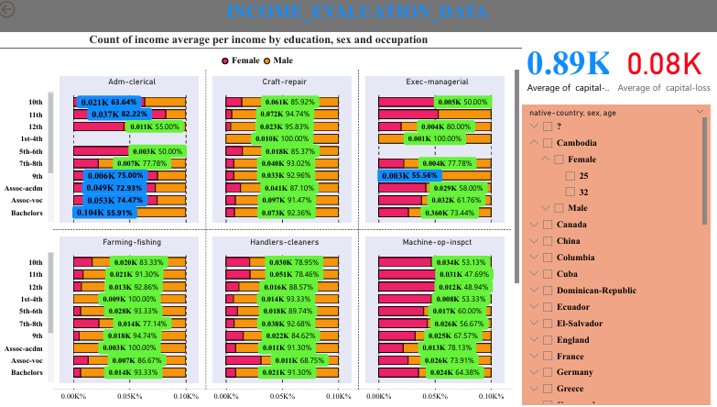
COUNTRY OF INCOME AVERAGE PER INCOME BY EDUCATION,SEX AND OCCUPATION

Slide 4
COUNTRY OF INCOME AVERAGE PER INCOME BY EDUCATION,SEX AND OCCUPATION
This data can be useful for understanding economic disparities and making informed decisions in policy-making, education, and workforce development.
Occupation Categories
Adm-clerical:
Education Levels: Includes various levels from 1st-4th grade to Bachelors.
Gender Distribution: Both females (pink) and males (orange) are represented, with income values color-coded.
Craft-repair:
Education Levels: Similar range of education levels.
Gender Distribution: Both genders are represented, with noticeable differences in income values.
Exec-managerial:
Education Levels: Higher education levels (some-college and Bachelors) are more prominent.
Gender Distribution: Both genders are present, with higher income values for males.
Farming-fishing, Handlers-cleaners, Machine-op-inspct:
Education Levels
The chart covers a wide range of education levels, including:
1st-4th grade,5th-6th grade,7th-8th grade,9th grade
10th grade,11th grade,12th grade, Some-college,Bachelors
Gender Distribution
The data is color-coded to represent females (pink) and males (orange), making it easy to compare income values across different education levels and occupations.
Filter Section
Sex: Options for Female or Male
Age: Specific age groups can be selected
Income: Different income levels can be analyzed
Native Country: Options include Dominican-Republic, Cambodia, Ecuador, Canada, El-Salvador, China, England, Columbia, France, Cuba, and Germany.

Slide 5
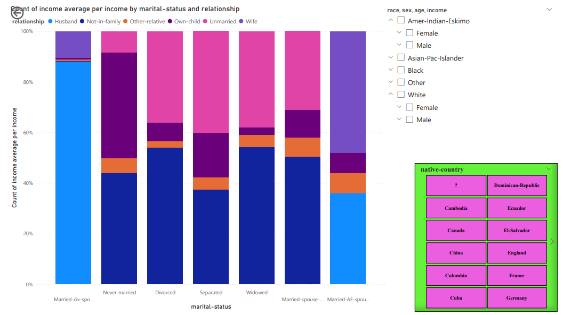
COUNT OF INCOME AVERAGE PER INCOME BY MARITAL-STATUS AND RELATIONSHIP

Slide 6
COUNT OF INCOME AVERAGE PER INCOME BY MARITAL-STATUS AND RELATIONSHIP
Marital Status Categories
Married-civ-spouse:
Husband: This relationship category has the highest count of income, indicating that married individuals with a spouse have a significant income representation.
Wife: Similar to husbands, wives in this category also show a high count of income.
Never-married:
Not-in-family and Own-child: These relationship categories dominate the income count in the never-married group, suggesting a different economic profile compared to married individuals.
Divorced:
Not-in-family and Unmarried: These relationships are more prominent in the divorced category, indicating income distribution varies significantly from married individuals.
Separated, Married-AF-spouse, absent,Widowed
Relationship Categories
Husband:
Predominantly seen in the married-civ-spouse category with the highest income count.
Not-in-family:
Prominent in never-married, divorced, separated, and widowed categories, indicating individuals not living with family have varied income distributions.
Other-relative, Own-child,Unmarried,Wife:
Age: Specific age groups can be selected
Income: Different income levels can be analyzed
Native Country: Options such as Dominican-Republic, Cambodia, Ecuador, Canada, El-Salvador, China, England, Columbia, France, Cuba, and Germany.

Slide 7
Conclusion
The data highlights income disparities, significant economic activities, and a strong correlation between education levels and income.
Diverse representation of individuals from various countries, primarily working in government sectors and transportation-related jobs.
Majority of individuals are married-civ-spouses, with variations in marital statuses.
This analysis provides valuable insights into the socio-economic patterns and disparities across different races, sexes, education levels, native countries, and work environments.

Slide 8
thanks

