Slide 1
PRESENTATION TITLE
Home Loans Prediction
02/03/2023

Slide 2
TEXT LAYOUT 1
Agenda
Data Science Lifecycle​
Project Overview​
Data
Analysis
Modeling
Model Evaluation
Recommendations

Slide 3
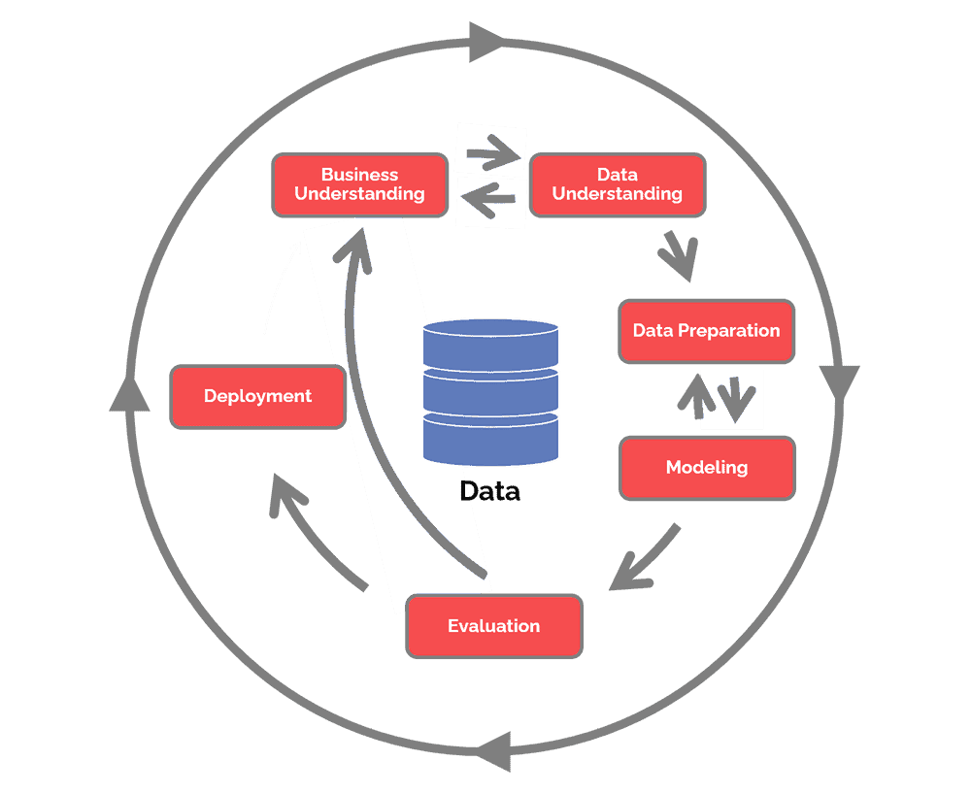
TEXT LAYOUT 1
Data Science Lifecycle

Slide 4
The data science life cycle for the Loan Prediction dataset can be summarized as follows:
Business Understanding: The first step in the data science life cycle is to understand the business problem and define the objectives of the project. In this case, the business problem is to predict whether a loan applicant will be approved or not based on various factors such as credit history, income, employment status, etc.
Data Collection: The next step is to collect the relevant data needed to solve the problem. In this case, the data is already provided in the form of two datasets - one for training the machine learning model and another for testing the model.
Data Preparation: Once the data is collected, it needs to be prepared for analysis. This involves cleaning the data, handling missing values, transforming the data, and performing feature engineering to create new features that may be useful for the model.
Exploratory Data Analysis: Exploratory data analysis involves exploring the data to identify patterns and relationships between variables. This step can help to identify which features are most important for predicting loan approval and which factors may be driving loan rejection.

Slide 5
Model Selection: Once the data is prepared and explored, the next step is to select the best machine learning model for the task. In this case, since the problem is a binary classification problem (approved or not approved), suitable algorithms for this task could be logistic regression, decision trees, KNN, random forests, or gradient boosting.
Model Training: After selecting the appropriate model, the next step is to train the model on the training dataset. This involves feeding the model the training data and adjusting its parameters until it produces the best results.
Model Evaluation: Once the model is trained, it needs to be evaluated on the test dataset to determine how well it performs on unseen data. This step involves calculating various evaluation metrics such as accuracy, precision, recall, F1-score, and ROC-AUC.
Model Deployment: After the model is evaluated and deemed satisfactory, it can be deployed in a production environment to make predictions on new data. The model should be monitored regularly to ensure that it continues to perform well and is providing accurate predictions.
Business Understanding: Finally, the results of the model should be interpreted in the context of the original business problem to determine if the objectives of the project have been met and whether the model is providing useful insights that can inform business decisions.

Slide 6
TEXT LAYOUT 1
Project Overview
Business Problem: The business problem for the Loan Prediction dataset is to predict whether a loan application will be approved or not, based on various factors related to the applicant's personal and financial information.
Business Objective: The business objective is to improve the efficiency and accuracy of the loan approval process, by using data-driven methods to evaluate loan applications.

Slide 7
TEXT LAYOUT 1
Project Overview
Hypothesis: A hypothesis related to this business problem and objective could be that certain factors, such as credit history, income level, and loan amount, have a significant impact on the likelihood of loan approval. This hypothesis could be tested by analyzing the dataset and building a predictive model to identify the most important features for loan approval.

Slide 8
TEXT LAYOUT 1
Process Overview / Solution
Based on above business problem we need to solve this problem by following these steps.
Data understanding: The first step is to understand the dataset and its features. This involves performing exploratory data analysis (EDA) to identify missing values, duplicates, and other issues that may affect the quality of the data.

Slide 9
Data cleaning and preprocessing: After understanding the data, the next step is to clean and preprocess the data to prepare it for machine learning algorithms. This involves handling missing values, encoding categorical variables, scaling numerical variables, and other steps as necessary.
Feature engineering: Once the data is cleaned and preprocessed, feature engineering can be performed to extract useful information from the available features.
Model selection: The next step is to select a machine learning algorithm that is appropriate for the task at hand. For the Loan Prediction dataset, a binary classification algorithm would be suitable, as the task is to predict whether a loan application will be approved or not.

Slide 10
Model training and evaluation: After selecting a model, the next step is to train the model on the available data, and evaluate its performance using appropriate metrics such as accuracy. This step involve splitting the data into train and validation sets to estimate the model’s generalization performance.
Model deployment: Once the model is optimized and its performance is satisfactory, the final step is to deploy the model in a production environment, where it can be use to predict loan approval for new loan applications.

Slide 11
TEXT LAYOUT 1
Data
The Loan Prediction dataset contains information about loan applicants, including their personal and financial information, as well as whether or not their loan application was approved. Here is a description of the dataset features:
Loan ID: A unique identifier for each loan application
Gender: The gender of the loan applicant (Male/Female)

Slide 12
Married: Whether the loan applicant is married or not (Yes/No)
Dependents: The number of dependents the loan applicant has (0, 1, 2, 3+)
Education: The level of education of the loan applicant (Graduate/Not Graduate)
Self-employed: Whether the loan applicant is self-employed or not (Yes/No)
Applicant Income: The income of the loan applicant in dollars (numeric)
Coapplicant Income: The income of the loan applicant's co-applicant (if any) in dollars (numeric)
Loan Amount: The amount of the loan requested in dollars (numeric)
Loan Amount Term: The term (in months) of the loan requested
Credit History: The credit history of the loan applicant (1 - has credit history, 0 - does not have credit history)
Property Area: The type of location where the loan applicant's property is located (Rural/Semiurban/Urban)
Loan Status: Whether the loan was approved or not (Y - approved, N - not approved

Slide 13
The train dataset contains 614 rows and 13 columns and the test dataset contains 367 rows and 12 columns. Some of the features are categorical, such as gender, married, education, and property area, loan amount term, and credit history while others are numerical, such as applicant income, coapplicant income, and loan amount. The target variable is loan status, which is a binary variable indicating whether or not the loan application was approved.

Slide 14
TEXT LAYOUT 1
Analysis
z

Slide 15
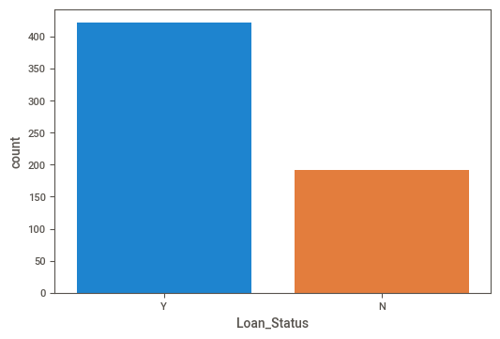
Loan statuses compare
From above plot we see that most of the applicants are approved for loan based on historical data.

Slide 16
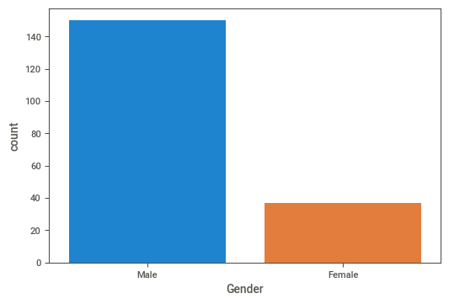
Female and male compare when it comes to defaulting on loans
From the above plot we can see that mostly 80% of male are default on loans compare to Female based on historical data.

Slide 17
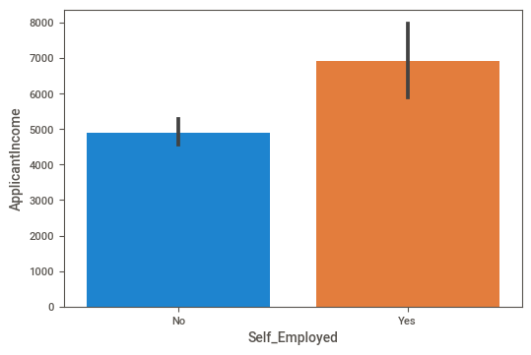
Incomes of those who are employed compare to those who are self employed based on the historical dataset.
Average Income of Self_Employed Applicants is 6912.579832
Average Income of Not Self_Employed Applicants is 4892.030979
From above plot we can see that Self_Employed Applicants Income is high.

Slide 18
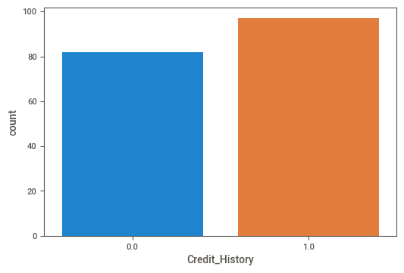
Applicants with a credit history more likely to default than those who do not have one?
54% of Applicants who has Credit_History were default on loans compare to the Applicants who don’t has Credit_History.

Slide 19
TEXT LAYOUT 1
Modeling
Used Auto ML with autosklearn and other traditional Machine Learning algorithms, such as Logistic Regression, Decision trees, and KNeighbors Classifier to build a model to predict loan approval.

Slide 20
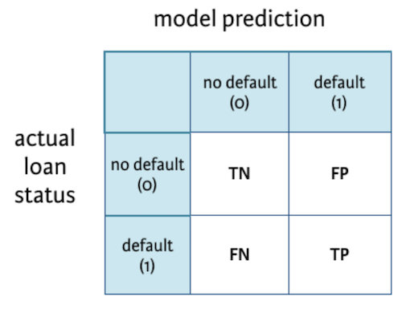
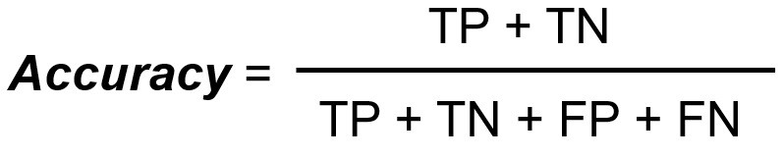
TEXT LAYOUT 1
Model Evaluation
Evaluated the each builded model by using confusion matrix and accuracy metric.

Slide 21
Results of each Bespoke ML models
Logistic Regression:
[[0 0]
Confusion matrix: [43 80]]
Accuracy Score: 65%
Decision Tree Classifier:
[[22 21]
Confusion matrix: [15 65]]
Accuracy Score: 70.73%
KNeighbors Classifier :
[[13 30]
Confusion matrix: [9 71]]
Accuracy Score: 68.29%

Slide 22
Results of AutoML model
Logistic Regression:
[[18 1]
Confusion matrix: [25 79]]
Accuracy Score: 78.86%
From above results AutoML Logistic Regression performing better so we go for AutoML model to deploy.

Slide 23
TEXT LAYOUT 1
Recommendations
AutoML and Bespoke ML are two approaches to machine learning that differ in their level of automation and customization.
AutoML: AutoML refers to the use of automated tools and techniques to automate the process of machine learning. AutoML tools can automatically generate machine learning models, select the best algorithms and hyperparameters, and perform feature engineering and selection. AutoML is designed to reduce the time and effort required to build and deploy machine learning models.

Slide 24
Bespoke ML: Bespoke ML, on the other hand, refers to the process of developing customized machine learning solutions from scratch. Bespoke ML involves a high degree of customization and requires expert knowledge in machine learning algorithms, feature engineering, and model selection. Bespoke ML is designed to meet specific business needs and solve unique problems.
The main difference between AutoML and bespoke ML is the degree of customization and automation. AutoML is designed to automate the machine learning process and reduce the need for manual intervention, while bespoke ML requires a high degree of customization and expertise. AutoML is generally used for more standardized and routine tasks, while bespoke ML is used for more complex and unique business problems that require a customized approach.
So it is better to use AutoML to build model on loan prediction which reduce the need for manual intervention, and also reduce the time and effort required to build and deploy machine learning models. And also compare to Bespoke ML models AutoML Logistic Regression Performing better.

