Slide 1
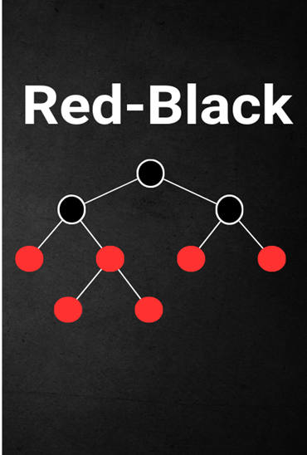
Red and Black Search Tree
Submitted By: Ramanpreet Kaur

Slide 2
Agenda
1
2
3
4
5
Background and introduction
Strength and weakness Red-Black Tree
Operations and their time complexity analysis
Demo
References

Slide 3
Background and introduction
The Red Black tree is a balanced binary search tree. A set of rules is used to maintain balance between tree nodes and ensure logarithmic time complexity for performing different operations like insertion, deletion, and searching. This tree is also called a self-balancing tree. There is also a simple color coding scheme used to maintain tree balance after each modification. Red-black tree in each node has an additional attribute which is color it should be either red or black color. This tree aims to maintain the balance of the tree during insertion and deletion of node data and it also ensures that data should be retrieved and manipulated (GeeksForGeeks (08 Jul 2024)).

Slide 4
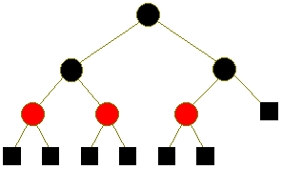
Properties of Red-black Tree
Node Color: Every node should be red or black
Root property: the root of this tree always be black
Red property: as you know red nodes can not have red children according to this rule no two consecutive red nodes on any path
Black property: every node descendant means null nodes have the same number of black nodes
Leaf nodes always be black in color. GeeksForGeeks (08 Jul 2024))

Slide 5
Strength and weakness of Red-Black Tree
Strength
These are dynamic in Nature
It balances the level of the parallel tree.
It is easy to implement and understand.
It can search for specific items so that uses less time in the search rather another search tree.
It can be helpful in database indexing, memory management, and network routing.(GeeksForGeeks (19 May 2023))

Slide 6
Weakness of Red-Black Tree
Generally you had to use a standard library execution example tree set in Java language.
Simultaneous access is difficult with a red-black tree in the locking process.
Management of nodes is also difficult when the number of nodes increases simultaneously.
Insertion is slow in the red-black tree as compared to the AVL tree(GeeksForGeeks (19 May 2023).

Slide 7
RED-Black Tree Time Complexity
 | Insert | Delete | Search | Sort
Best Case time Complexity | O(log n) | O(log n) | O(log n) | O(N log n)
Worst case time complexity | O(log N) | O(log N) | O(log N) | O(N log N)
Average Case Time Complexity | O(log N) | O(log N) | O(log N) | O(N log N)
(GeekforGeeks (16 Feb 2024))

Slide 8
RED-Black Tree Time Complexity
Insert Operation in Student record management: Time complexity(O(log n)) : it finds a suitable spot for a new node and then rebalances the tree so both things are done with rotation so logarithmic time is required.
Delete Operation(O(log n)): it is similar to insertion because first locate the node before deletion, perform the deletion, and then rebalance the tree if necessary.
Search Operation(O(log n)): In which first traverses the tree nodes then finds the node and takes logarithmic time.
Sort Operation(O(n)): It sorts the elements by their keys in a Red-Black Tree can be achieved via an in-order traversal. Since each node is visited exactly once during in-order traversal, the time complexity for sorting all nodes is linear, O(n),

Slide 9
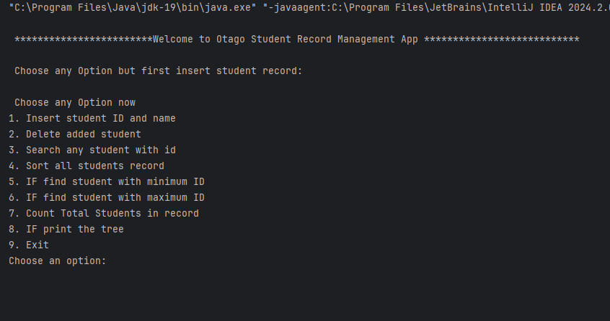
Demo Output

Slide 10
References
GeeksForGeeks (19 May 2023), Advantages and Disadvantages of Red-Black Tree
https://www.geeksforgeeks.org/applications-advantages-and-disadvantages-of-red-black-tree/?ref=lbp
GeekforGeeks (16 Feb 2024), Time complexities of different data structures
https://www.geeksforgeeks.org/time-complexities-of-different-data-structures/
GeeksForGeeks (08 Jul 2024), Introduction to Red-Black Tree
https://www.geeksforgeeks.org/introduction-to-red-black-tree/

