Slide 1
QUIZ GAME
Submitted in the partial fulfillment for the award of the degree of
BACHELOR OF ENGINEERING
IN
ARTIFICIAL INTELLIGENCE & MACHINE LEARNING
Submitted by:
Ramanuj Asati
20BCS6430
Under the Supervision of:
Ms. Deepanshu Garg
Department of AIT-CSE
DISCOVER . LEARN . EMPOWER

Slide 2
Outline
Introduction to Project
Methodology used
Results and Outputs
Future Scope
Conclusion
References

Slide 3
Introduction to Project
Quiz Game is a program developed to conduct a quiz.
It is an console based game.
Quiz game will start with three options –
Play
Add Questions
Exit

Slide 4
There will be 5 questions in the quiz game.
Each will be of 5 marks.
No negative marks for wrong answers.
After the completion of the quiz, the result will be shown on the score board.

Slide 5
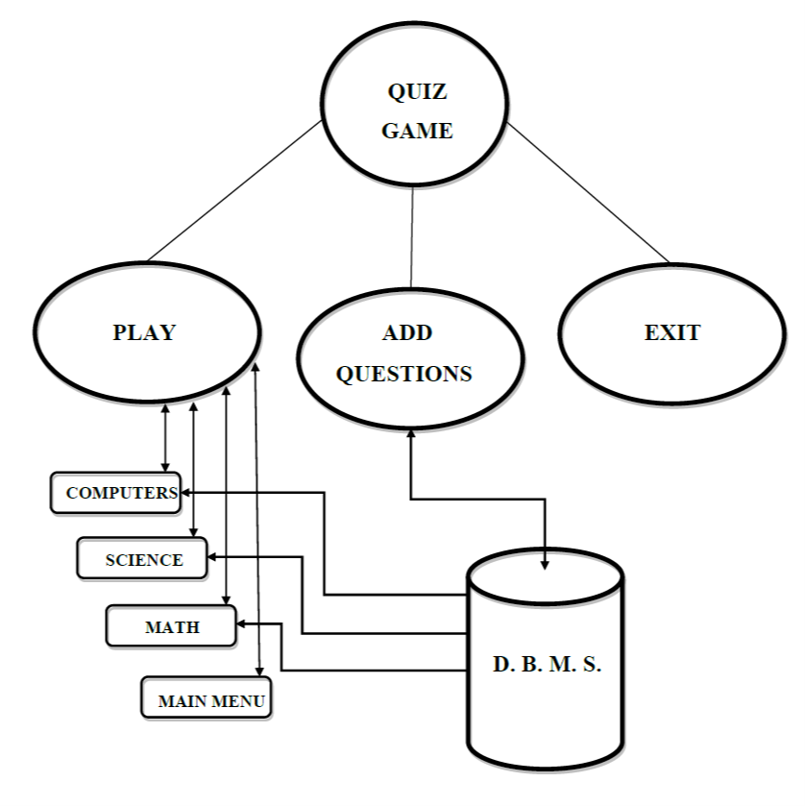
Methodology used
FLOW CHART

Slide 6
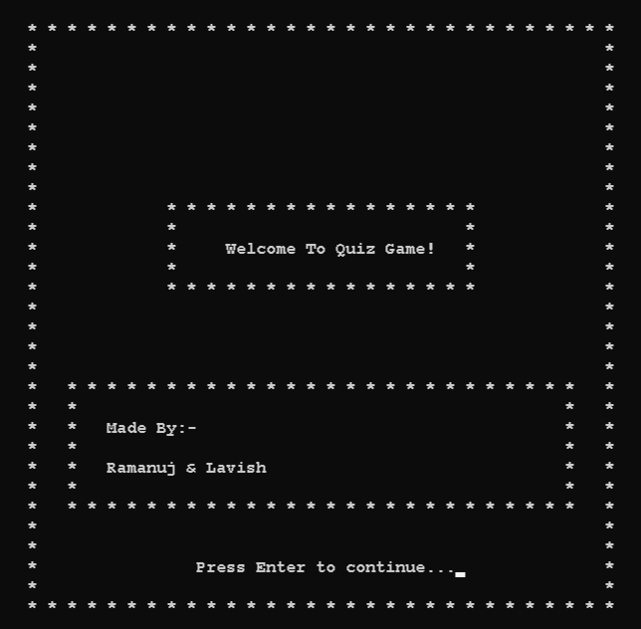
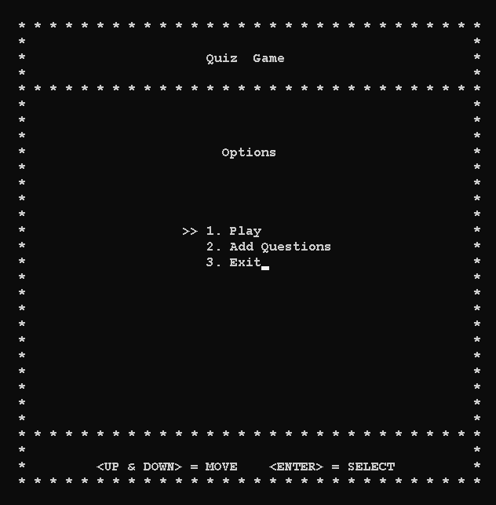
Results and Outputs
WELCOME SCREEN
MAIN MENU

Slide 7
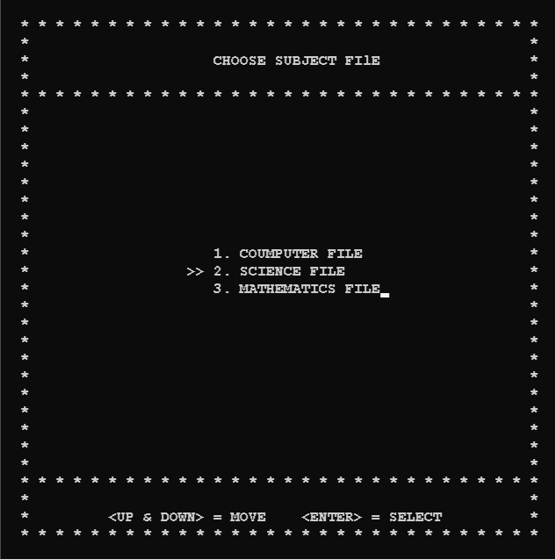
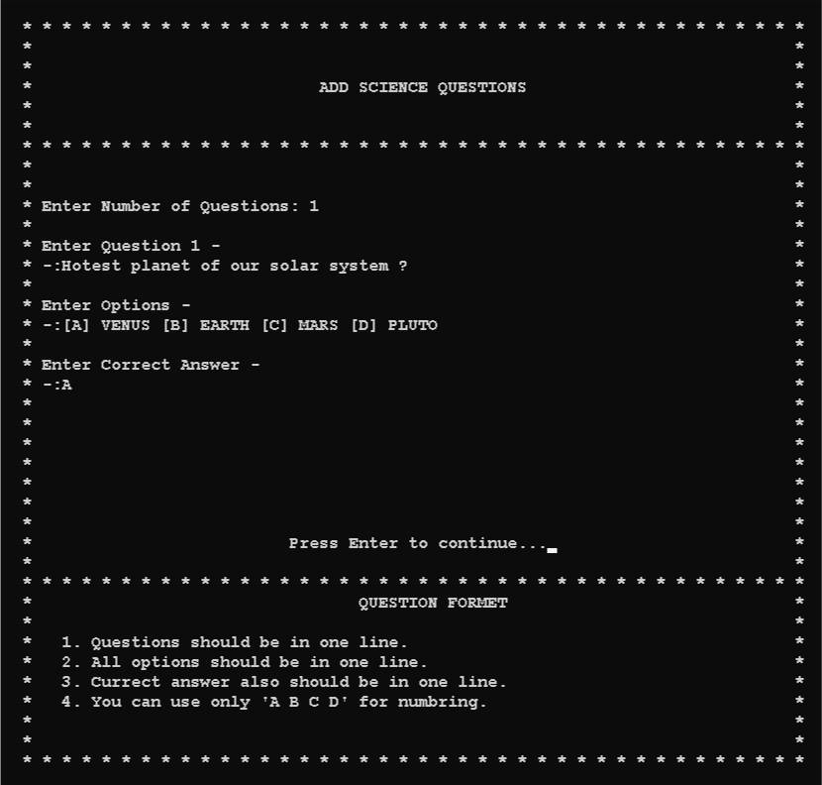
FILE MENU
ADD QUESTIONS

Slide 8
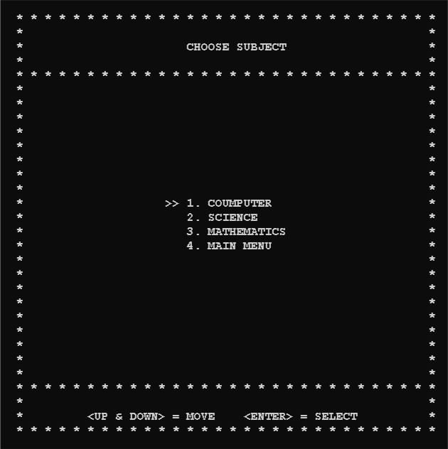
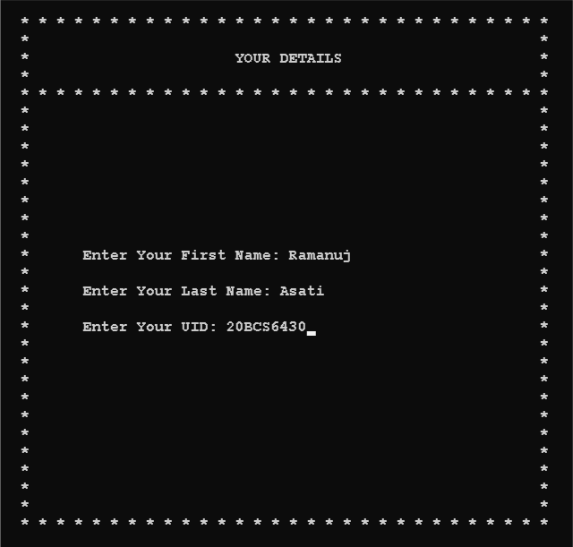
SUBJECT MENU
DETAILS

Slide 9
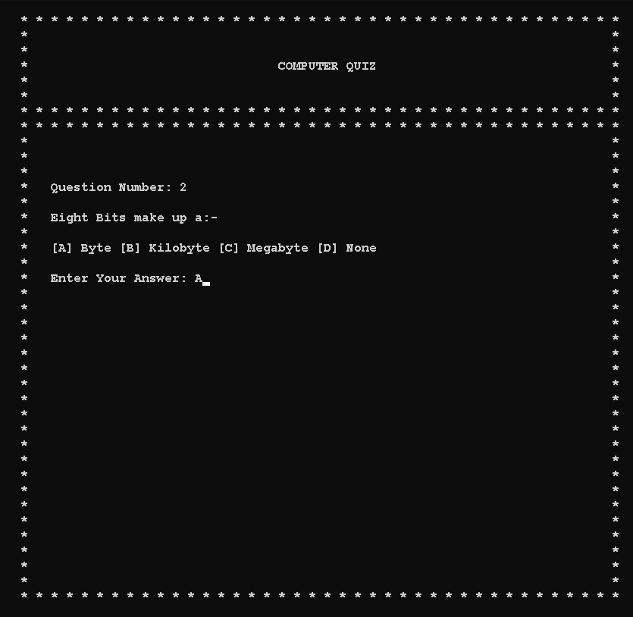
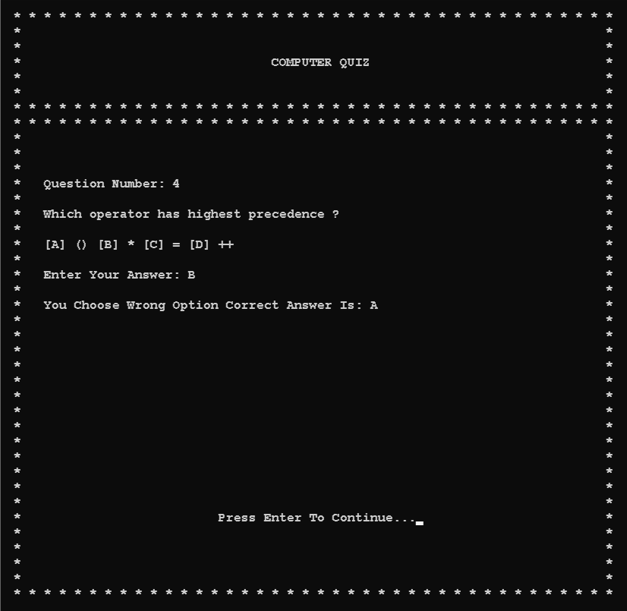
QUESTIONS & OPTIONS
WRONG ANSWER

Slide 10
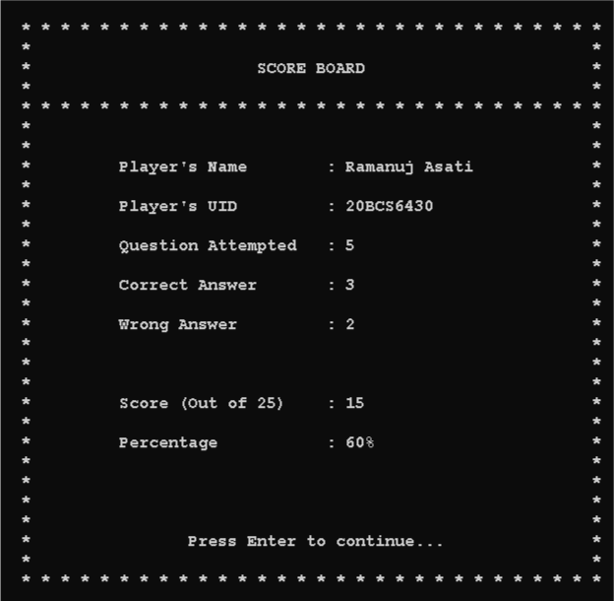
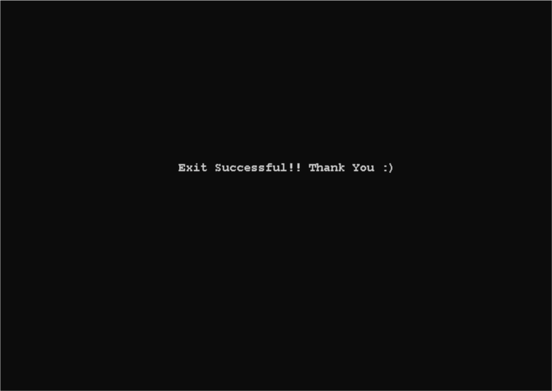
SCORE BOARD
EXIT

Slide 11
Future Scope
Gaining knowledge and sharing knowledge among world.
Can be used anywhere and any time.
This application will be used in educational institutes as well as in corporate world.

Slide 12
Conclusion
The Quiz Game application provides facility to play quiz anywhere and anytime.
User get extra knowledge and skills.
The Quiz Game is capable to add number of questions in backend files.
The Quiz Game is capable to handle number of Question record having all their information stored in the backend files.

Slide 13
References
[1] Google :
https://www.google.com/
[2] You Tube :
https://www.youtube.com/
[3] Git Hub :
https://github.com/wilfredarin/Cpp-Quiz-Game
[4] Stack Overflow :
https://stackoverflow.com/
[5] Geeks For Geeks:
https://www.geeksforgeeks.org/

Slide 14
Thank You
Presentation Made By
Ramanuj Asati

