Slide 1

Predicting Flank Wear in CNC Milling machine
presented by :
CHINTHALA PRAJAY VARMA 230003018
JAAJIMOGGALA RAMARAJU 230003028
BANOTH SANTHOSH 230003014

Slide 2
Problem Statement
Problem Description
Objectives
To monitor the flank wear of a CNC milling machine tool.
Investigate tool wear on a CNC milling machine.
Understand how various factors influence flank wear over time.
Sensor data:
Spindle Motor Current (DC) sensor
Use the training data to:
Vibration (Spindle) sensor
Accurately predict flank wear.
Key variables include:
Identify key features contributing to the prediction of flank wear in the testing dataset.
Case no., Run, VB (Flank wear), Time, Depth of Cut (DOC), Feed rate

Slide 3
Data Preprocessing
For Score 1:
For Score 2: Missing runs of VB were added by taking the average of the preceding and succeeding runs.
No changes were made to the data during the first submission.
Feature Extraction
Training Dataset: 52 runs Testing Dataset: 57
Score 1 Approach:
Computed the mean of 9000 data samples for each run (both sensors).
This resulted in a single sensor value corresponding to VB for each run.
Attempts to use standard deviation increased error rates compared to the mean approach.

Slide 4
Score 2 Approach:
For each run, data points were arranged in ascending order.
Removed the lowest and highest 1000 data points.
Computed the mean for the remaining 7000 data points.
Feature Set
Score 1
Score 2
Training Features
4 × 52 = 208
3 × 52 = 156
Testing Features
4 × 57 = 228
3 × 57 = 171
variables used
DC, VIB, Feed, DOC
DC, VIB, Time

Slide 5
Model Training and Evaluation
Data Loading: Used readtable() to load the training and testing datasets.
Feature Extraction: Selected relevant variables:
VIB, DC, DOC, Feed (Score 1)
VIB, DC, Time (Score 2)
Target variable: VB (Flank wear)
Model Training:
Applied a Linear Regression Model using fitlm().
Performance Evaluation:
Computed the Root Mean Square Error (RMSE) for training and testing datasets:{predictions_test = predict(lrModel, X_test); rmse_test = sqrt(mean((y_test - predictions_test).^2)); disp(['Linear Regression RMSE (test): ', num2str(rmse_test)]);}
5.Visualization:
Generated a scatter plot comparing actual vs. predicted values for validation:{scatter(y_test, predictions_test, 'b', 'filled', 'DisplayName', 'Predicted vs Actual');}

Slide 6
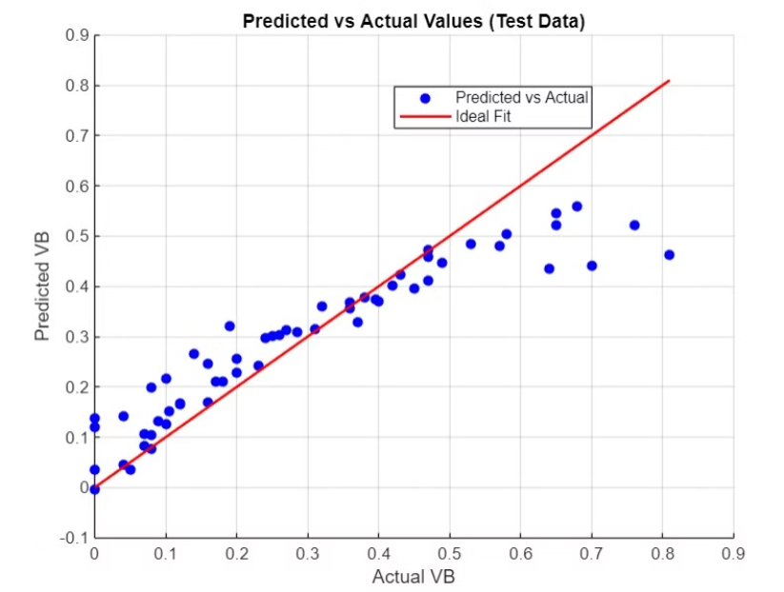
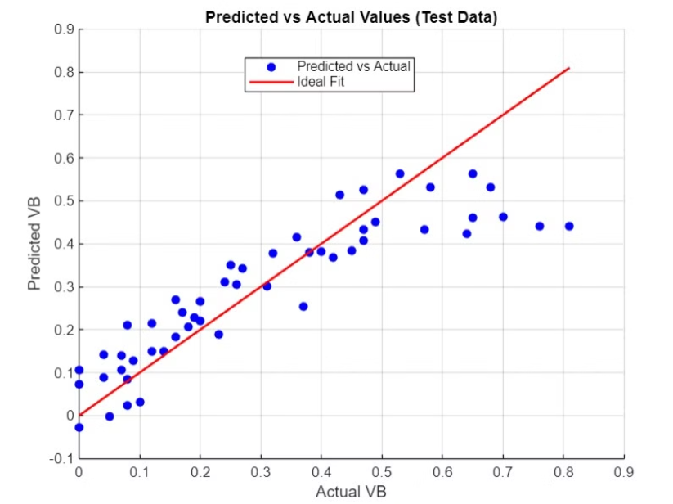
comparing models through visualization
linear regression model for score 1
linear regression model for score 2

