Slide 1

Fraud Switch
Enterprise Payment Fraud Detection Platform
Real-time fraud evaluation with intelligent routing, PCI-compliant security, and multi-region deployment for payment gateways
Payment Gateway Integration
Architecture Overview 2025

Slide 2
Executive Summary
Ultra-Low Latency
Single Integration Point
Enterprise Security
<100ms p99
One API connects to multiple fraud providers (Ravelin, Signifyd) with intelligent routing and failover.
PCI-compliant with AES-256-GCM encryption, 30-minute DEK rotation, and OAuth 2.0 authentication.
FraudSight product with parallel processing and circuit breakers for optimal performance.
Global Scale
Complete Observability
Production Ready
1,300 TPS
OpenTelemetry, Instana APM, ELK, Grafana dashboards.
8 microservices, auto-scaling, comprehensive error handling.
Multi-region (US-Ohio, UK-London) with 99.9% SLA.

Slide 3
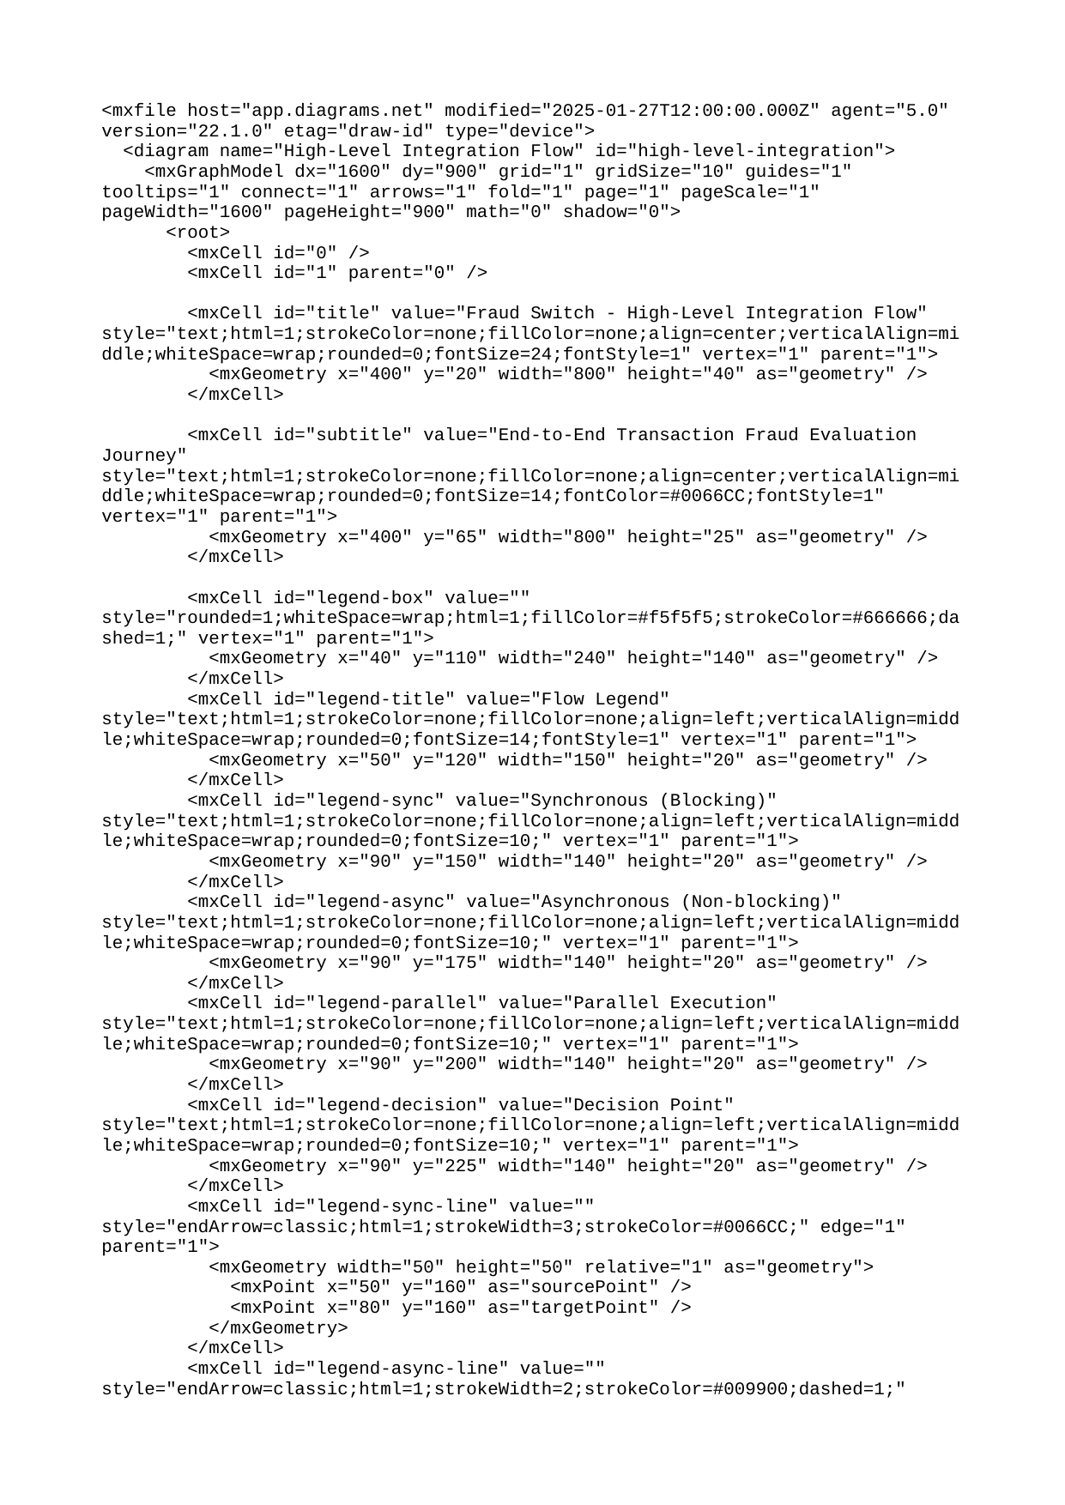
High-Level Integration Flow

Slide 4
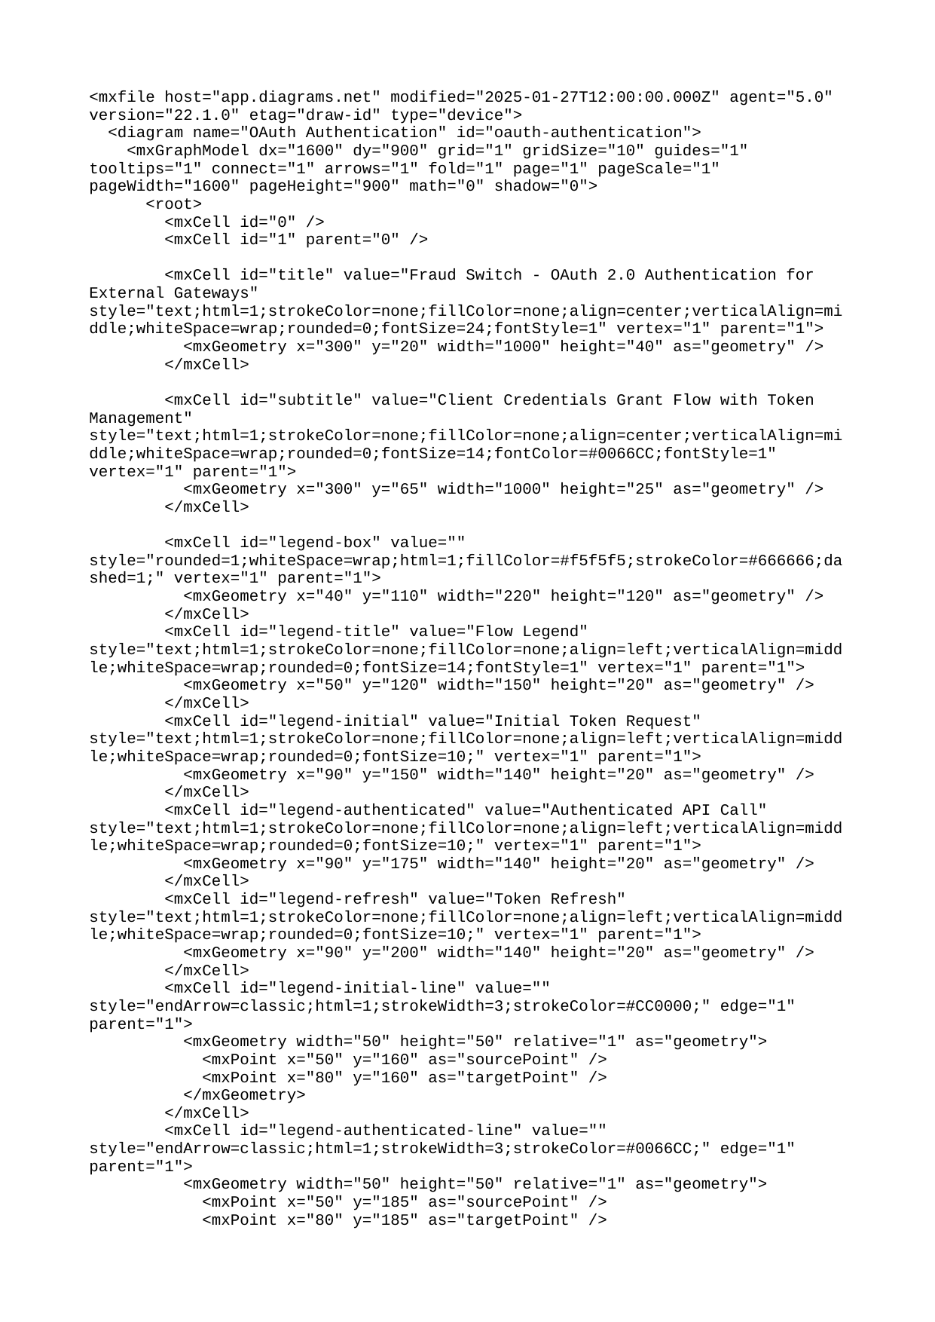
OAuth 2.0 Authentication

Slide 5
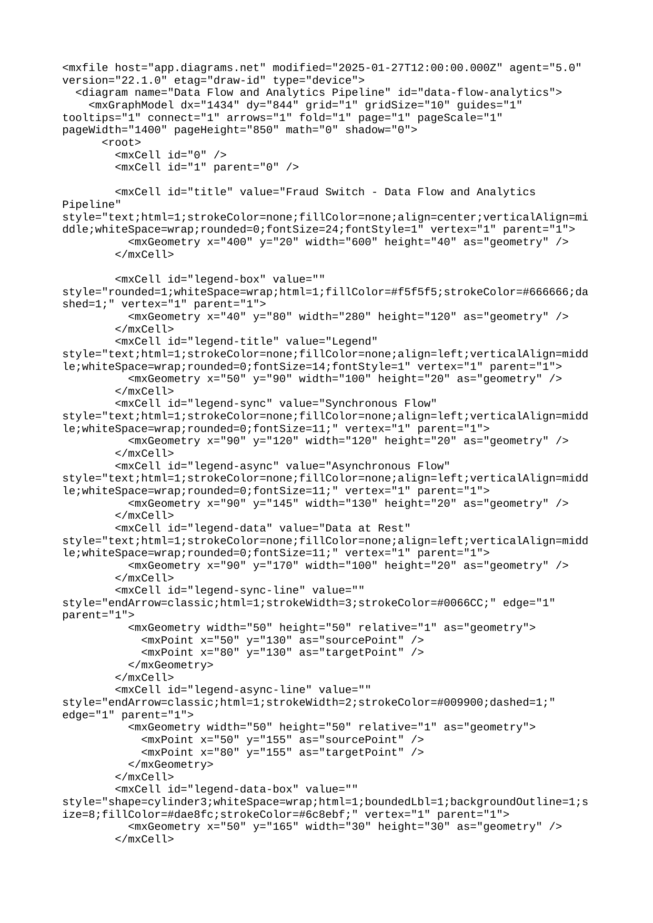
Data Flow & Analytics Pipeline

Slide 6
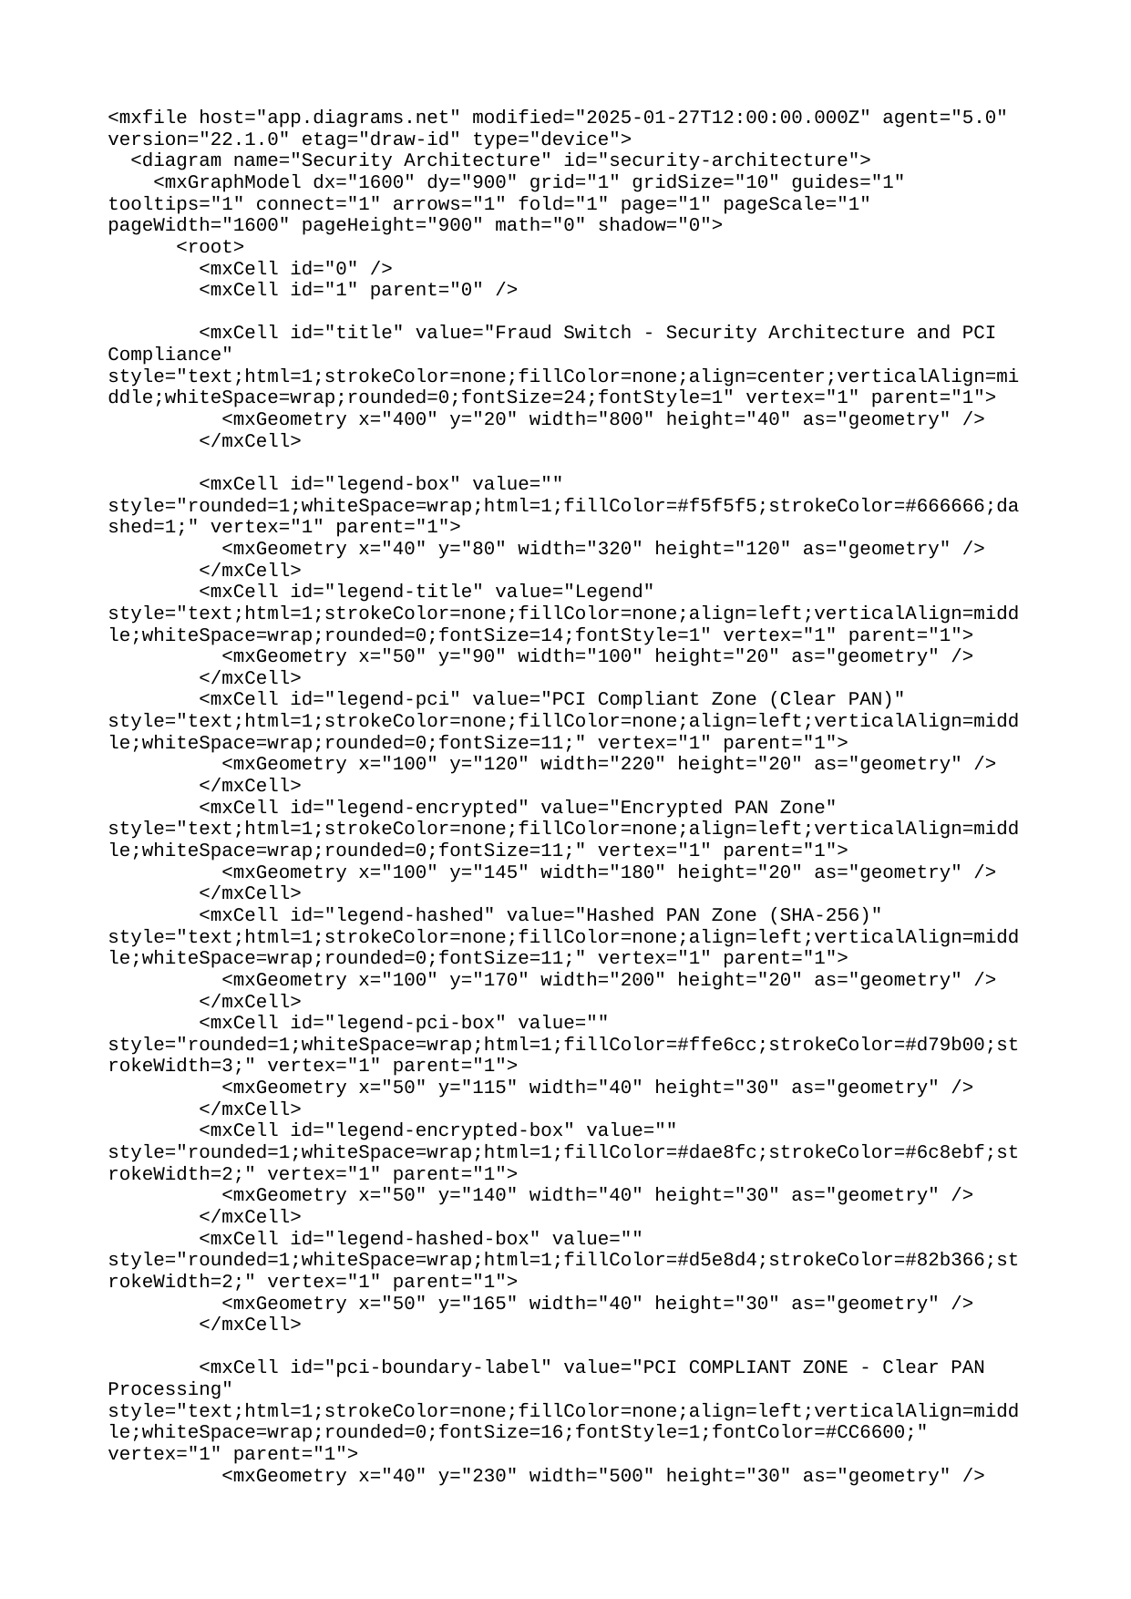
Security Architecture

Slide 7
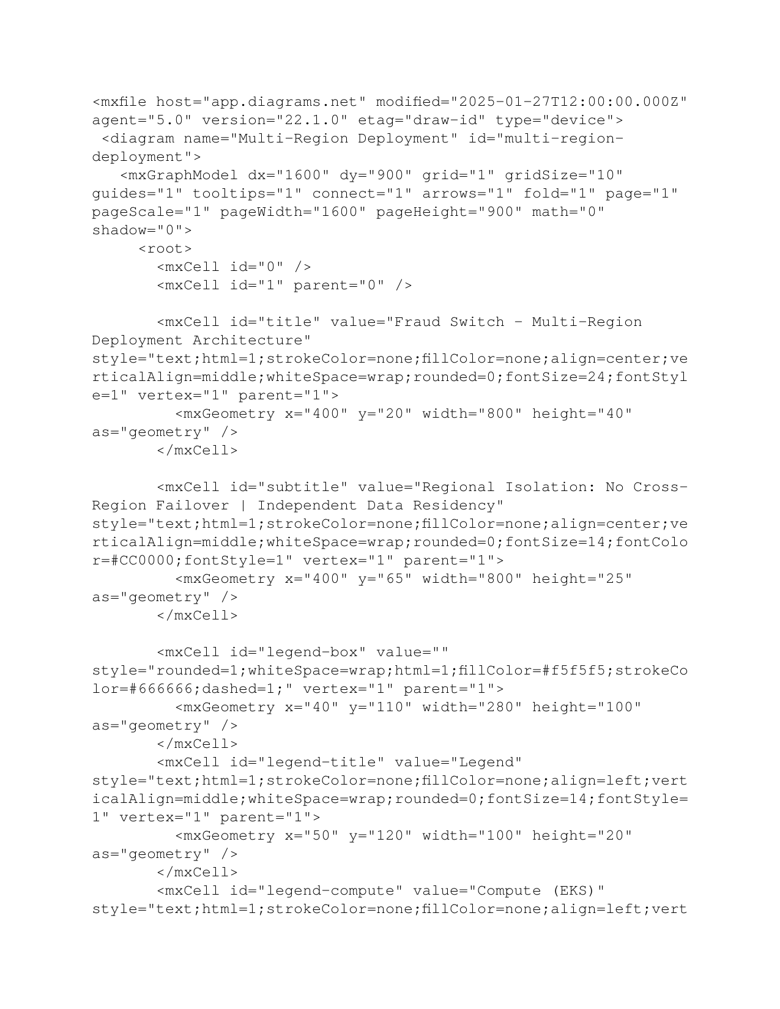
Multi-Region Deployment

Slide 8
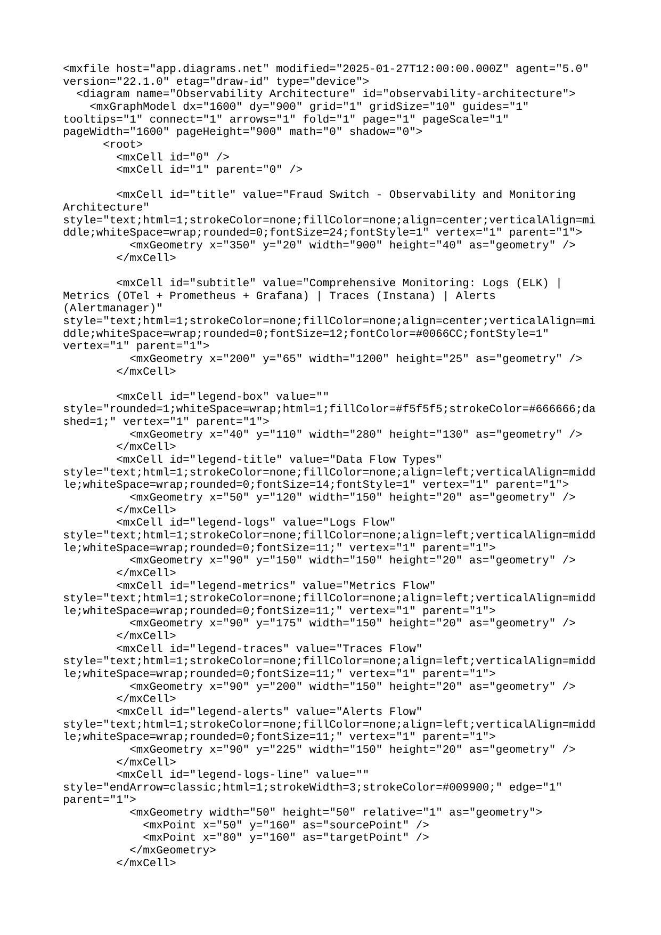
Observability & Monitoring

Slide 9
Key Performance Metrics
Performance Targets
FraudSight Latency (p99)
<100ms
GuaranteedPayment (p99)
<350ms
Sync Throughput
300 TPS/region
Async Throughput
1,000 TPS/region
Availability
99.9% SLA

Slide 10
Integration Requirements
Required Transaction Data
Onboarding Process
Technical Requirements
PAN (clear text, encrypted in transit)
Transaction amount and currency
Merchant ID and metadata
Customer details (name, email, address)
Device fingerprint (optional but recommended)
Gateway registration and approval
client_id and client_secret provisioning
IP whitelist configuration
Sandbox environment testing
Load testing validation
Production deployment approval
HTTPS/TLS 1.2+ support
OAuth 2.0 client credentials flow
JSON request/response format
IP whitelisting capability
Token refresh implementation
Circuit breaker pattern support

Slide 11

Next Steps
Integration Timeline
Technical deep-dive session with architecture team
Review API documentation and integration guide
Sandbox environment provisioning and OAuth setup
Development and testing (2-4 weeks typical)
Load testing and performance validation
Production deployment and go-live support
Ready to Get Started?
Contact: fraud-switch-integrations@company.com

