Slide 1
TIDE-HF
Trajectory Integrated Decision Engine for Heart Failure
Chronic Heart Failure Medication Titration
Max Pierson · Chinmaya Sri Rama Seshu Pasupuleti · Krishna Chaitanya Bhupathi Raju
Team ROC · MS Data Science, University at Buffalo
Client: QAS.AI · Supervisor: Dr. Ciprian Ionita

Slide 2
THE PROBLEM
Heart failure is the silent epidemic.
HFrEF patients need continuous medication titration after discharge.
26M+
50%
<25%
Americans with CHF
Readmitted within 6 months
Receive optimal GDMT
#1 cause of hospitalisation
in patients over 65
$30 billion annual cost
to US healthcare
Significant gap between
guidelines and practice
HFrEF patients need continuous personalised medication titration after discharge — current systems fail them.
TIDE-HF — Trajectory Integrated Decision Engine for Heart Failure
2 / 17

Slide 3
GUIDELINE-DIRECTED MEDICAL THERAPY
Four foundational drug classes — Day 1.
All four classes initiated simultaneously per STRONG-HF.
ARNI
Beta-Blocker
MRA
SGLT2i
CONTRAINDICATIONS
CONTRAINDICATIONS
CONTRAINDICATIONS
CONTRAINDICATIONS
Angioedema history
Pregnant / nursing
Liver dysfunction
ACEi within 36 hours
HR < 50–60 BPM
Active bronchospasm
2nd/3rd heart block
Cardiogenic shock
Hyperkalemia
Renal insufficiency
Creatinine > 2.0 (M) / 1.8 (F)
eGFR < 30
Pregnant / nursing
Dialysis
MONITOR
MONITOR
MONITOR
MONITOR
Hypotension < 90/60
Creatinine > 3 mg/dL
Potassium > 5.5 mEq/L
HR > 110 / SBP < 120
Hypotension
Worsening HF
K 5.5–5.9 → 50% dose
K > 6.0 → stop
Resume when normal
eGFR decline
Ketoacidosis
Volume depletion
May reduce diuretic needs
Prioritise titration first
Check K+ at 1wk · 1mo · 3mo
Initial dose = target dose
TIDE-HF — Trajectory Integrated Decision Engine for Heart Failure
3 / 17

Slide 4
SOLUTION ARCHITECTURE
From daily monitoring to clinical decision support.
5-stage intelligent pipeline.
1
2
3
4
5
Data
Collection
ML Agent
EHR
Integration
Titration
Logic (GOFAI)
Clinician
Decision
HR/BP, SpO2
ECG, Weight
1–2× daily
Weekly run
Boolean symptom
classification
Labs, conditions
Meds and doses
Patient history
GDMT guardrails
Conditional rules
Dose adjustments
Recommendation
Prescription
Lab orders
Future: LLM layer to communicate decisions to patients — describe side effects and lifestyle recommendations.
TIDE-HF — Trajectory Integrated Decision Engine for Heart Failure
4 / 17

Slide 5
DATA REQUIREMENTS
What data do we need?
Two categories of data are required to build the TIDE-HF decision engine.
Patient Vitals
GDMT Medications
ECG
Beta-Blockers
Cardiac rhythm — 12-lead waveform
Bisoprolol · Carvedilol · Metoprolol
RAAS Inhibitors
Blood Pressure
ACEi · ARB · ARNi (Entresto)
Systolic & diastolic — mmHg
Diuretics
Heart Rate
Furosemide · Torsemide · Bumetanide
Beats per minute — BPM
SGLT-2 Inhibitors
Empagliflozin · Dapagliflozin
Oxygen Levels
MRA
SpO₂ saturation — %
Spironolactone · Eplerenone
TIDE-HF — Trajectory Integrated Decision Engine for Heart Failure
5 / 17

Slide 6
DATA SOURCE
What is MIMIC?
MIMIC = Medical Information Mart for Intensive Care
HOSPITAL
TIME PERIOD
Beth Israel Deaconess Medical Center — Boston, MA
2008 — 2022 (14 years of patient records)
PATIENTS
MAINTAINED BY
546,028 unique patients admitted
Massachusetts Institute of Technology (MIT)
Every patient record includes:
Vitals
Lab Tests
Medications
Diagnoses
ECGs
Doctors' Notes
Hospital stays
ICU records
TIDE-HF — Trajectory Integrated Decision Engine for Heart Failure
6 / 17

Slide 7
MIMIC-IV-ECG
Open-access ECG waveform dataset.
Directly linked to MIMIC-IV clinical records via subject_id.
800,035
160K+
12
500 Hz
ECG
Recordings
Unique
Patients
Leads per
Recording
Sampling
Frequency
record_list.csv
800,035 rows
Index of all ECG recordings — subject_id, study_id, ecg_time, waveform file path
machine_measurements.csv
800,035 × 33 cols
Automated measurements: RR interval, QRS duration, P/QRS/T axes, HR, PR interval + 15 report text columns
waveform_note_links.csv
609,272 rows
Links ECG study IDs to clinical discharge notes — enables cross-referencing waveforms with clinical data
TIDE-HF — Trajectory Integrated Decision Engine for Heart Failure
7 / 17

Slide 8
DATA EXTRACTION PIPELINE
Read directly from local MIMIC-IV files.
From raw clinical tables to one-row-per-visit master.csv.
1
Load
Patient IDs
2
Read MIMIC
Tables
3
Filter &
Classify
14,729 pure HFrEF
patients, diagnoses
labs, prescriptions
ICD codes → class
lab thresholds
4
Process
Vitals
5
Add ECG
Features
6
Export
Output
ICU + chartevents
machine_measurements
computed flags
Master.csv
One row per Visit · all joined
TIDE-HF — Trajectory Integrated Decision Engine for Heart Failure
8 / 17

Slide 9
COHORT CONSTRUCTION
HFrEF cohort construction.
Filtered 546,028 patients down to the relevant HFrEF cohort using ICD codes.
546,028
14,729
61,353
7
MIMIC-IV
Total Patients
Pure HFrEF
(19 ICD codes)
Expanded CHF
(113 ICD codes)
Comorbidity
Classes
Pure HFrEF ICD-10 (11 codes)
Adverse Effect Classes (6 groups)
Classification Logic
I50 — Heart failure
I5020 — Unspecified systolic HF
I5021 — Acute systolic HF
I5022 — Chronic systolic HF
I5023 — Acute-on-chronic systolic HF
I5040–I5043 — Combined HF
Chronic Kidney Disease (46 codes)
Hyperkalemia (E875, E8751, E8759)
Hypotension (I951–R030, 9 codes)
Edema (R609, R6000–R6009)
Bradycardia (R001)
Ketoacidosis (14 codes)
Healthy = HFrEF + NO comorbidities
CKD = ICD code OR Creatinine > 3.0
Hyperkalemia = ICD OR K⁺ > 5.5 mEq/L
Hypotension = ICD OR SBP < 90 mmHg
Bradycardia = ICD OR HR < 50 BPM
Ketoacidosis / Edema = ICD code only
TIDE-HF — Trajectory Integrated Decision Engine for Heart Failure
9 / 17

Slide 10
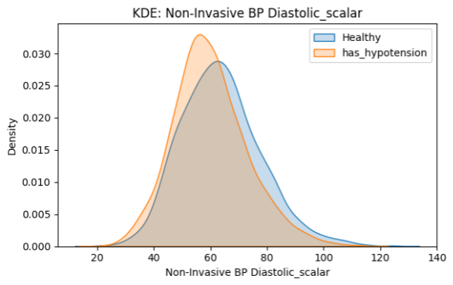
FIRST CLASSIFIER RESULTS
Why visit-level features were a dead end.
Random forest on visit-level features couldn't separate the classes.
Setup & finding
KDE — Healthy vs. has_hypotension
Data filtered to strict CHF cohort.
Random forest on visit-level features.
Three feature strategies — earliest, median, full summary stats — all performed similarly.
Some success on bradycardia + ketoacidosis. Most other classes ≈ coin flip.
ROOT CAUSE
MIMIC vital trajectories come from ER/ICU encounters — not home monitoring.
"Healthy" and adverse-effect classes overlap heavily on every vital we tracked. Visit-level features were a dead end — we needed synthetic trajectories.
Distributions overlap → low signal
TIDE-HF — Trajectory Integrated Decision Engine for Heart Failure
10 / 17

Slide 11
THE PIVOT
Synthetic patient-weeks anchored in real MIMIC contexts.
Each row = one week of twice-daily vitals + ECG (14 timepoints) for a single patient context.
1
Sample labels
2
Sample context
3
Synthesize week
4
Optional confirm-labs draw
Balanced over the 11 adverse-effect flags
Forces enough positives per class
Real MIMIC visit
Demographics, baseline labs, GDMT prescription pattern
14 vital + ECG timepoints
Trajectory consistent with sampled labels
Mirror baseline labs schema
End-of-week values where applicable
Default training set: 10,000 weeks · Generation takes ~90s in mimic mode.
synthetic_CHF_visits_v2.parquet (135 MB MIMIC-seeded contexts) → synthetic_data_weeks.parquet → 108-feature vector → 11 LightGBM classifier heads.
TIDE-HF — Trajectory Integrated Decision Engine for Heart Failure
11 / 17

Slide 12
CLASSIFIER V2
11 LightGBM heads on a 108-feature vector.
One classifier head per adverse-effect flag.
Feature blocks (108 total)
Per-flag test-set AUROC
Per-vital channel statistics — 40
hypotension_detected
0.93
5 channels × 8 stats (mean/min/max/range/first/last/slope/n_missing)
severe_hypotension_detected
0.97
bradycardia_detected
0.95
Per-ECG-scalar statistics — 18
severe_bradycardia_detected
0.98
6 channels × 3 stats (mean/min/max)
volume_depletion_detected
0.91
worsening_HF_detected
0.89
ECG pattern + quality — 16
hyperkalemia_detected
0.84
T-peaked, rhythm one-hot, signal quality
renal_dysfunction_detected
0.81
hyponatremia_detected
0.78
Demographics + medication state — 34
metabolic_acidosis_detected
0.79
Age, sex, per-class on/off, dose, target, ratio
any_emergency_flag
0.96
TIDE-HF — Trajectory Integrated Decision Engine for Heart Failure
12 / 17

Slide 13
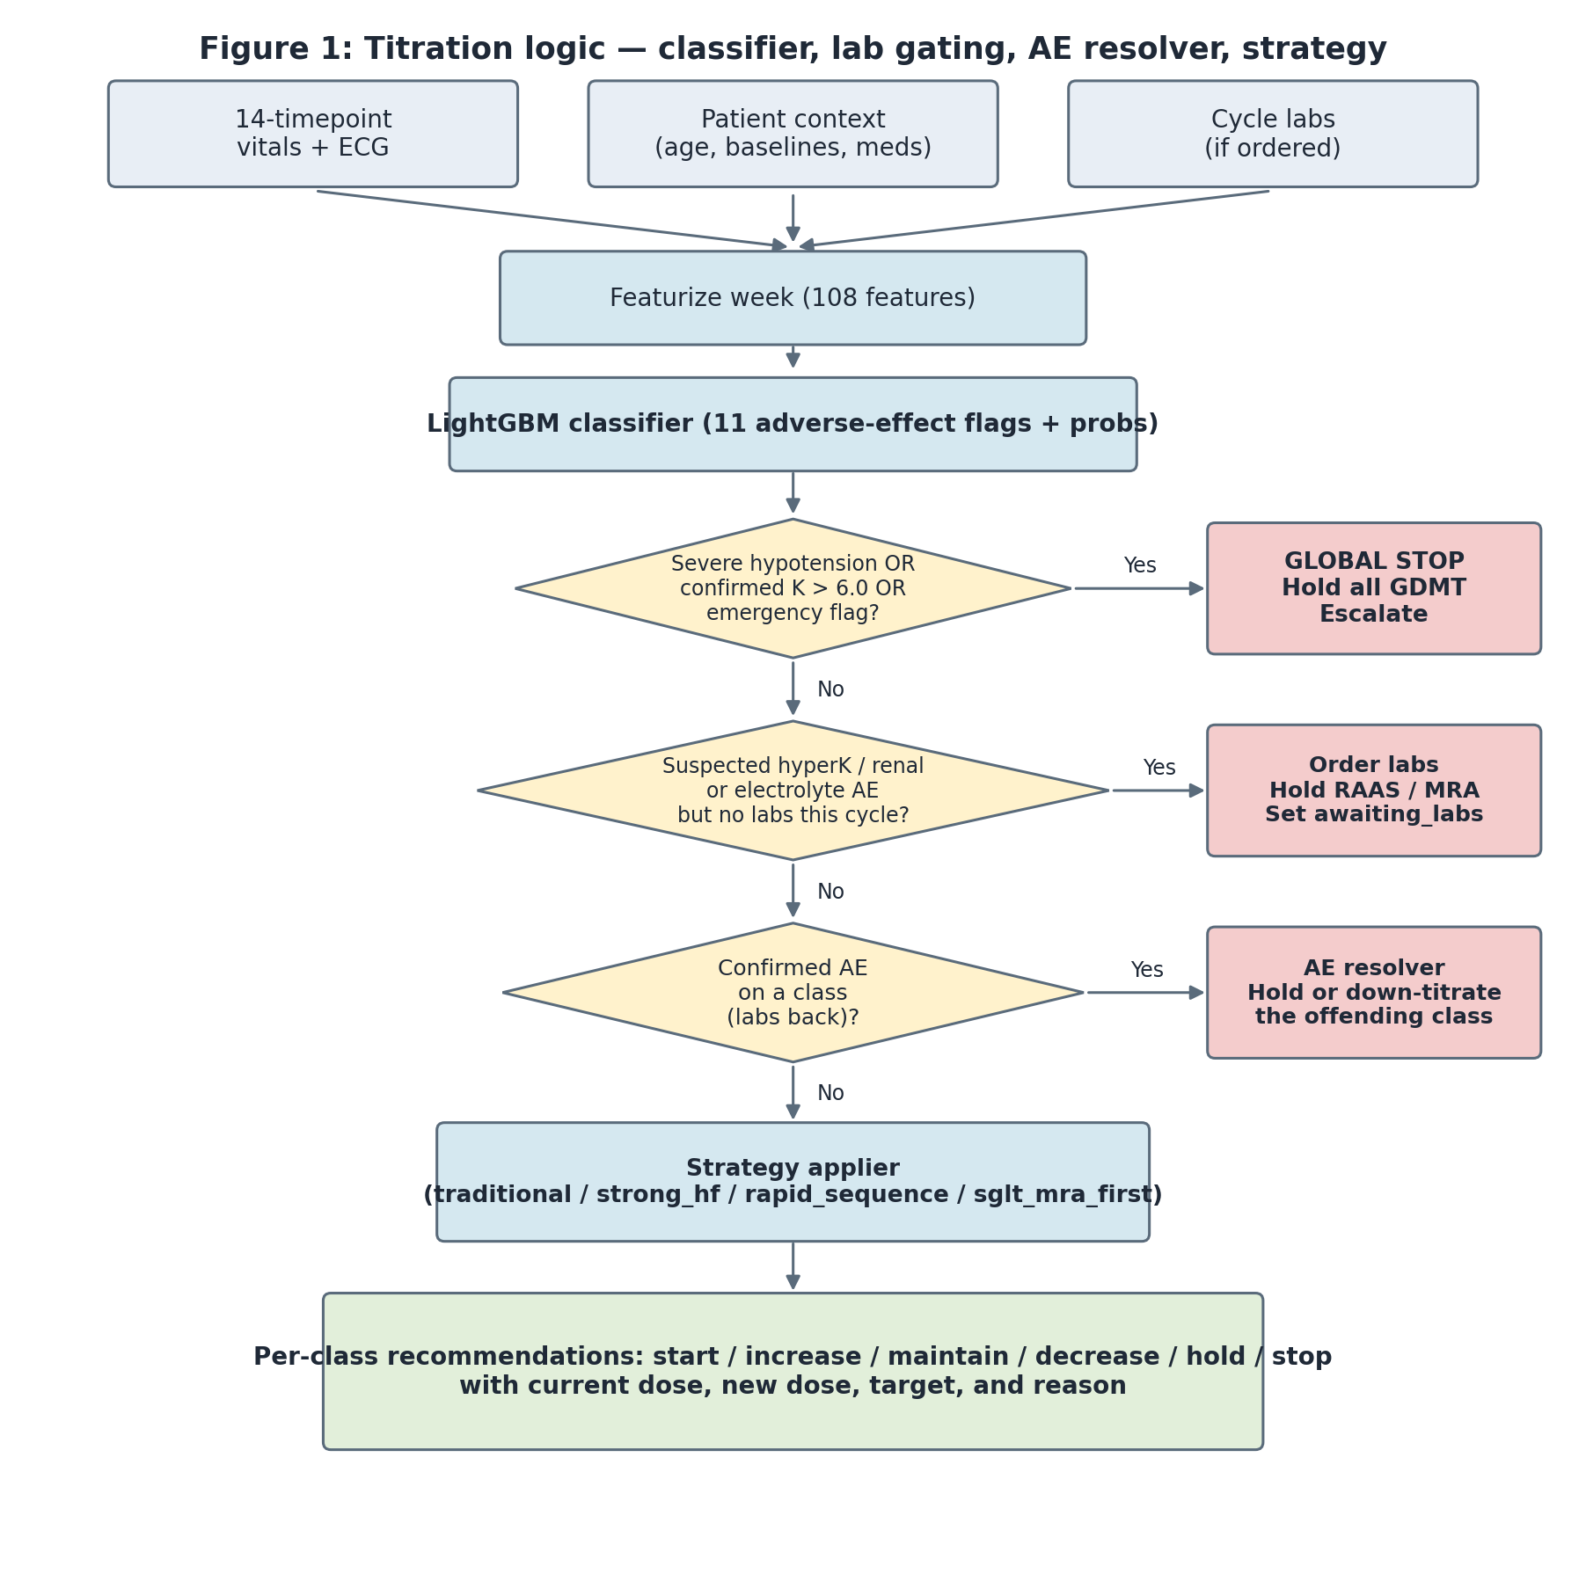
DECISION LOGIC
Titration engine: lab gating + AE resolver.
Every action carries a reason — auditable and contraindication-aware.
Figure 1 — Titration logic
Decision points
Global stop
Severe hypotension or brady, K > 6, emergency. All GDMT held. Escalate.
Suspected lab AE, no labs yet
Hold gated classes, set awaiting_labs, request labs.
Confirmed AE (labs back)
AE resolver hold/decreases the offending class.
Otherwise → strategy applier
Per-class action: maintain · increase · decrease · hold.
TIDE-HF — Trajectory Integrated Decision Engine for Heart Failure
13 / 17

Slide 14
ONCE IT'S SAFE TO TITRATE
Four selectable strategies.
Each strategy returns a per-class change record with explicit reasoning.
STRATEGY
BEHAVIOR
RATIONALE
traditional
One new class per week, in the order RAAS → BB → MRA → SGLT2i → loop. Single-rung steps.
Closest to conservative ladder (Emory 2025)
strong_hf
All eligible classes started simultaneously. Double-rung up-titration.
100% of target in 2 weeks (STRONG-HF, Lancet 2022)
rapid_sequence
All eligible classes started simultaneously. Single-rung steps.
Greene 2021 compromise
sglt_mra_first
Phase 1: SGLT2i + MRA. Phase 2: ARNi + beta-blocker.
Built around safest tolerability profile
Per-class change record: action · current dose · new dose · dose ratio · free-text reason for the patient-facing explanation.
TIDE-HF — Trajectory Integrated Decision Engine for Heart Failure
14 / 17

Slide 15
TIDE-HF ASSISTANT
Decisions you can ask questions to.
A clinical co-pilot — grounded in the engine, AHA 2022, STRONG-HF, and drug monographs.
PATIENT MODE
CLINICIAN MODE
Plain-language answers, in their words.
Engine-grounded, citation-backed reasoning.
"What do my heart-failure medications do?"
"Why did the engine hold the MRA this week?"
"Why was my dose changed this visit?"
"Show the contraindication trail for ARNI."
"What symptoms should I watch for this week?"
"Which AE flag triggered global_stop?"
"When should I call the doctor?"
"Cite the AHA 2022 source for this dose change."
Same engine, two voices. The patient gets reassurance. The clinician gets receipts.
TIDE-HF — Trajectory Integrated Decision Engine for Heart Failure
15 / 17

Slide 16
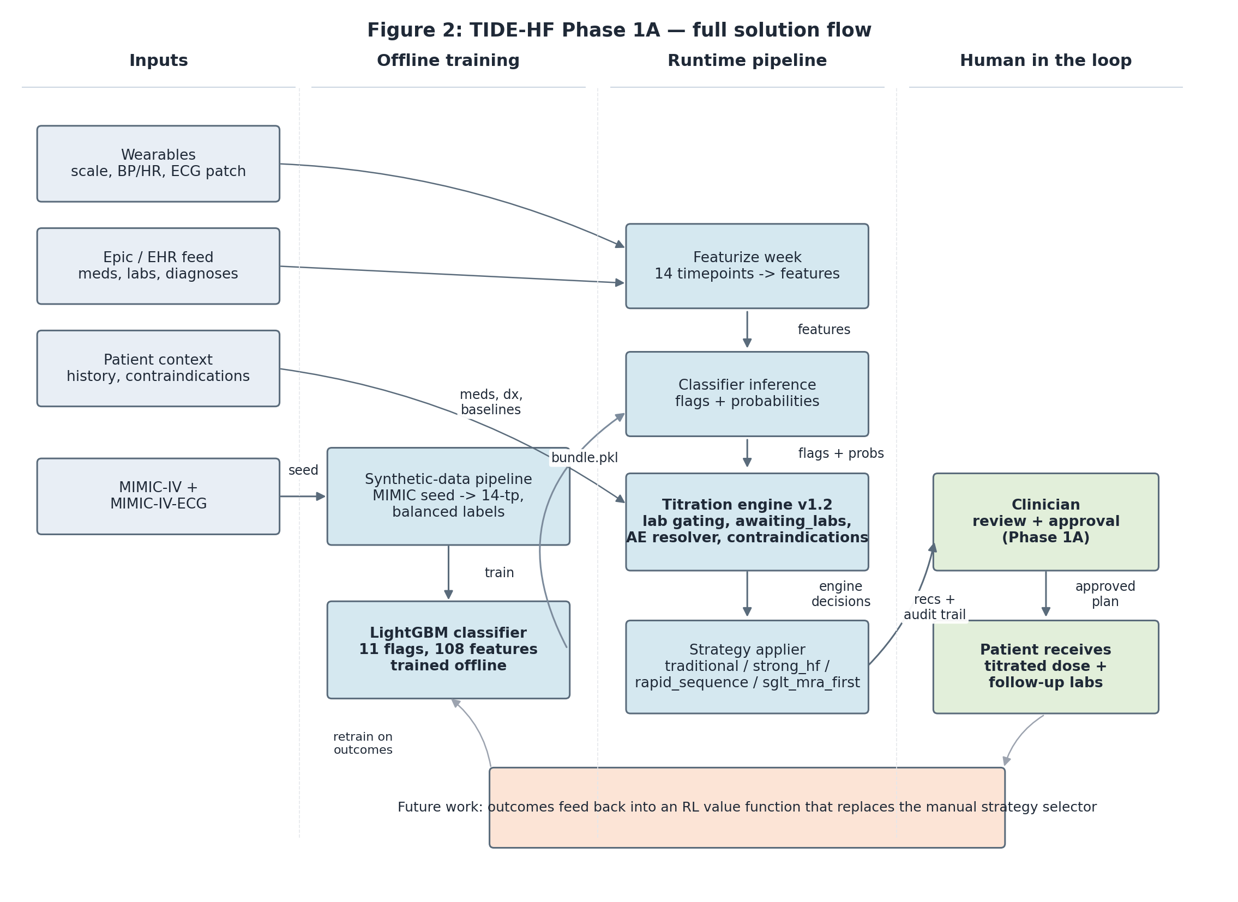
LIVE DEMO
End-to-end solution.
Streamlit UI tying the full pipeline to a clinician-facing review screen.
Figure 2 — TIDE-HF Phase 1A — full solution flow
STREAMLIT UI
What the demo shows
Pick a preset
Inspect EHR snapshot
Review classifier flags
Engine + strategy decisions
Order-labs / global-stop banner
Patient-friendly summary (RAG)
TIDE-HF — Trajectory Integrated Decision Engine for Heart Failure
16 / 17

Slide 17
Thank you.
Questions, critiques, and curiosities — we'd love to hear them.
EXPLORE THE PROJECT
ramaseshu0.github.io/TIDE-HF
Live demo, architecture deep-dives, and our previous milestone presentations.
Team ROC · Max Pierson · Chinmaya Sri Rama Seshu Pasupuleti · Krishna Chaitanya Bhupathi Raju
MS Data Science · University at Buffalo · Client: QAS.AI · Supervisor: Dr. Ciprian Ionita
Q & A

