Slide 1
RESTful web services with Java (JAX-RS) using Jersey

Slide 2
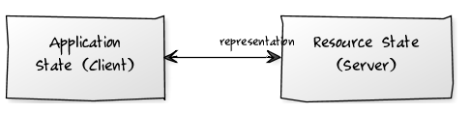
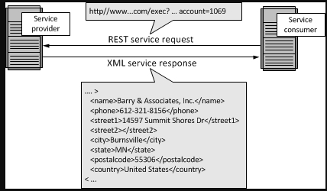
REST
REpresentational State Transfer
REST permits different data format such as Plain text, HTML, XML, JSON etc.
architectural style

Slide 3
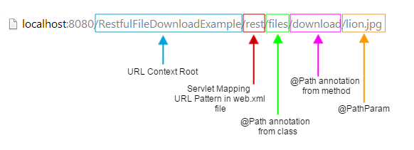
REST uses URI to expose business logic.
Request {
method type : GET | POST | PUT | DELETE
URI : http://WWW.demo.com/rest/resourcename/methodName”
data : in form of json / xml …
header :
}
Response {
      SuccessCallBack { … }
      ErrorCallBack { … }
}

Slide 4
Requirement for build a project
Elipse
Java JDK
Apache topcat server
Apache Mavin Build tool
MySQL
Heidisql (optional)
Client side
      HTML
      Style
      script

Slide 5
Steps to create RESTfull web application.
Step 1 :create Dynamic web project .
Step 2: convert it to maven project .
use of maven
update library through dependancy
Clean
install – to generate jar , war (webapp arch..) ..
Step 3 : Edit Pom.xml
Step4 : creating packages and java classes .

Slide 6
Step 5 : Edit web.xml
Step 6 : Create HTML pages .
Step 7 : Maven Build
Step 8 :Run on server .

Slide 7


