Slide 1
GENERATED WITH AI
Software Engineering
Building robust, scalable, and maintainable digital systems
10 SLIDES
01

Slide 2
AI PRESENTATION
OVERVIEW
What is Software Engineering?
• The systematic application of engineering approaches to the development of software.
• Aims to produce reliable, efficient, and cost-effective software solutions.
• Balances technical constraints with business and user requirements.
02

Slide 3
AI PRESENTATION
KEY IDEAS
Core Pillars
01
02
03
Maintainability: Code must be readable and easily modifiable by future developers.
Scalability: Systems should handle growing amounts of work gracefully.
Reliability: Software must perform consistently without unexpected failures.
03

Slide 4
AI PRESENTATION
COMPARISON
Methodology Shift
Waterfall
Agile
Linear and sequential approach with distinct phases like requirements, design, implementation, and testing.
Iterative approach focusing on continuous collaboration, customer feedback, and small rapid releases.
04

Slide 5
AI PRESENTATION
PROCESS
The Software Development Life Cycle
01
02
03
04
05
Requirement Analysis: Gathering and defining system needs.
System Design: Architecting the software structure and databases.
Implementation: Writing code and building features.
Testing: Identifying and resolving bugs and performance bottlenecks.
Deployment and Maintenance: Releasing to production and providing ongoing updates.
05

Slide 6
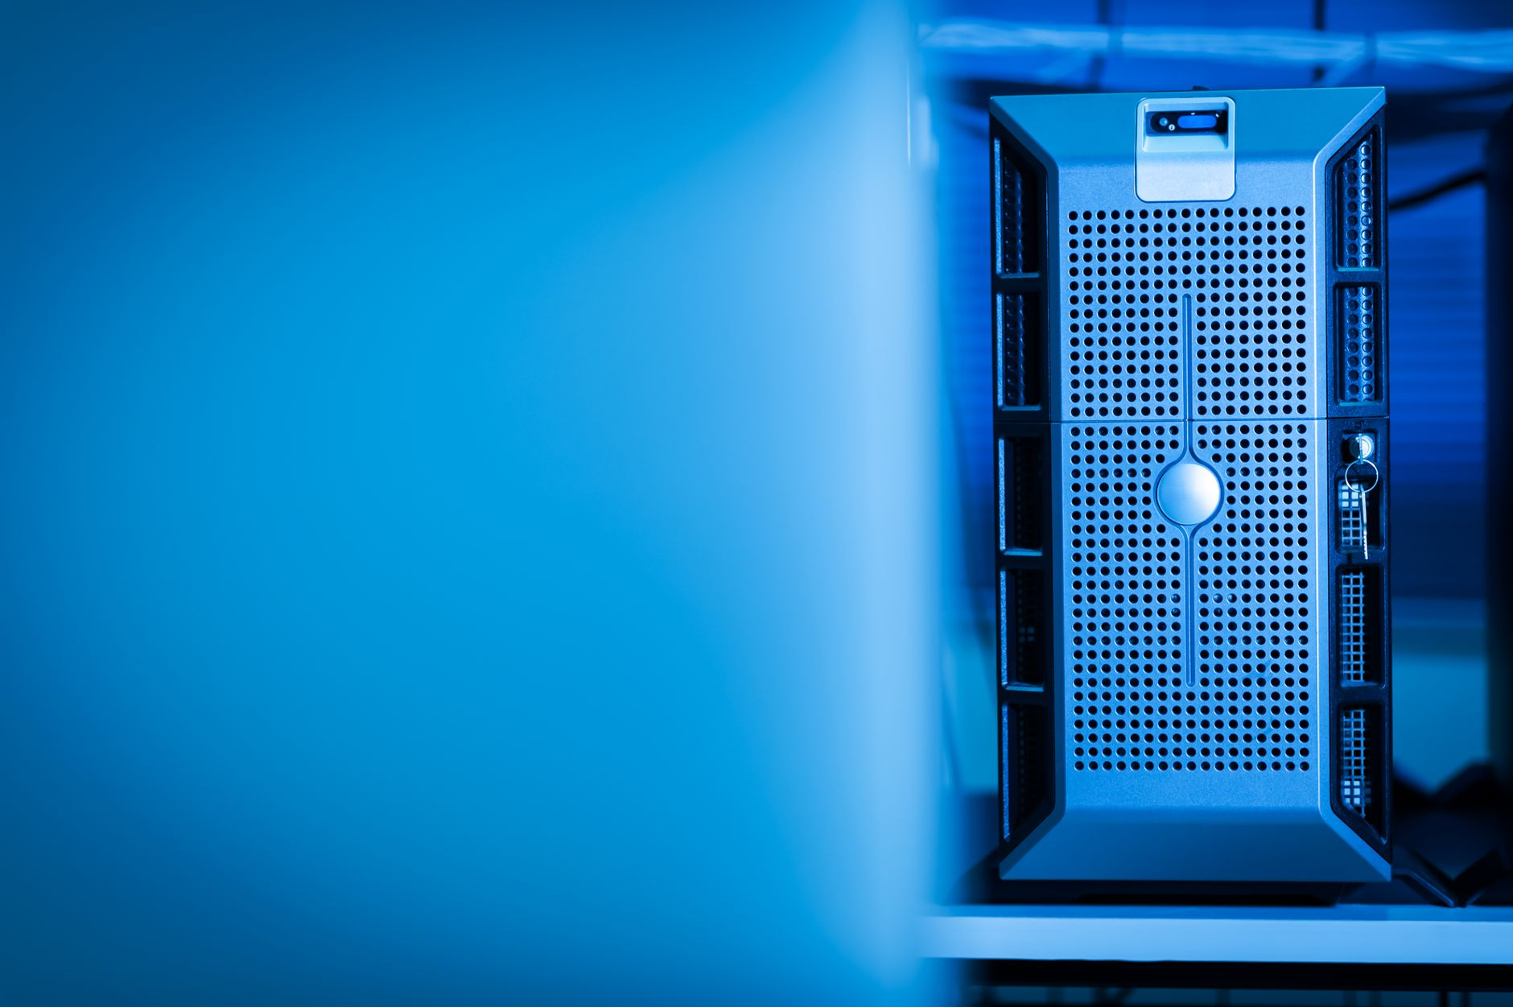
AI PRESENTATION
VISUAL
Modern Architecture
• Decomposition of monolithic applications into independent services.
• Improved fault isolation and independent deployment cycles.
• Enhanced scalability for high-traffic web applications.
06

Slide 7
AI PRESENTATION
KEY IDEAS
Quality Assurance
01
02
03
Unit Testing: Verifying individual components or functions in isolation.
Integration Testing: Ensuring combined modules work together seamlessly.
Automated CI/CD: Running tests and deploying builds automatically on every commit.
07

Slide 8
AI PRESENTATION
QUOTE
Design Philosophy
“
Programs must be written for people to read, and only incidentally for machines to execute.
08

Slide 9
AI PRESENTATION
METRIC
The Cost of Maintenance
60-80%
Of total software costs typically spent on maintenance and updates rather than initial development.
09

Slide 10
END
The Future of Engineering
Looking ahead
10

