Slide 1






Kanban Board
Member 1: John Doe (XXXXXXXXX)
Member 2: John Doe (XXXXXXXXX)
Member 3: John Doe (XXXXXXXXX)
Member 4: John Doe (XXXXXXXXX)

Slide 2

Technology
FRONTEND: REACT JS
BACKEND: SPRINGBOOT
DATABASE: MYSQL

Slide 3
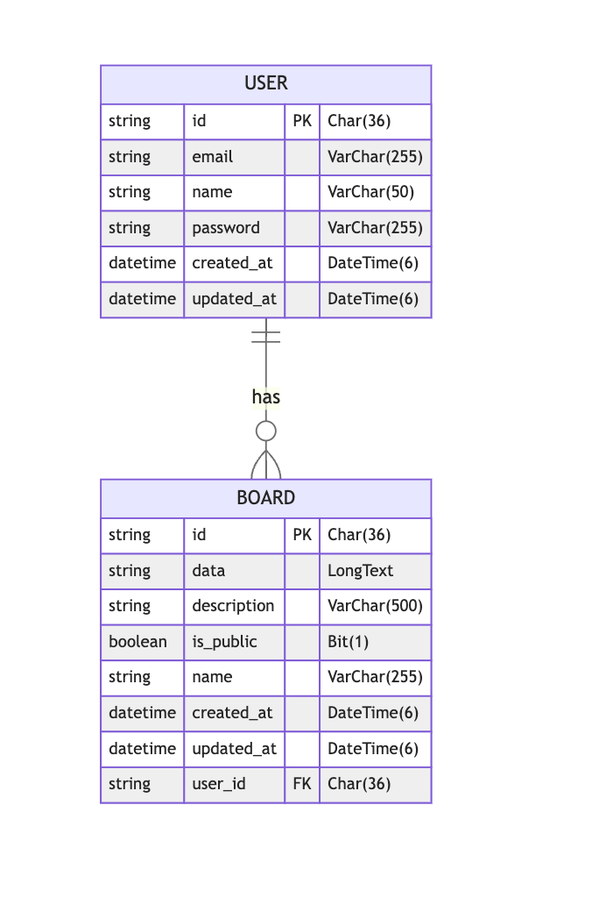
ER Diagram

Slide 4
Features
Kanban Board app developed with ReactJS and Spring Boot
Work stages in columns
Enables creating, editing, and deleting stages and tasks
Drag-and-drop interface
JWT Session Cookies for user account authentication

Slide 5
References
JIRA CLONE https://github.com/zayarlyn/jira-clone
DnD Core Kit https://dndkit.com/
Multiple Container Example https://master--5fc05e08a4a65d0021ae0bf2.chromatic.com/?path=/story/presets-sortable-multiple-containers--trashable-items

