Slide 1
Object Oriented Programming

Slide 2
Object Oriented (OO)
People often use the acronym OO to stand for anything object-oriented, yielding acronyms such as the following:
OOP - Object-oriented programming
OOA - Object-oriented analysis
OOD - Object-oriented design

Slide 3
History of Object Oriented Programming.
OOP concepts started surfacing in the mid-1960s with a programming language called Simula.
It further evolved in the 1970s with advent of Smalltalk.
A resurgence of interest in object-oriented methodologies occurred in the mid-1980s. Specifically, OOP languages such as C++ and Eifle became popular with mainstream computer programmers
OOP continued to grow in popularity in the 1990s, most notably with the advent of Java.
In 2002, in conjunction with the release of the .NET Framework, Microsoft introduced a new OOP language, C#
Notes:
Users of software programs are isolated from the logic needed to accomplish a task. For example, when you print a page in your word processor, you initiate the action by clicking a print button. You are isolated from the internal processing that needs to occur; you just wait for a response telling you if it printed. Internally, the button object interacts with a printer object, which interacts with the printer to accomplish the task of printing the page.
OOP concepts started surfacing in the mid-1960s with a programming language called Simula and further evolved in the 1970s with advent of Smalltalk. Although software developers did not overwhelmingly embrace these early advances in OOP languages, object-oriented methodologies continued to evolve. A resurgence of interest in object-oriented methodologies occurred in the mid-1980s. Specifically, OOP languages such as C++ and Eifle became popular with mainstream computer programmers. OOP continued to grow in popularity in the 1990s, most notably with the advent of Java and the huge following it attracted. And in 2002, in conjunction with the release of the .NET Framework, Microsoft introduced a new OOP language, C# (pronounced C-sharp) and revamped Visual Basic so that it is truly an OOP language.

Slide 4
Procedural Programming
Procedural languages organize the program in a linear fashion—they run from top to bottom.
In other words, the program is a series of steps that run one after another.
This type of programming worked fine for small programs that consisted of a few hundred code lines, but as programs became larger, they became hard to manage and debug.

Slide 5
Structured Programming
In an attempt to manage the ever-increasing size of the programs, structured programming was introduced to break down the code into manageable segments called functions or procedures.
This was an improvement, but as programs performed more complex business functionality and interacted with other systems, the shortcomings of structural programming methodology began to surface:
Programs became harder to maintain.
Existing functionality was hard to alter without adversely affecting all of the system’s functionality.
New programs were essentially built from scratch. Consequently, there was little return on the investment of previous efforts.
Programming was not conducive to team development. Programmers needed to know every aspect of how a program worked and could not isolate their efforts on one aspect of a system.
It was hard to translate business models into programming models.
Notes:
In addition to these shortcomings, some evolutions of computing systems caused further strain on the structural program approach:
Nonprogrammers demanded and were given direct access to programs through the incorporation of graphical user interfaces and their desktop computers.
Users demanded a more-intuitive, less-structured approach to interacting with programs.
Computer systems evolved into a distributed model where the business logic, user interface, and backend database were loosely coupled and accessed over the Internet and intranets.

Slide 6
Benefits of Object Oriented Programming
A more intuitive transition from business analysis models to software implementation models
The ability to maintain and implement changes in the programs more efficiently and rapidly
The ability to more effectively create software systems using a team process, allowing specialists to work on parts of the system
The ability to reuse code components in other programs and purchase components written by third-party developers to increase the functionality of programs with little effort
Better integration with loosely coupled distributed computing systems
Improved integration with modern operating systems
The ability to create a more intuitive graphical user interface for the users

Slide 7
What is an Object?
An object is a software construct that encapsulates data, along with the ability to use or modify that data, into a software entity.
An object is a self-contained entity which has its own private collection of properties (ie. data) and methods (ie. operations) that encapsulate functionality into a reusable and dynamically loaded structure.
Notes:
Booch defines an object as

Slide 8
About Object Oriented Programming
Object-Oriented Programming :
A large application consists of component objects, which interact with each other.
Can be used to develop various applications.

Slide 9
What is an Object (Continued)
An object has:
state
behavior
the structure and behavior of similar objects are defined in their common class.”

Slide 10
Example
MyCar
Accelerate
Brake
Change Gear
brand : Maruti
color : White
wheels : 4
speed : 45 kmph
gear : 3rd

Slide 11
What is an Object Oriented Program
An Object-Oriented Program consists of a group of cooperating objects, exchanging messages, for the purpose of achieving a common objective.

Slide 12
What is a Class?
A class is a blueprint or prototype that defines the variables and the methods common to all objects of a certain kind.
blueprint: A class can't do anything on its own.
defines: A class provides something that can be used later.
objects: A class can only be used, if it had been "brought to life" by instantiating it.

Slide 13
Example
A Car
Accelerate
Brake
Change Gear
brand
color
wheels
speed
gear

Slide 14
Methods
An operation upon an object, defined as part of the declaration of a class.
The methods, defined in a class, indicate, what the instantiated objects are able to do.

Slide 15
Example
Driver wants to increase the speed of the car?
A Car
Driver
Accelerate
Brake
Change Gear
brand: Maruti
color: White
wheels: 4
speed: 45 kmph
speed: 50 kmph
gear: 3rd

Slide 16
Question
Driver wants to decrease the speed of the car?
A Car
Click To
Know The Answer
Driver
Accelerate
Brake
Change Gear
brand: Maruti
color: White
wheels: 4
speed: 50 kmph
gear: 3rd

Slide 17
Answer
Driver wants to decrease the speed of the car?
A Car
Driver
Accelerate
Brake
Change Gear
brand: Maruti
color: White
wheels: 4
speed: 50 kmph
speed: 45 kmph
gear: 3rd

Slide 18
Advantages of OOP
Real-world programming
Reusability of code
Modularity of code
Information hiding

Slide 19
Features of OOPS
Encapsulation
Inheritance
Polymorphism

Slide 20
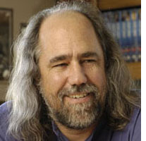
Encapsulation
Encapsulation is the ability of an object to place a boundary around its properties (ie. data) and methods (ie. operations).
Grady Booch, defined the encapsulation feature as:
“Encapsulation is the process of hiding all of the
details of an object that do not contribute to its
essential characteristics.”

Slide 21
Encapsulation (Example)
MyCar
Accelerate
Access Allowed
Brake
Other object
Change Gear
Access Denied
brand: Maruti
color: White
wheels: 4
speed: 45 kmph
gear: 3rd

Slide 22
Abstraction
“An Abstraction denotes the essential characteristics of an object that distinguishes it from all other kinds of objects and thus provides crisply defined conceptual boundaries, relative to the perspective of the viewer.”
Encapsulation hides the irrelevant details of an object and Abstraction makes only the relevant details of an object visible.

Slide 23
Inheritance
Inheritance is the capability of a class to use the properties and methods of another class while adding its own functionality.
Enables you to add new features and functionality to an existing class without modifying the existing class.

Slide 24
Inheritance (Continued)
Superclass and Subclass
A superclass or parent class is the one from which another class inherits attributes and behavior.
A subclass or child class is a class that inherits attributes and behavior from a superclass.

Slide 25
Inheritance (Continued)
Employee
Manager
Secretary
Programmer

Slide 26
Types of Inheritance
Single inheritance
Subclass is derived from only one superclass.
Super class
/Base Class
(Parent)
Sub class
/Derived Class
(Child)

Slide 27
Types of Inheritance (Continued)
Multiple Inheritance
A subclass is derived from more than one super class.
Super Class
(Parent 1)
Super Class
(Parent 2)
Sub Class
(Child)

Slide 28
Dynamic Method Binding
Dynamic Method Binding
At execution time, method calls routed to appropriate version
Method called for appropriate class
Example
Triangle, Circle, and Square all subclasses of Shape
Each has an overridden draw method
Call draw using superclass references
At execution time, program determines to which class the reference is actually pointing
Calls appropriate draw method

Slide 29
final Methods and Classes
Declaring variables final
Indicates they cannot be modified after declaration
Must be initialized when declared
Declaring methods final
Cannot be overridden in a subclass
static and private methods are implicitly final
Program can inline final methods
Actually inserts method code at method call locations
Improves program performance
Declaring classes final
Cannot be a superclass (cannot inherit from it)
All methods in class are implicitly final

Slide 30
Abstract Super classes and Concrete Classes
Abstract classes (abstract super classes)
Sole purpose is to be a super class
Other classes inherit from it
Cannot instantiate objects of an abstract class
Can still define constructor
Too generic to define real objects
Declare class with keyword abstract
Concrete class
Can instantiate objects
Provide specifics
Class hierarchies
Most general classes are usually abstract
TwoDimensionalShape - too generic to be concrete

Slide 31
Continued…
Object-Oriented Programming
Introduce protected member access
Relationships
"is a" - inheritance
Object of subclass "is a" object of the superclass
"has a" - composition
Object "has a" object of another class as a member
Class libraries
New classes can inherit from them
Someday software may be constructed from standardized, reusable components (like hardware)
Create more powerful software

Slide 32
Composition vs. Inheritance
"is a" relationship
Inheritance
"has a" relationship
Composition, having other objects as members
Example
Employee “is a” BirthDate; //Wrong!
Employee “has a” Birthdate; //Composition

Slide 33
Composition
This is ideal when an object of NewClass isn’t logically an object of OldClass
Fails the “is a” test
This is scheme is used by the input and output stream classes of the java.io package
Ex:
DataOutputStream out = new DataOutputStream(new FileOutputStream(“file.out”));
‘out’ stores the passed in FileOutputStream as an instance variable
A FileOutputStream isn’t necessarily a DataOutputStream, nor is a DataOutputStream necessarily a FileOutputStream
Both are still output stream objects, though

Slide 34
Inheritance and “is a”
We can understand this better by considering the “is a” idea
A subclass object “is a” superclass object
However, some extra instance variables and methods may have been added and some other methods may have been changed
Note that “is a” is a one way operation
Subclass “is a” superclass (specific "is a" general)
With modifications / additions
Superclass is NOT a subclass (general not "is a" specific
Missing some properties
Ex: Bird “is a” Animal

Slide 35
Inheritance and “is a”
Animal
is a
is a
is a
Bird
Human
Fish
Bird, Human and Fish are all Animals
However, an Animal is not necessarily a Bird, Human or Fish

Slide 36
Polymorphism
Derived from two Latin words - Poly, which means many, and
morph, which means forms.
It is the capability of an action or method to do different things
based on the object that it is acting upon.
In object-oriented programming, polymorphism refers to a
programming language's ability to process objects differently
depending on their data type or class.

Slide 37
Method Polymorphism
The real power comes with methods/behaviors.
A better example:
shape object types used by a drawing program.
we want to be able to handle any kind of shape someone wants to code (in the future).
we want to be able to write code now that can deal with shape objects (without knowing what they are!).

Slide 38
Shapes
Shape:
color, layer fields
draw() draw itself on the screen
calcArea() calculates it's own area.
serialize() generate a string that can be saved and later used to re-generate the object.

Slide 39
Kinds of Shapes
Each could be a kind of shape (could be specializations of the shape class).
Each knows how to draw itself, etc.
Could write code to have all shapes draw themselves, or save the whole collection to a file.
Rectangle
Triangle
Circle

Slide 40
Test Your Understanding
1. _ _ _ _ _ programming involves a large program into a set of subprocedures or subprograms that perform specific tasks.
a. Sequential
b. Procedural
c. Object Oriented
d. Rule-Based
2. _ _ _ _ _ among the following operates on the data.
a. Variables
b. Class
c. Method
d. All of the above

Slide 41
Test Your Understanding (Contd.)
3. What is the acronym for OOP?
a. Object Oriented Programming
b. Object Orientation programming
c. Object Oriented Program
d. Object Oriented Procedure
4. _ _ _ _ _ _ is the concept that capsules data members and methods.
a. Abstraction
b. Polymorphism
c. Encapsulation
d. Inheritance

Slide 42
Test Your Understanding (Contd.)
5. _ _ _ _ _ feature of OOPS that means ignoring the non-essential details of an object and concentrating on its essential features?
Inheritance
Encapsulation
Abstraction
Polymorphism
6. Pick the odd one out.
State
Class
Behavior
Identity

Slide 43
UML

Slide 44
Design related questions before building an application
What classes exists and how are they related?
How objects collaborate?
Where should each objects be declared?
How should multiple processes be scheduled?

Slide 45
The following diagrams are used to answer the previous questions.
Class diagrams
Object diagrams
Sequence Diagrams
Interaction diagrams

Slide 46
UML
The Unified Modeling Language (UML) is a standard language for specifying, visualizing, constructing, and documenting the artifacts of software systems, as well as for business modeling and other non-software systems.
The UML is a very important part of developing object oriented software and the software development process.
The UML uses mostly graphical notations to express the design of software projects.
Using the UML helps project teams communicate, explore potential designs, and validate the architectural design of the software.

Slide 47
Primary goals of UML
Provide users with a ready-to-use, expressive visual modeling language so they can develop and exchange meaningful models.
Provide extensibility and specialization mechanisms to extend the core concepts.
Be independent of particular programming languages and development processes.
Provide a formal basis for understanding the modeling language.
Encourage the growth of the OO tools market.
Support higher-level development concepts such as collaborations, frameworks, patterns and components.
Integrate best practices.

Slide 48
Class Diagram
Class diagrams are widely used to describe the types of objects in a system and their relationships.
Class diagrams model class structure and contents using design elements such as classes, packages and objects.
Class diagrams describe three different perspectives when designing a system, conceptual, specification, and implementation.
These perspectives become evident as the diagram is created and help solidify the design.

Slide 49
Class Diagram
A class icon is simply a rectangle divided into three compartments. The topmost compartment contains the name of the class.
The middle compartment contains a list of attributes (member variables),
and the bottom compartment contains a list of operations (member functions).
Class
Attribute
Operations()
Notes:
In many
diagrams, the bottom two compartments are omitted. Even when they are present, they typically
do not show every attribute and operations. The goal is to show only those attributes and operations
that are useful for the particular diagram.
This ability to abbreviate an icon is one of the hallmarks
In many
diagrams, the bottom two compartments are omitted. Even when they are present, they typically
do not show every attribute and operations. The goal is to show only those attributes and operations
that are useful for the particular diagram.
This ability to abbreviate an icon is one of the hallmarks

Slide 50
Class Diagram
Attributes and operations may have their visibility marked as follows:
"+" for public
"#" for protected
"-" for private
"~" for package

Slide 51
Class Diagram
Circle
radius:double
center:Point
area:double
circumference:double
setRadius(double)
setCenter(Point)
Notes:
Notice that each member variable is followed by a colon and by the type of the variable. If the
type is redundant, or otherwise unnecessary, it can be omitted. Notice also that the return values
follow the member functions in a similar fashion. Again, these can be omitted. Finally, notice that
the member function arguments are just types. I could have named them too, and used colons to
separate them from their types;

Slide 52
Association
An Association represents a family of links. Binary associations (with two ends) are normally represented as a line, with each end connected to a class box.
Higher order associations can be drawn with more than two ends. In such cases, the ends are connected to a central diamond.
An association can be named, and the ends of an association can be adorned with role names, ownership indicators, multiplicity, visibility, and other properties.
Associations can only be shown on class diagrams.

Slide 53
Composition
Each instance of type Circle seems to contain an instance of
type Point. This is a relationship known as composition
Point
Circle

Slide 54
Composition (Contd.)
The black diamond represents composition.
It is placed on the Circle class because it is the Circle that is composed of a Point.
The arrowhead on the other end of the relationship denotes that the relationship is navigable in only one direction. That is, Point does not know about Circle.
Notes:
In UML relationships are presumed to be bidirectional unless the arrowhead is present to restrict them.

Slide 55
Composition (Contd.)
Composition relationships are a strong form of containment or aggregation. Aggregation is a whole/part relationship. In this case, Circle is the whole, and Point is part of Circle.
Composition is more than just aggregation. Composition also indicates that the lifetime of Point is dependent upon Circle.
This means that if Circle is destroyed, Point will be destroyed with it.

Slide 56
Inheritance
The inheritance relationship in UML is depicted by a triangular arrowhead.
This arrowhead, points to the base class. One or more lines proceed from the base of the arrowhead connecting it to the derived classes.

Slide 57
Inheritance
Shape
Erase()
Draw()
Circle
Square
Notes:
In this diagram we see that
Circle
and
Square
both derive from
Shape
. Note that the name of class
Shape
is shown in italics. This
indicates that
Shape
is an abstract class. Note also that the operations,
Draw()
and
Erase()
are also shown in italics. This indicates that they are pure virtual.

Slide 58
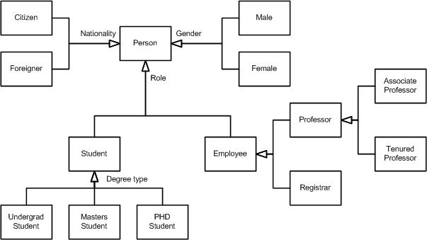
A taxonomy of people within the university
Notes:
It takes a “single section” approach to classes, instead of the three section approach that we’ve seen in previous diagrams, because we’re exploring relationships between entity types but not their responsibilities.
It uses UML 2.0’s generalization set concept, basically just an inheritance arrowhead with a label representing the name of the set. In UML 1.x this label was called a discriminator. There are three generalization sets for Person: Nationality, Role, and Gender.
These generalization sets overlap – a person can be classified via each of these roles (e.g. someone can be a male foreign student). This is called multiple classification.
You can indicate “sub generalization” sets, for example Student within the Role generalization set.
Some generalization sets are mutually exclusive from others, not shown in the example, where an entity type may only be in one set. This is referred to as single classification and would be modeled using an XOR (exclusive OR) constraint between the two (or more) discriminators.

Slide 59
Aggregation
The weak form of aggregation is denoted with an open diamond. This relationship denotes that the aggregate class (the class with the white diamond touching it) is in some way the “whole”, and the other is somehow part of the whole.
*
Shape
Window
Its Shapes

Slide 60
Aggregation (Contd.)
In this case, the Window class contains many Shape instances.
In UML the ends of a relationship are referred to as its “roles”.
Notice that the role at the Shape end of the aggregation is marked with a “*“.
This indicates that the Window contains many Shape instances.
The role has been named. This is the name that Window knows its Shape instances by i.e. it is the name of the instance variable within Window that holds the shapes.

Slide 61
Dependency
Sometimes the relationship between a two classes is very weak. They are not implemented with member variables at all.
The relationship might be implemented as member function arguments.
Consider, for example, the Draw function of the Shape class.

Slide 62
Dependency
Window
Shape
*
draw(DrawingContext ctx)
ItsShapes
itsContext
DrawingContext
Notes:
Suppose that this function takes an argument of type DrawingContext.

Slide 63
Interface
There are classes that have nothing but pure virtual functions.
In Java such entities are not classes at all;
They are a special language element called an interface.
UML has followed the Java example and has created some special syntactic elements for such entities.
The primary icon for an interface is just like a class except that it has a special denotation called a stereotype.

Slide 64
Interface
<<type>>
DrawingContext
setPoint(int x, int y)
clearScreen()
getVerticalSize():int
getHorizontalSize():int
Shape
Window
DrawingContext
Notes:
Note the «type» string at the top of the class. The two surrounding
characters “«»” are called guillemets (pronounced Gee-may). A word or phrase surrounded
by guillemets is called a “stereotype”. Stereotypes are one of the mechanisms that can be
used to extend UML. When a stereotype is used above the name of a class it indicates that this
class is a special kind of class that conforms to a rather rigid specification.
The «type» stereotype indicates that the class is an interface. This means that it has no member
variables, and that all of its member functions are pure virtual.
UML supplies a shortcut for «type» classes. Figure 9 shows how the “lollypop” notation can be
used to represent an interface. Notice that the dependency between Shape and DrawingContext
is shown as usual. The class WindowsDC is derived from, or conforms to, the Drawingcontext
interface.

Slide 65
Multiplicity
The UML representation of an association is a line with an optional arrowhead indicating the role of the object (s) in the relationship, and an optional notation at each end indicating the multiplicity of instances of that entity (the number of objects that participate in the association).
Common multiplicities are:
0..1 No instances, or one instance (optional, may)
1 Exactly one instance
0..* or *Zero or more instances
1..* One or more instances (at least one)
Notes:
The association relationship indicates that (at least) one of the two related classes makes reference to the other. In contrast with the generalization relationship, this is most easily understood through the phrase 'A has a B' {a mother cat has kittens, kittens have a mother cat}.

Slide 66
Object Diagrams
Although we design and define classes, in a live application classes are not directly used, but instances or objects of these classes are used for executing the business logic.
A pictorial representation of the relationships between these instantiated classes at any point of time (called objects) is called an "Object diagram." It looks very similar to a class diagram, and uses the similar notations to denote relationships.

Slide 67
Elements of an Object Diagram
Because an Object Diagram shows how specific instances of a class are linked to each other at runtime, at any moment in time it consists of the same elements as a class diagram; in other words, it contains classes and links showing the relationships.
However, there is one minor difference. The class diagram shows a class with attributes and methods declared. However, in an object diagram, these attributes and method parameters are allocated values

Slide 68
Class diagram
Order
date_received:
price
isprepaid
dispatch()
close
Customer
name
address
creditRating()
n
1

Slide 69
Object diagram
order1:Order
date_received:12-05-02
price:200
isprepaid:true
dispatch()
Customer1:Customer
name: Nancy
address: Mumbai
creditRating()
order2:Order
date_received:12-05-02
price:340
isprepaid:false
dispatch()

Slide 70
Interaction Diagrams
Interaction diagrams model the behavior of use cases by describing the way groups of objects interact to complete the task. The two kinds of interaction diagrams are
sequence and collaboration diagrams.
Interaction diagrams are used when you want to model the behavior of several objects in a use case.
They demonstrate how the objects collaborate for the behavior.
Interaction diagrams do not give a in depth representation of the behavior.

Slide 71
Sequence Diagrams
Sequence diagrams generally show the sequence of events that occur.
Sequence diagrams demonstrate the behavior of objects in a use case by describing the objects and the messages they pass.
The diagrams are read left to right and descending

Slide 72
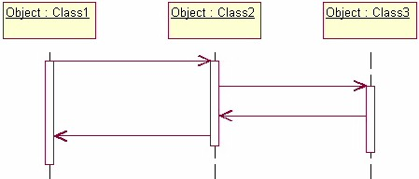
Sequence Diagram
The example below shows an object of class 1 start the behavior by sending a message to an object of class 2. Messages pass between the different objects until the object of class 1 receives the final message.

Slide 73
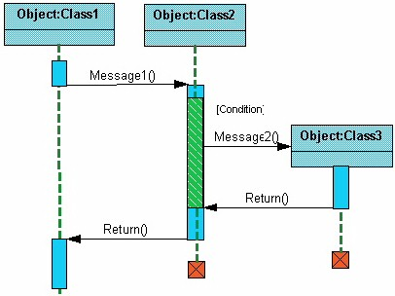
Sequence Diagram (Contd.)
The diagram depicts the activation and the life cycle of an object.
Notes:
The light blue vertical rectangles the objects activation while the green vertical dashed lines represent the life of the object. The green vertical rectangles represent when a particular object has control. The represents when the object is destroyed. This diagrams also shows conditions for messages to be sent to other object. The condition is listed between brackets next to the message. For example, a [condition] has to be met before the object of class 2 can send a message() to the object of class 3.

Slide 74
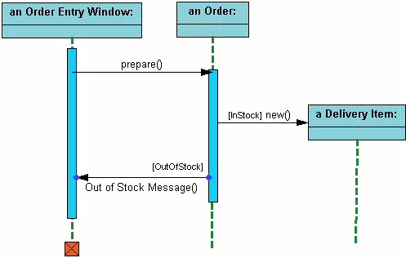
Sequence Diagram
Notes:
The object an Order Entry Window is created and sends a message to an Order object to prepare the order. Notice the the names of the objects are followed by a colon. The names of the classes the objects belong to do not have to be listed. However the colon is required to denote that it is the name of an object following the objectName:className naming system.
Next the Order object checks to see if the item is in stock and if the [InStock] condition is met it sends a message to create an new Delivery Item object.

Slide 75
Collaboration Diagram
Collaboration diagrams show the relationship between objects and the order of messages passed between them.
The objects are listed as icons and arrows indicate the messages being passed between them.
The numbers next to the messages are called sequence numbers.
As the name suggests, they show the sequence of the messages as they are passed between the objects.
There are many acceptable sequence numbering schemes in UML. A simple 1, 2, 3... format can be used, as the example below shows, or for more detailed and complex diagrams a 1, 1.1 ,1.2, 1.2.1... scheme can be used.

Slide 76
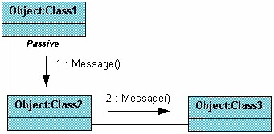
Collaboration Diagrams (Contd.)

Slide 77
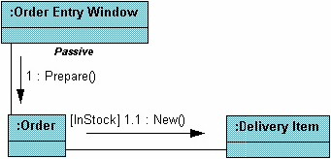
Collaboration Diagrams (Contd.)
Notes:
. This time the names of the objects appear after the colon, such as :Order Entry Window following the objectName:className naming convention. This time the class name is shown to demonstrate that all of objects of that class will behave the same way.

Slide 78
State Diagrams
State diagrams are used to describe the behavior of a Application.
State diagrams describe all of the possible states of an object as events occur.
Each diagram usually represents objects of a single class and track the different states of its objects through the Application.

Slide 79
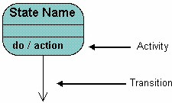
State Diagrams (contd.)
State diagrams have very few elements. The basic elements are rounded boxes representing the state of the object and arrows indicting the transition to the next state.
The activity section of the state symbol depicts what activities the object will be doing while it is in that state.

Slide 80
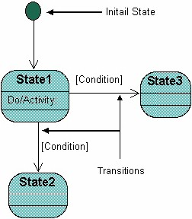
State Diagrams (contd.)
All state diagrams being with an initial state of the object. This is the state of the object when it is created.
After the initial state the object begins changing states.
Conditions based on the activities can determine what the next state the object transitions to.

Slide 81
Example of a State Diagram
Let us consider an example of a state diagram might look like for an Order object.
When the object enters the Checking state it performs the activity "check items." After the activity is completed the object transitions to the next state based on the conditions [all items available] or [an item is not available].
If an item is not available the order is canceled. If all items are available then the order is dispatched.
When the object transitions to the Dispatching state the activity "initiate delivery" is performed.
After this activity is complete the object transitions again to the Delivered state.

Slide 82
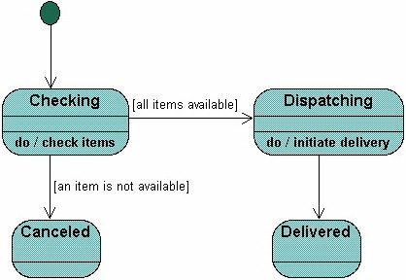
Example of a State Diagram (Contd.)

Slide 83
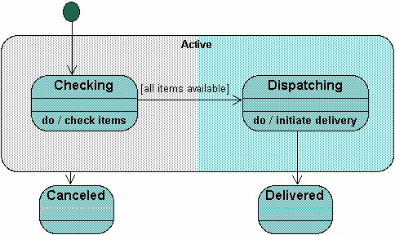
Example of a State Diagram (Contd.)
Notes:
The diagram below shows a super-state. Both the Checking and Dispatching states can transition into the Canceled state, so a transition is shown from a super-state named Active to the state Cancel. By contrast, the state Dispatching can only transition to the Delivered state, so we show an arrow only from the Dispatching state to the Delivered state.

Slide 84
Summary
Class diagrams are widely used to describe the types of objects in a system and their relationships.
Class diagrams model class structure and contents using design elements such as classes, packages and objects.
Class diagrams also display relationships such as containment, inheritance, associations and others
The association relationship is the most common relationship in a class diagram.
The association shows the relationship between instances of classes.
Interaction diagrams model the behavior of use cases by describing the way groups of objects interact to complete the task. The two kinds of interaction diagrams are sequence and collaboration diagrams.

Slide 85
Test Your Understanding
Class diagrams are widely used to describe the types of _______ in a system and their ___________________
Objects and relationships
Objects and Classes
Objects and messages
Encapsulation and Classes
A generalization is used when two classes are similar
True
false

Slide 86
Test your understanding
3. Example of a Dynamic diagram is:
Class diagram
State Diagram
Object Diagram
Component Diagram

Slide 87
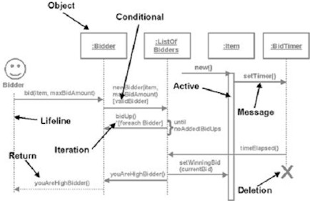
Test your understanding

Slide 88
Test your understanding
The diagram represents a
Class Diagram
Object Diagram
Sequence Diagram
Use Case diagram

Slide 89
End

