Slide 1
Multi-Ingredient Food Image Classification and Context-Aware Recipe Recommendation System
Topic : CS5841 Project Presentation
Team : K-Nearest Party
Team Members : Dhanush Biligiri N H, Fnu Sowrabh, Ram Bagaria, Akhilesh Dandavati

Slide 2
Overview
Problem Statement
Methodology
YOLO V8n Model
Hyperparameter optimization
Recipe Recommendation
Demo
Conclusion
Future Work

Slide 3
Problem Statement
Growing demand for personalized, healthy, and accessible, food recommendations.
Key challenge: detecting multiple ingredients in complex food images.
Goal: Build a complete pipeline from image to personalized recipe.

Slide 4
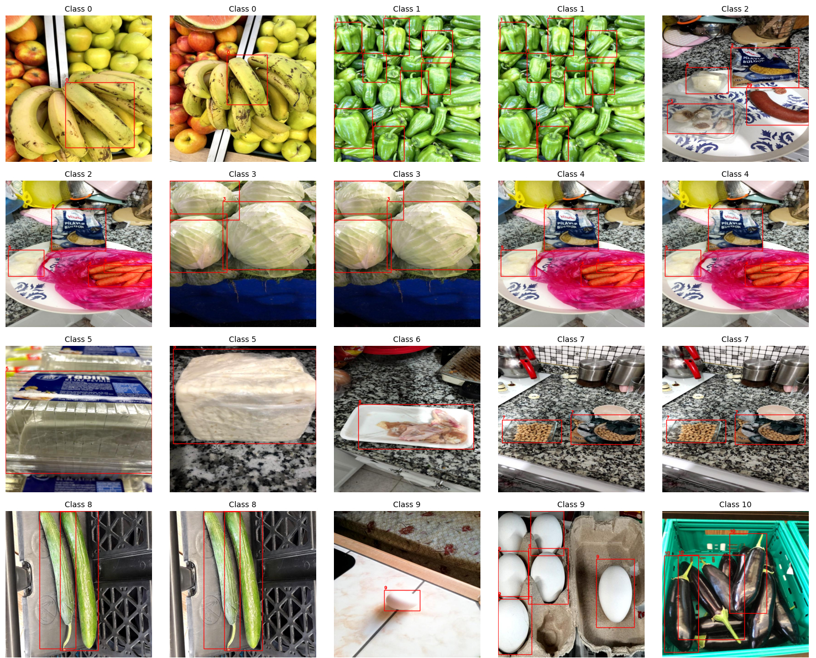
Dataset
Dataset: FOOD INGREDIENTS DETECTION dataset
Size: 1425 training images, 286 validation images, and 190 test images.
Type: All data is image-based, with labels in YOLO format, where each label represents a bounding box with class ID and normalized coordinates.
Distribution: The dataset is slightly imbalanced.
The top five most common ingredients are:
Egg (203 instances)
Lemon (178)
Cucumber (164)
Onion (160)
Tomato (150)
Classes in the Dataset

Slide 5
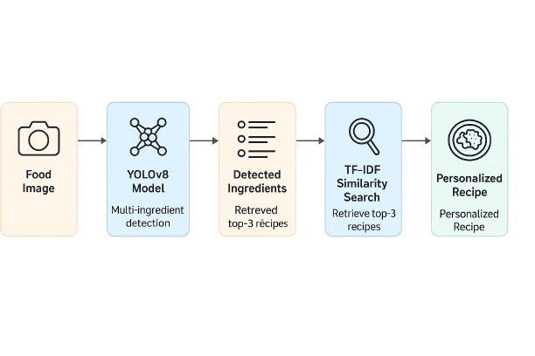
Methodology
2-stage pipeline:
YOLOv8s for ingredient detection
TF-IDF + T5 for recipe recommendation
Object detection flowchart

Slide 6
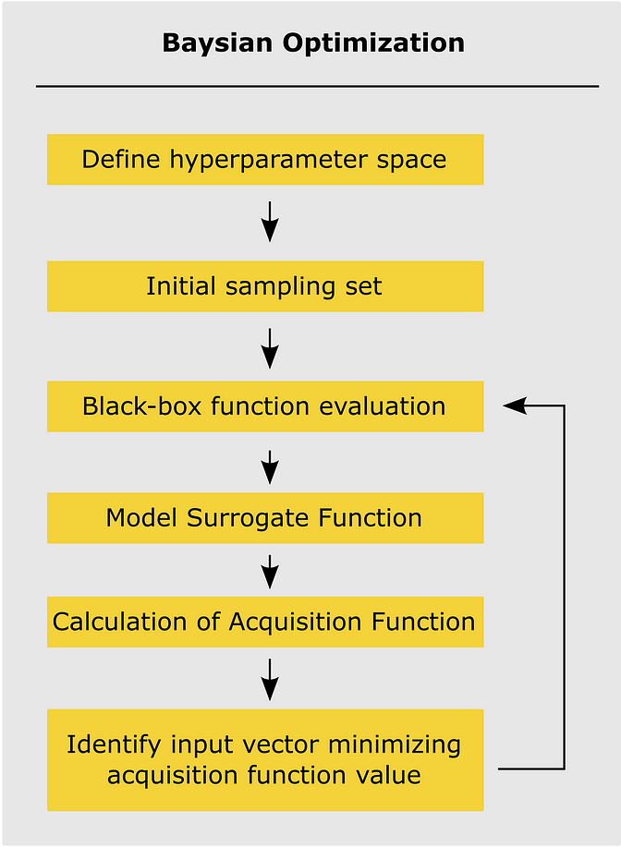
Hyperparameter Optimization
Used Optuna for Bayesian Optimization
Tuned:
Epochs: 5–50
Learning rate: 1e-05 to 1e-02
Optimizers: Adam, AdamW, SGD
Best Config: AdamW, 50 epochs, LR = 0.00049
Achieved mAP@50 = 0.829
Bayesian optimization

Slide 7
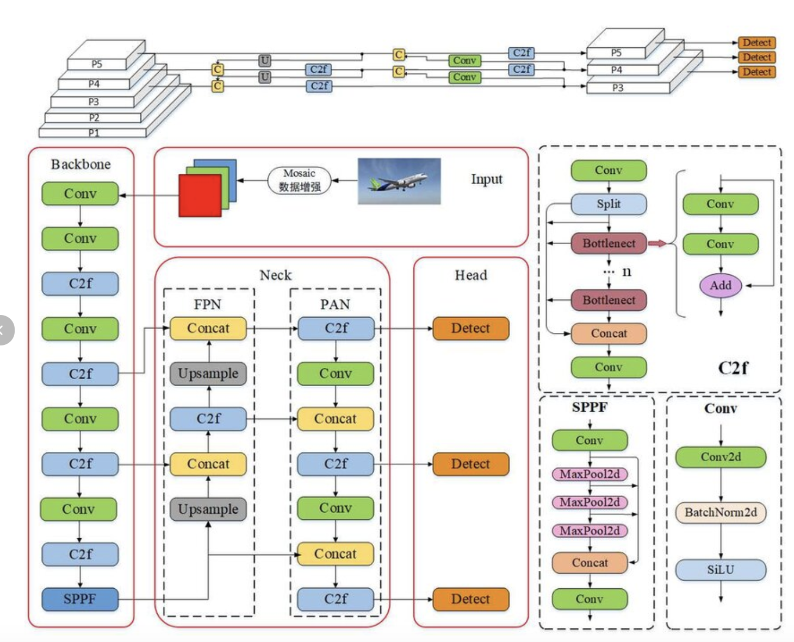

YOLO V8n model
Lightweight: 129 layers, ~3M params, 8.2 GFLOPs
Real-time inference & optimized for low-resource systems
Custom training using Ultralytics API
Yolov8 Architecture

Slide 8
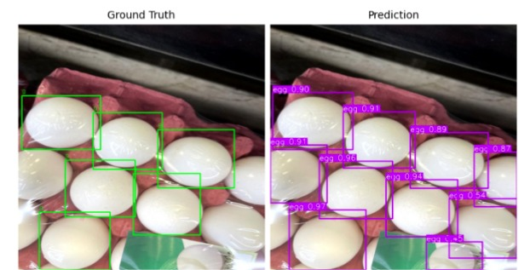
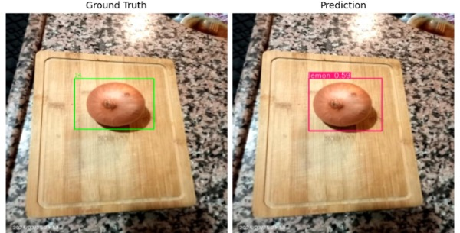
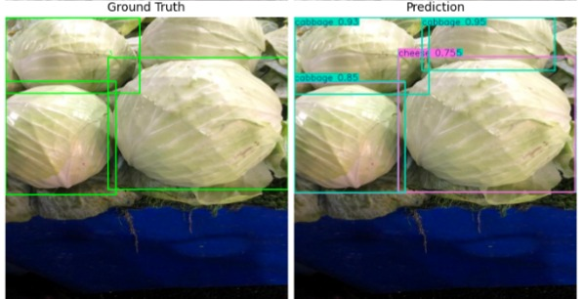
Predictions

Slide 9
Recipe Recommendation
TF-IDF Retrieval:
Handcrafted dataset: Title, Ingredients, Calories, Tags
Cosine similarity used to match detected ingredients to recipes
Top-3 relevant recipes retrieved
T5 Generation:
Fine-tuned T5 model generates complete and coherent recipe instructions from detected ingredients.
Delivers human-readable, context-aware recipes, enhancing personalization and usability.

Slide 10
CONCLUSION
Achieved mAP@50 of 0.829 using YOLOv8n for multi-ingredient food detection.
Accurately detected diverse and overlapping ingredients in real-time.
Provided context-aware recipe suggestions via TF-IDF retrieval + T5 generation.
Enabled interactive predictions and visualization through a Gradio interface.

Slide 11
FUTURE WORK
Expand to more cuisines
Real-time deployment on mobile
User feedback integration

