Slide 1
Bakery Sales
Prepared by: Rohan Tambe
Tool used: Tableau Desktop
Date: August 2025

Slide 2
Dashboard objective
Provide business stakeholders with a real-time, visual summary of bakery sales.
Enable data-driven decisions using KPIs, trends, and product insights.
Monitor sales growth, item performance, and customer purchase patterns.

Slide 3
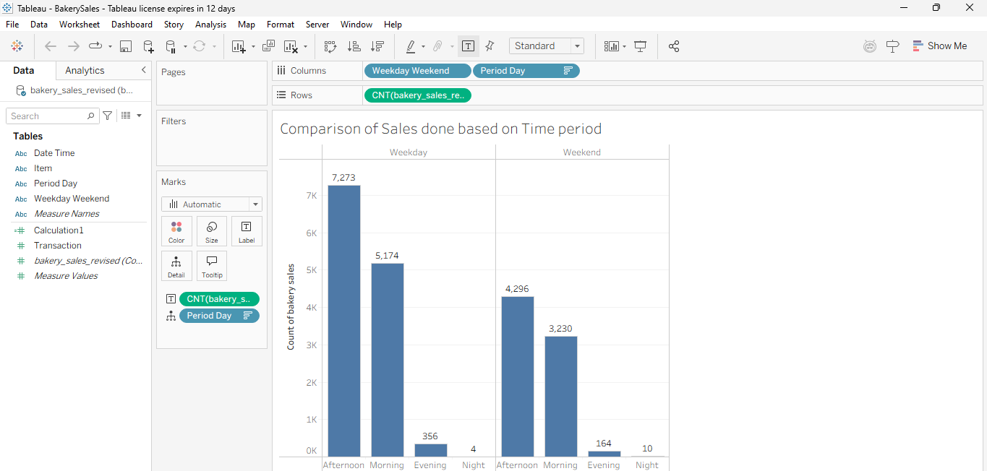
Time-Series Sales Analysis
Trends reveal peak sales on weekdays.
Maximum Sales are done during the Daytime.
Less than 10% of sales is done after Office timings.

Slide 4
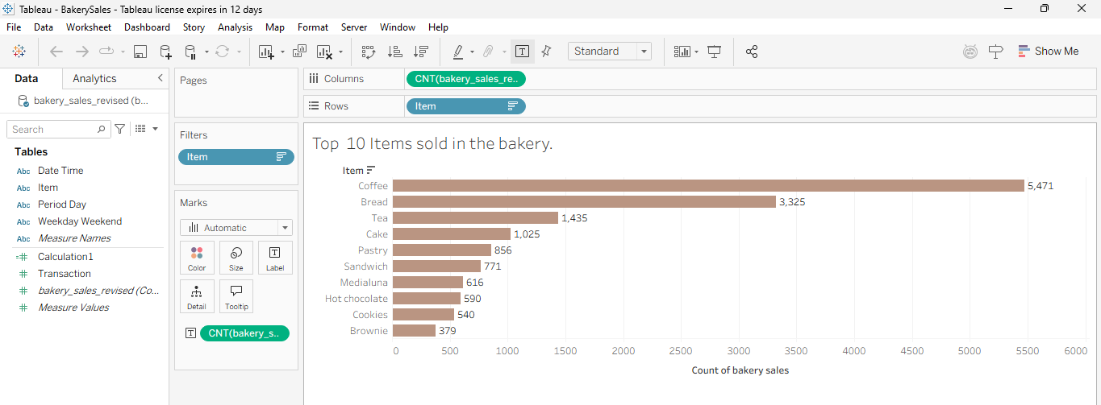
Customer Sales insights
Coffee and Bread are the most sold products.
Sweets occupy less than 15% of sales.

Slide 5
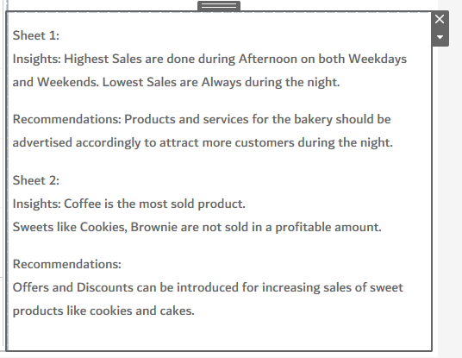
Summary and recommendations

