Slide 1

Probability Theory and Introductory Statistics
Final Project Presentation
Rambhupal Payyavula
NEU ID: 002108015

Slide 2
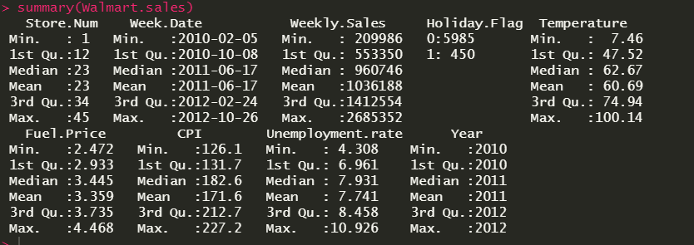
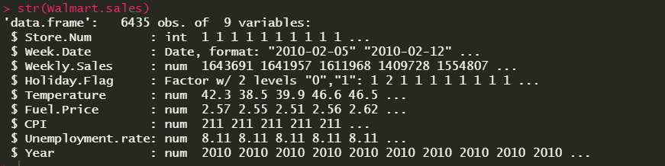
Walmart Retail store sales dataset
About dataset:
Dataset represents the historical sales data of 45 Walmart retail stores for a time between 2010 and 2012. Dataset initially contains 8 variables and 6,435 observations.
Dataset has been cleaned and a new variable year, derived from the date, has been added.

Slide 3
Information needed from the Walmart sales data:
Store1 and Store2 performance in three consecutive years, 2010, 2011, and 2012.
Are average weekly sales of all stores in 2011 greater than average weekly sales of all stores in 2010?
Are average weekly sales of all stores in 2012 greater than average weekly sales of all stores in 2011?
Had fuel price and unemployment rate influenced the combined weekly sales of all stores through out the three years.
Was unemployment rate increased from 2010 to 2012?

Slide 4
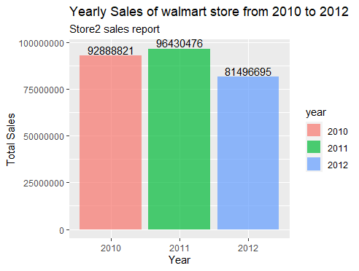
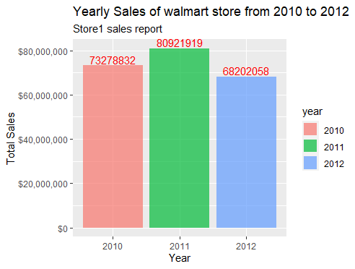
Store1 and Store2 Sales report:
Store2 weekly sales increased from 2010 to 2011 and decreased from 2011 to 2012. Highest sales recoded in 2011 and lowest sales recorded in 2012
Store2 weekly sales increased from 2010 to 2011 and decreased from 2011 to 2012. Highest sales recoded in 2011 and lowest sales recorded in 2012.

Slide 5
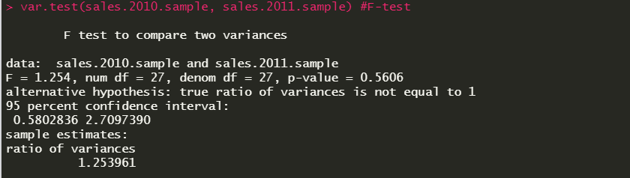
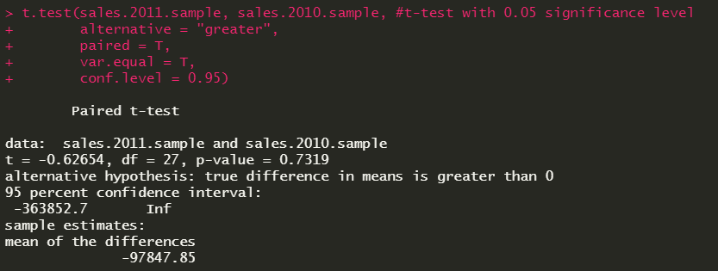
Comparison of 2010 and 2011 average Weekly sales of all Walmart stores
Validating the homogeneity of two samples:
Null Hypothesis: True ratio of variances of 2011 and 2010 samples is equal to 1
Alternative Hypothesis: True ratio of variances of 2011 and 2010 samples is not equal to 1
Significance level: 0.05
Paired t-test with equal variance:
Null Hypothesis: True difference in the means of 2011 and 2010 samples is equal to zero
Alternative Hypothesis: True difference in means is greater than zero.
Significance level: 0.05
As p-value, 0.5606 is greater than 0.05, we can conclude that variance of 2010 and 2011 samples are same. Since the variance is same, we will be performing the paired t-test with equal variance.
From the t-test, we have obtained the p-value of 0.7319, which is greater than significance level 0.05. We don’t enough statistical evidence to reject the null hypothesis. Average sales remained same in 2010 and 2011.

Slide 6
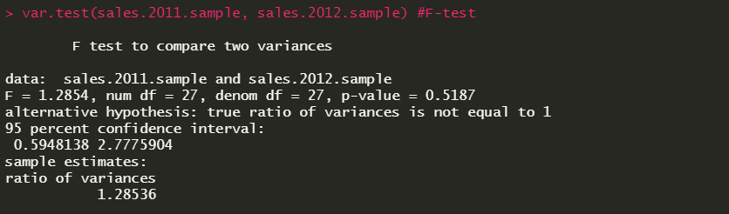

Comparison of 2011 and 2012 average Weekly sales of all Walmart stores
Validating the homogeneity of two samples:
Null Hypothesis: True ratio of variances of 2011 and 2012 samples is equal to 1
Alternative Hypothesis: True ratio of variances of 2011 and 2012 samples is not equal to 1
Significance level: 0.05
Paired t-test with equal variance:
Null Hypothesis: True difference in the means of 2012 and 2011 samples is equal to zero
Alternative Hypothesis: True difference in means is greater than zero.
Significance level: 0.05
As p-value, 0.5187 is greater than 0.05, we can conclude that variance of 2011 and 2012 samples are same. Since the variance is same, we will be performing the paired t-test with equal variance.
From the t-test, we have obtained the p-value of 0.6248, which is greater than significance level 0.05. We don’t enough statistical evidence to reject the null hypothesis. Average sales remained same in 2011 and 2012.

Slide 7
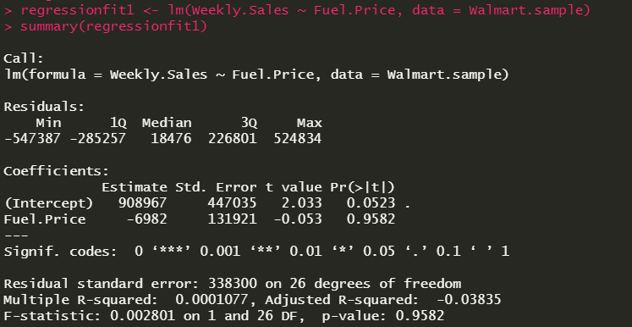
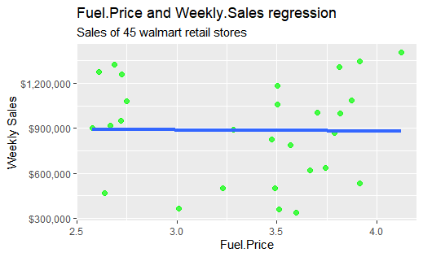
Fuel Price influence on weekly sales
Independent Variable: Fuel Price
Dependent Variable: Weekly Sales
Independent Variable: Fuel Price
Dependent Variable: Weekly Sales
We can see from the summary that residuals range is very high, which is not good for the model. P-value is far greater than the significance level 0.1that shows that the covariance does not differ from zero and R-squared value is very near to zero, which shows the poor best line fit for the estimations. Overall p-value 0.9 which shows that it is not a good regression model
we can see that the regression line is almost horizontal. However, we can see a slight negative slope which is negligible. We can say that fuel price has no effect on the weekly sales.

Slide 8
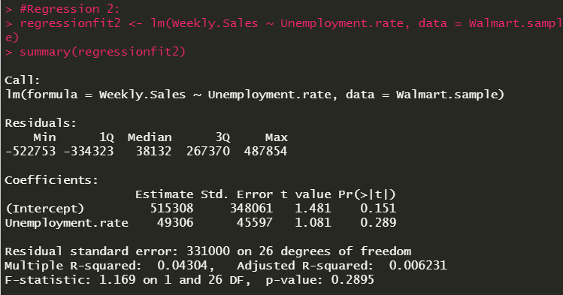
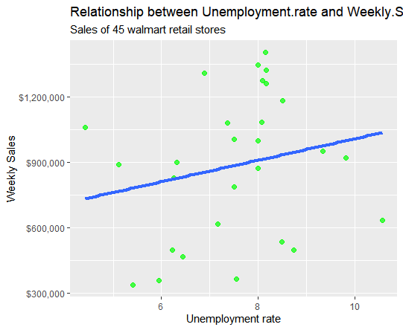
Unemployment rate influence on weekly sales
Independent Variable: Unemployment rate
Dependent Variable: Weekly Sales
Independent Variable: Unemployment rate
Dependent Variable: Weekly Sales
We can see from the below summary that residuals range is very high, which is not good for the model. P-value 0.289 is greater than the significance level 0.1 that shows that the covariance does not differ from zero and R-squared value is very near to zero, which shows the poor best line fit for the estimations. Overall p-value 0.289 which shows that it is not a good regression model.
we can see that the regression line has a positive slope where can say that weekly sales were increased with the unemployment rate.

Slide 9
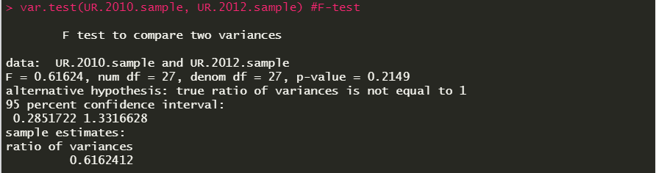
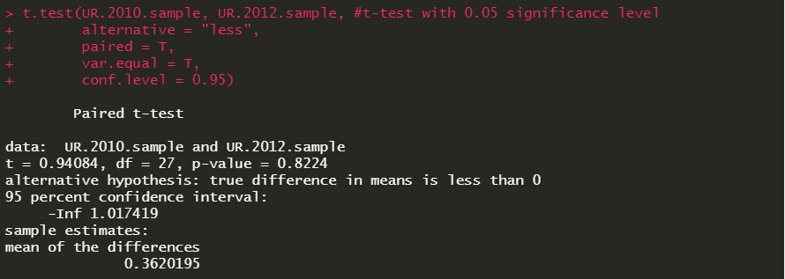
Comparison of 2010 and 2012 average Unemployment rate
Validating the homogeneity of two samples:
Null Hypothesis: True ratio of variances of 2010 and 2012 samples is equal to 1
Alternative Hypothesis: True ratio of variances of 2010 and 2012 samples is not equal to 1
Significance level: 0.05
Paired t-test with equal variance:
Null Hypothesis: True difference in the means of 2010 and 2012 samples is equal to zero
Alternative Hypothesis: True difference in means is less than zero.
Significance level: 0.05
As p-value, 0.5187 is greater than 0.05, we can conclude that variance of 2010 and 2012 samples are same. Since the variance is same, we will be performing the paired t-test with equal variance.
From the t-test, we have obtained the p-value of 0.8224, which is greater than significance level 0.05. We don’t enough statistical evidence to reject the null hypothesis. Average unemployment rate remained same in 2010 and 2012.

Slide 10
Summary:
Store 2 has recorded more sales in every financial year from 2010 to 2012 compared to store1. For both store1 and store2, Sales had been increased from 2010 to 2011 and decreased from 2011 to 2012.
Average Weekly sales of all stores are equal in2010, 2011, 2012.
weekly sales were not influenced by the fuel price, but surprisingly unemployment rate has a little positive affect on the weekly sales as weekly sales increased with the unemployment rate
Average unemployment rate remained same in 2010 and 2012.

Slide 11
References:
Hypothesis Test: Difference Between Means. (n.d.). Retrieved from stattrek: https://stattrek.com/hypothesis-test/difference-in-means.aspx
Kabacoff, R. I. (2020). R in Action Third Edition. Manning Publications.
linear regression. (n.d.). Retrieved from tutorialspoint.com: https://www.tutorialspoint.com/r/r_linear_regression.html
r multiple regression. (n.d.). Retrieved from tutorialspoint.com: https://www.tutorialspoint.com/r/r_multiple_regression.html

