Slide 1
BikeHub

Slide 2
Content
1
Task description
2
Data exploration
3
Feature engineering
4
Model comparison

Slide 3
1
Task description

Slide 4
Task description
This task is based around UrbanBike, an bicycle rental company who is HQ’d in Boston, USA.
They would like to predict capacity in the next 30-90 mins so they can make this data available on their
application for customers. A key step in predicting capacity is to predict the duration of the bike trips from
the time when a bike is picked up from a docking station to the time when it is returned to a docking
station. To make these predictions UrbanBike has given us data of their bike docking stations and historical
trips and weather data.
Target: Predict the duration of a trip with related features

Slide 5
2
Data exploration

Slide 6
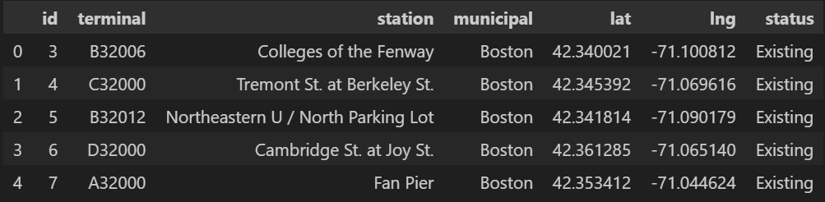
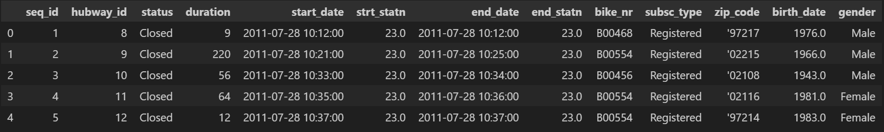
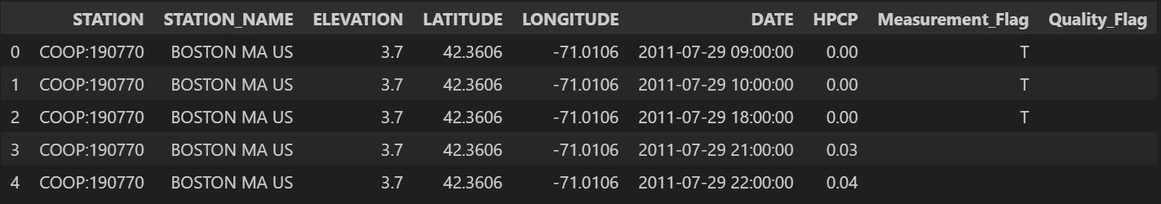
Data exploration
Station data:
Trip data:
Weather data:

Slide 7
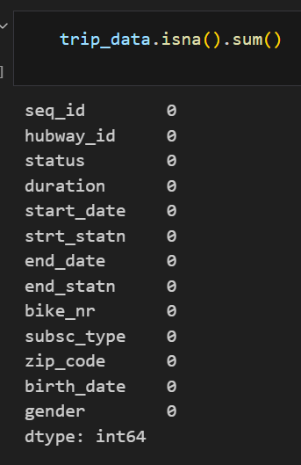
Data cleaning
The trip data have missing values and for this reason we perform some basic data cleaning.
Drop the na rows: "strt_statn", "end_statn", "bike_nr"
Replace missing values:
Fill the na with the mean value for numeric values: birth_date
Fill the na with ‘Unknow’ for category values: gender, zip_code
Expected result

Slide 8
Data Transformations
Transform the columns of trip data:
strt_statn: integer
end_statn: integer
birth_date: integer
Replace the old station IDs with new station IDs：
1. Get the map of New station IDs for changed station IDs
2. Replace the old station IDs for station and trip table

Slide 9
Data Augumentation
Get the round hour of start_date for the alignment with weather data
Get the hour of DATE
Hour_sine
Hour_cosine
Determine whether the day is a weekday or weekend
Day_of_week_sine
Day_of_week_cosine
Establish season: winter (0), spring (1), summer (2), fall (3)
Season_sine
Season_cosine

Slide 10
Data Filter
Filter the trip data to keep only the trips in Boston(The weather data is only in Boston):
Get the station IDs in Boston
Filter the trip data which start station and end station are in Boston
birth_date: integer
Replace the old station IDs with new station IDs：
1. Get the map of New station IDs for changed station IDs
2. Replace the old station IDs for station and trip table

Slide 11
Data Aggregation
Join the weather data to every trip:
Join the weather data according to the end date
Add the HPCP and Mesurement_Flag for every trip
Join the station data to every trip:
Only consider the start station because the end station is unknown when a trip is doing

Slide 12
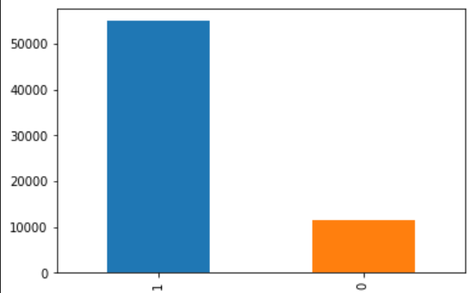
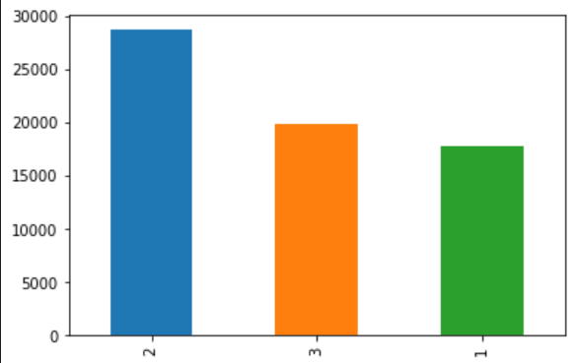
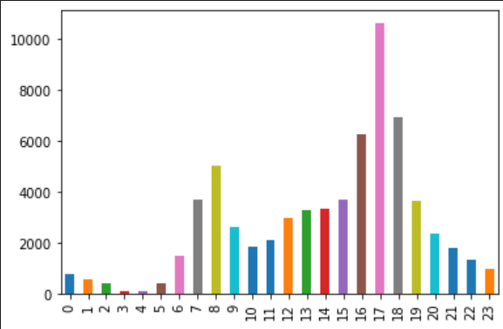
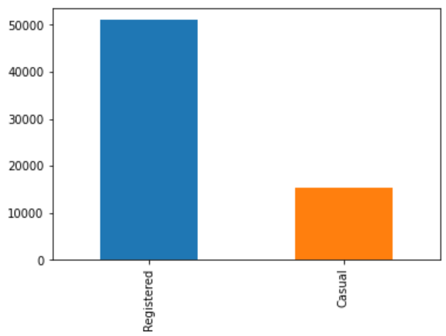
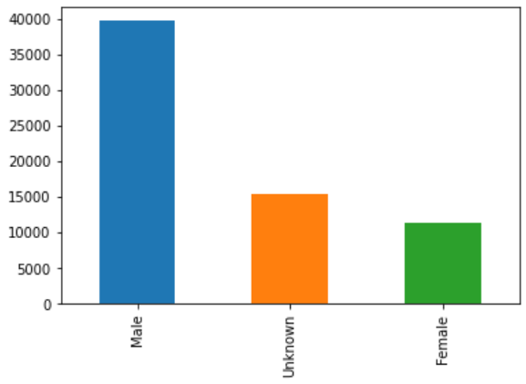
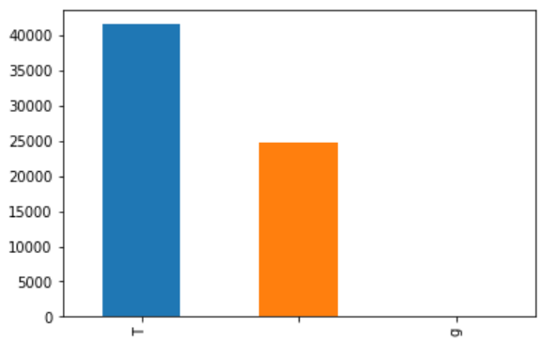
Data Visualization
Week day
Season
Hour
subsc_type
Measurement_Flag
Gender

Slide 13
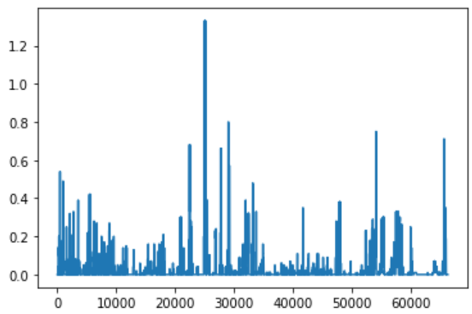
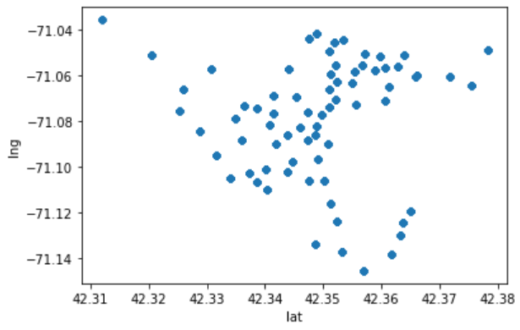
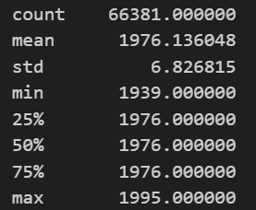
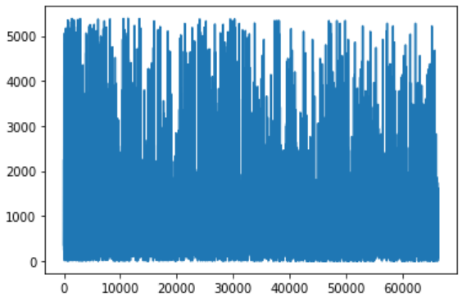
Data Visualization
birth_date
HPCP
lat and lng
duration

Slide 14
3
Feature engineering

Slide 15
Feature engineering
One hot coding for the catogory features:
strt_statn, subsc_type, gender, Measurement_Flag
Feature selection with feature selector:
Missing Values
Single Unique Values
Collinear Features
Zero Importance Features
Low Importance Features

Slide 16
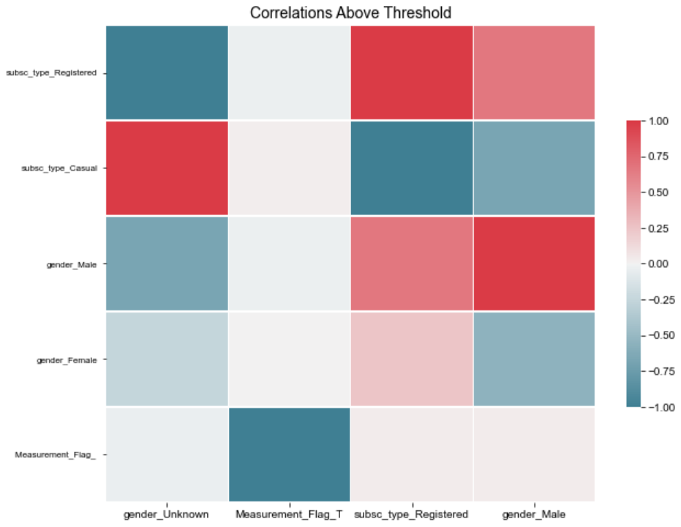
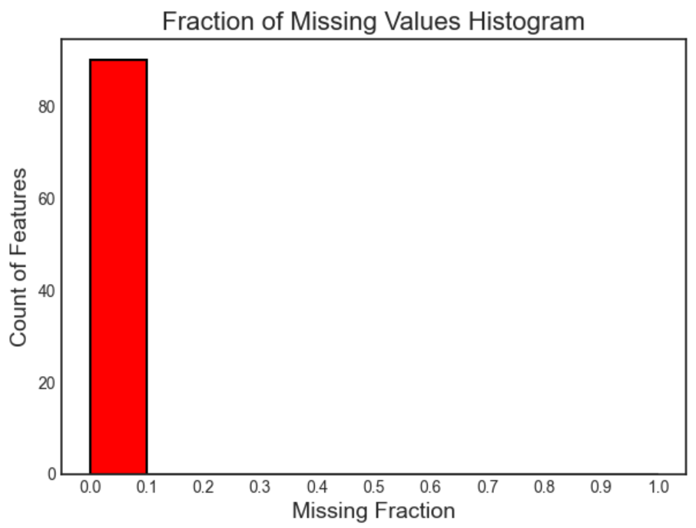
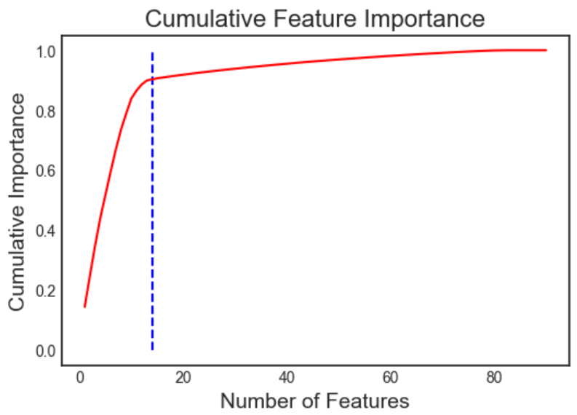
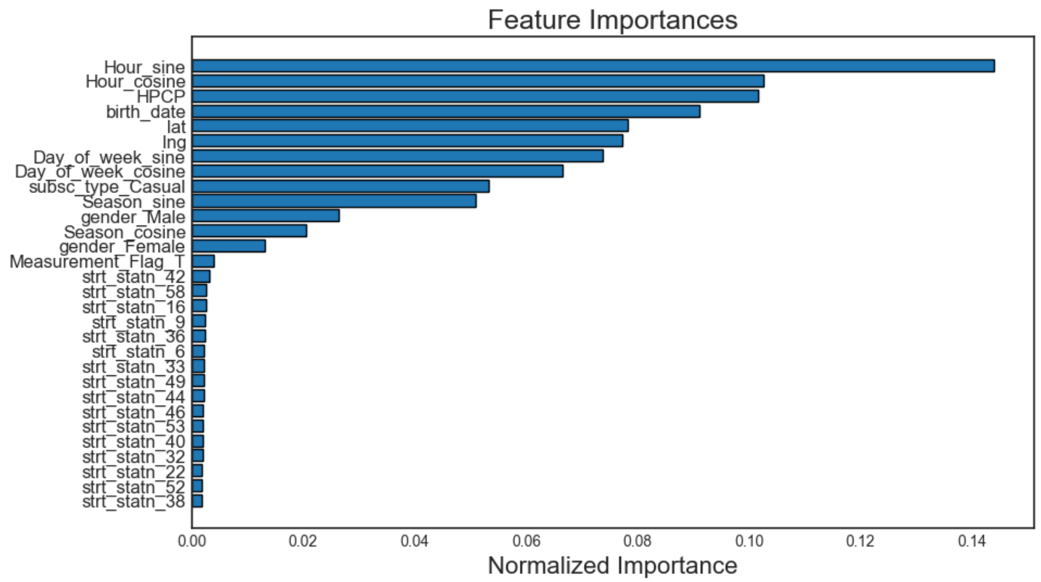
Feature engineering

Slide 17
4
Model comparison

Slide 18
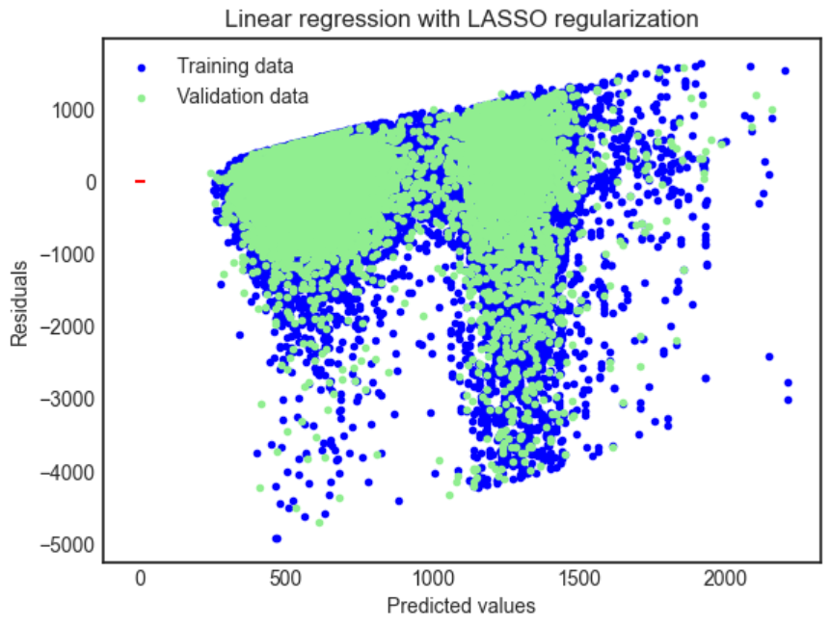
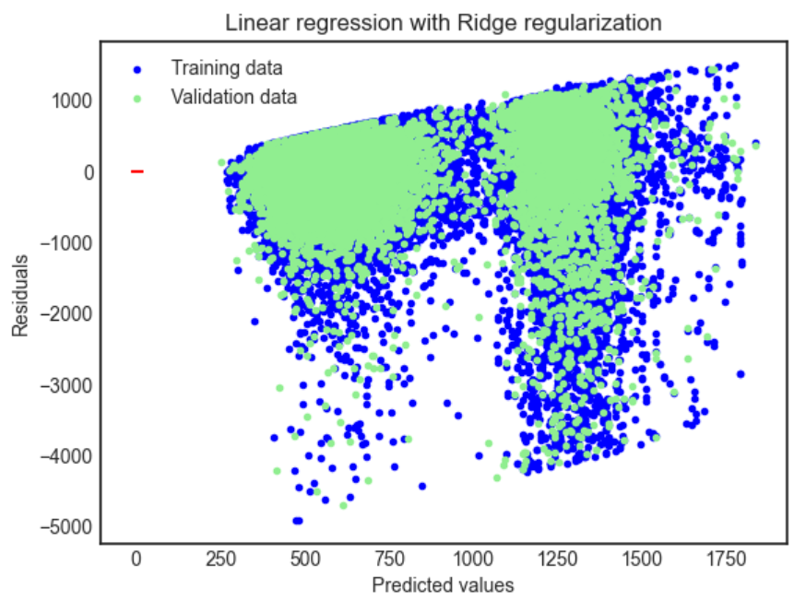
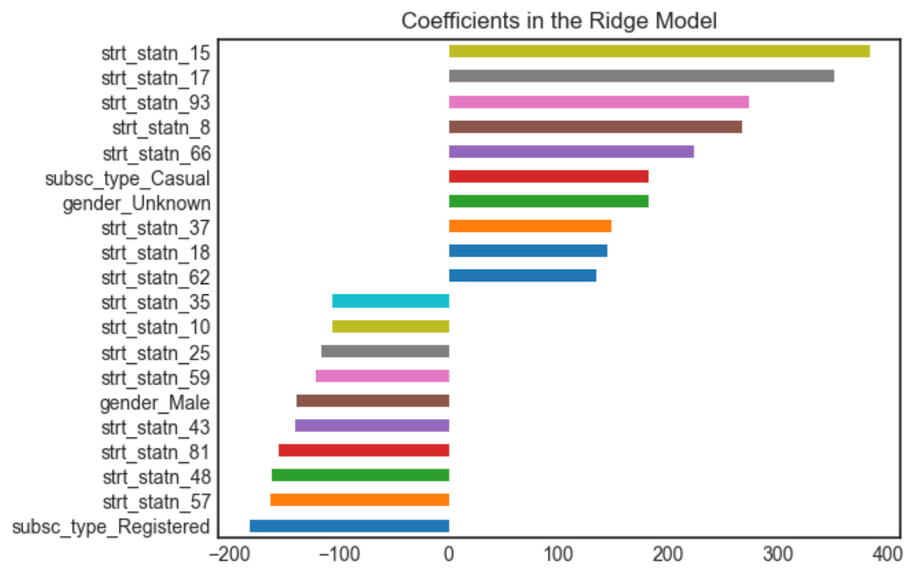
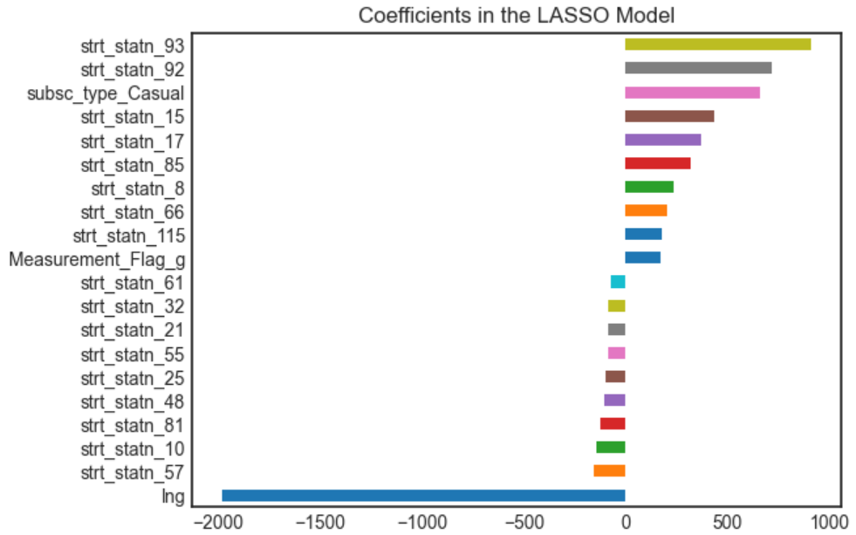
Model comparison
Linear Regression with Lasso regularization (L1 penalty)
Linear Regression with Ridge regularization (L2 penalty)

Slide 19
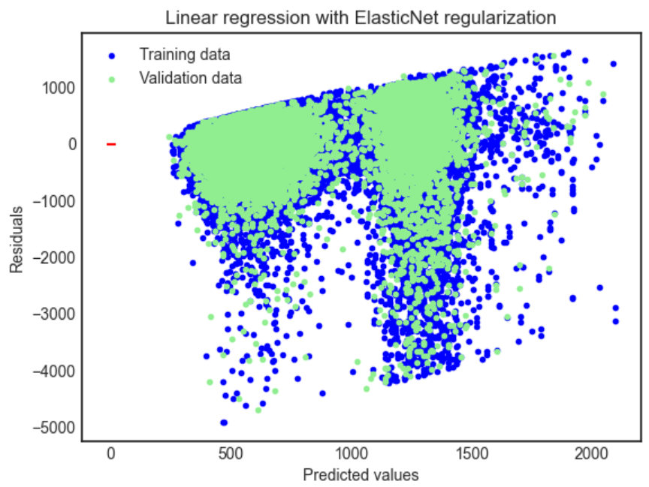
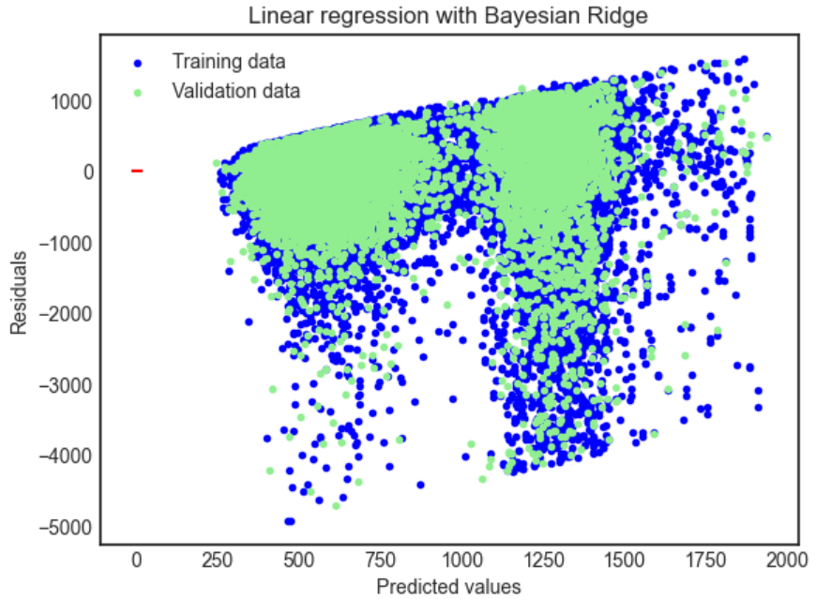
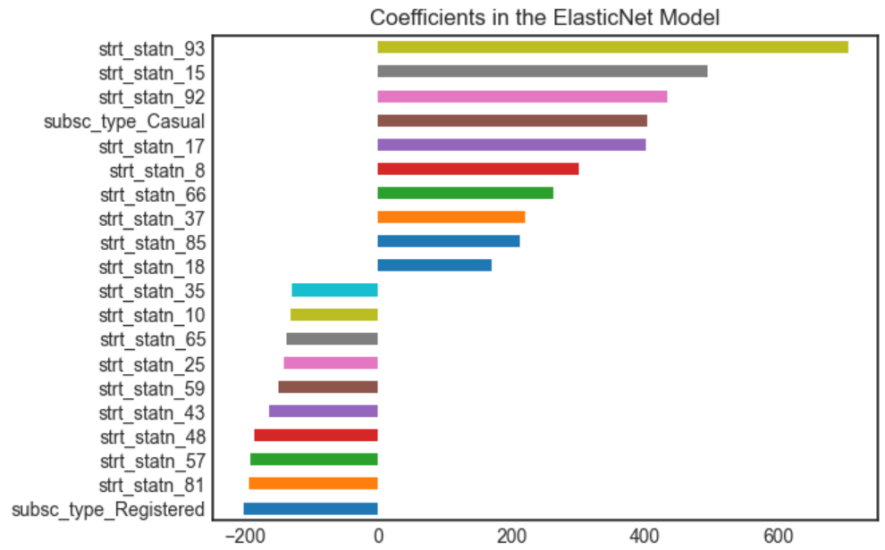
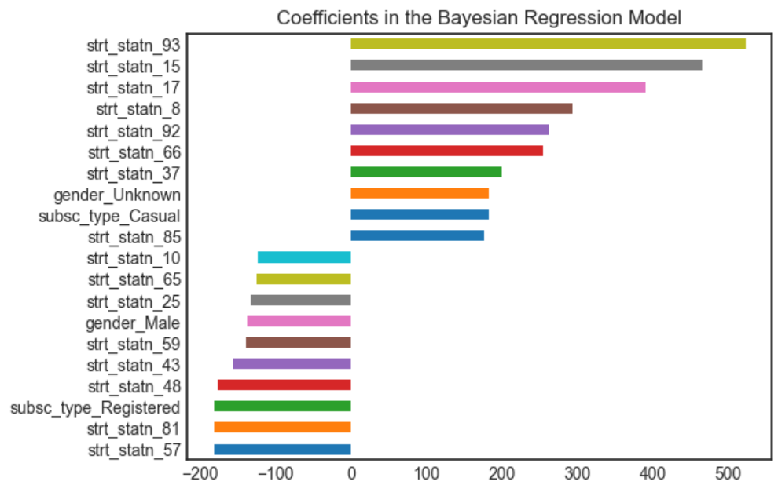
Model comparison
Linear Regression with ElasticNet regularization (L1 and L2 penalty)
Linear regression with Bayesian Ridge regularization

Slide 20
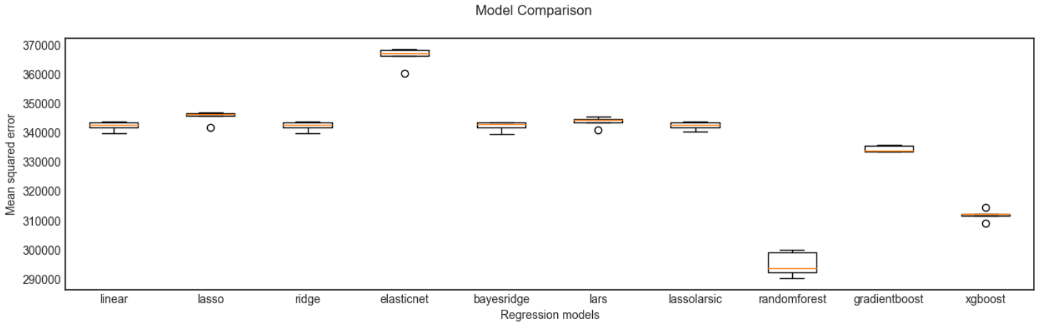
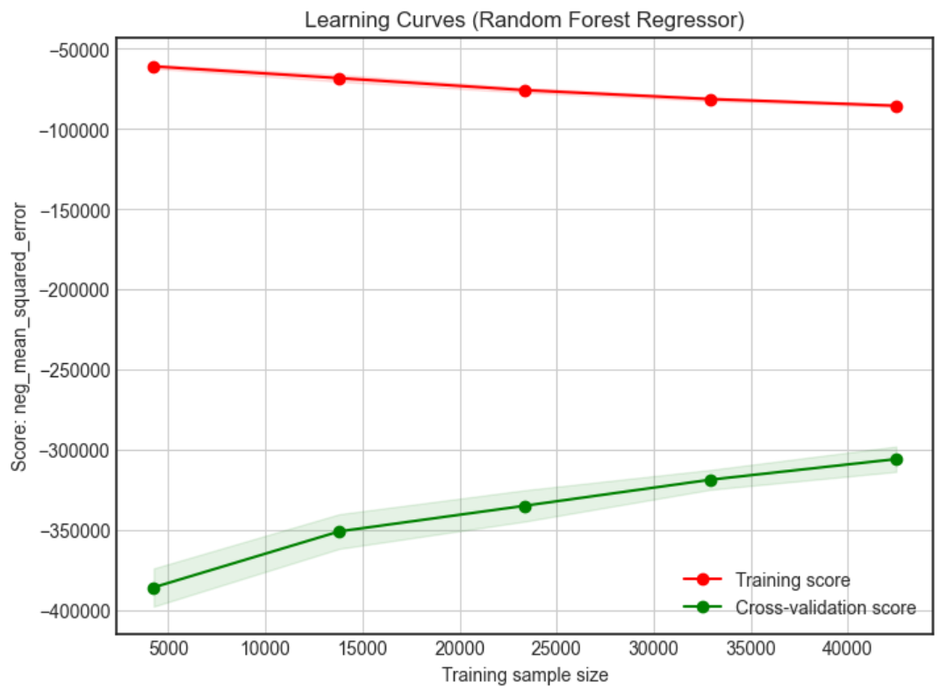
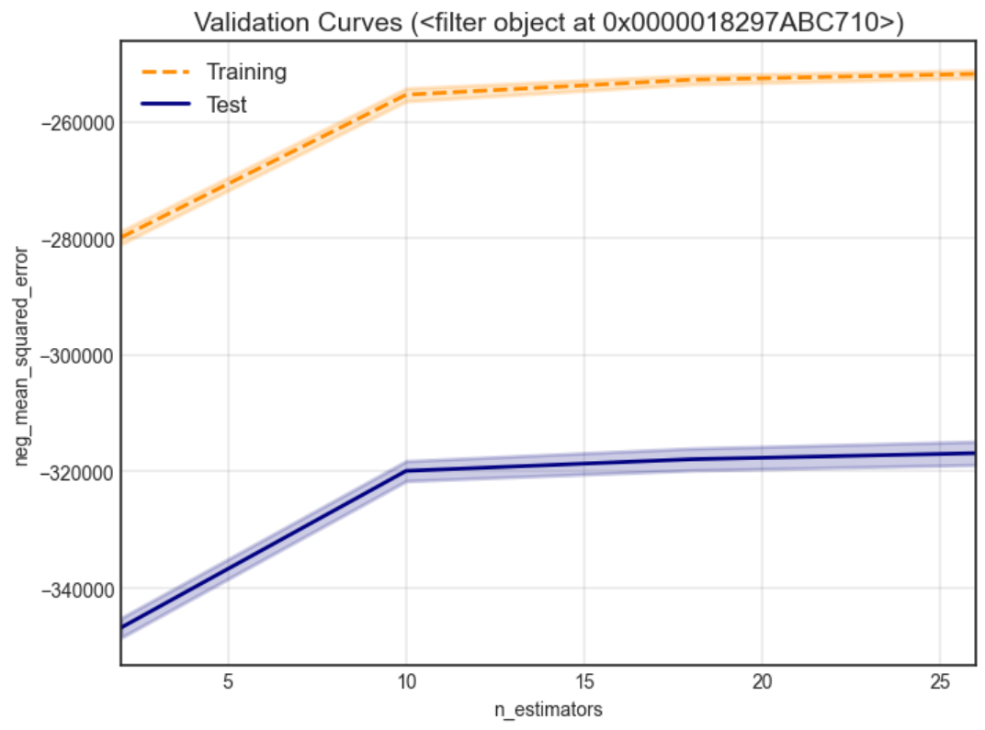
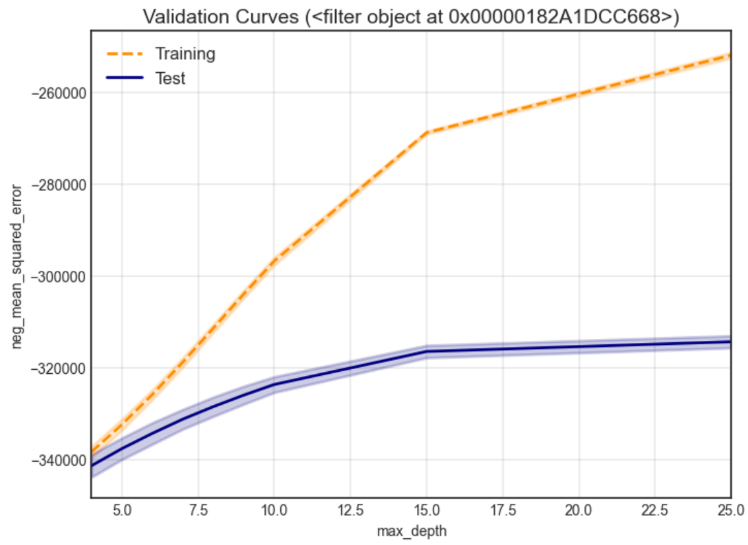
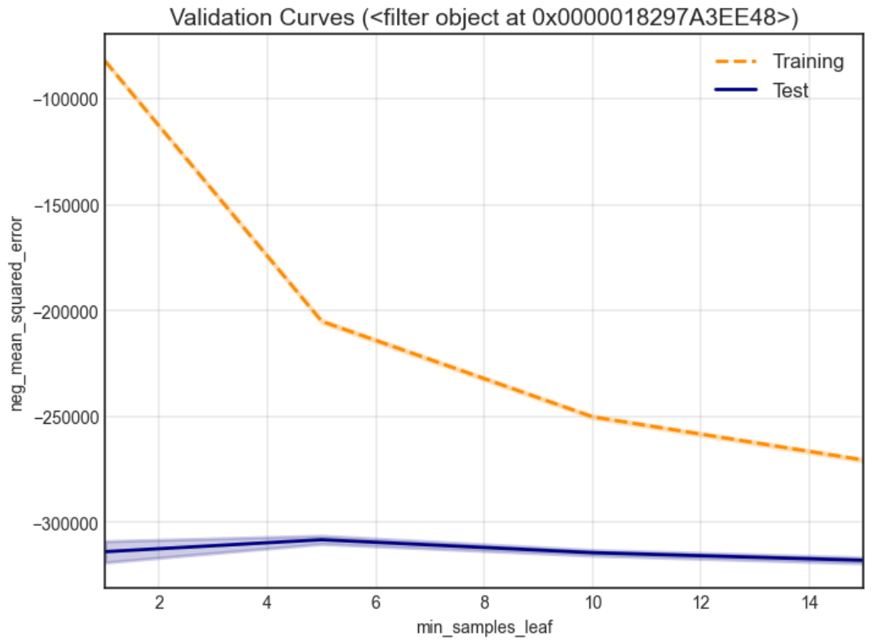
Model comparison
By comapring several different regressoin alorithm we can establish the baseline model for further study and improvement

Slide 21
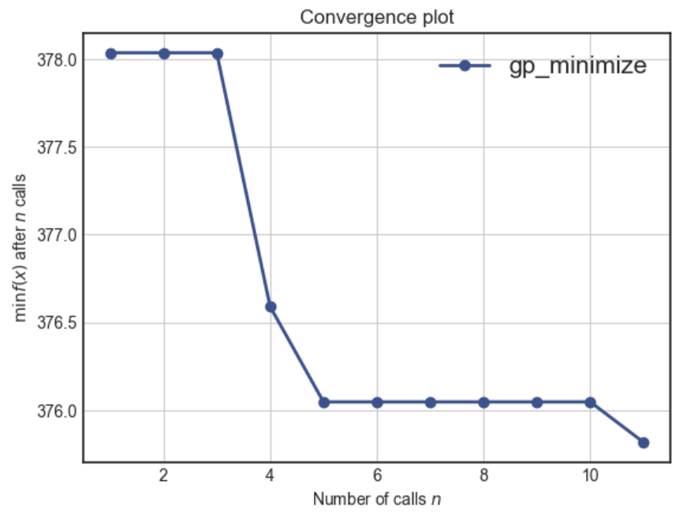
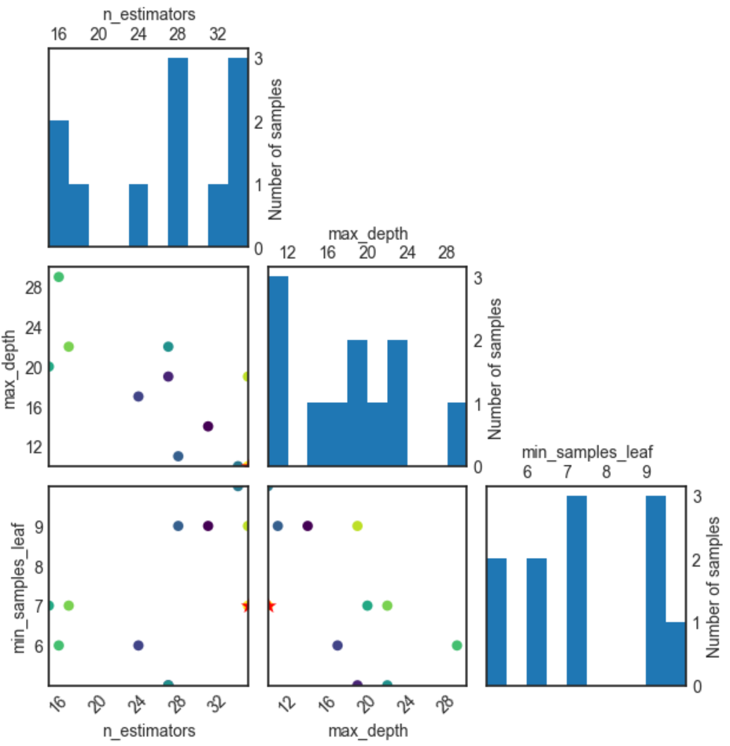
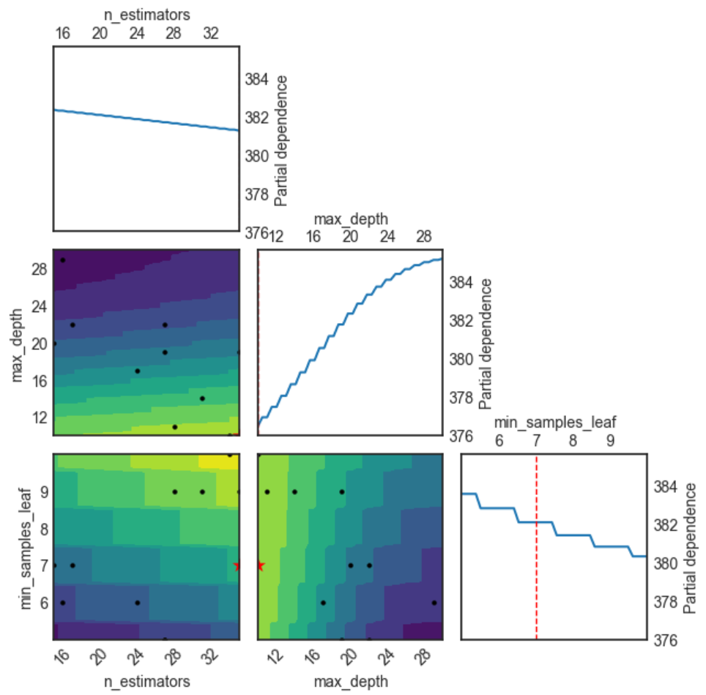
Model optimization
Model tuning with Bayesian Optimization

Slide 22
Thank you for listening

