Slide 1





Gitam BookMart
Visit Our Website
gitamhackthon.ccbp.tech

Slide 2


Team Members
Ram Chetlaoalli (VU21CSEN0100274)
vamshi Gunda
(VU21CSEN0100341)
Moturi Chaitra
(VU21CSEN0100342)
Dhanya Sree
(VU21CSEN0100348)

Slide 3


Vision And Mission
Our Vision
To create a vibrant online community where students can easily buy and sell textbooks, fostering a more affordable and sustainable approach to education.
Our Mission
To simplify textbook buying and selling for students, making education more affordable and sustainable.

Slide 4
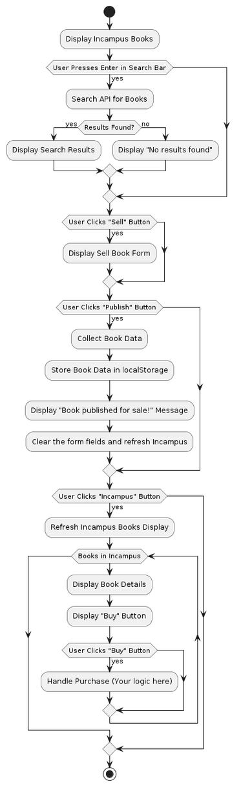
complexity understanding
FrontEnd
Dynamic DOM Manipulation
Data Persistence with LocalStorage
Event Handling
UI/UX Considerations
BackEnd
API Integration (Search)
Data Storage (Published Books)
Authentication and Authorization
Payment Processing

Slide 5
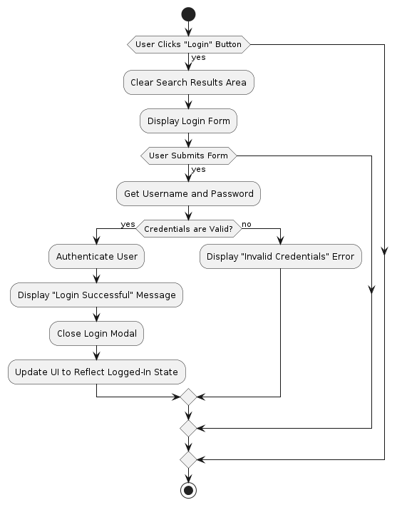
Security Implementation
Cross-Site Scripting
Third-Party Libraries
Data Validation
Local Storage Manipulation

Slide 6
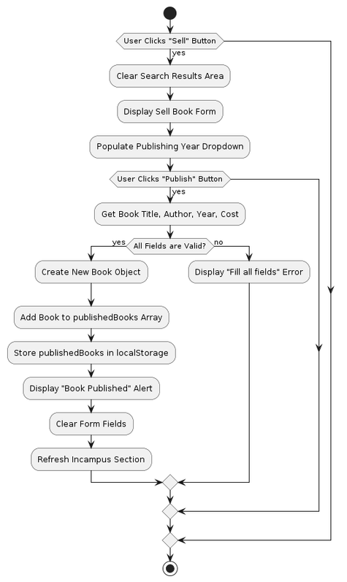
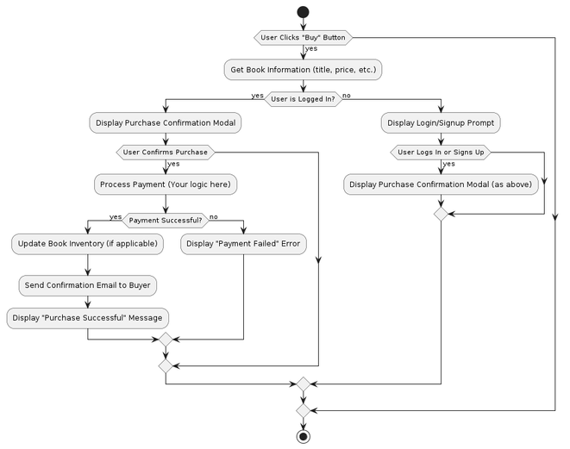
Unit Testing Skill
Buy funtionality : The "Buy" button empowers students to conveniently purchase textbooks listed by their peers. It's a gateway to affordable course materials, fostering a sharing economy within the campus community.
Sell funtionality : The "Sell" option provides students with a platform to list their used textbooks for sale. It's a chance to recoup some of their investment while helping fellow students save money on essential course materials.
sell funtionality
Buy funtionality

Slide 7
Validation and Error Handling
Preventing crashes: Your app should gracefully handle unexpected errors, like network issues or invalid user input, so it doesn't break.
Guiding users: Clear error messages help users fix mistakes and complete tasks smoothly.
Protecting your data: Validation ensures that only correct and safe data is stored in your system.
sell funtionality

Slide 8
Validation and Error Handling
API Integration (Search): The project demonstrates the ability to integrate with external APIs (e.g., the book search API) to fetch and display relevant data, enhancing the functionality of the application.
LocalStorage Integration: The use of localStorage showcases the ability to integrate browser storage mechanisms to persist data locally, providing a seamless user experience even when the user refreshes or closes the page.
UI/UX Integration: The project combines multiple user interface elements (search bar, buttons, forms, book listings) and user interactions (searching, selling, buying) into a cohesive user experience. This demonstrates a strong understanding of how different components work together to create a functional and user-friendly application.
Event Handling Integration: The script includes multiple event listeners for different elements (search input, buttons, forms), highlighting the ability to integrate various user interactions and respond appropriately to them, creating a dynamic and interactive web application.
sell funtionality

Slide 9
Thank You
For Your Attention
Visit Our Website
gitamhackthon.ccbp.tech

