Slide 1

Project Based Learning
Topic: ASL using CNN
By
Kiran Chavan -77
Shubham Tandale -51
Ramchandra Rane -154
Under the guidance of
Prof. Vidhi Parikh

Slide 2
What is American Sign Language (ASL)?
American Sign Language (ASL) is a complete, natural language that uses hand gestures, facial expressions, and body movements to convey meaning.
It is the primary language of the Deaf and Hard of Hearing community in the United States and parts of Canada.
ASL has its own grammar, syntax, and sentence structure, different from English.
Communication in ASL involves both manual signs (hands) and non-manual markers like facial expressions and head movements.

Slide 3
ASL Recognition Using Deep Learning
Involves capturing images or video frames of hand gestures.
Feature extraction and pattern recognition are used to identify gestures.
Deep learning models like Convolutional Neural Networks (CNNs) learn to classify signs automatically.
Real-time ASL recognition can be done through webcams or mobile cameras.

Slide 4
Problem Statement
Millions of deaf and hard-of-hearing individuals face communication barriers in virtual platforms.
AccessTech aims to develop an AI-powered real-time ASL recognition system.
The system should identify ASL gestures (A–Z, 0–9) accurately from RGB images.
Goal: Achieve at least 90% accuracy using a CNN-based model.

Slide 5
Objectives
Collect and preprocess ASL gesture images.
Train a deep learning model (e.g., CNN, MobileNetV2, or AlexNet).
Evaluate model accuracy and visualize results.
Enabling gesture prediction by giving image input.

Slide 6
Key Challenges
Limited Dataset Size – Only 56 samples per class; prone to overfitting.
Similar Gestures – Subtle differences between signs (e.g., ‘v' vs. ‘2’,’o’ vs ’0’,’i’ vs ‘j’,’6’ vs ‘w’).
Data Variability – Non-uniform lighting, background clutter, and hand tones.
Performance Constraint – Must exceed 90% accuracy with limited data.

Slide 7
Applications
Real-time ASL translation in video conferencing.
Educational tools for sign language learning.
Healthcare communication for patients and doctors.
Accessibility systems for public service counters.

Slide 8
Dataset and Preprocessing
Dataset: American Sign Language dataset (A–Z hand gestures).
Images converted to grayscale for simplicity and speed.
Applied normalization and data augmentation to improve model generalization.
Data split into training and testing sets.

Slide 9
Model Architecture — EfficientNet
EfficientNet balances model size, accuracy, and computation using compound scaling.
Architecture built on:
Depthwise separable convolutions
Swish activation
Batch normalization
Global average pooling
Dense output layer with softmax activation
Transfer learning from EfficientNetB0 pretrained on ImageNet.
Optimizer: Adam, Loss: Categorical Crossentropy.

Slide 10
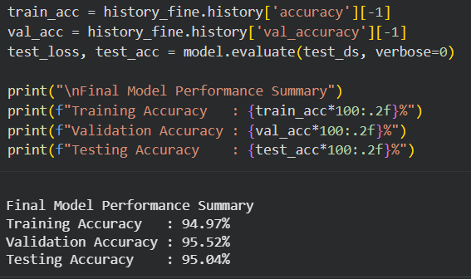
Model Performance

Slide 11
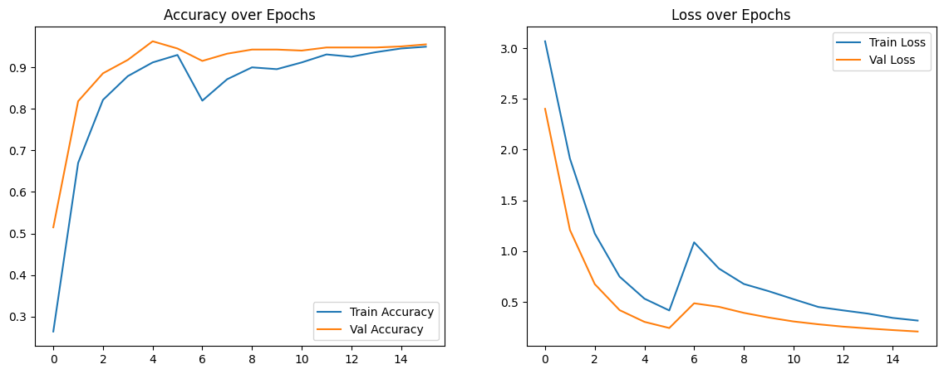
Plot Metrics

Slide 12
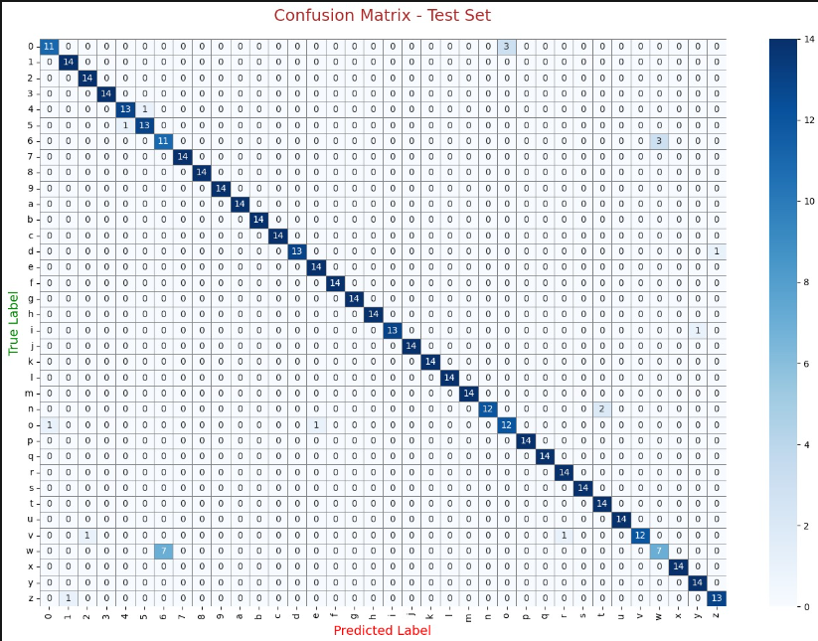
Confusion Matrix

Slide 13
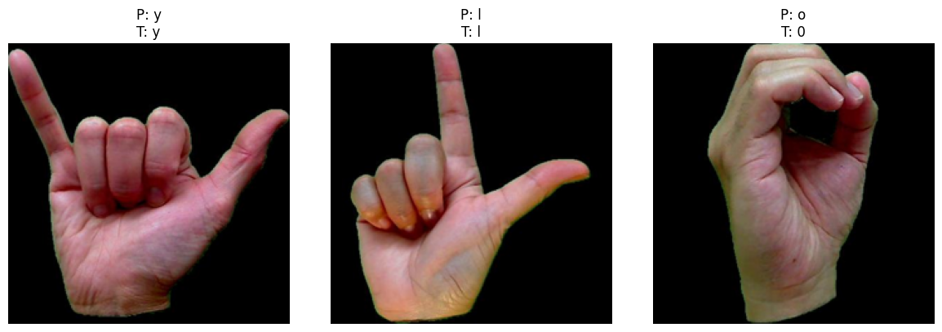
Outputs

Slide 14
THANK YOU

