Slide 1
Stroke Prediction Analysis
Ramchandra Reddy Sathu A20526126
Venkata Madhu Vinay Nalamati A20526859
Akash Chaturvedi Battula A20549559
Vijay Goud Kodipyaka A20529999

Slide 2
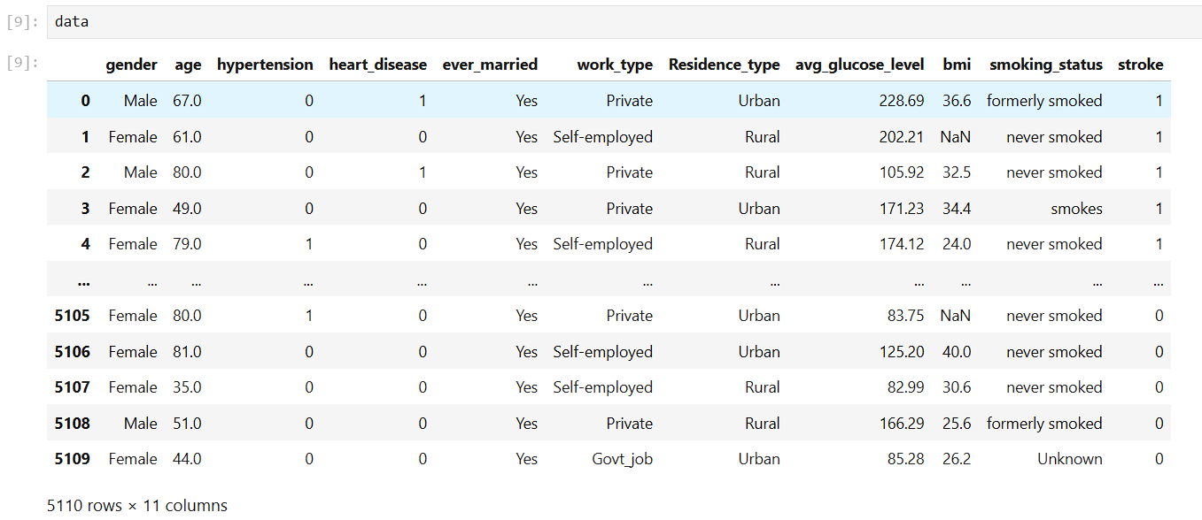
Dataset Overview
5110 records and 16 features
Numerical, binary, and categorical data
Target variable: Stroke (0 = No, 1 = Yes)
Preprocessing steps include scaling and one-hot encoding

Slide 3
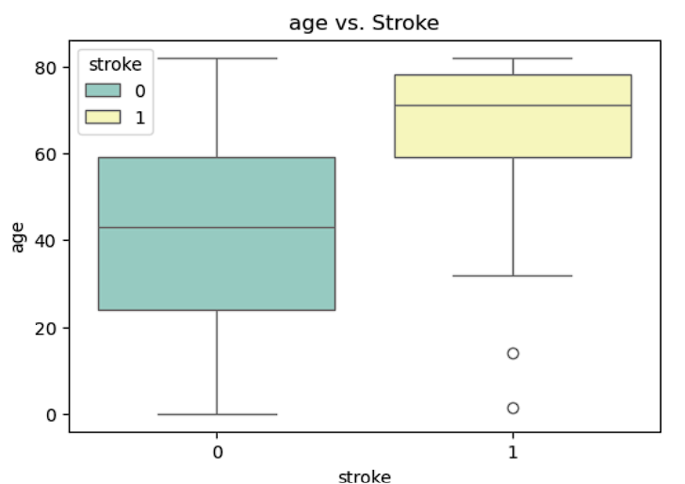
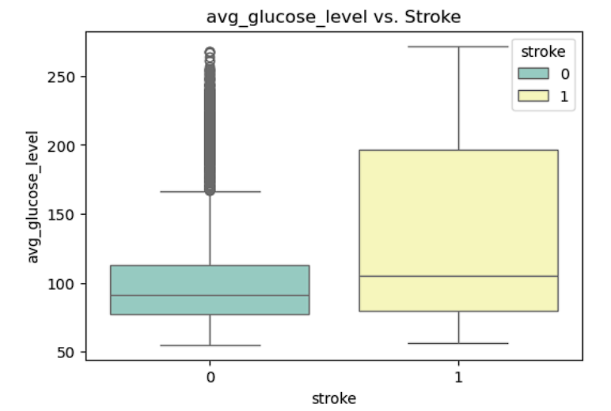
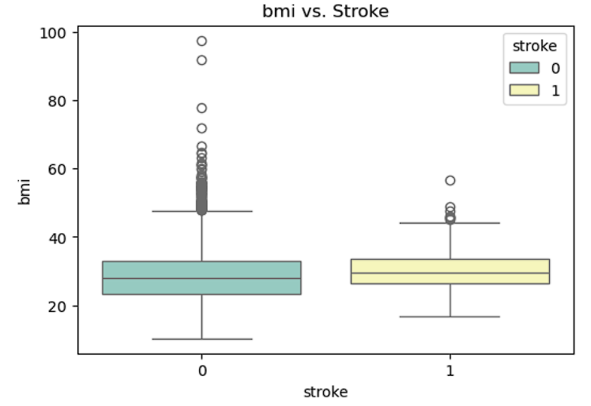
Boxplot Insights
The stroke group (1) predominantly consists of older individuals (median ~70 years)
No-stroke group (0) has a broader age distribution (median ~40 years)
Outliers in stroke group suggest rare cases of younger individuals experiencing strokes

Slide 4
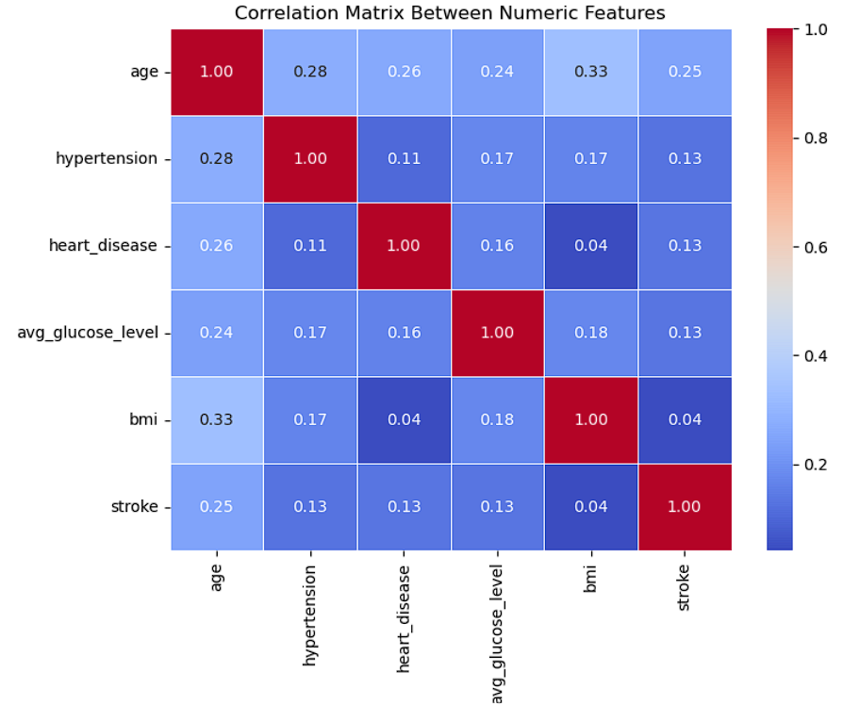
Heatmap Visualization
A heatmap visualizes relationships in a matrix using a color gradient, where warm colors indicate strong positive values, cool colors indicate strong negative values, and neutral tones represent near-zero values.
Annotations add clarity by displaying numeric values, while grid lines enhance readability.
It's widely used for correlation analysis, feature selection, and identifying data patterns.

Slide 5
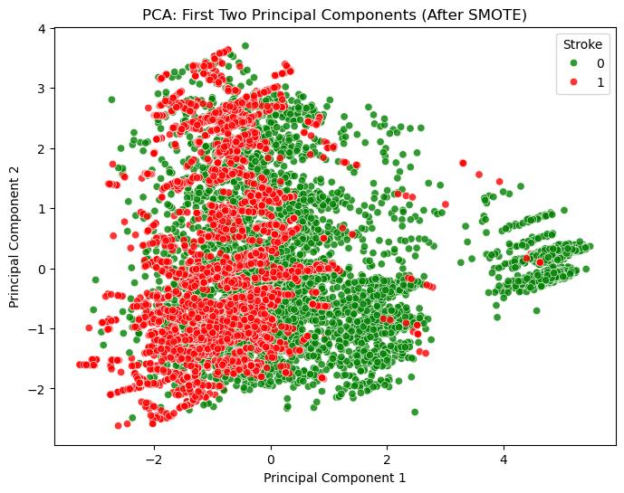
PCA Insights
PCA captures ~29% variance in the first two components
Useful for visualizing high-dimensional data in 2D space
Shows partial separation between stroke and no-stroke cases

Slide 6
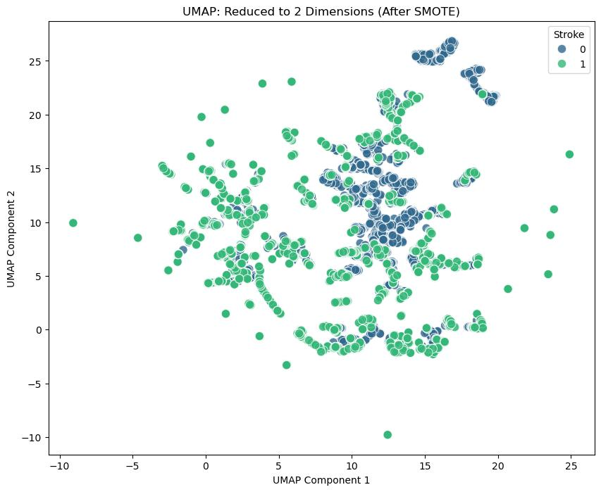
UMAP Insights
UMAP clusters data based on local and global structures
Clearer separation of stroke and no-stroke cases compared to PCA
Reveals patterns not captured by linear methods

Slide 7
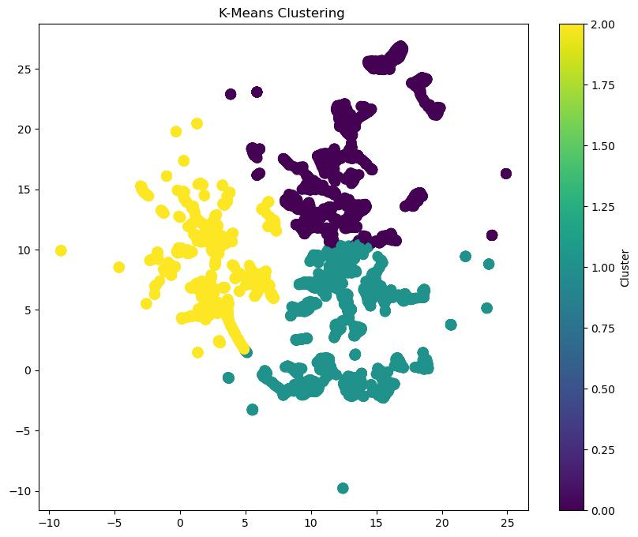
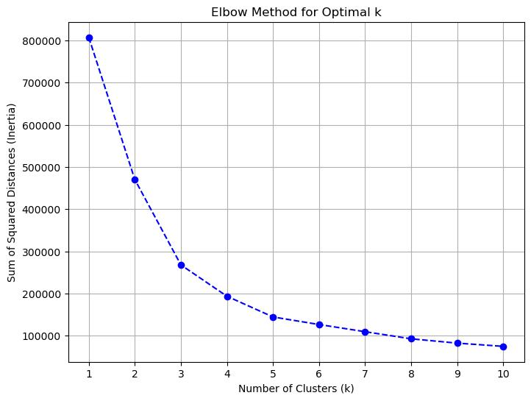
K-Means Clustering
The visualization demonstrates K-Means clustering, dividing data into three distinct clusters represented by yellow, teal, and purple.
Clear cluster separation highlights the algorithm's ability to identify patterns and group similar data points effectively.
The legend indicates cluster IDs (0, 1, 2), making the plot useful for interpreting data segmentation and understanding patterns.

Slide 8
One-Hot Encoding
Handling Class Imbalance with SMOTE
Converted categorical features into numerical representations suitable for machine learning models.
Each category was represented as a binary vector, ensuring that the algorithm doesn’t assume any ordinal relationship between categories.
Increased the number of features due to the creation of binary vectors. Ensured that categorical data was appropriately handled.
Balanced the dataset to avoid bias in predictions due to the underrepresentation of the minority class (stroke = 1).
Used SMOTE to generate synthetic samples for the minority class. Synthetic samples were created by interpolating between existing samples in the minority class.
Highly imbalanced with a minority class ratio of ~5%.After SMOTE: Achieved a balanced dataset with an equal number of samples for both classes.

Slide 9
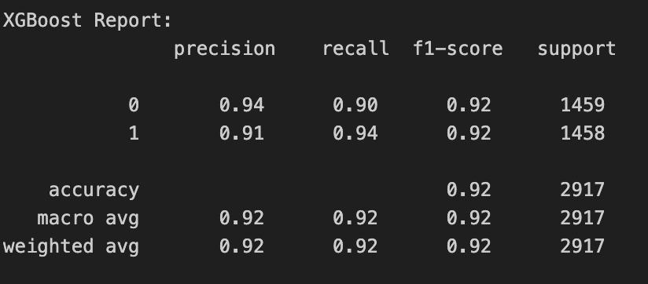
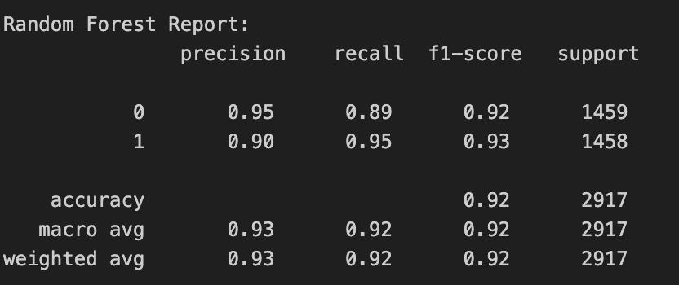
XG Boost & Random Forest
The XGBoost and Random Forest models achieve identical overall accuracy of 92%, with comparable macro and weighted averages for precision, recall, and F1-score.
XGBoost shows slightly better recall for Class 0 (0.90) compared to Random Forest (0.89), whereas Random Forest outperforms XGBoost with a higher F1-score for Class 1 (0.93 vs. 0.92).
Both models demonstrate balanced performance, but Random Forest achieves slightly better precision and macro averages (0.93 vs. 0.92).

Slide 10
More to Implement
Hyper Parmater tuning
Feature Selection
L1/L2 Regularization

Slide 11
THANK YOU

